Slide 1
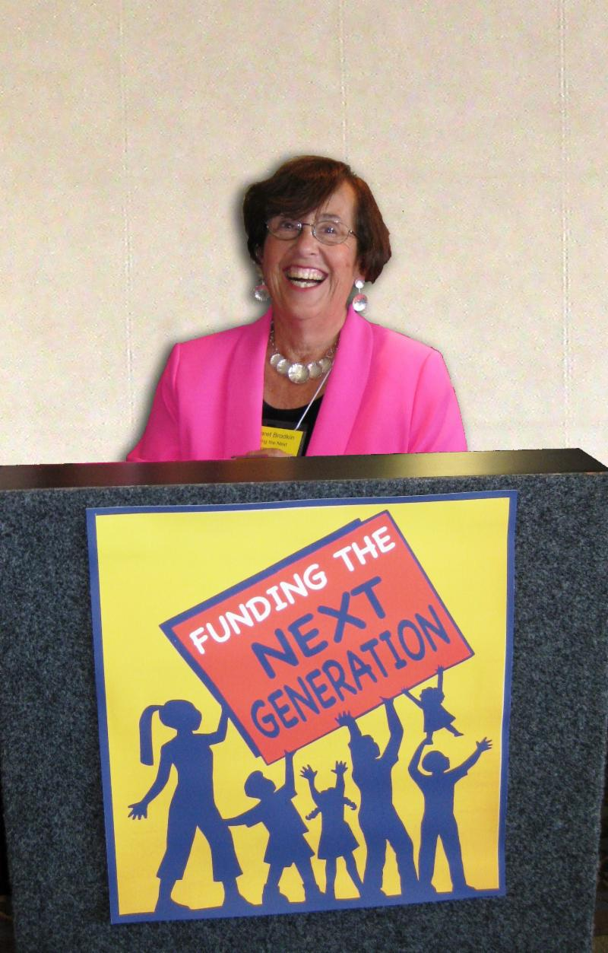
Dedicated local funding for children and youth: Can DC make it happen?
DC Children and Youth Investment Trust,
June 18

Slide 2
BENEFITS OF A LOCAL FUND are TRANSFORMATIVE
Services expanded
Flexibility in funding
Delivery system stabilized
Innovation and new models
New populations and new neighborhoods
Leveraging of resources
Creation of city-wide infrastructure
Increased accountability, coordination and planning
Empowered constituency
HUGE RETURN ON INVESTMENT
$75 M -- 50,000 children

Slide 3
SOME BASICS
Must focus on HOW
Time is right
Public support for local initiatives
Power of organizing at local level
Focus of policy-making at the local level
New allies and new evidence
Economic recovery
Two ways to get money – It’s a Big Lift
Reallocation
New revenue streams
Local funding for kids is a quilt – no one panacea

Slide 4
The San Francisco Story
A Children’s Agenda – policy is not enough
Children’s Budget Coalition
Creating a Children’s Budget
Powerful budget advocacy
FRUSTRATION

Slide 5
CRAFTING A NEW REVENUE POLICY
Goal – Sustainable, stable, funding for broad range of children’s services – no more annual battles
Institutionalization – City charter
Models – Required funding in city charter
Revenue Stream – New funds or reallocations – rational for “carve-out”
Specific objectives – What can be funded
Potential Sabotage – Baseline budget; Prohibitions
Implementation – Administration, planning, oversight
THE CHILDREN AND YOUTH FUND

Slide 6
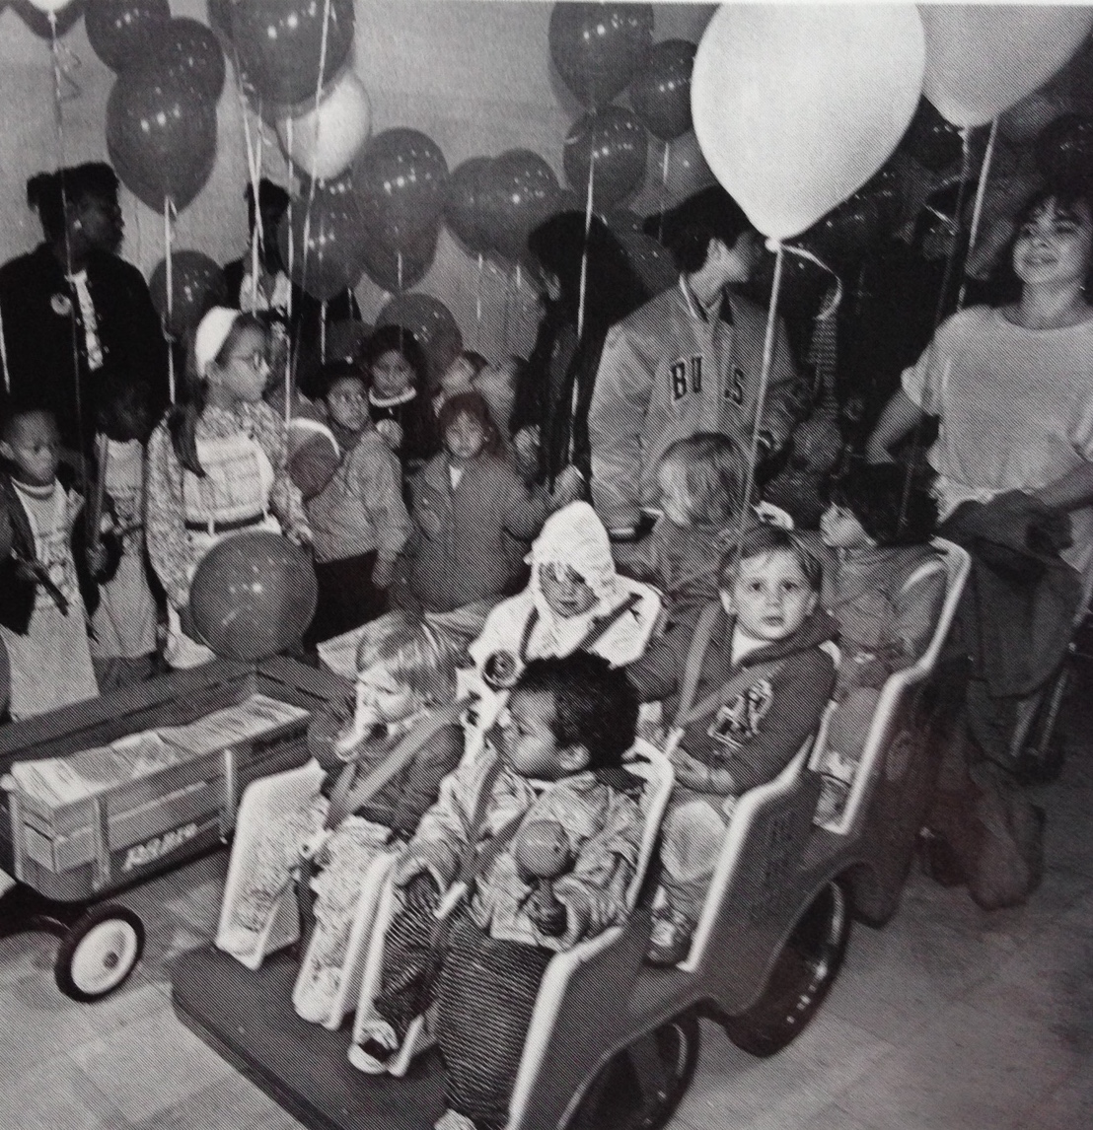

Slide 8
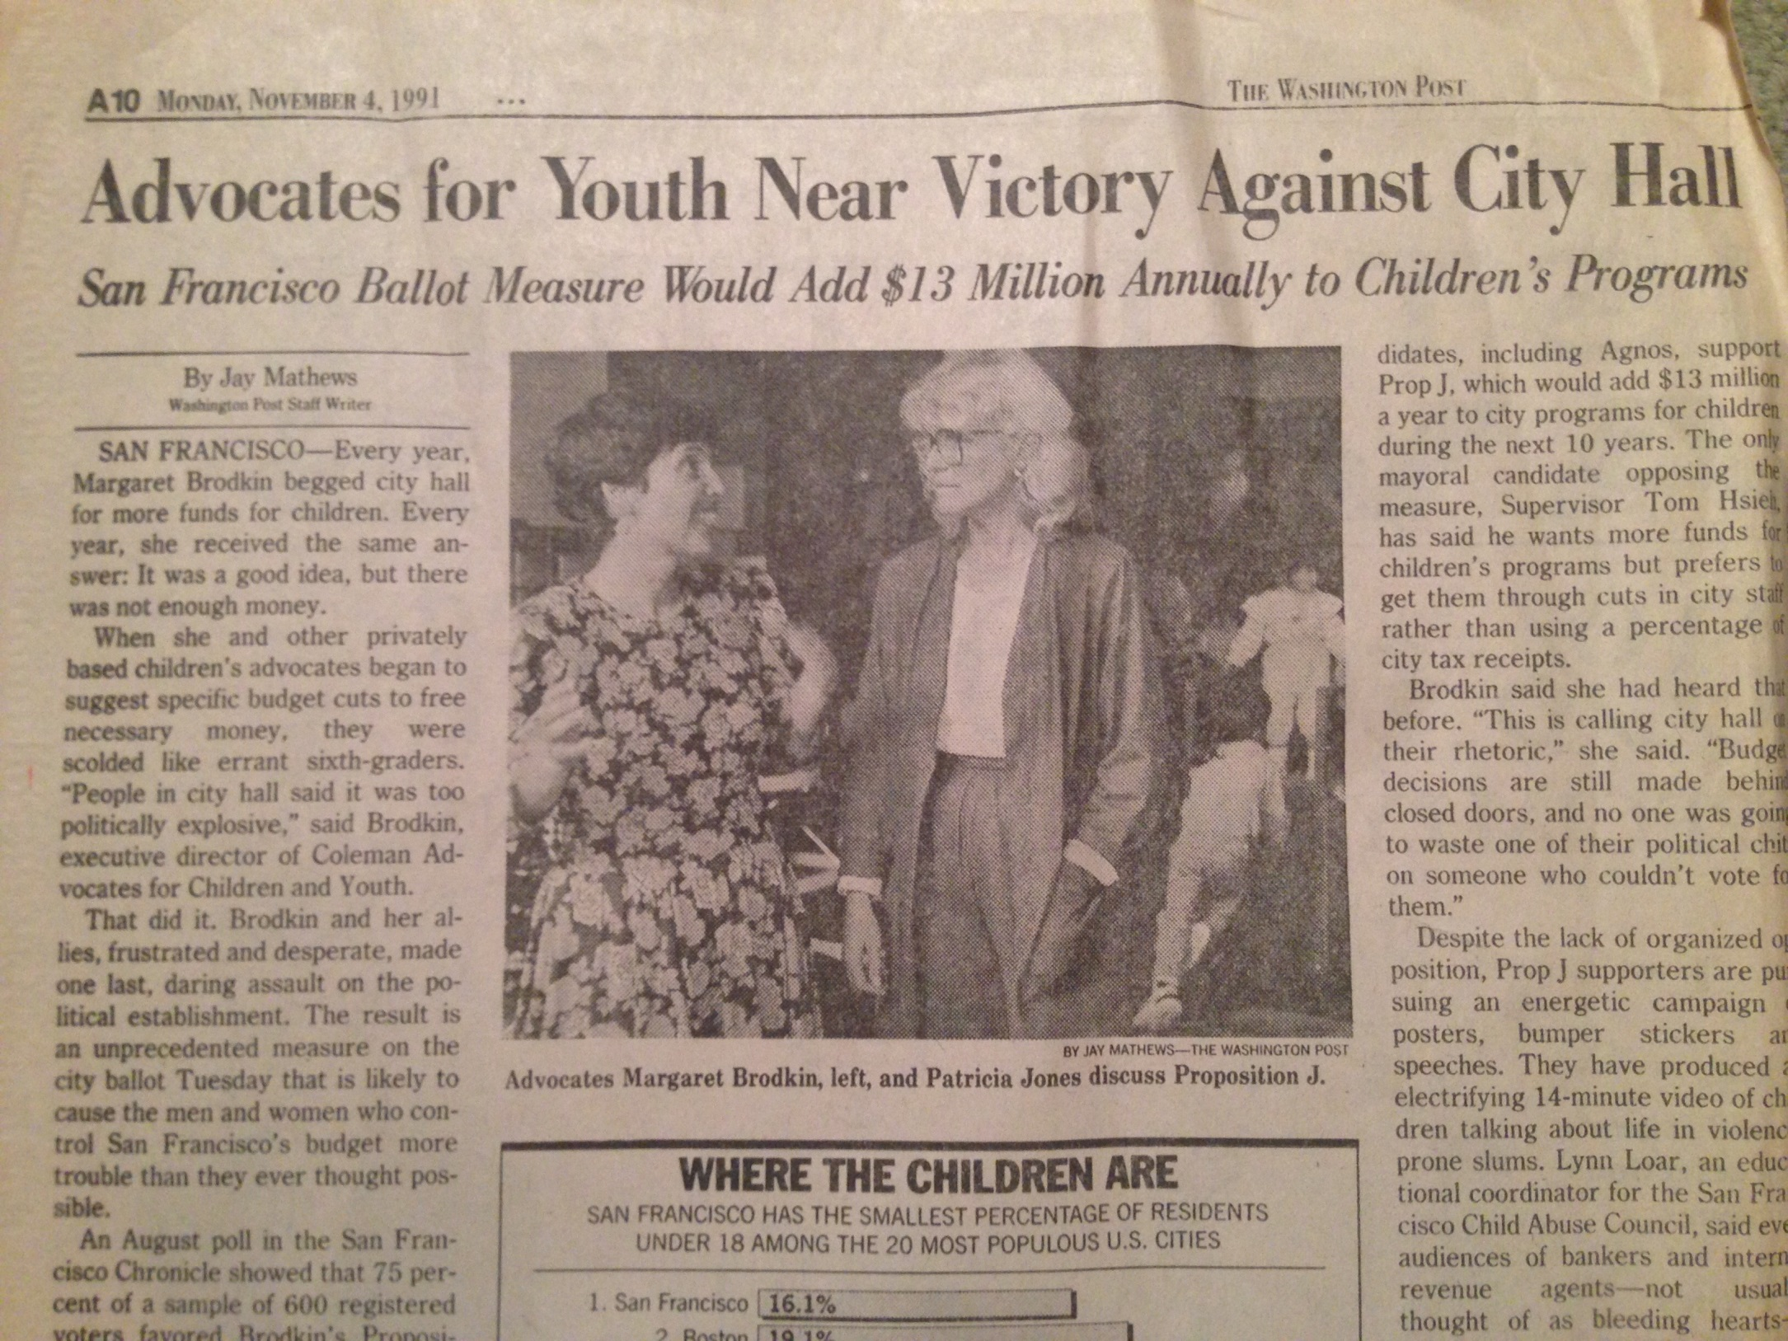

Slide 9
LESSONS LEARNED –still learning
Kids are a winning issue.
Take the initiative – Frame the issue.
Think big. Propose a positive solution.
It takes time to build a major policy change.
Outcome is always uncertain – requires risk.
Elections are powerful venues for advancing policy change.
Requires “political” activity – but not partisan.
Must empower public – parents, youth, community organizations.
“Small group of committed citizens” can provide leadership – service providers can be nucleus.
It’s NEVER over! Success breeds success.
New revenue triggers policy and systems change.

Slide 10
STEPS TOWARD A FUND
Make the case
Research and document needs
Follow the money
Build a consensus agenda
Communicate the case for investing in children – be multi strategic
Build a strong influential organization/partnership/coalition
Create a go-to organization that can speak for many issues
Gradually broaden the coalition – beyond the usual suspects
Increase visibility and capital on the political and civic landscape
Develop a revenue policy
Determine priority funding needs to be met through the measure
Continually build public support for those services
Research options – tax vs. carve-out, other funds, legal support, etc.
Craft a revenue measure – visionary and pragmatic
Source of funds, What services, Governance, Administration, Sunset
How to put on ballot, Which election? Collaboration?

Slide 11
FUNDING THE NEXT GENERATION www.fundingthenextgeneration.org
Hubs of action are emerging in counties and cities in California – creating a community of learners
More lessons learned:
Power of polling
Power of “we’re doing it”
Look for the sweet spot – creativity is essential
Inside-outside strategies
Staff is essential
Takes time, but easy to waste time
Always a “work in progress” – building a civic culture

Slide 12
ARE YOU READY?
Is there a convening entity with credibility to organize early phase of work?
Is there a history of collaboration to increase budgets for kids?
Are there community-wide goals and outcomes for children, youth and families
Is there a consensus about unmet needs?
Is there a civic culture to support kids or key leaders who have prioritized kids?
Are there funders who will support the work?

Slide 13
ROLE FOR FOUNDATIONS
Support the groundwork – it’s legal.
Assessing funding – where is the money?
Building a community coalition
Developing a community consensus about needs and priorities
Educating the public about needs – making the case
Developing youth and parent leadership
Analyzing policy options

Slide 14
IDEAS FOR FIRST STEPS
No perfect place to start – Not a linear process.
Convene a community meeting to present options and a vision
Build a community consensus about priority funding needs
Create an ad-hoc exploratory group of supportive stakeholders
Assess public support – conduct a poll
Identify a political champion
Create a resource map

Slide 15
THE CAMPAIGN GOES ON
https://www.youtube.com/watch?v=KoTf4ckCEmw
https://www.dropbox.com/s/kp4xl88368p9lbu/What_Do_You_C_YT.mov?dl=0

