Slide 1
Funding the Next Generation Budget Workshop March 27, 2015

Slide 2
Agenda
Start with the End in Mind – Margaret
Budget 101 – Ed
State Funding and Realignment – Reed
Getting/Using Budget Information – Patti V.

Slide 3
How much and What do you need to know?
You know a lot already
How much priority services might cost?
How much you can reasonably raise?
Sample Fact Sheet

Slide 5
Do you need to do a Children’s Budget—or just gather some facts?
Will take time and need help
Can be good to start the discussions
Can be a great way to organize advocates
Focus on what’s important

Slide 6
Budget 101
Timeline
Understand Terms
Start with Big Picture
Focus on what can be controlled locally
Don’t get lost in the details
Have County staff do the work—but ask nicely and be flexible

Slide 7
Timeline
July to June Fiscal Year
October-December – budget instructions
January-March – Departmental Preparation/Hearings
April-May – CAO Budget Office/Auditor Controller
June – Board of Supervisors

Slide 8
Budget Terms
Budget – Appropriations Ordinance
Sources/ Uses
Funds
Governmental
General
Special Revenue
Capital and Debt
Internal Service/Enterprise/ Special Districts
Fund Balance/Reserves
Departments/Programs/Functions
Characters/Objects

Slide 9
Napa County Table of Contents

Slide 10
San Joaquin Summary

Slide 11
San Joaquin Summary

Slide 12
San Joaquin Summary

Slide 13
Merced County

Slide 14
Solano County Summary

Slide 15
San Francisco Human Service Program Summary

Slide 16
Del Norte Budget Units

Slide 17
State Controller Schedules
1 – All Funds Summary*
2 – Governmental Funds Summary*
3 – Fund Balances of Governmental Funds
4 – Fund Balance Reserves
5 – Sources Summary by Fund*
6 – Sources Detail
7 – Uses Summary by Function and fund*
8 – Uses Summary by Function and Activity*
9 – Sources and Uses by Budget Unit
10-15 Other Funds Detail

Slide 18
Sonoma County Schedule 1

Slide 19
Sonoma County Schedule 5

Slide 20
Sonoma County Schedule 8

Slide 21
Del Norte – Schedule 9

Slide 22
State Funding and Realignment

Slide 23
What programs were realigned in 2011? Over two thirds of the dollars transferred to county control under 2011 Realignment fund health and human services programs.
“Protective Services”
Foster Care
Child Welfare Services
THP-Plus, ILP, STOP, SFP, KSSP
Adoptions/ Adoptions Assistance
CAPIT: Child Abuse Prevention, Intervention, & Treatment
Adult Protective Services
“Behavioral Health”
EPSDT
Mental Health Managed Care
Drug Medi-Cal
Drug Courts
Perinatal Drug Services
Non-Drug Medi-Cal Services
Women & Children’s Residential Treatment

Slide 24
Intersection of 1991 & 2011 Realignments: The fiscal relationship between the state and counties is complex and changeable
1991 Realignment
2011 Realignment
AB 8 County Health Services
Local Health Services
California Children’s Services
Indigent Health
CalWORKs
Employment Services
County Services Block Grant
In-Home Supportive Services
County Stabilization Subvention
County Juvenile Justice Subvention (AB90)
Adult Protective Services
Child Abuse Prevention, Intervention & Treatment (CAPIT)
Women and Children’s Residential Treatment
Drug Medical
Nondrug Medical
Drug Court
Law Enforcement
Trial Court Security
Juvenile Justice
District Attorney and Public Defender
Community
Corrections
Local Public Safety
Subventions
Shared
Foster Care
CWS
Adoptions
Mental Health
EPSDT
Managed Care
Notes:
24

Slide 25
What does 2011 Realignment do?
Provides counties with increased flexibility to prioritize among the Realigned programs AND provides revenue growth (so long as the economy is growing).
Changes incentives for included programs
Reshapes state policy design and implementation
Complicates advocacy and accountability
Conversations that took place in 1 Capitol now take place in 58 county chambers

Slide 26
Flexibility: Realignment gives counties new choices
“Tailor programs to the needs of their communities”
Reallocate funds among programs and/or between social services and mental health
Eliminate optional programs without giving up the money; reinvest according to local priorities
Leverage Realignment funds by redirecting funding towards programs with federal match
Establish reserve accounts

Slide 27
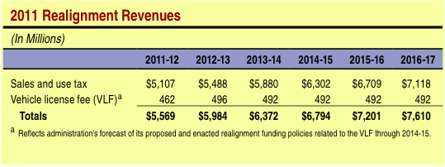
Growth: Total revenue growth faster than predicted
Significant growth in Realignment revenues - actual higher than 2011 LAO estimates:

Slide 28
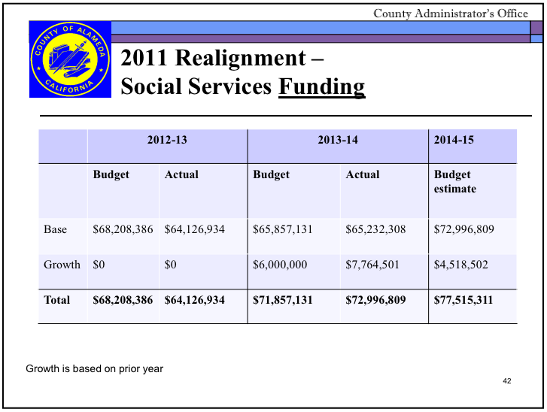

Slide 29
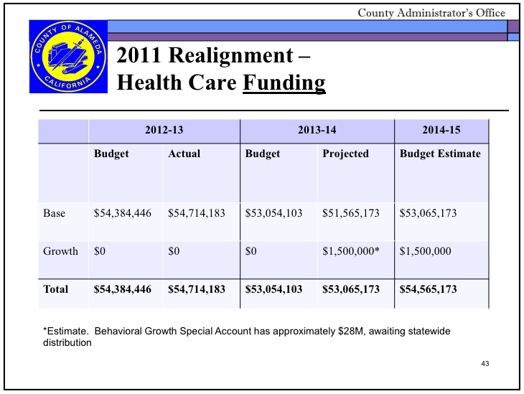

Slide 30
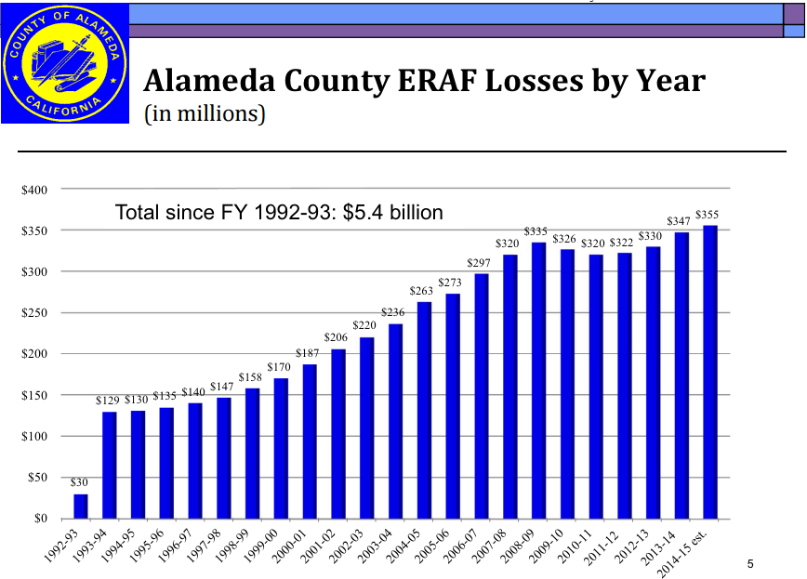
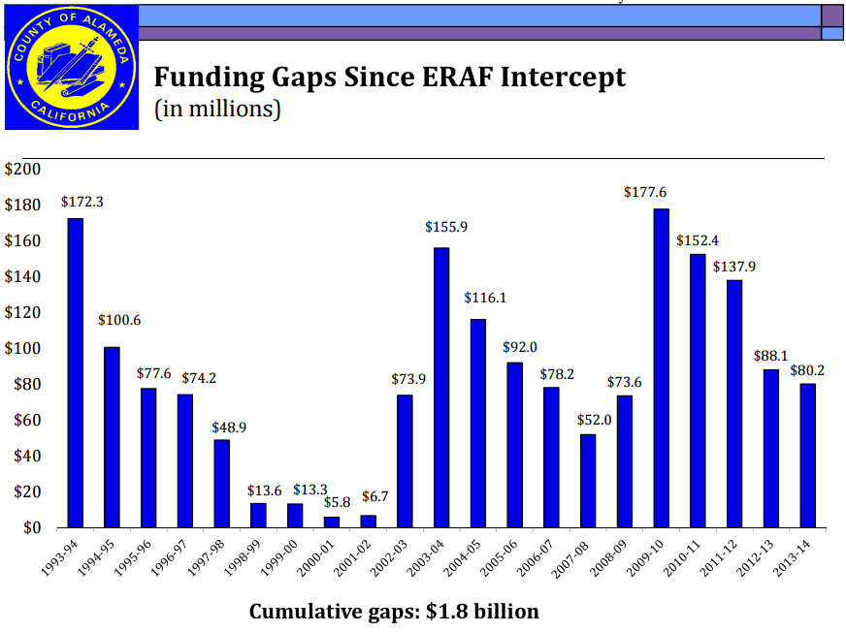
“New state dollars” vs 1992 ERAF

Slide 31
What could counties do with Realignment?
Expand previously under-funded programs, for example:
Child or adult community mental health
Transitional housing
Adult protective services
Create new programming, for example:
Prevention, family supports
Supports for parenting foster and probation youth

Slide 32
How’s it playing out?
Multiple “calls on growth”
Differing county interpretations, especially on mandates and cost sharing
Enough examples of county use of flexibility to demonstrate scope of possibility
Little transparency/accountability at the state or county levels

Slide 33
What did we learn from 1991 realignment? (per Diane Cummins)
Bases and growth formulas don’t work if the projections are too rosy: Shortfall: $2.2 > $1.9 bn within first year
Formulas can’t be inflexible over the medium to long-term, as underlying conditions change
Changes in the sharing ratios in entitlement programs essentially acted as a mandated allocation of growth
Significant inequities among counties
11-19 counties per year used the flexibility to transfer between Behavioral Health and Social Services, mostly from BH > SS

Slide 34
We’ll be hearing more about this in the next 18 months
Current Prop 30 tax increases sunset on 12/31/17
California’s economy is roaring, but California’s fiscal problems were (are?) huge
Very slim majority (52%) currently favor extending tax increases
Some wonks favor slight tweaks, others want to make the tax increases permanent
Over 70% of Californians think that voters should make some of the state’s fiscal decisions at the ballot box
http://www.ppic.org/main/blog_detail.asp?i=1673

Slide 35
The Del Norte Experience
Patti Vernelson

Slide 36
Questions?

