Slide 2
Public Education Enrichment Fund: Preamble
Quality public education is highly correlated with higher earnings potential,
reduced crime, lower rates of teen pregnancy and substance abuse, and greater self-esteem;
Urban public schools have the greatest need for comprehensive educational programs
Despite its high cost of living, San Francisco per pupil spending ranks 34th among 43 comparable central city U.S. public school districts of similar size.
SFUSD enrollment has dropped in recent years as families have left San Francisco in search of affordable neighborhoods with high-quality public schools;
As the economy begins to recover, now is the time to invest in our children’s
future, before further declines begin to erode the progress the SFUSD has made.

Slide 3
Charter Amendment
In March 2004, San Francisco voters passed Proposition H, a Charter Amendment declaring that
The City shall appropriate money in the Public Education Enrichment Fund to the San Francisco Unified School District for arts, music, sports, and library programs in the schools.
AND
To First 5 San Francisco to provide all four-year-old children who are City residents the opportunity to attend preschool
Approved by 71% of the electorate
San Francisco City Charter SEC. 16.123-2. PUBLIC EDUCATION ENRICHMENT FUND

Slide 4
Universal Preschool For All
High-quality early education is the right of every child
Universal programs are easiest to access
Universal programs do not discriminate on the basis of immigration status
Universal programs are more diverse
Universal programs are less administratively burdensome

Slide 5
How did we target?
Targeted roll-out
Enhancement funding for subsidized programs
Targeted pre-PFA assistance
Targeted supplemental funding
Targeted curriculum enhancements
State Preschool backfill

Slide 6
Provider Reimbursement
Maximum of $6,000 per child annually
Varies depending on enrollment, teacher qualifications, and other public subsidy
Reimbursements support new spaces, more affordable spaces, extending part-day to full-day, and quality
Modifications for voucher children, bridge funding, and Preschool Plus, but embedded within PFA

Slide 7
Preschool For All To Date
$27 million General Fund set-aside in 2014-15
Serving 4,000 children in 2015-16, about 65% of all four-year-olds in San Francisco
150 sites, including Head Start, State Preschool, school district, nonprofit, for-profit, family child care
Expanded education opportunity while raising program quality
Improved children’s early literacy, math, and self-regulation skills

Slide 8
Preschool for All
Expands Opportunity
for all children to attend high-quality preschool
2007
2009

Slide 9
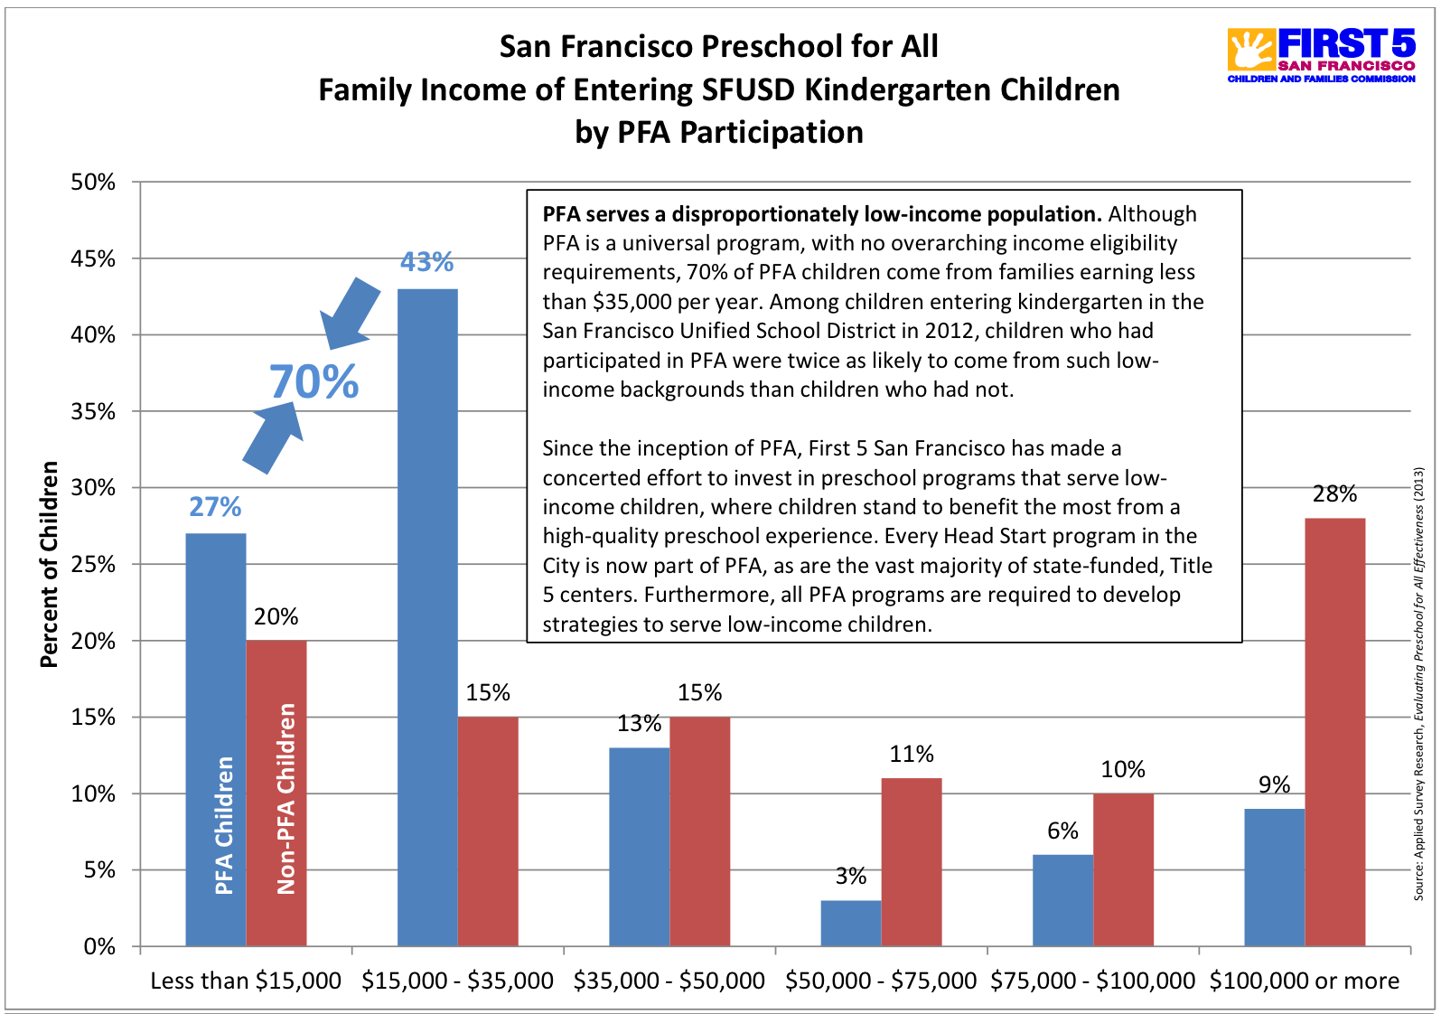
Preschool for All
Expands Opportunity
for all children to attend high-quality preschool

Slide 10
Readiness by Preschool Attendance
Children who went to preschool were more ready for school

Slide 11
Preschool for All
Results: Improves Quality

Slide 12
Preschool for All
Gets Children Ready
to succeed in kindergarten and beyond

Slide 13
Challenges- Tensions- Debates
Universal Targeted
Early Education Childcare
State Funded Local Funded
Quality Access/Slots
Operations Teacher Compensation
Facilities
Preschool for All ECE for All
School Districts Community Based Programs
County Offices of Ed Mayor’s Office
First 5

Slide 14
Next Phase
Passage of Prop C in November 2014 provides funding for the next 26 years, transfers responsibility to Office of Early Care and Education
First 5 SF will continue the Quality Improvement Efforts
SFUSD Early Education Department will continue the PreK to Third alignment

