Slide 1
How did we get to Y?
Joelle Gallagher, Executive Director, Cope Family Center, Napa, CA
Proponent, Yes on Y
Notes:
Good morning, I am Joelle Gallagher, from Cope Family Center in Napa and a Proponent for Measure Y.
(CLICK) How DID we get to Y?
I’m going to review our journey and lessons learned so far. (CLICK)

Slide 2
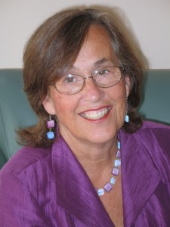
Pre-game
Notes:
This all started for Napa County in September of 2013 when, several of us, including one Supervisor, attended Margaret’s statewide conference.
We decided we wanted to pursue this grand notion of a “children’s fund” for Napa County.
We set to work, and started with gathering community stakeholders together
To rally around the creation of…
(CLICK)

Slide 3
We resolve to invest in all children and youth so that: -they are raised in an environment that is peaceful, supportive, secure where all their basic needs are met (nutritious food, shelter, clothing, health care, childcare).
-they have healthy attachments to parents, guardians or caregivers who nurture and love them from birth.
-they enjoy healthful and plentiful meals daily and partake in physical activity and time outdoors and in nature.
-they have access to healthcare to maintain optimum physical, mental and dental health.
-they have access to quality education that promotes future success in school, career and life.
-they have freedom from mistreatment, abuse and neglect.
-they voice opinions in matters of interest to them, develop their leadership capacity and engage in their community.
-they feel supported by the larger community and maintain a sense of hope for the future.
-they are encouraged to explore and express their innate curiosity and creativity.
Napa County Childrens’ Bill of Rights
Notes:
The Napa County Children’s Bill of Rights.
This gave us the opportunity to get buy in from our community, including our board of supervisors and all five city council’s which endorsed it.
This was an important first step.
It heightened the profile of children in the community and created a sense of commitment to meeting their needs.
(CLICK)

Slide 4
The Numbers
= 2% on kids
Notes:
Next, we had to determine, what do we currently spend on kids as a County.
There are many ways of looking at the numbers.
Ultimately, we determined that County spends roughly 2% on programs for kids, while children 0-18 make up 22% of our population.
Next, we looked at the possible funding mechanisms, and with the help of Dave Metz and his crew, we conducted a poll.
What we learned, was that the most important issue for Napa County residents was…
(CLICK)

Slide 5
Notes:
ROADS
NO surprise there, Dave told us, but interestingly, the next five issues of concern were related to kids
(CLICK)

Slide 6
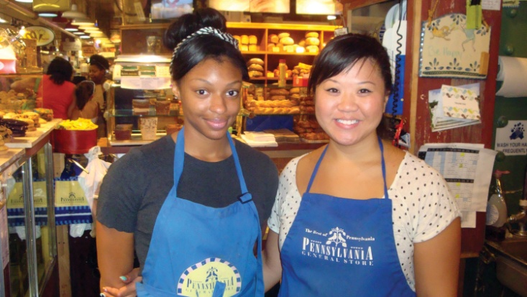
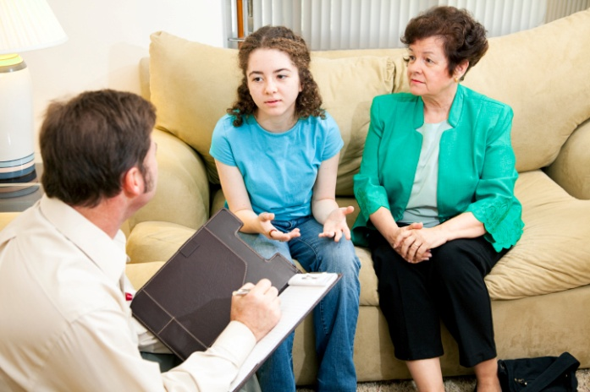
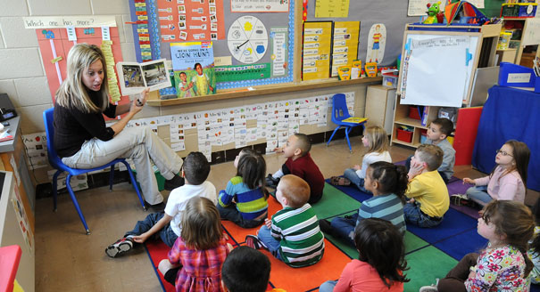
Polling
Notes:
We learned that, like children’s advocates, the community cares about (CLICK)
what kids do when they are out of school, (CLICK)
how to prepare them for the work force, (CLICK)
their mental health, (CLICK)
their education, starting with preschool and quality childcare (CLICK)
and their health and safety
Numbers in hand, kids in hearts, and a poll that showed a large majority of Napa county voters would favor a set aside of County funds for children’s programming, we began to write our measure… (CLICK)

Slide 7
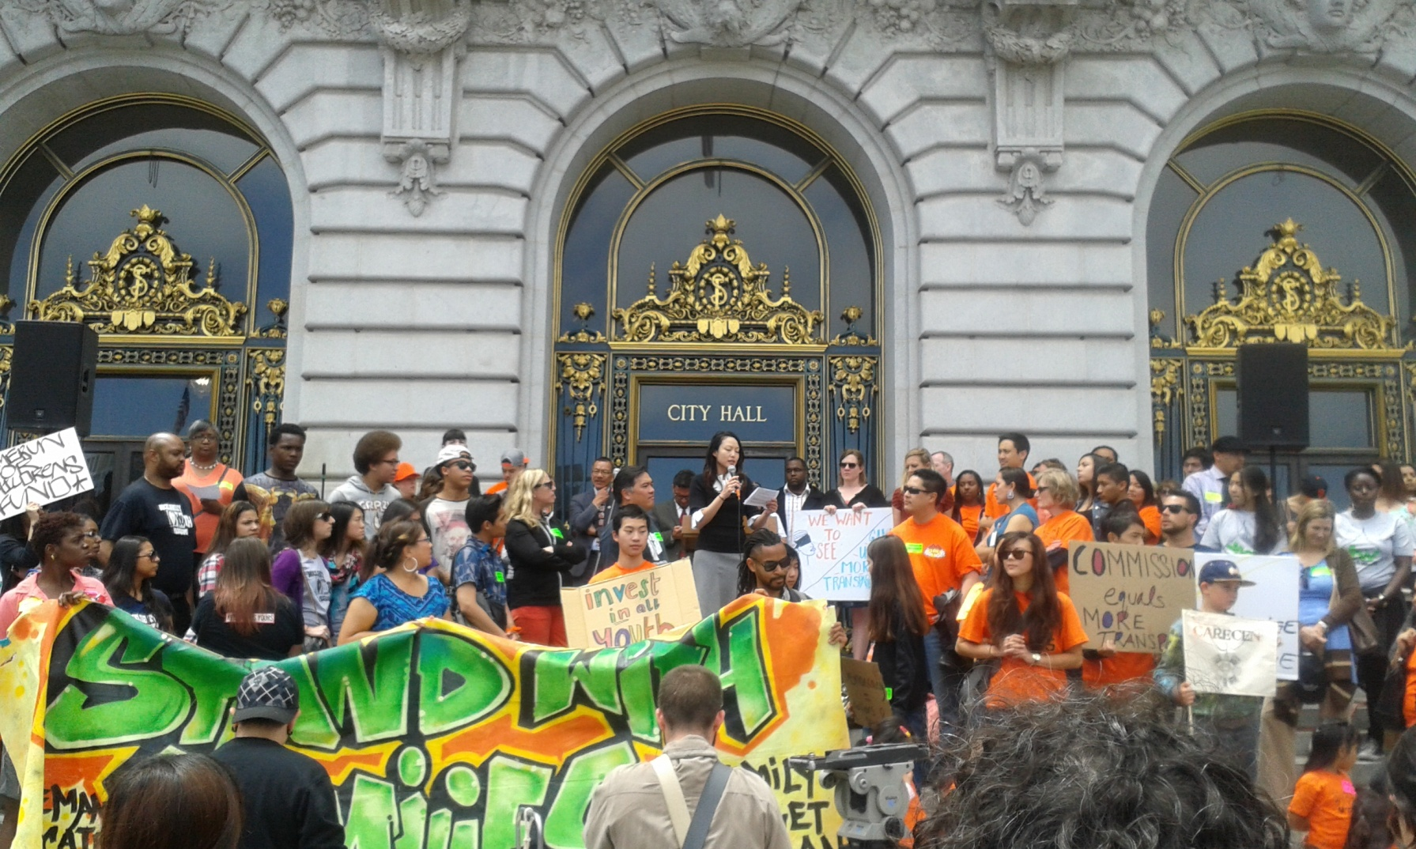
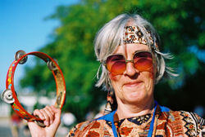
Napa County Child Wellness Act
Notes:
We wanted to create a fund modeled after the San Francisco Children’s Fund. (CLICK)
In a nutshell, the Measure called for a set aside of County General Fund, starting at 1% and growing to 4% over 5 years.
The money would live in County Health and Human Services, but would be overseen by a Citizen’s Oversight Committee
Funding would be distributed through a grant process
As you might imagine, our Board of Supervisor’s did not relish the idea of being directed how to spend discretionary dollars, but our argument was, kids don’t have a union, so you need to negotiate with us!
We spoke to several of the Board members about alternative funding mechanisms; however, most dismissed us
As we say, jokingly, (CLICK) they thought we were the “little old ladies from social services” and didn’t think we had the strategic capability, support and frankly, hutzpuh, to pull this off.
We went ahead and filed our Measure… (CLICK)

Slide 8
Curve Ball
Notes:
That’s when they threw the curve ball…
County Counsel sued the proponents (myself included) saying our Measure was “invalid” and that they refused to write the title and summary for the Measure.
The judge ruled in our favor…
However, we knew that the fight was far from over, as they made clear that they would continue to pursue us in Court…
We had a tough decision to make, did we want to argue this in Court, gather signatures and raise money for legal fees and the campaign, all at the same time?
We decided to go back to our County reps and discuss alternatives, seriously this time, as they knew we weren’t kidding about this Children’s Fund!
After public and private conversations, we came to an agreement, we would partner on what is now known as Measure Y.

Slide 9
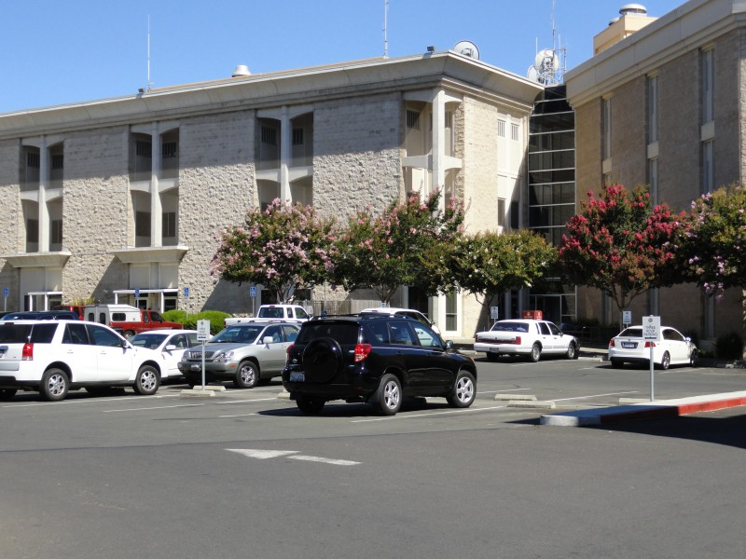
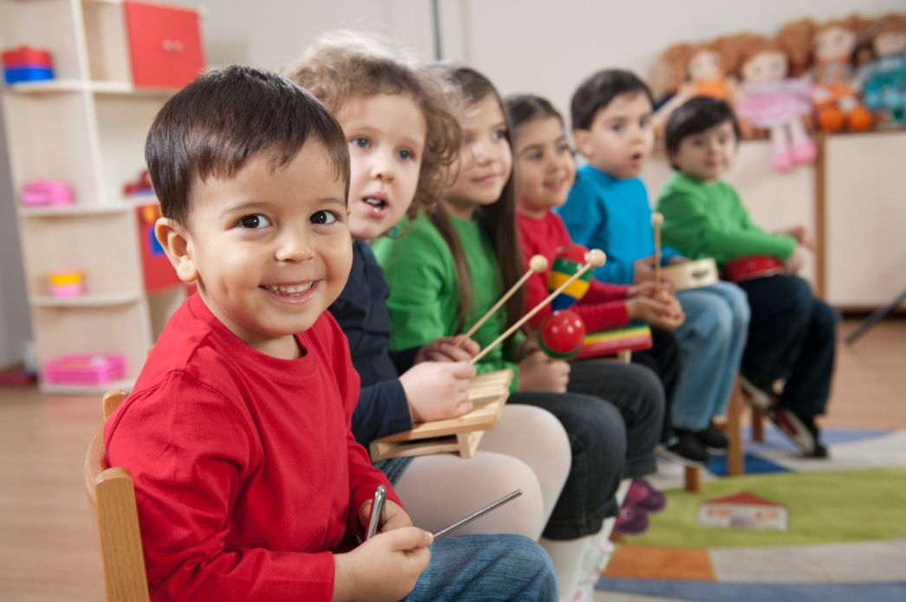
What is Y?
Notes:
So what is it, and how does it work for kids?
(CLICK)
The funding mechanism is a ¼ cent general sales tax, which has been put directly on the ballot by our County Board of Supervisors,
as a strategy to pay debt service on a new, badly needed, correctional facility (CLICK)
We made the argument that if we were going to expect the community to pay for corrections,
we should also show a real commitment to PREVENTION.. Namely an investment in our kids. (CLICK)
It took a while for everyone to get their heads around this concept, but it works.
The County decided to build a smaller jail then they had originally intended, and agreed that prevention programming made the most sense.
The conversation went from “big jail” and “no extra money for kids” to “invest in kids and we won’t need a bigger jail 20 years from now!” (CLICK) Measure Y was born.

Slide 10
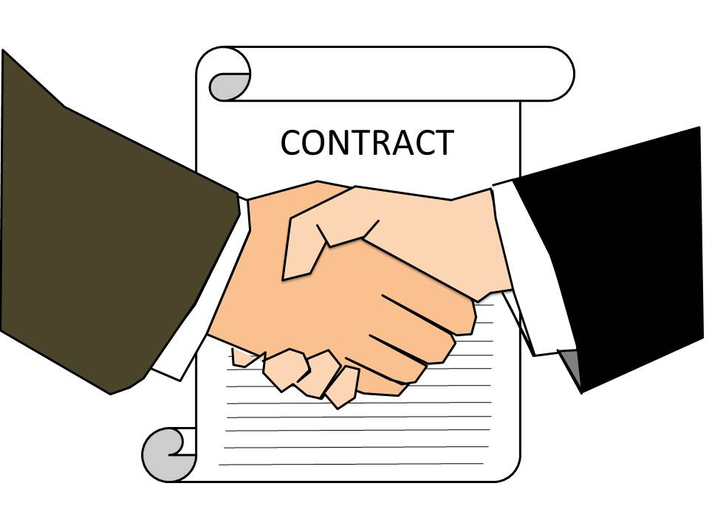
Vote YES on Y!
General Sales Tax: 50% +1
Specific tax: 2/3rd
www.yesonmeasurey.com
$2.5 million to $8 million??
Notes:
(CLICK)
Since Measure Y is a general sales tax, we cannot codify how the money will be spent until after the measure passes. (CLICK) Immediately following, we will be working with the County to write a Resolution of Intent, to clearly define the funding for corrections and kids. This has been a difficult selling point with voters, because the guarantee is not yet explicit; however, a general tax is the most likely to pass. (CLICK)
This campaign itself lives within the community, and is run by a small team of CBO’s and other activists.
The main message is: kids, safety and community. Our challenge is getting that message to voters, using a “bare bones” campaign budget and a lot of volunteer time.
(CLICK)
When Measure Y passes, we should earn approximately $2.5 million annually for the Children’s Fund.
After 10 years, and proof to the community that our programming works, we will work to reauthorize the tax.
Then we are talking about $8 million plus for kids programming… that is the REAL GAME CHANGER.

Slide 11
Lessons Learned
So far…
Notes:
I don’t believe we would have gotten to Measure Y with out first filing the Napa County Child Wellness Act.
It truly was the catalyst for compromise.
Be prepared to do something that is different and controversial, in order to focus priorities on kids.
(CLICK)

Slide 12
Start Early…
CBO Partners
Know your rights and responsibilities
Alliance for Justice: www.bolderadvocacy.org
501(h) election
County Electeds
Partnership and collaboration
Notes:
Need to start early:
Educate your Community Based Organizations. (CLICK)
Many do NOT understand their role in advocacy, and frequently are told by accountants and attorneys that they cannot advocate. (CLICK)
If you are a County Supervisor or City Council member, invite collaboration. Work together toward a viable solution… and know it may not look like anything you have ever done before.
If this had taken place in Napa County, for example, we would have saved copious amounts of time and money.
As proponents, instead of using $30,000 to defend ourselves in Court, we could have used that money on the current campaign.
START FUNDRAISING as early as possible; (CLICK)
Even a bare bones campaign is about $100,000 (CLICK)

Slide 13
Notes:
Pull your team together and make it diverse
Make sure your Steering Committee is committed and okay getting out of their comfort zone;
Assure several of your team members have had experience in political campaigns;
Keep in constant communication with CBOs and electeds, and coordinate your efforts
Lean on the learning community and those who have gone before you.
A “win” may look very different than you originally planned, be willing to take a small step forward if the big leap isn’t panning out.
The solution may be imperfect, but it is a move in the right direction.
Doing nothing, until everyone agrees on the perfect solution, will probably paralyze your effort.
And remember…(CLICK)

Slide 14
It ain’t over till…
Notes:
This is going to take some time. It will be a multi year process
We started three years ago… and there will be a lot more work before we are done.
Once a final agreement is made on the funding, we will need to assure the fund is set up correctly, program impacts are promoted, and in 10 years, we will need to reauthorize the tax
If you don’t win the first time, be prepared to go back… take time to create a strategy that incorporates contingency plans and encompasses at least 2 election cycles.
Most of all… (CLICK)

Slide 15
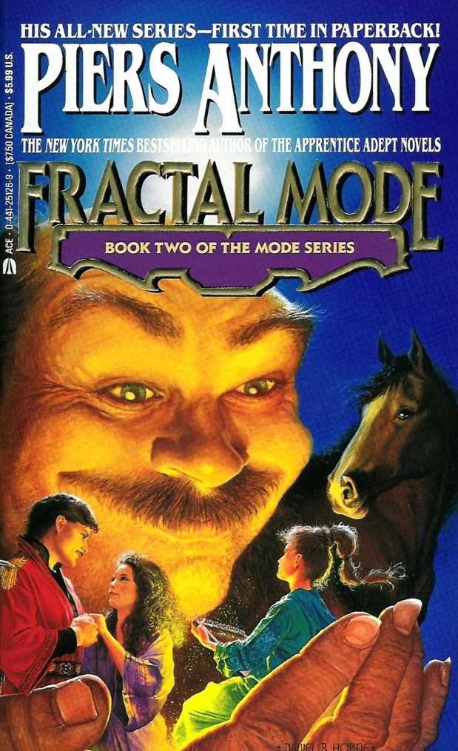
Remember WHY you do it.
“One thing you who had secure or happy childhoods should understand about those of us who did not: we who control our feelings, who avoid conflicts at all costs or seem to seek them, who are hypersensitive, self-critical, compulsive, workaholic, and above all survivors — we are not that way from perversity, and we can not just relax and let it go. We have learned to cope in ways you never had to.”
Notes:
REMEMBER why you do it. (CLICK)
Piers Anthony, although an eccentric science fiction writer, (CLICK) writes poignantly,
(CLICK)
One thing you who had secure or happy childhoods should understand about those of us who did not: we who control our feelings, who avoid conflicts at all costs or seem to seek them, who are hypersensitive, self-critical, compulsive, workaholic, and above all survivors — we are not that way from perversity, and we can not just relax and let it go. We have learned to cope in ways you never had to.”
I want to create communities where all kids are secure, valued and know they are loved…that is my mission
Define yours, align it with your advocacy efforts and stay the course. Most of all, believe YOU CAN DO IT!

