Slide 1
Richmond Kids First: Building Power thru a Ballot Effort
Notes:
Thanks to Margaret
This presentation is focused less on the end goal and more on our process along the way
Since day one we have had a commitment to values driven camapiging

Slide 2
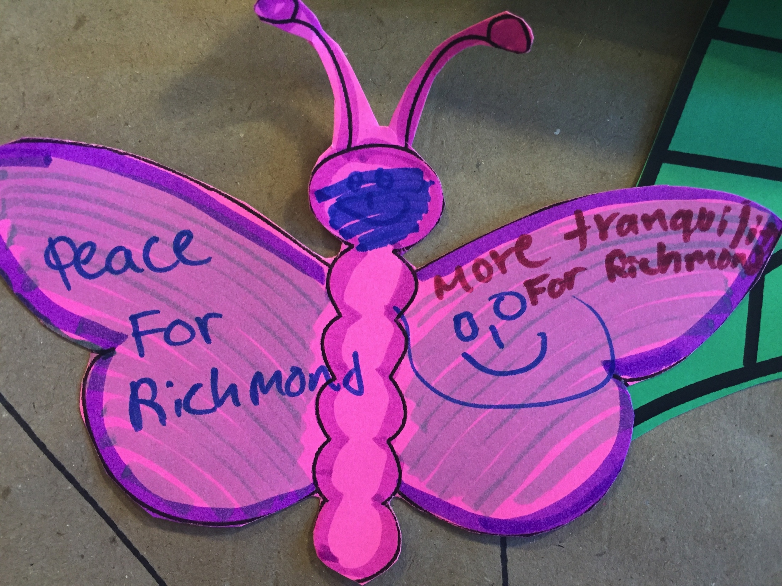
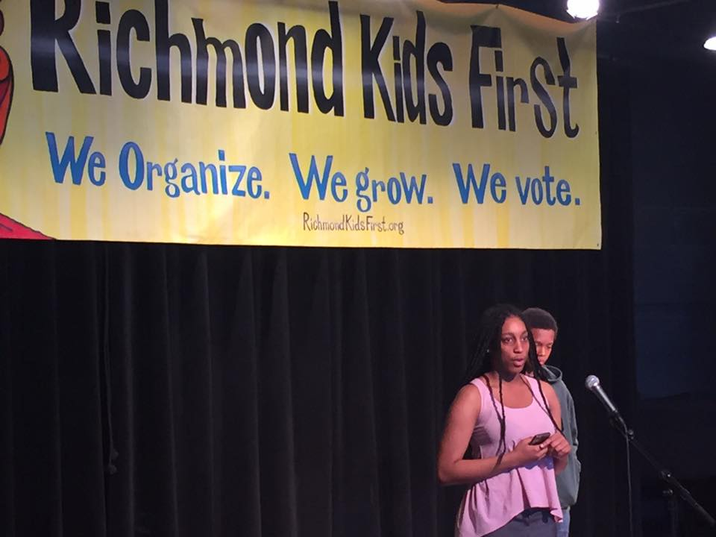
Purpose of RFCY
To create a Richmond Fund for Children and Youth with a sustainable, long-term funding stream in order to create a children and youth-friendly city.
Notes:
Such a fund will support the holistic well-being and of children and youth through a trauma-informed, asset-focused continuum of resources and services that fill-in the gaps in services and are highly effective, well coordinated and accountable to youth, their loved ones and the public.

Slide 3
Organizing Goals of Campaign
Whether we win or lose the ballot measure, we want to:
Build a shared vision for the needs and priorities of children and youth in Richmond;
Continue to build productive collaborations across community-based service, community institutions and public agencies;
Increase voter registration and turn out for Richmond residents ages 18-30 by 500;
Inspire and improve civic engagement skills of young people;
Create more responsiveness and accountability of government & CBOs to young people; and
Engage new funders and funding sources for children, youth and families in Richmond.

Slide 4
Goals of RFCY
To ensure that Richmond’s children, youth and young adults are physically, emotionally, mentally and socially healthy, educated, successful in school, and live in stable, safe and supported families and communities;
To increase safety for children, youth, young adults, their parents/guardians, families and the communities in which they live by preventing problems and enhancing strengthens;
To ensure young people are provided with gender-responsive, trauma-informed, population-specific and culturally-competent services;
To strengthen collaboration among public agencies and community-based organizations around shared outcomes;
To ensure an equitable distribution of resources to all of Richmond’s young people from birth through young adulthood;
To fill gaps in services and leverage other resources

Slide 5
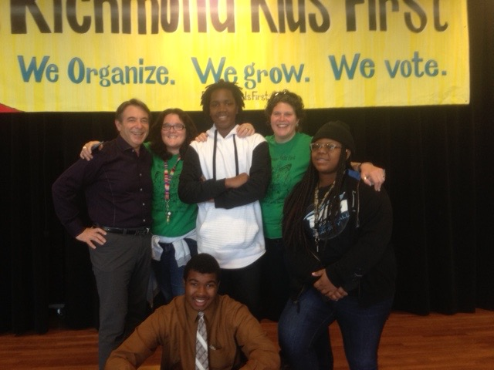
Who will RFCY serve?
Children and youth ages 0-18 years
Disconnected Transitional-Aged Youth 18 through 24 years old
Children, youth and young adults living in Richmond and North Richmond and most impacted by harm, inequity and lack of access to support and services
Notes:
, including but not limited to: system-involved children and youth, homeless children, youth and their families as well as those living in poverty, immigrant children, youth and families, LGBT children, youth and families, teen parents and families, single mothers, youth with poor physical, mental, emotional and behavioral health outcomes, youth with disabilities, and families with children and youth who are impacted by the criminal legal system and/or who have family members who are incarcerated.
Disconnected Transitional-Aged Youth 18 through 24 years old, including: homeless or in danger of homelessness; dropped out of high school; have a disability, including substance abuse; are low-income parents; are undocumented; are new immigrants and/or English Learners; are Lesbian, Gay, Bisexual, Transgender and Queer (“LGBTQQ”); and/or are transitioning from the foster care, juvenile justice, criminal justice

Slide 6
Services to be Funded
Violence prevention and response
Alternatives to incarceration and re-entry for systems involved youth and young adults
Education and job training
Parent and guardian support
Media, arts, culture and technology
Young people and family leadership, organizing and civic engagement
Health and well-being
Environmental justice education and outdoor recreation, including sports, gardening, play and urban agriculture

Slide 7
Phasing in of Fund
Jan – June 2017: $250,000 – to establish and build infrastructure of fund.
July 1, 2017 – June 30, 2018: $700,000 – to complete strategic planning, design evaluation, create and release RFP & solicit & review 1st cycle of grants to be awarded on July 1, 2018.
2018-2019: 1% of City of Richmond unrestricted general fund (RUGF)
2019-2020: 2% of RUGF
2020-2021-2027: 3% of RUGF

Slide 8
Strategic Planning & Application Timeline
January & February 2017: hire staff, launch Oversight Committee, contract strategic planning firm.
March – September 2017: strategic planning
October 2017 – January 2018: create RFP
February 1, 2018: release RFP
April 1, 2018: proposals due
May 15, 2018: recommendations made to CC
June 15, 2018: final approval
July 1, 2018: grants awarded

Slide 9
RFCY Oversight Committee
15 residents of Richmond & North Richmond (attempt to represent Richmond’s diverse communities)
12 appointed by City Council Members: 2 each – one 15-24; one over 24
3 appointed by Mayor: at least one 15-24
1-2 year terms

Slide 10
RFCY Oversight Committee: Roles & Responsibilities
Strategic Planning to set priorities (every three years)
Soliciting & reviewing applications
Recommending grants to award to City Council for approval
Facilitating annual evaluation
Review financial reports & audits

Slide 11
Administration of RFCY
City Managers office (until Dept. of Children and Youth Services is created)
10% for Administration
5% for Evaluation
Limit overhead %
Not to replace existing children & youth funding
10-year commitment then reassess

Slide 12
Emergency Contingencies
If one of top 3 revenue sources is reduced by 10%, then fund reduces to 2% of general fund
If one of top 3 revenue sources is reduced by 20%, then fund reduces to 1% of general fund

Slide 13
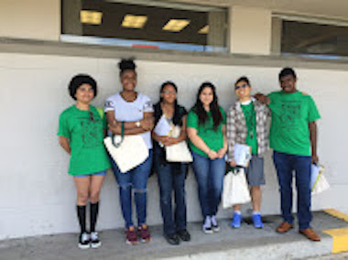
How are we doing it?
Young people are leading signature drive & have input in all aspects of campaign.
Strong & active coalition.
Support from funders with whom we have relationships.
Support from public officials with whom we have relationship.
Keeping it respectful.

