Slide 1
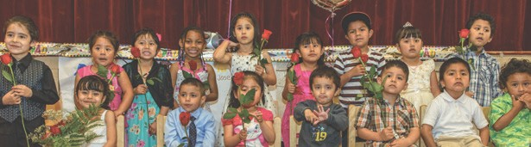

Marijuana and Children
The case for using marijuana tax revenue to mitigate health and discrimination impacts on children, youth and families.

Slide 2


Background
2016 – Prop 64 passed in California - decriminalizing recreational marijuana and personal cultivation.
Cities and counties now have authority to regulate and tax marijuana businesses.
Sales, cultivation, testing, transportation, distribution, and manufacturing of marijuana can be taxed at the local level if approved by voters.
Communities can prohibit marijuana, but only those that choose to allow it will have access to state-level revenues set aside for prevention, youth programs and education.
Investments of tax revenue in health, youth programs and prevention are clearly aligned with voter intentions.

Slide 3
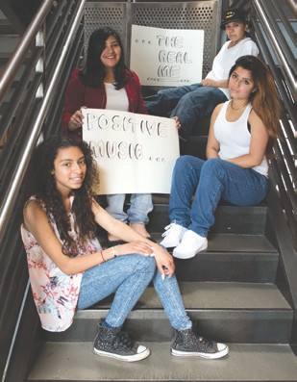
Concerns for Our Children
Increased use & acceptance
of recreational cannabis can lead to
unintended health effects
  Colorado’s experience
  Public health research

Slide 4


Concerns for Our Children
Colorado
  Cannabis-related visits to the Children’s Hospital of Colorado:
Public Health
  Short-term & long-term impacts
2014
1.2 per 100,000
2016
2.3 per 100,000
Source: George Sam Wang et al. “Unintentional Pediatric Exposures to Marijuana in Colorado, 2009-2015.” JAMA Pediatrics 170, no. 9 (2016)

Slide 5

RESEARCH ON HEALTH IMPACTS
Prenatal and early exposure through breast milk can be harmful – Marijuana crosses the placenta and could decrease a baby’s growth and development. Children of mothers who smoke are more likely to have social, learning and behavioral problems.
Communities with high levels of marijuana use among parents also have levels of child neglect that are higher than the statewide average. Heavy marijuana use can have a negative impact on parenting capacity.

Slide 6

RESEARCH ON HEALTH IMPACTS cont.
  17% of those who begin use in adolescence become addicted
  Marijuana use during adolescence results in cognitive impairment, impacting learning, memory and attention.
  Marijuana use has a negative impact on educational outcomes, with increased likelihood of school dropout.

Slide 7

REPAIRING THE DAMAGE
The War on Drugs has had a devastating
impact on children – who suffer from severe trauma
and whose families live in poverty.
1 in 28 children have an incarcerated parent. 10
million children will have an incarcerated
parent during their childhood.
Revenue from marijuana taxes provides
an opportunity to invest in those children
who have been most negatively impacted by mass incarceration.

Slide 8

INVEST IN CHILDREN AND YOUTH
FOR EACH $1 INVESTED
THE SOCIETAL RETURNS ARE
$8.60 for Childhood Development
$4 for Mental Health Services
$9 - $12 for Afterschool Funds
$9 for Health Prevention
$4.69 for Career Development

Slide 9
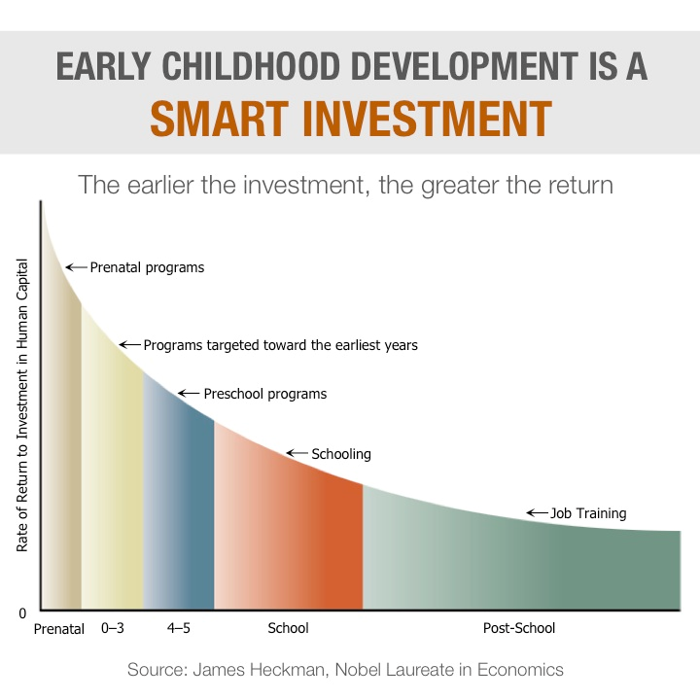

Investment in Our Children

Slide 10

RECOMMENDATION
Allocate 30% of the local cannabis tax for prevention programs for children and youth.

