Slide 1
Overview: Bay Area County Special Funding for Children’s Services
Ellen Dektar
June 21, 2017
Interagency Children’s Policy Council

Slide 2
Most (6/9) Bay Area Counties have backed initiatives which fund children’s services in some manner in the past four years

Slide 3
Most Bay Area Counties have backed initiatives which fund children’s services in some manner in the past four years
Year of Initial Attempt | City/County | Measure/Subject
1991, Renewed and expanded in 2000, 2014 | San Francisco County | Prop C Children’s Fund
2004, Renewed in 2014 | San Francisco County | Public Education Enrichment Fund
2004, Renewed in 2014 | Alameda County | Measure AA
2012, Renewed in 2016 | San Mateo County | Half Cent sales tax for broad uses, 2 allocations include children
2016 | Marin, Napa, Santa Cruz, Solano, Humboldt | Humboldt and Santa Cruz: cannabis

Slide 4
San Francisco provides the most dedicated, ongoing revenue

Slide 5
San Mateo and Alameda have carved out one time/limited investments from broader taxes

Slide 6
Alameda Measure A Recently Increased Young Child Funding for Two Years;
In 2018: $1.6 m In Home Visiting

Slide 8
2/10 Bay Area counties have recently made new General Fund investments in ECE
Sonoma contributed $305,000 for ECE facilities
Santa Clara allocated $175,000 cover furnishings for large state of the art child care center

Slide 9
In Summary, Most Tax/Funding for Children’s Services in the Bay Area is Currently Minimal and Limited to One or Two Years

Slide 10
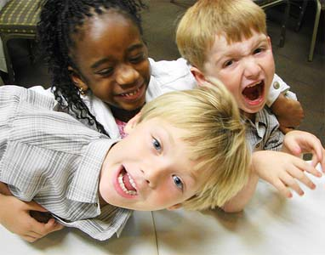
Thank you!

