Slide 2

Voters have a strong sense of collective responsibility to help young children.
#1:

Slide 3
Voters feel a strong sense of collective responsibility for helping kids.
All Solano County residents have a shared responsibility in helping local children grow up healthy and ready to learn
Total Agree
81%
Total Disagree
18%
2014 Solano County Voter Survey

Slide 4
Voters recognize we are in a different era and economy, making early childhood education a need for many families.
In today's economy, families often need two incomes to get by ‐ and many single parents are working more than one job. Access to quality early childhood education is not a luxury, but a need for many families. | 66% % Strongly Agree | 88% % Total Agree
2015 National Survey by Public Opinion Strategies/Hart Research Associates

Slide 5
Youth services rank in a top tier of funding needs.
I am going to read a short list of public services in San Joaquin County. Please tell me if you think there is a great need for additional funding, some need, a little need or no real need for additional funding for that service.
Great/Some Need
88%
81%
77%
72%
72%
67%
63%
56%
52%
2016 San Joaquin County Voter Survey

Slide 6

Voters see broad social benefits from investments in early childhood education.
#2:

Slide 7
Voters believe increased access to early education will have broad benefits for society.
(% Believing Expanded Access to Early Education is Likely to Produce Each Benefit)
2015 FM3/POS National Voter Survey for NAEYC

Slide 8
When asked directly, voters consistently say that pre-school benefits everyone – not just the families directly served.
Pre-school programs benefit everyone, by leading to better-educated kids, lower crime rates, and a stronger economy.
Pre-school programs primarily benefit the children who are enrolled in them, and their parents and families.
Both/Neither/Not sure/Don't know
OR
2012 San Antonio Voter Survey

Slide 9

Voters back investment in a wide range of services – education, health, job training and more – to help children and youth.
#3:

Slide 10
Helping homeless youth stay in school stood out as a priority in Richmond.
I am going to read you a list of some specific services for children and youth that may be provided. Please tell me how important it is to you that additional funding be dedicated to that specific service.
Ext./Very Impt.
95%
86%
78%
85%
84%
78%
83%
2015 Richmond Survey

Slide 11
Quality pre-school and preventive health services were also seen as important.
Ext./ Very Impt.
74%
84%
79%
79%
77%
78%
78%
2015 Richmond Survey

Slide 12
While of lowest relative importance, youth empowerment and media and technology education were still highly valued.
Ext./Very Impt.
71%
70%
71%
71%
72%
70%
73%
2015 Richmond Survey

Slide 13

Voters prioritize helping at-risk youth – but generally don’t like to draw distinctions.
#4:

Slide 14
Youth involved in the justice system and with mental health problems are seen as the highest priorities for assistance.
I am going to read you a list of some of different groups of youth that may benefit from these services. Please tell me how high a priority you think it should be to provide additional funding to help that group of youth: one of the highest priorities, a high priority, a medium priority, or a low priority.
One of the Highest/High
81%
80%
80%
79%
79%
78%
73%
2015 City of Richmond Survey

Slide 15
Majorities rate every subgroup a high priority.
One of the Highest/High
73%
71%
71%
67%
67%
56%
54%
2015 City of Richmond Survey

Slide 16
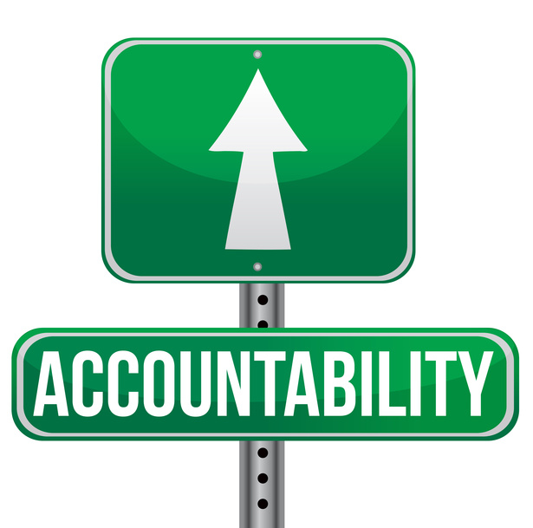
Accountability and oversight are more critical than ever.
#5:

Slide 17
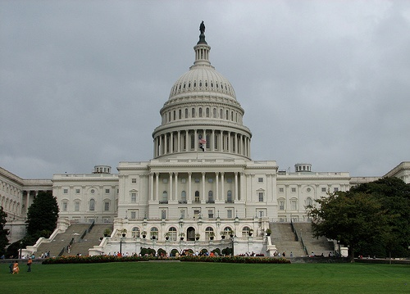
Proportion Believing Government Can be Trusted to Do What is Right “All or Most of the Time”
1972
1974
August 2014
53%
36%
13%
University of Michigan Surveys
Notes:
16
16

Slide 18
Voters are much more likely to support a funding measure with accountability mechanisms.
I am going to read you some other possible provisions of this measure. Please tell me whether you would be more likely or less likely to vote for the measure if that provision were included.
Difference
+50%
+46%
+38%
+38%
Napa County 2015 Voter Survey

Slide 19
Voters often like to see engagement from CBOs with experience serving young people.
And whom would you prefer actually provide the services
to children, youth, and their families?
OR
OR
2015 Richmond Voter Survey

Slide 20

Top messages remain very consistent.
#6:

Slide 21
Top-testing messages are consistent across locations.
(PARENTS) The most important factor in helping kids succeed in school is getting their parents involved. That’s why this measure requires parents to actively participate in their kids’ education, from pre-school through graduation – by bringing kids to school on-time and ensuring they have excellent attendance; participating in school activities; and reading to kids at home.
^(BRAIN DEVELOPMENT) Research shows that a child’s brain develops most dramatically during the first five years of life. This critical period is a window of opportunity to lay the foundation for all of the years that follow. By voting for this measure, we can help ensure that every child in Solano County has the health and education support they need to get off to a strong start.
(SCHOOL READINESS) Voting “yes” on this measure will help to strengthen local schools. Increasing access to quality pre-school programs will help strengthen K-12 education. Studies show that kids who go to pre-school are better prepared to learn, more likely to read by the fourth grade and more likely to graduate and go on to college.
80%
75%
77%
2014 Solano County Voter Survey

Slide 22
California voters across the ideological spectrum also say pre-school strengthens K-12 education.
Pre-school programs strengthen K through 12 education. Studies show that kids who go to pre-school learn to read faster, are less likely to fall behind their classmates, and are less likely to drop out of school.
Pre-school programs weaken K through 12 education. They take money and qualified teachers away from elementary and secondary school classrooms, where investments in education are more likely to help our kids.
Both/Neither/NS/DK
OR

Slide 23
Messaging on equity and the ROI on ECE has done well recently.
Message | % Very Convincing
(EQUITY – SONOMA COUNTY ) Pre-school should not be a luxury only available to a few families. In Sonoma County, the cost of sending a child to pre-school is nearly $13,000 dollars per year – that’s 39% of the median annual income for Sonoma County women. This measure will make early education available and affordable to families of all incomes, including middle-class families.
(RETURN ON INVESTMENT – SANTA FE) This measure provides a broad set of benefits to our community; in addition to preparing kids for school and improving their long-term outcomes, it allows parents to return to the workforce while their young children are in school and creates hundreds of jobs in early education. Experts say that for every dollar in local funding generated, we will receive as much as $3.30 in benefits to the community.
45%
39%
2017 Santa Fe Survey

Slide 24

Crowded ballots raise questions about election timing.
#7:

Slide 25

State Versus Local Taxes
As a general principle, when there are state and local funding measures on the same topic on the same ballot, voters prefer the local measure to the state measure
Consider Prop 51 last November – a statewide school bond at the top of the ballot passed with 55% of the vote
At the same time, voters approved 97% of local school bonds requiring 55% - well over the historic average of 81%

Slide 26

The New Importance of Acting Locally

Slide 27

New funding mechanisms are gaining popularity.
#8:

Slide 28
Voters’ favorite taxes are the ones they do not have to pay.
Total Supp. | Total Opp.
75% | 23%
64% | 34%
60% | 36%
45% | 53%
38% | 57%
2015 Santa Clara County Survey

Slide 29


The New Funding Frontier:
Pros and Cons

