Slide 2
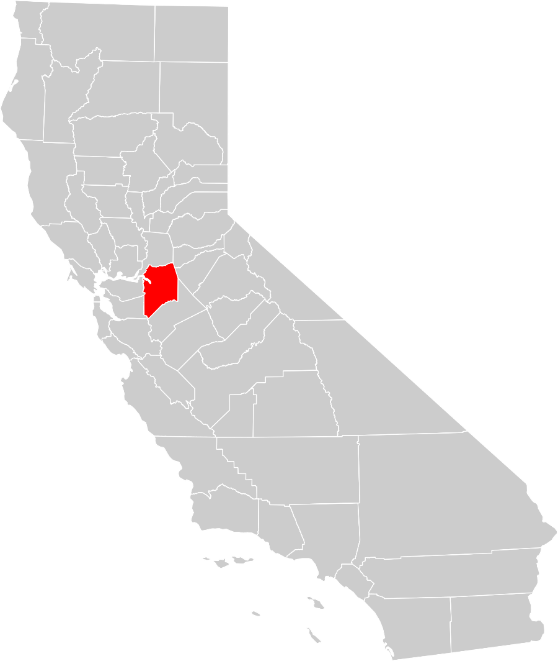
Methodology
400 telephone interviews with voters likely to cast ballots in June 2018 in San Joaquin County
Interviews conducted November 2-5, 2017
Interviews on landlines and cell phones, and in English and Spanish
Margin of sampling error of +/- 4.9% at the 95% confidence level
Some percentages may not sum to 100% due to rounding

Slide 3
Voters feel positive about the direction of the County.
In general, would you say that things in San Joaquin County are generally headed in the right direction, or do you feel that things are pretty seriously off on the wrong track?
Q1.

Slide 4
Voter Support for a Cannabis Cultivation Tax

Slide 5
Based on draft ballot language, a solid majority supports the proposed tax.
“In order to provide funding for cannabis enforcement and prosecution; early childhood education/ other programs for children and youth; substance abuse prevention/treatment; and other public health programs, shall the ordinance imposing a tax on commercial cannabis businesses in the unincorporated area of San Joaquin County up to a maximum of $120 per square foot on cultivation and 15% of gross receipts on other cannabis business activities, with an annual adjustment for inflation, be adopted?”
Total Yes 57%
Total No 37%
Q2. Do you think you would vote “yes” in favor of this measure or “no” to oppose it?

Slide 6
Voters who support the measure think cannabis businesses should be taxed, and like that it will create revenue.
In a few of your own words, what are the main reasons why you would vote YES on this measure?
Q3a. Open-Ended; Responses of 4% or More

Slide 7
Those opposed have strong anti-tax sentiments, and tend to oppose cannabis cultivation in principle.
In a few of your own words, what are the main reasons why you would vote NO on this measure?
Q3b. Open-Ended; Responses of 4% or More

Slide 8
After hearing a statement in favor of the measure, more than two-thirds support it.
Supporters of this measure say that the cannabis industry will benefit from our County; we should ensure that they pay their own way and contribute to the community. This measure will ensure our County has the funding to appropriately regulate these newly-legalized cannabis businesses, and enforce laws protecting our community’s public safety, without having to take resources from existing programs. This revenue will allow us to fund substance abuse prevention programs. It will also provide sorely needed, locally-controlled revenue for public health programs and early childhood education services for young children. By expanding access to early childhood care and to family services for parents, we can help ensure that every child in San Joaquin County gets off to a strong start and has the support they need to grow up healthy, happy and prepared for their future. Funds from this measure will be subject to strict accountability provisions, including annual independent audits and citizen oversight.
Total Yes 69%
Total No 26%
Q8. Having heard this, do you think you would vote “yes” in favor of this measure or “no” to oppose it?

Slide 9
After a statement opposing the measure, a slim majority supports it.
Opponents of the tax measure say that taxing cannabis cultivation will only encourage more suppliers to stay in the illegal, unregulated and untaxed black market, increasing criminal activity and endangering public health. Others say that taxing cultivation will force growers to move to other counties, depriving us of jobs and future tax revenue.
Total Yes 55%
Total No 39%
Q9. Having heard this, do you think you would vote “yes” in favor of this measure or “no” to oppose it?

Slide 10
Younger voters are among the most supportive, particularly after an argument in favor of the measure.
(Total Yes)
Demographic Group | Initial Vote | After Positive Message | After Negative Message
Age
18-29 | 69% | 80% | 58%
30-39 | 68% | 79% | 58%
40-49 | 58% | 72% | 54%
50-64 | 47% | 62% | 60%
65-74 | 66% | 72% | 53%
75+ | 49% | 65% | 43%
Gender
Men | 57% | 69% | 52%
Women | 58% | 69% | 57%
Q2, Q8 & Q9. Do you think you would vote “yes” in favor of this measure or “no” to oppose it?

Slide 11
Support falls along partisan lines; Democrats and independents strongly back it, while Republicans are more modestly supportive.
(Total Yes)
Demographic Group | Initial Vote | After Positive Message | After Negative Message
Party
Democrats | 65% | 80% | 56%
Independents | 57% | 70% | 58%
Republicans | 48% | 56% | 51%
Ethnicity
Whites | 60% | 68% | 54%
Latinos | 64% | 82% | 54%
All Voters of Color | 58% | 73% | 54%
Parents
Dads | 59% | 74% | 57%
Moms | 50% | 69% | 61%
Men With No Children | 55% | 67% | 50%
Women With No Children | 63% | 69% | 54%
Q2, Q8 & Q9. Do you think you would vote “yes” in favor of this measure or “no” to oppose it?

Slide 12
Geographic differences are relatively modest.
(Total Yes)
Demographic Group | Initial Vote | After Positive Message | After Negative Message
Supervisorial District
District 1 (Villapudua) | 53% | 81% | 52%
District 2 (Miller) | 61% | 66% | 60%
District 3 (Patti) | 63% | 75% | 57%
District 4 (Winn) | 55% | 63% | 53%
District 5 (Elliott) | 53% | 66% | 50%
City
Stockton | 63% | 78% | 60%
Tracy | 47% | 69% | 46%
Lodi | 53% | 67% | 51%
Manteca | 56% | 57% | 51%
Other Cities | 59% | 70% | 57%
Unincorporated Area | 55% | 64% | 54%
Q2, Q8 & Q9. Do you think you would vote “yes” in favor of this measure or “no” to oppose it?

Slide 13
Elements of the Measure

Slide 14
A majority would prefer that the spending allocations be determined by the measure, and not left up to the board.
The details of this measure have not yet been finalized; which of the following statements come closer to your personal opinion?
53%
The measure should include specific requirements that direct what percentage of the measure’s revenue should go to each of its funding areas, which the Board of Supervisors could not change
33%
The measure should allow the Board of Supervisors to decide what percentage of the measure’s revenue should be spent in each funding area on an annual basis, based on recommendations from an oversight committee
14%
Both/Neither/ DK/NA
Q5.

Slide 15
Voters are clearly most interested in allocating revenue to early childhood education and youth programs.
I am going to read you a list of the four major areas to which funding from this measure may be dedicated. After I read all four, please tell me which one you think is the most important priority.
Q4.

Slide 16
When asked how they would allocate the spending, there was not a dramatic difference between spending areas.
I am going to ask you to imagine you are in charge of the revenue from this measure. I would like you to tell me how you would prioritize spending on the four funding areas we discussed before. For this exercise, assume you have $100 to spend on all four areas. Please tell me how many dollars out of $100 you would spend on each area, keeping in mind that the total must add up to $100.
Funding Area | Mean | First Choice
Early childhood education and other programs for children and youth | $29.70 | 41%
Substance abuse prevention and treatment programs | $24.20 | 21%
Public health programs | $23.90 | 17%
Public safety and cannabis enforcement programs | $22.20 | 14%
Q6.

Slide 17
Among more specific funding areas, voters prioritize childhood literacy and crime reduction.
I am going to read you a more specific list of services this measure could fund in San Joaquin County. Please tell me how important it would be to you that each service be funded.
Ext./Very Impt.
71%
79%
71%
71%
68%
63%
Q7. ^Not Part of Split Sample

Slide 18
Enforcing cannabis cultivation, support for foster youth, and public safety dedicated to illegal cannabis were all lower tier priorities.
Ext./Very Impt.
64%
62%
62%
75%
53%
67%
51%
Q7. I am going to read you a more specific list of services this measure could fund in San Joaquin County. Please tell me how important it would be to you that each service be funded. ^Not Part of Split Sample

Slide 19
Conclusions

Slide 20
Conclusions
San Joaquin County voters offer solid majority support for a proposed measure to tax cannabis cultivation; however, that support initially falls short of the two-thirds supermajority required for approval of a special tax.
Accordingly, the measure’s prospects for success may hinge on:
A public education and outreach effort, which the poll data suggests could yield supermajority support;
Placing the measure on the ballot through the initiative process, which a recent State Supreme Court decision suggests could permit simple majority approval; or
Considering a November election date, when voter turnout could be higher.
It will also be critical to make clear that the measure does not itself authorize marijuana cultivation; it simply establishes a tax on the activity.
Voters express a clear preference for having spending allocations written into the measure itself.
Voters place the highest priority on providing funding for early childhood education and youth programs.
At the same time, voters also back funding for public safety and public health programs from the measure.

