Slide 1

BUDGET ADVOCACY
Margaret Brodkin
Feb. 6, 2018
University of San Francisco

Slide 2


WHY BUDGETS MATTER?
A budget is a moral document that reflects community values.
Funding inequity is a social justice issue.
It all costs money. Lack of resources is greatest resistance to change

Slide 3
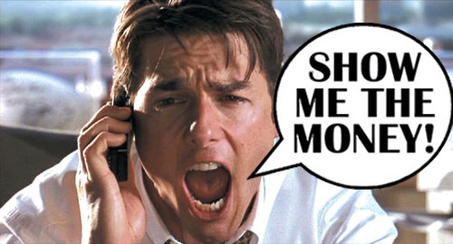
WHAT IS BUDGET ADVOCACY?
Process of working to change public budget priorities:
Reallocation
Expanding line items
New programs
Dedicated funding
Taxes and fees

Slide 4
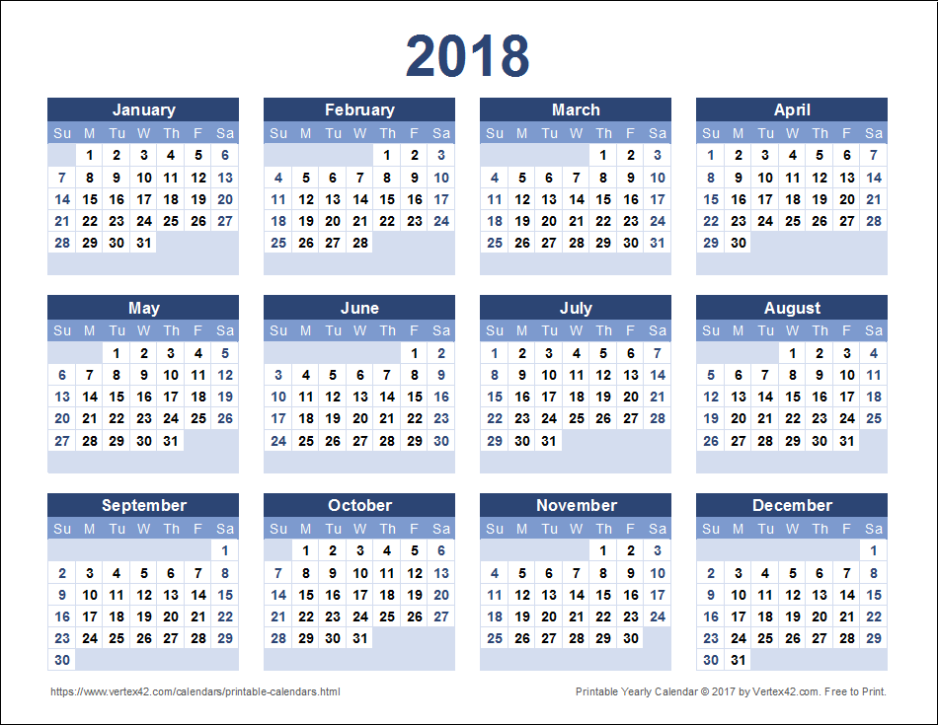
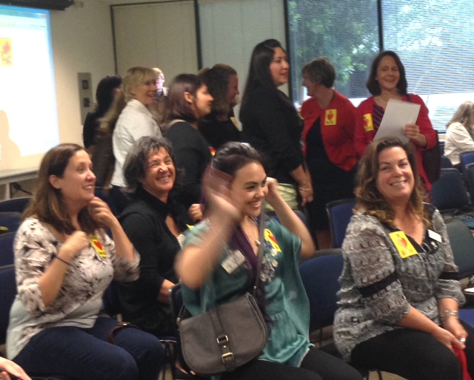
IMPORTANT TO REMEMBER
Creating a public budget is a year-round process.
Showing up is half the battle
Start small – oppose budget cuts
End big – create dedicated
funding for your priorities

Slide 5

CHALLENGES
PRESERVING THE STATUS QUO
SACRED COWS
TURF
NEVER THE RIGHT TIME
NEVER THE RIGHT APPROACH
NO NEW MONEY
PURPOSEFUL MYSTIFICATION
INEXPERIENCE OF ADVOCATES

Slide 6
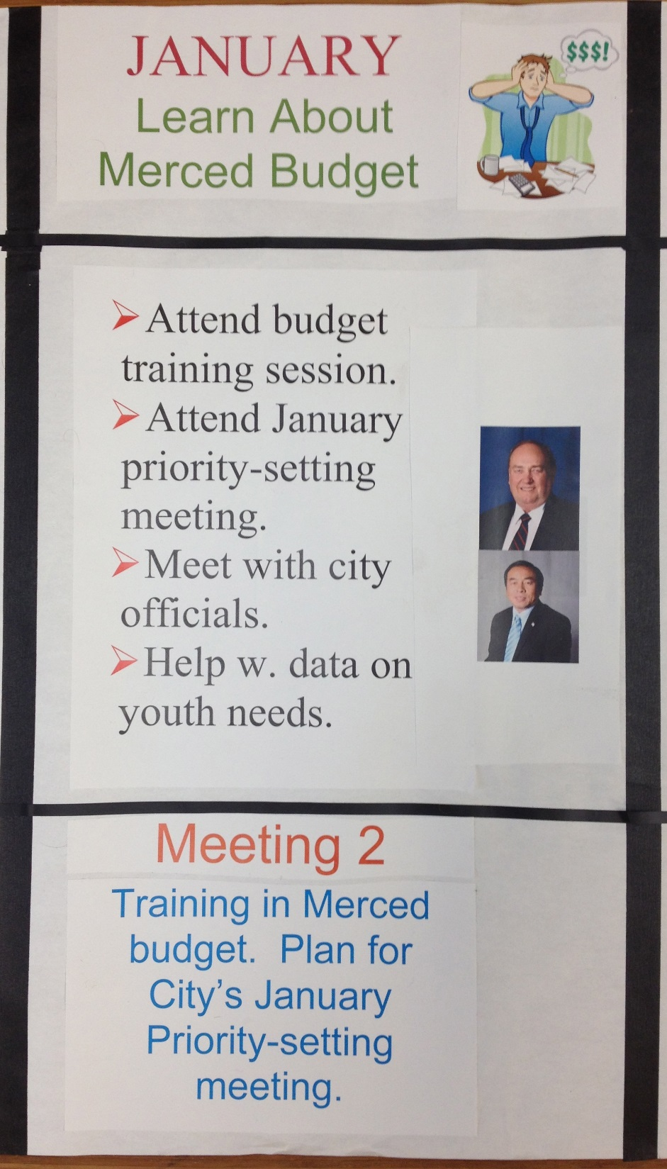
UNDERSTANDING THE BUDGET
HOMEWORK HELPS
What level of government can respond to your proposal?
What are current expenditures?
  Prevention vs. Rehabilitation
  Changes over the years
  Compared to other expenditures and overall budget
  How much is discretionary
What is the competition for dollars?
Do you have ideas for a funding source?

Slide 7
Expenditures by Primary Focus of Service

Slide 8
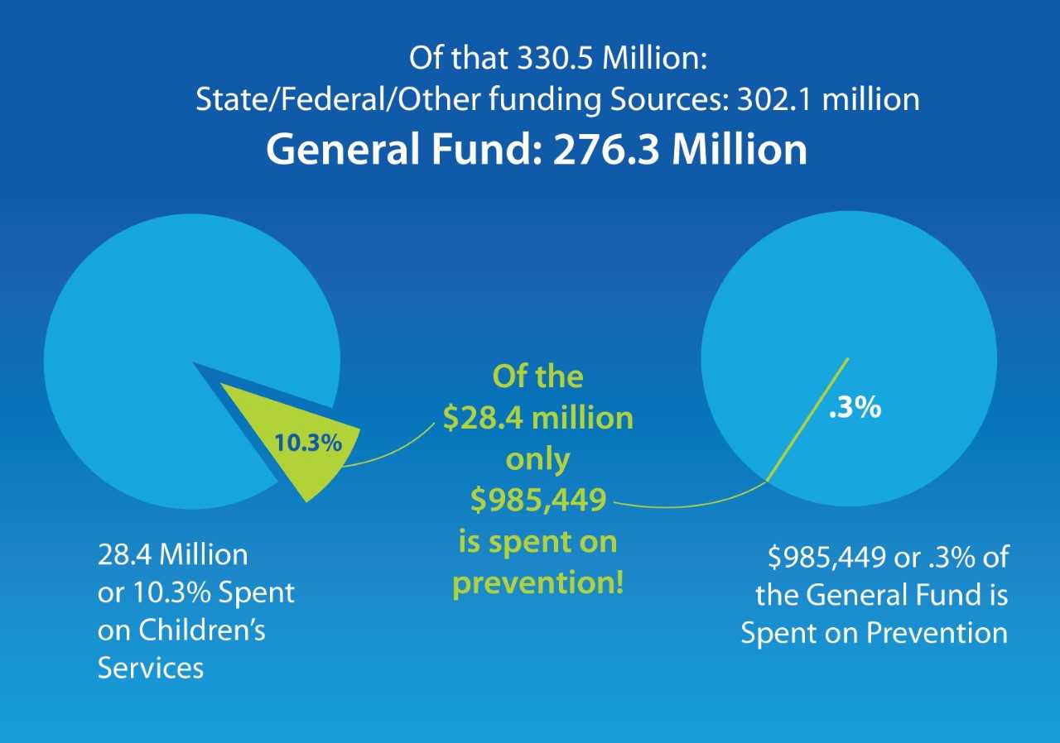

Slide 9
Data Collection & Analysis: Baseline Budget
Notes:
SC:
Result of forms you completed last year and info from HHS and other county departments—does not include General health, hospitals and Ole Health
What is does a baseline budget tell us?
First goal is to ensure that we maintain that baseline at $9M. Threshold for money that must remain committed if we are successful in establishing a sustainable public stream.
All additions funds would be above the baseline
It also tells us we are spending far less on children than our growing population of children deserves.—especially when we take out juvenile hall.
Walk through the numbers.

Slide 10
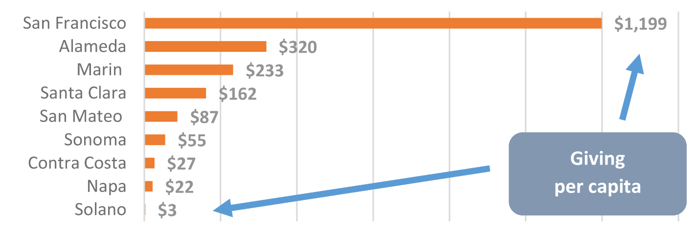
UNDERSTANDING THE CONTEXT
  Foundation giving does not seem directly linked to the level of community needs. For instance, compared to other Bay Area counties, Solano has highest rate of families in poverty (11%), but it has the lowest rate of per capita giving.
  The “giving gap” continues to widen over time. While foundation giving in the Bay Area overall increased 37% between 2006 and 2012, giving in Solano has stagnated, exacerbating the gaps between Solano and its wealthier neighbors.

Slide 11
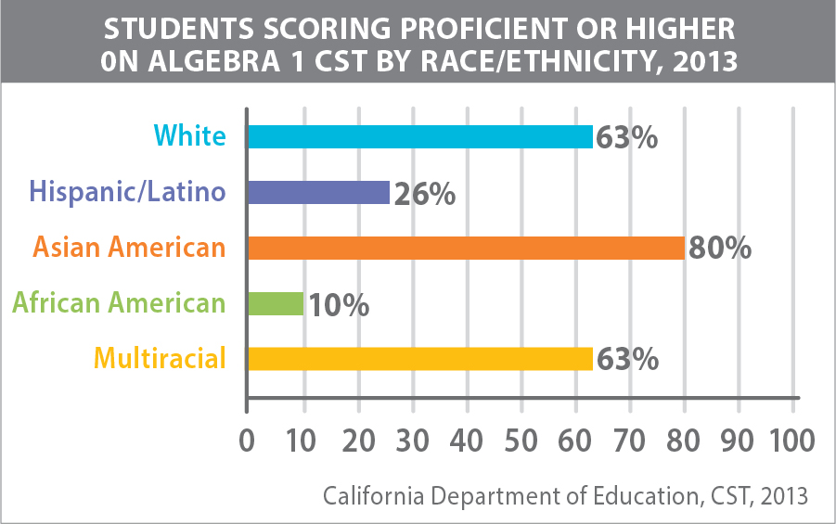
All 7th – 11th grade students CST Algebra, 2013
Notes:
Success in Algebra is a key indicator of ongoing educational achievement and is critical for college preparation and acceptance. In addition 26% of economically disadvantaged students scored proficient or higher compared to 62% of those not disadvantaged.

Slide 12
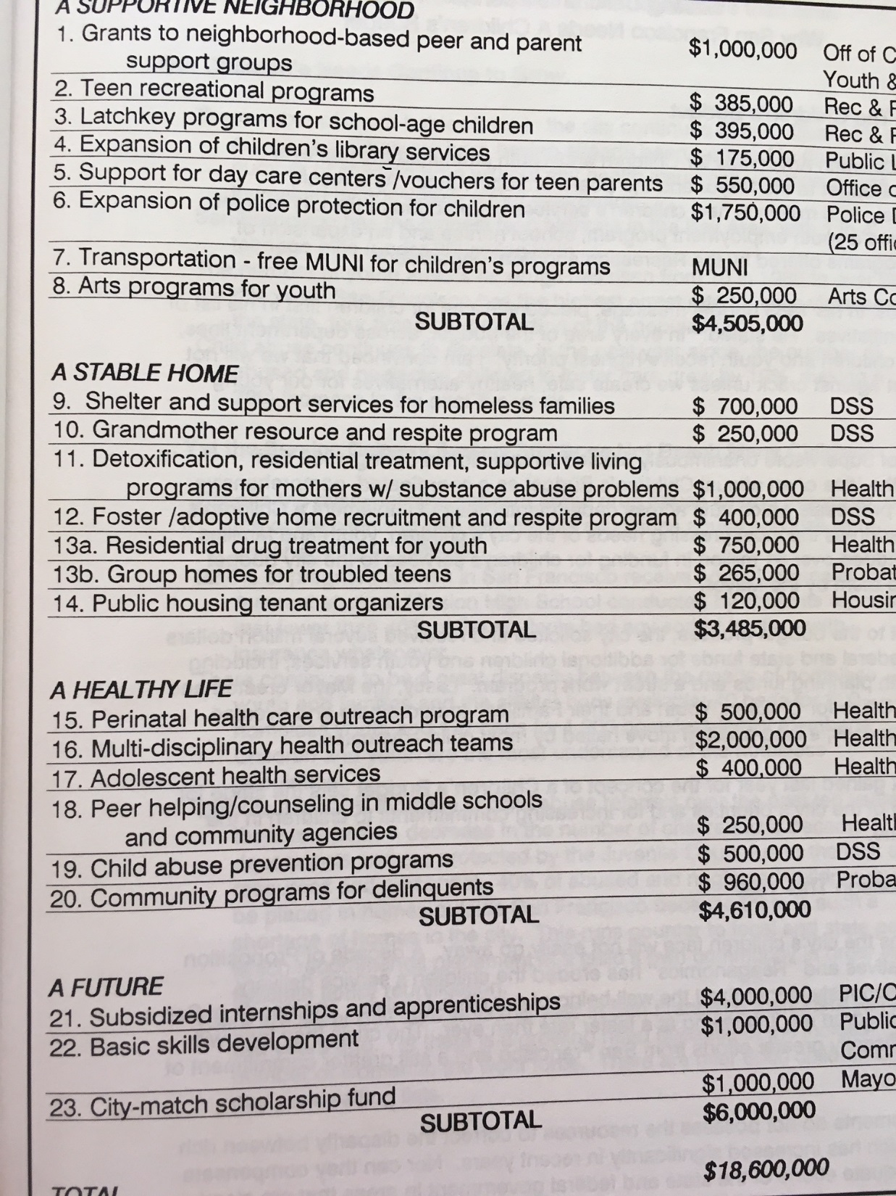
SETTING GOALS
Make goals very concrete.
What is the cost? What program? Who will be served? Documentation of need? Potential outcomes?
Criteria for setting goals:
Availability of resources, Popular with public, Coalition of supporters, Cost benefit, Visible results, Builds power, Rallies parents/youth/consituents,
Big enough to matter --- Small enough to win!

Slide 13
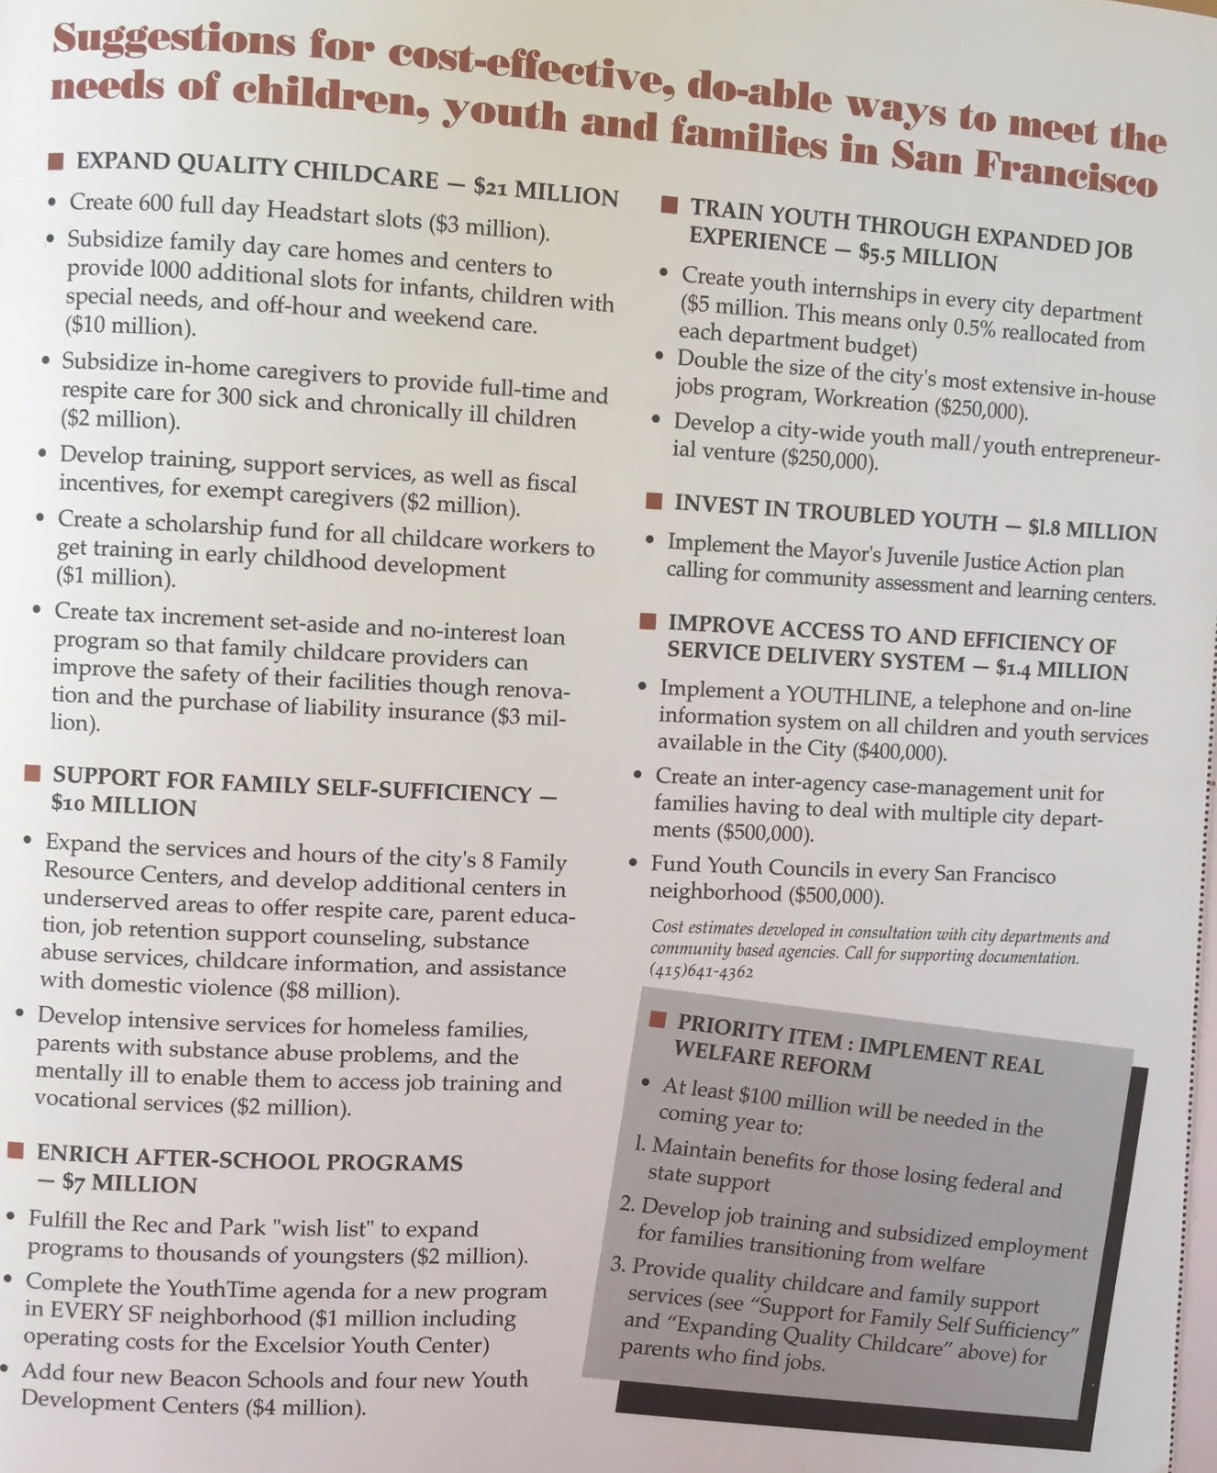
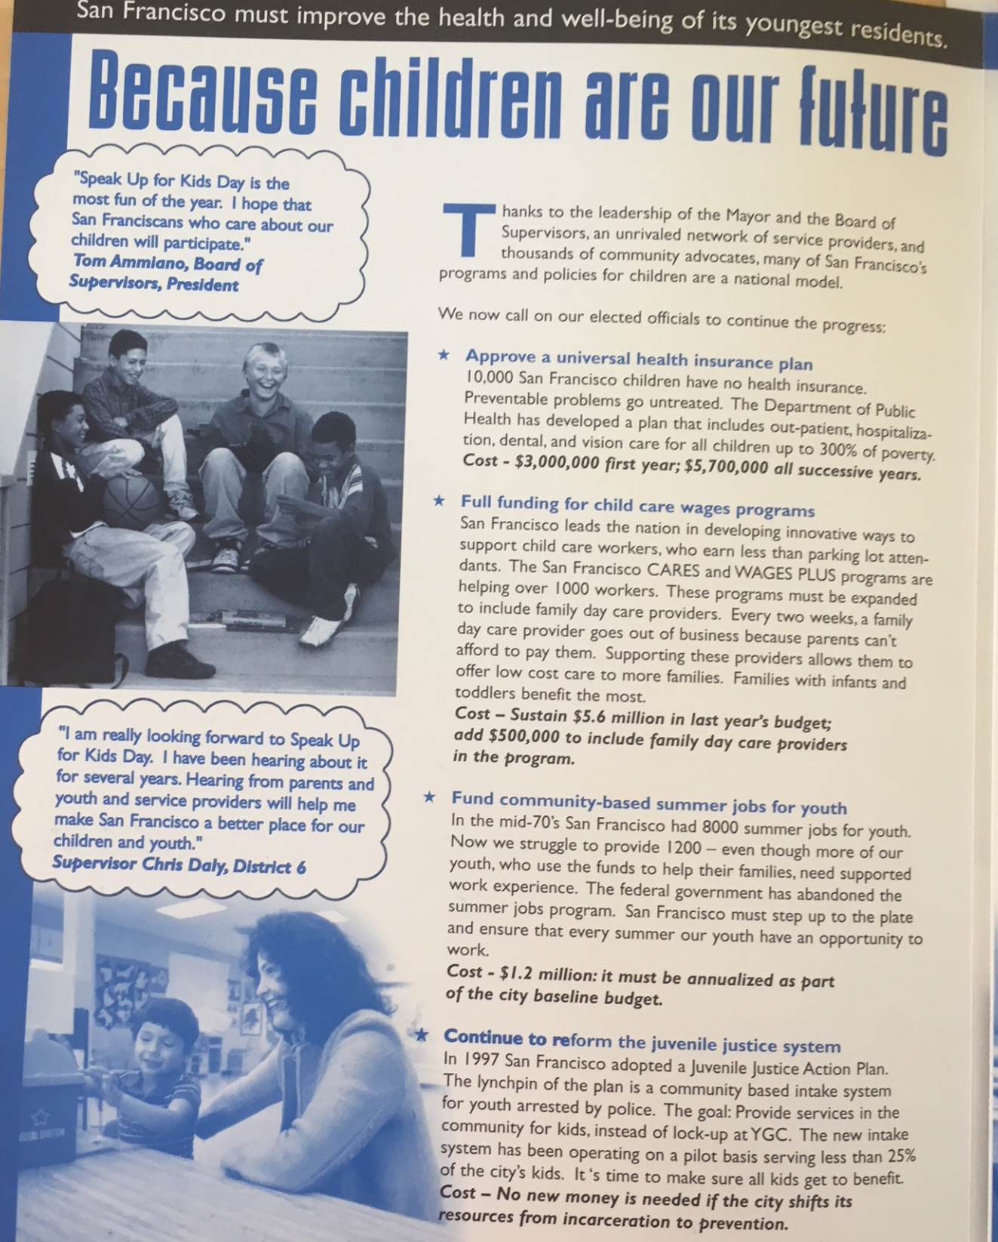

Slide 14

Affordable Child Care
Provide part day, wrap around child care services for estimated 200 children who currently do not have access with the expanded preschool program
Provide additional childcare subsidies for 60-65 children up to age 4 with a family income at or below 300% of FPL
Stabilize supply of center-based, subsidized infant care by providing small annual grants

Slide 15
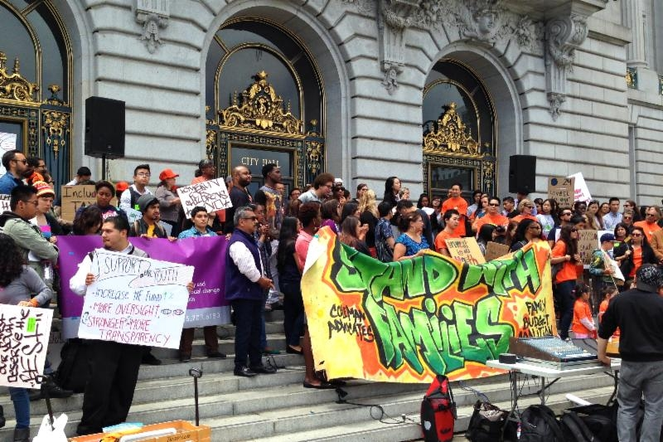
PERSUASION AND PRESSURE
Soft traditional tactics – reports, meetings, letters, testimony, op-eds, site visits, calls
POLITICAL HARDBALL – demonstrations, sit-ins, petitions, public challenges and direct criticism, guerilla theatre, press events, withdrawl of political support, circumventing the traditional process

Slide 16
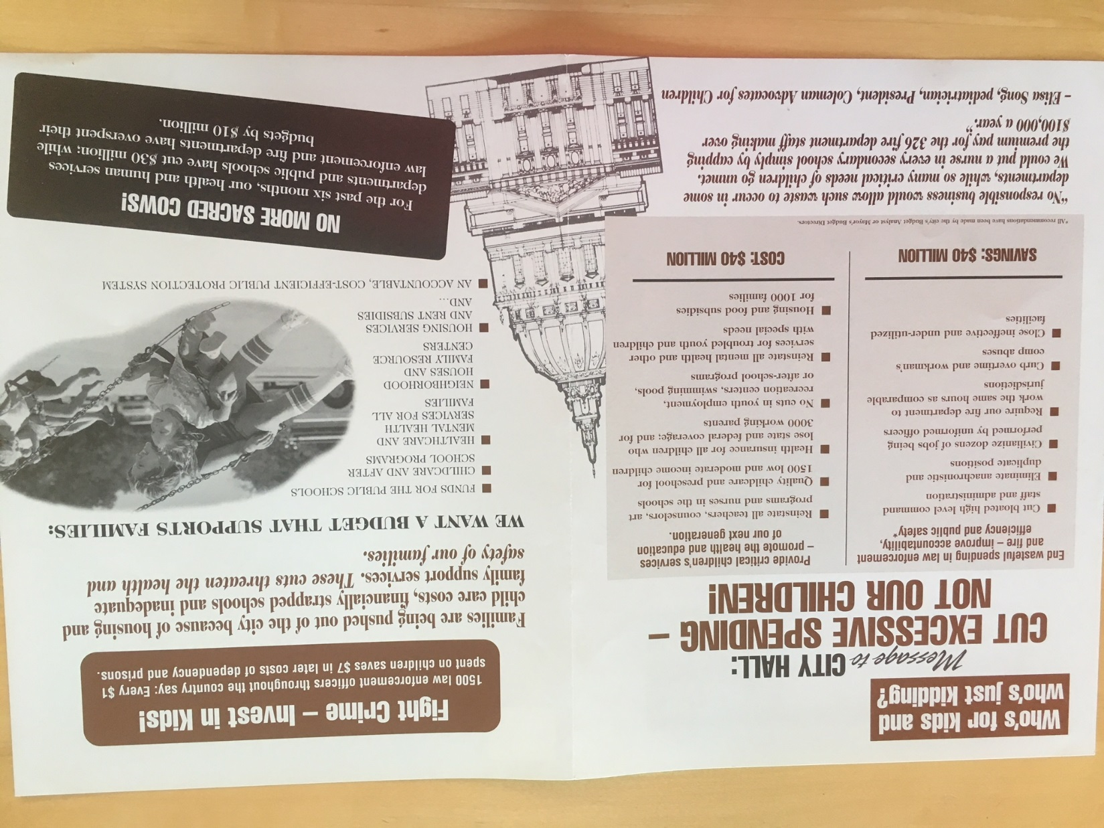
,

Slide 17
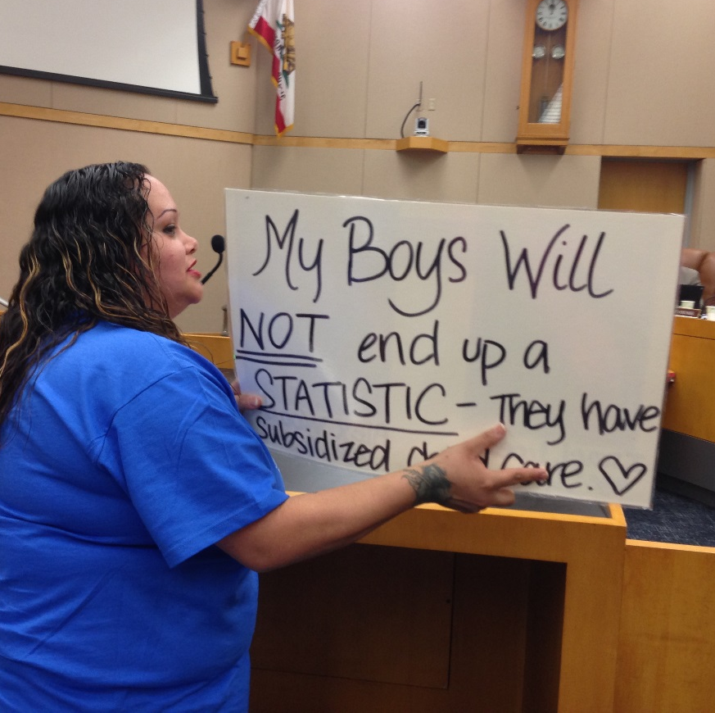
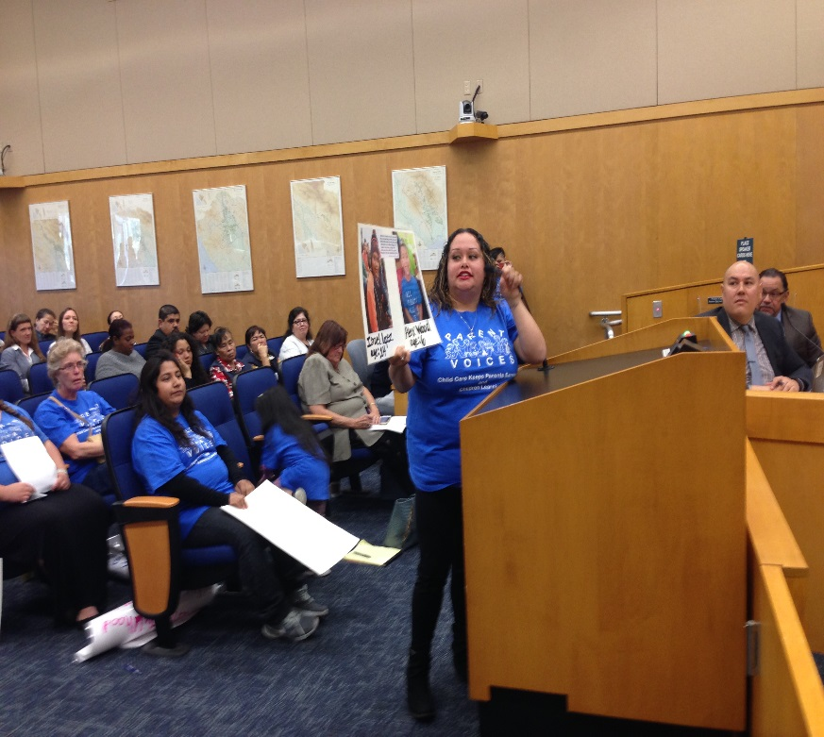
COMPELLING SIMPLE MESSAGES
Reports have a place, but they don’t change budgets.
Decision-makers have short attention spans.
3 minutes is all you get.
Avoid jargon and too much data.
Tell stories.
Make it personal.

Slide 18
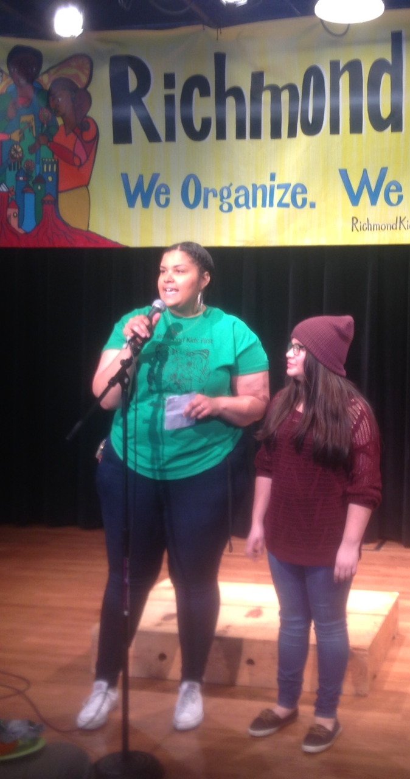
AUTHENTIC VOICES
Elected official to advocate: Whatever you do, stop bringing all those kids.
Advocate: I guess I’ll double the number of kids that we bring.
Hard to say no to kids and parents, and folks telling their real problems.

Slide 19
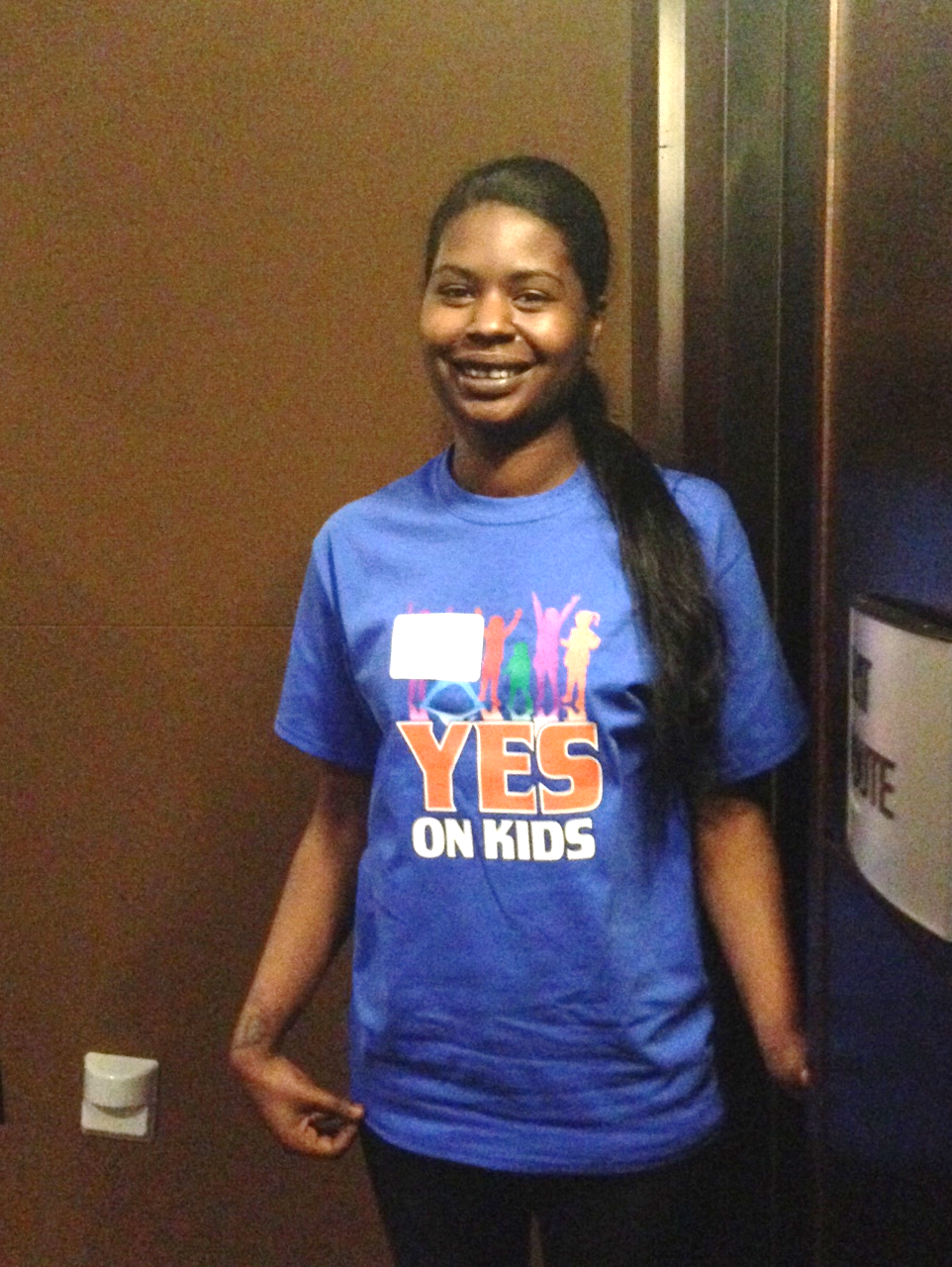
COALITIONS AND ALLIES
San Francisco Budget Justice Coalition
ACCE AFT 2121 AIDS Legal Referral Panel API Council Arts for a Better Bay Area Bay Area Community Resources (BACR) Causa Justa::Just Cause Chinese Progressive Association Coalition of Agencies Serving the Elderly Coalition on Homelessness Coleman Advocates for Children and Youth Community Alliance of Disability Advocates Community Housing Partnership Community Partnership for LGBTQQ Youth (CPQY) Dolores Street Community Services (DSCS) El/La Para TransLatinas Hamilton Families Homeless Emergency Service Providers Association (HESPA) HIV/AIDS Provider Network (HAPN) Hospitality House Jobs With Justice Larkin Street Youth Services LYRIC New Door Ventures NEXT Village SF Parent Voices St. James Infirmary San Francisco Child Care Planning & Advisory Council San Francisco Housing Rights Committee San Francisco Human Services Network San Francisco Immigrant Legal & Education Network (SFILEN) Senior and Disability Action Service Employees International Union, Local 1021 Sheroes Project South of Market Community Action Network (SOMCAN) Supportive Housing Provider Network (SHPN) TGI Justice Project Young Women's Freedom Center

Slide 20
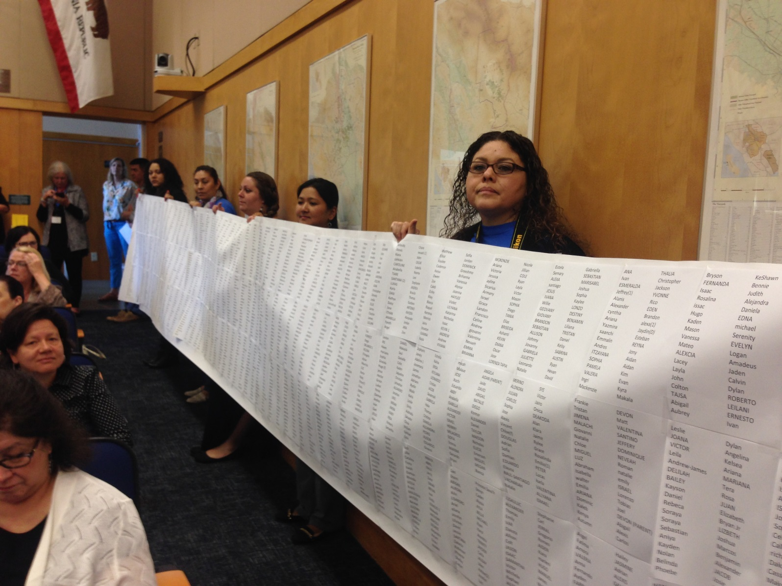
DRAMA HELPS

Slide 21
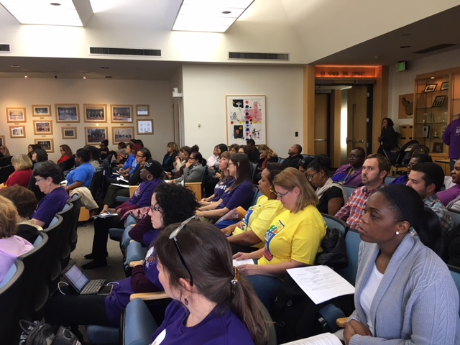
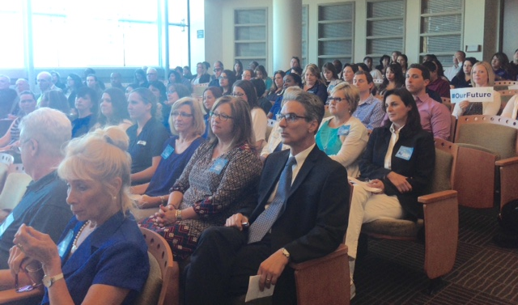
NUMBERS COUNT

Slide 22
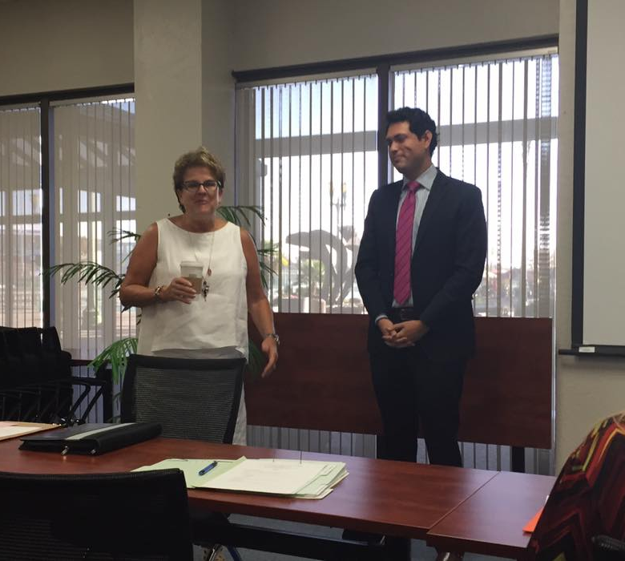
POWERFUL CHAMPIONS AND ALLIES IN GOVERNMENT
Often there are folks within the bureaucracy who want change as much as outside advocates – Find them and strategize together.
Elected officials may be champions of your cause. Your job is to make it easier for them to convince their peers.

Slide 23
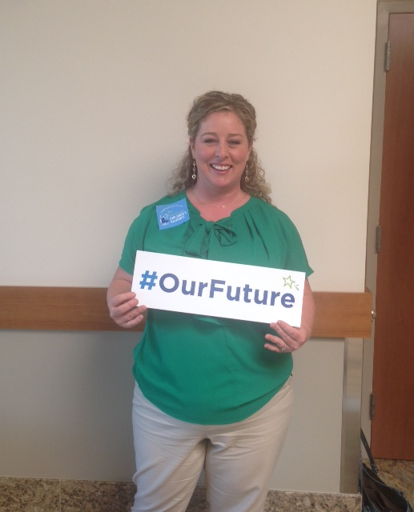
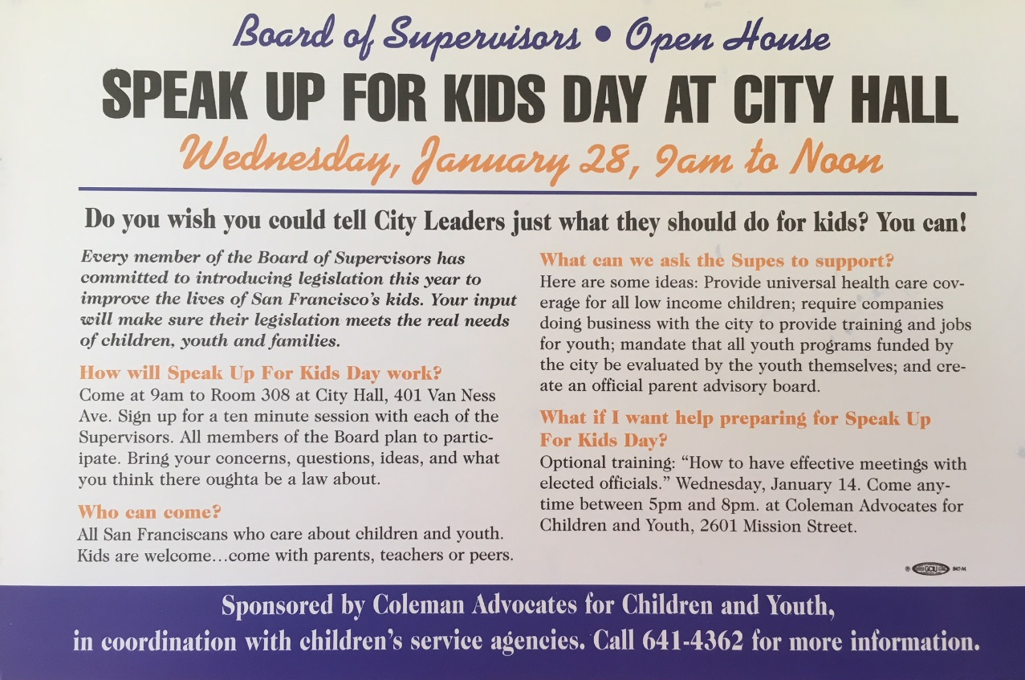
ORGANIZE PUBLIC SUPPORT
Social media
Outreach to community groups
Conferences and public forums
Mailings and newsletters
Speak out – speak up for kids days

Slide 24
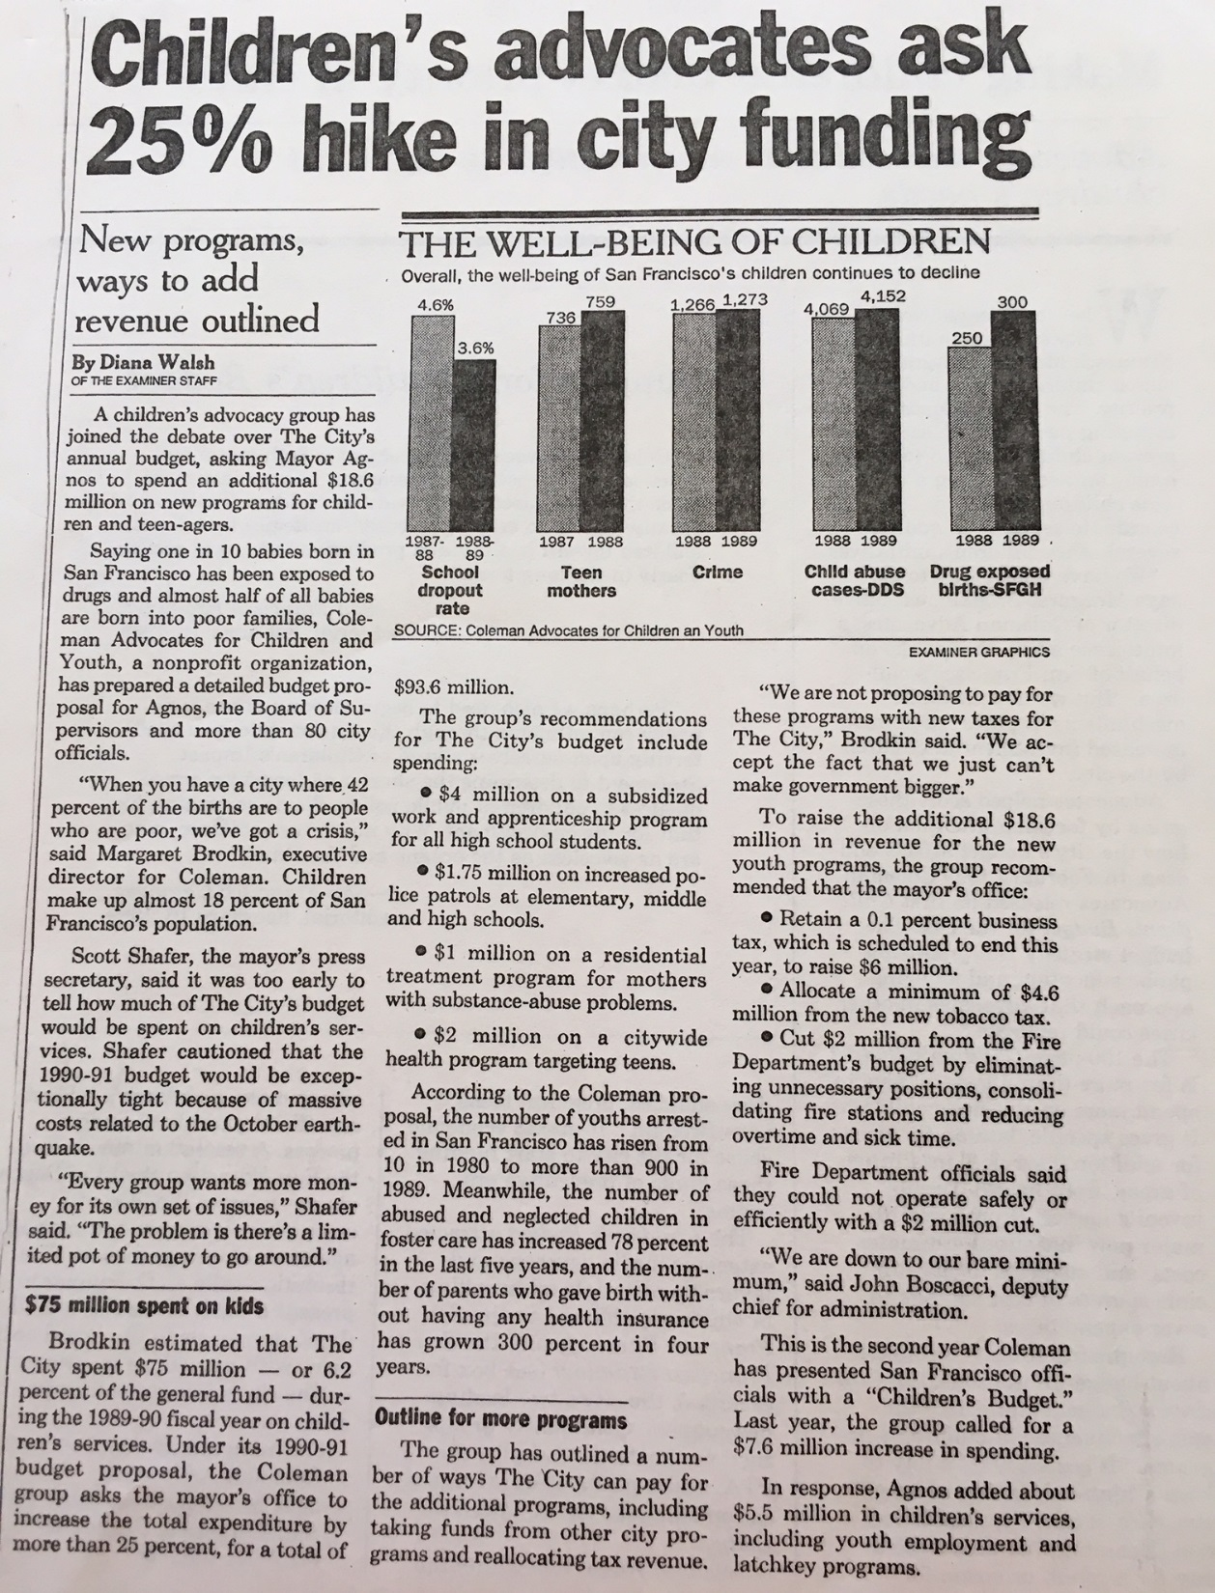
USE THE MEDIA
HAVE A SIMPLE MESSAGE
Press conferences
Op-eds
News releases
Feature stories
Follow the c’s – crisis, conflict, constumes, celebrities
Find a news hook.
OFTEN MORE IMPORTANT TO TALK TO THE MEDIA, THAN DIRECTLY TO DECISION-MAKERS.

Slide 25
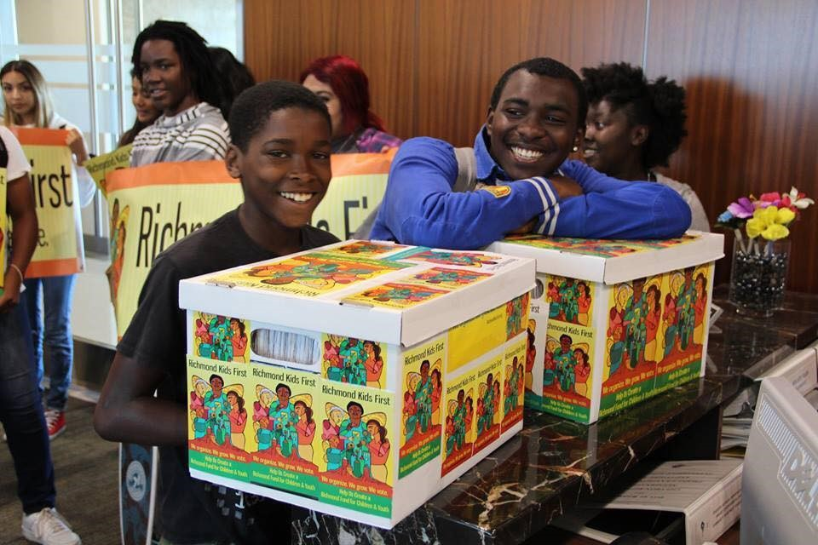

Elections are
Great Opportunities
Candidate forums
Candidate questionnaires
Educating candidates
Placing measures on ballot

Slide 26
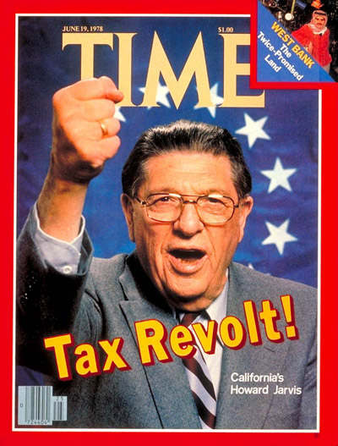
PREPARE FOR OPPOSITION
The Taxpayer revolt is alive and well.
New items in the budget threaten increased spending and therefore new taxes.
New revenue measures mean taxes or reallocations – built-in opposition.
Opposition is often behind the scenes – particularly when status quo is threatened.
BUDGET ADVOCACY IS ONE BATTLE AFTER ANOTHER.
Must be the folks who never go away.

Slide 27
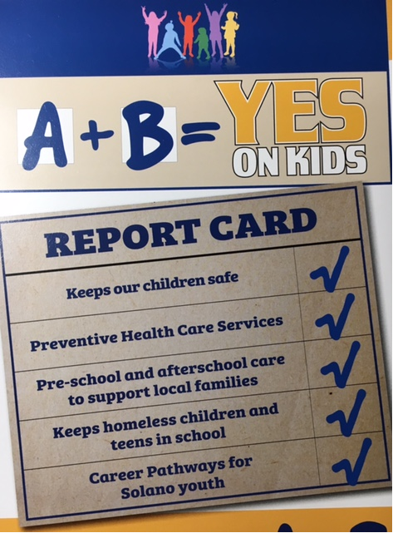
BUILD IN ACCOUNTABILITY
Hold decision-makers accountable after the budget process – for negative AND positive decisions.
  Newsletters
  Report cards
  Follow-up meetings
  Newspaper ads
  Accountability sessions

Slide 28
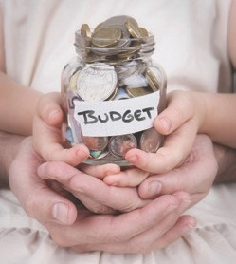
REFORM THE PROCESS
Creating accessible forums for public input at all levels and at all points in the process
Creating access to decision-makers
Empowering the legislative body
Strengthen budget policy support
TRANSPARENCY, TRANSPARENCY, TRANSPARENCY

Slide 29

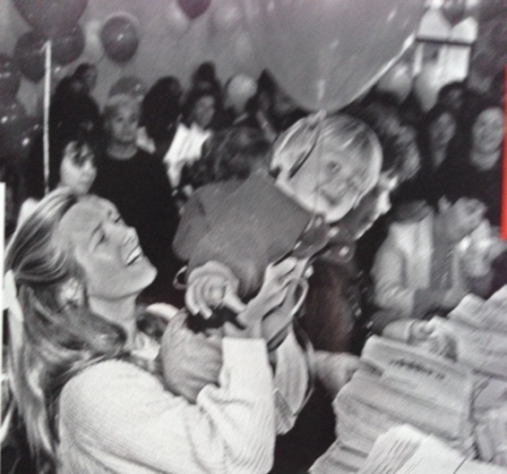
THE CHILDREN’S FUND STORY
Children’s Agenda
Children’s Budget
Baseline and set-aside
No political support
Petitions and election
Re-authorized twice
Preschool for All
LESSONS
Take initiative
Elections are powerful
Children can win
Play political hardball
Propose a solution

Slide 30

IT’S NEVER OVER!
Many ways to sabotage budget decisions.
It’s never enough money.
Current strategies in San Francisco
“Set-aside reform” – not really reform
New childcare measure

