Slide 1

Funding the Next Generation
Margaret Brodkin and Ed Harrington
Los Angeles
January 8, 2019

Slide 2
Budget Rules
Governmental Accounting—rules clear
  Rules set by GASB
  Implementation by GFOA
  Audited to insure compliance
Governmental Budgeting—no rules
  Reporting requirements by State Controller
    County Budget Guide (sco.ca.gov)
  NACSLB (National Advisory Committee on State and Local Budgeting) best practices
  GFOA/CSMFO Awards programs

Slide 3
Budget Timeline
October- December Budget Instructions
January-March Departmental preparations, hearings
April-May budget Office/Auditor-Controller
June Board of Supervisors

Slide 4
Budget Terminology
Proposed/Recommended Budget
  Before year starts
Adopted Budget/Appropriations Ordinance
  Start of year
Final Budget
  End of year
Revenues/Sources; Expenses/Uses

Slide 5
Funds (1of2)
Government Accounting is set up in funds
Governmental Funds:
  General Fund-basic government
  Special Revenue- Specific Revenues that are legally restricted for a specific purpose
  Capital Projects
  Debt Service

Slide 6
Funds (2 of 2)
Proprietary Funds
  Enterprise—business type activities
    Airport, water, hospital
  Internal Service
    IT, Risk Management, Motor pool
  Fiduciary Funds—held for others
    Pension, employee benefits

Slide 7
Charter vs. General Law
Los Angeles County Charter
  Los Angeles City Charter
Orange County Charter
  Santa Ana Charter
San Diego City Charter
San Bernardino Charter
  Rialto General Law
Ventura General Law

Slide 8
Budgets-just like your checkbook
+Money from prior year or reserves
+Current year revenues
- Current year expenses
-Remaining fund balance/reserves

Slide 9
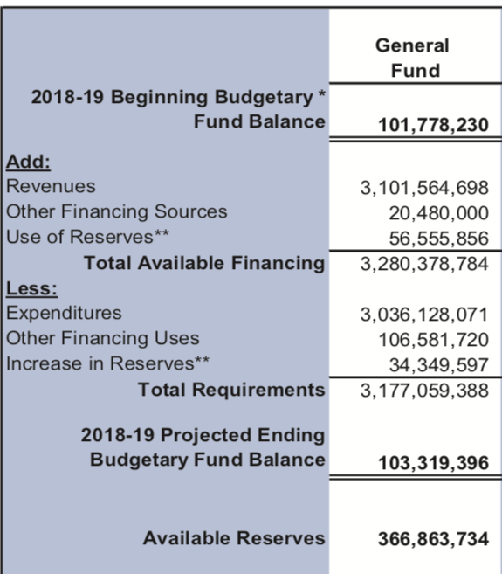
San Bernardino Budget Summary

Slide 10

Fund Balances and Reserves

Slide 11
Fund Balance and Reserves
Purpose
  Protect against risk
  Cash Flow
Typical
  Basic reserves 2-3 months or 15-25% of appropriations
  Higher in smaller communities, fewer taxes, fewer customers, etc.=higher risk
If large, may indicate too conservative budgeting
  Rialto 50% reserve
  San Bernardino 15.7%- target 20%
Watch for multiple reserves

Slide 12
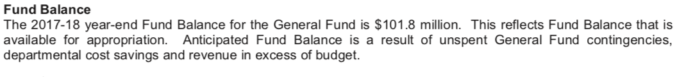
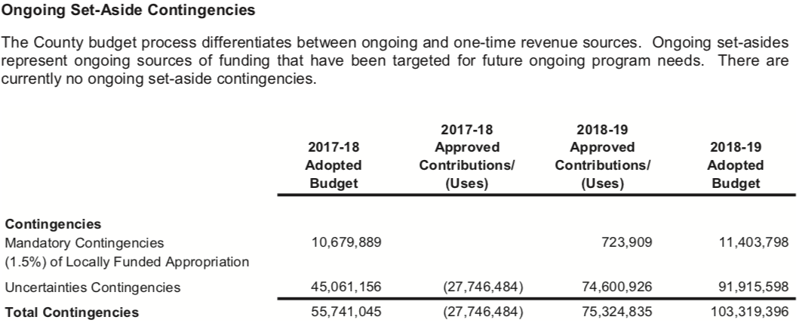
San Bernardino (General Fund $3.3 B)

Slide 13
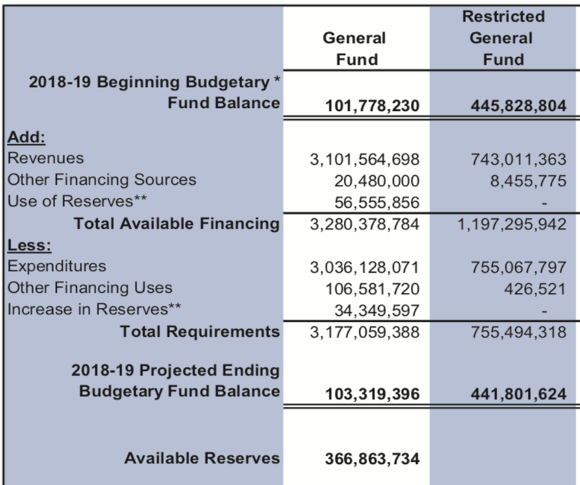
San Bernardino Expanded Reserves

Slide 14
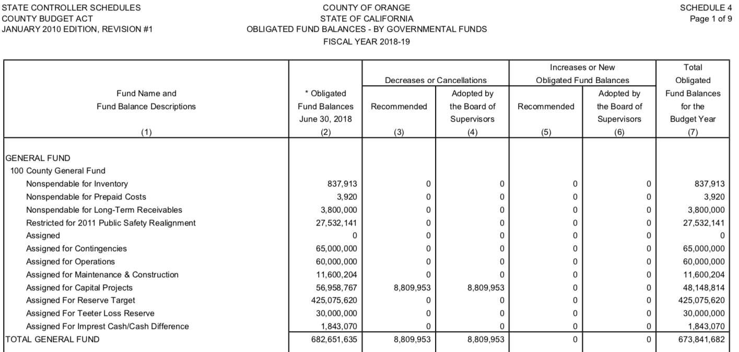
Orange County Reserves (total General fund $3.4 B)

Slide 15
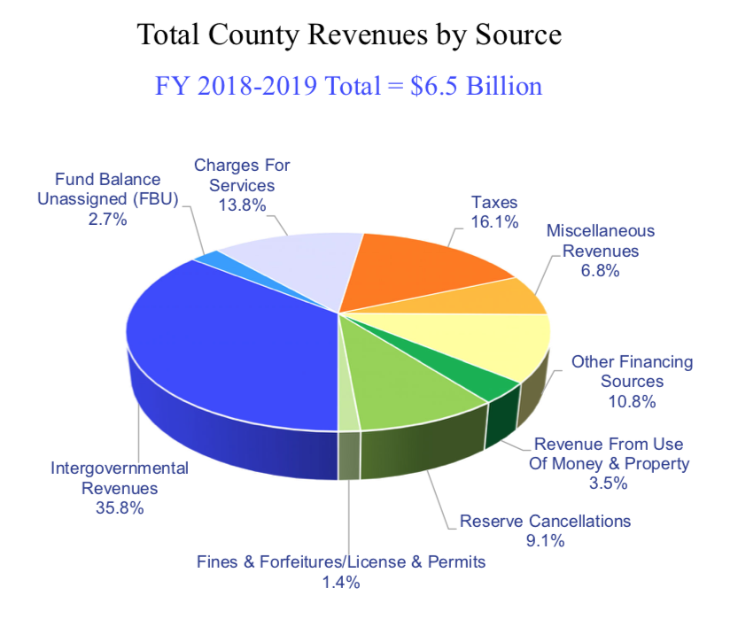
Orange County Revenue Sources

Slide 16

Current Year Revenues
Opportunities

Slide 17
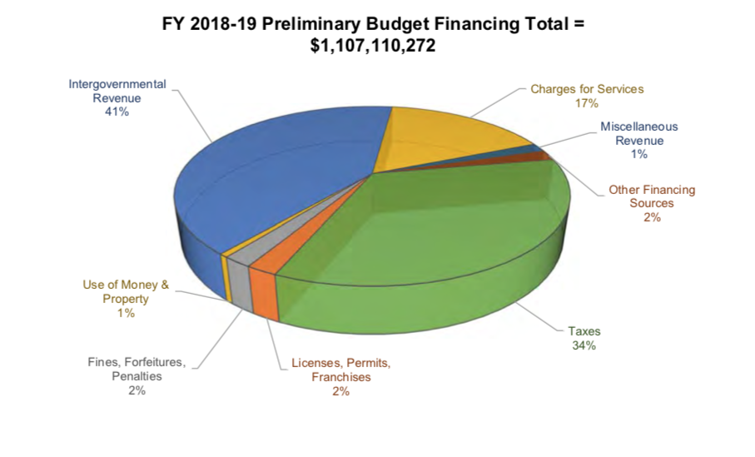
Ventura County Revenue Sources

Slide 18
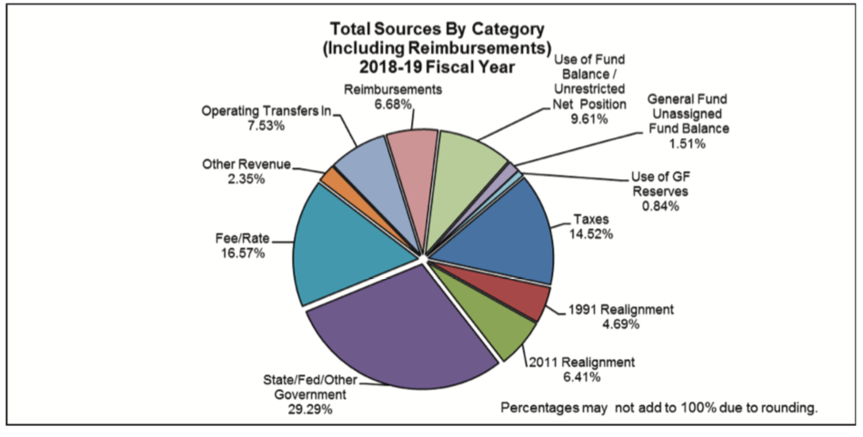
San Bernardino Revenue Sources

Slide 19
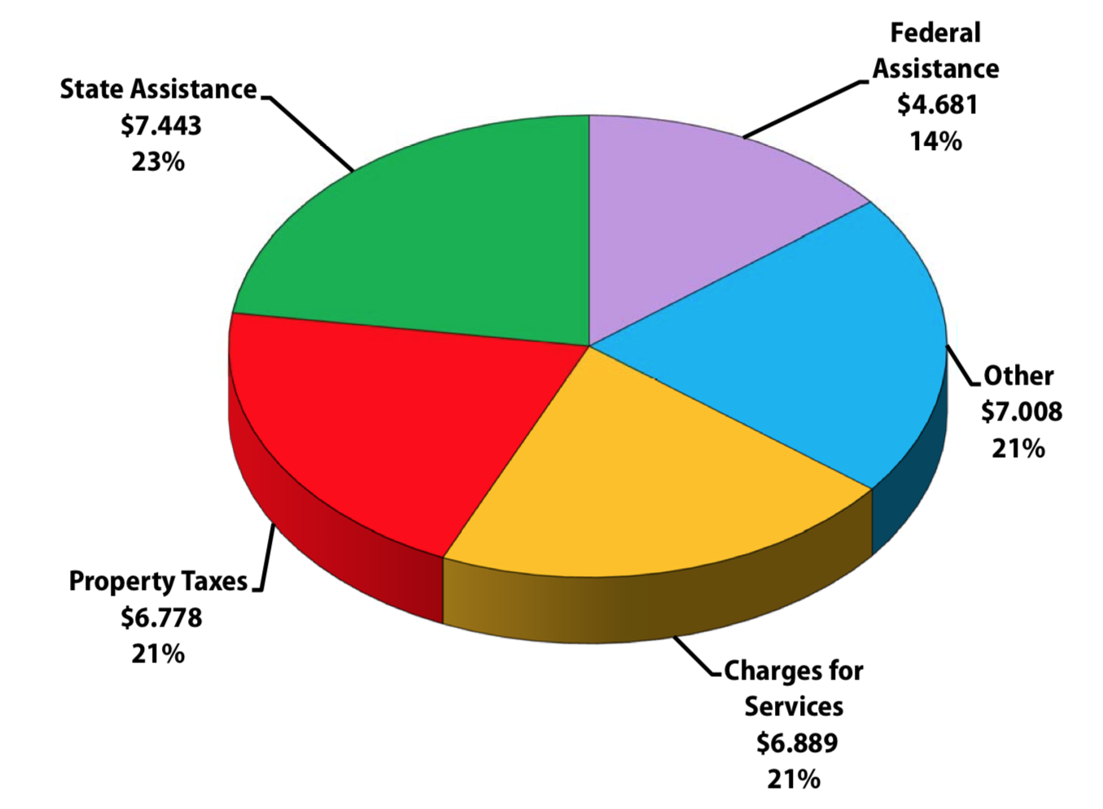
Los Angeles County Funding Summary

Slide 20
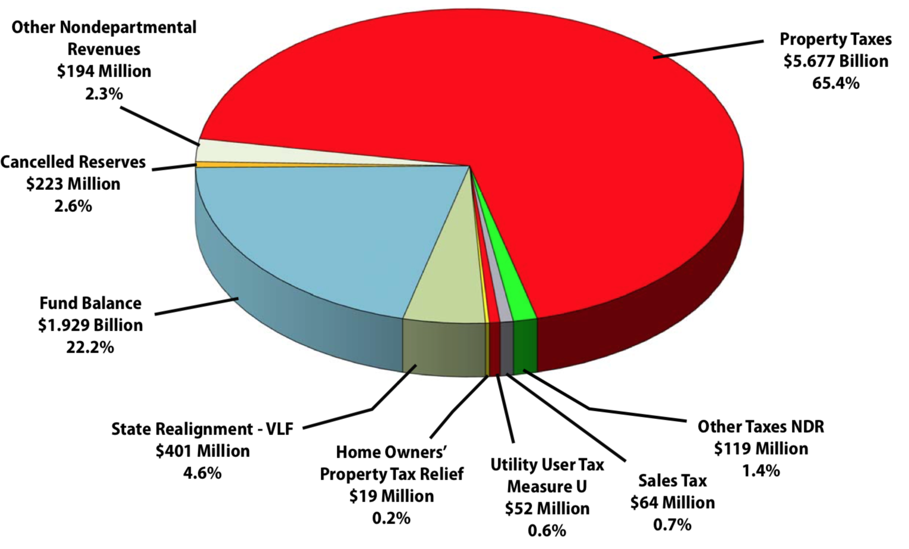
Los Angeles County Local Revenues

Slide 21
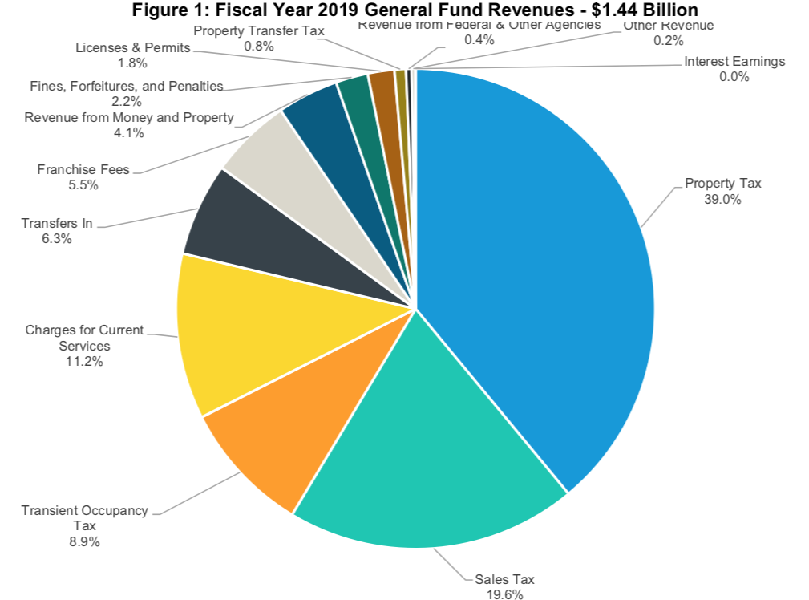
San Diego Revenue Summary

Slide 22
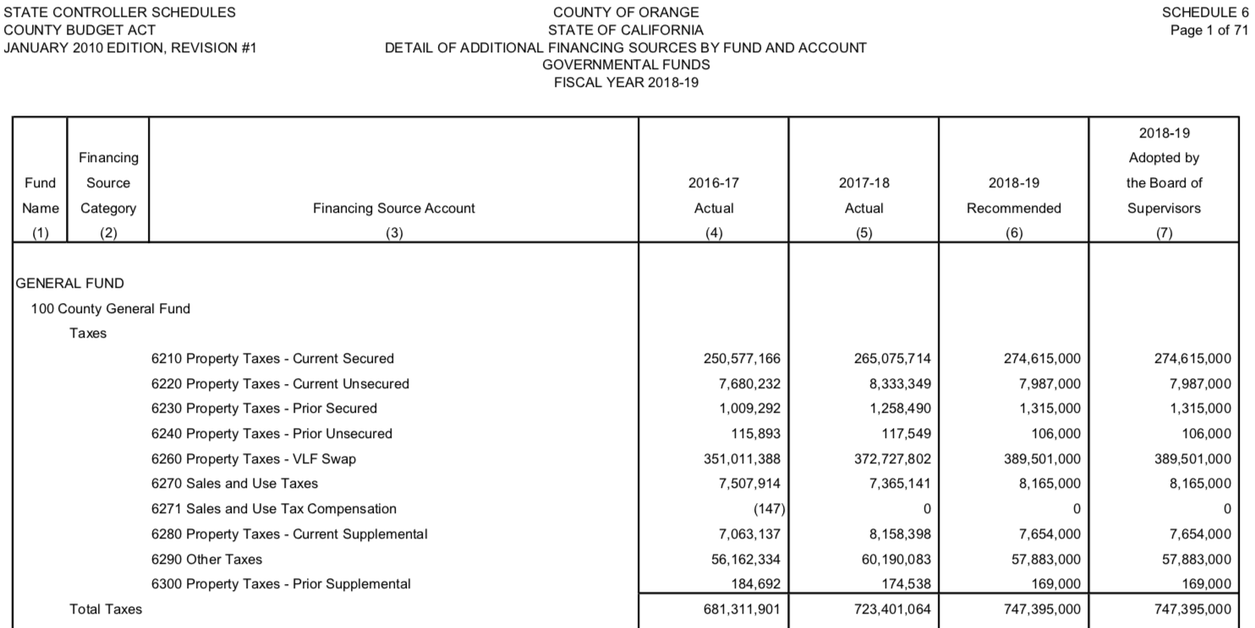
Orange County Tax Detail

Slide 23
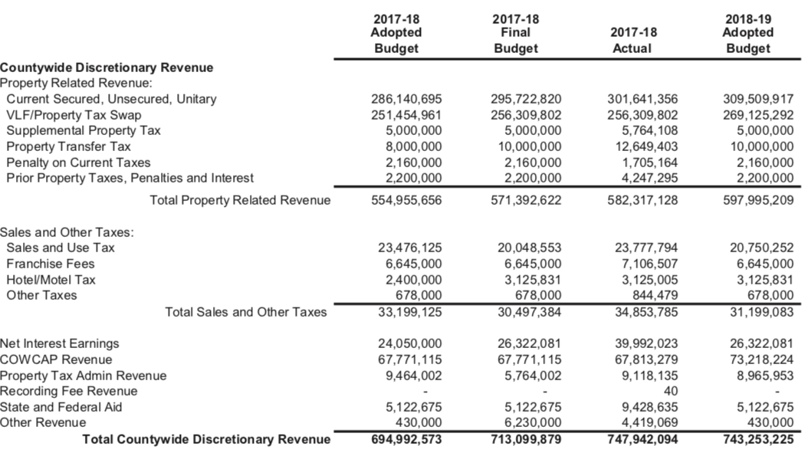
San Bernardino Tax Detail

Slide 24
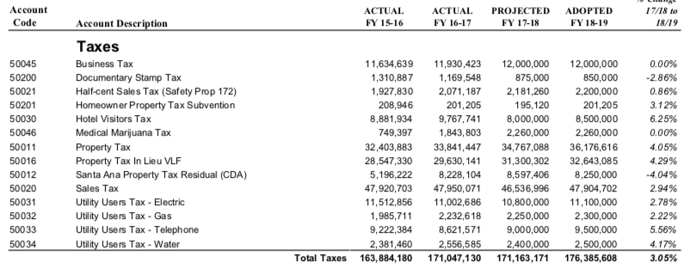
Santa Ana Tax Detail

Slide 25
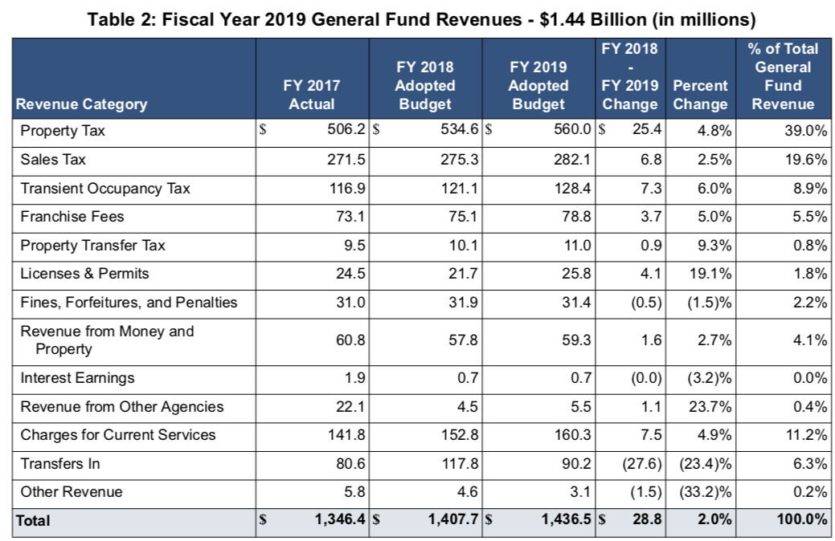
San Diego Tax Detail

Slide 26
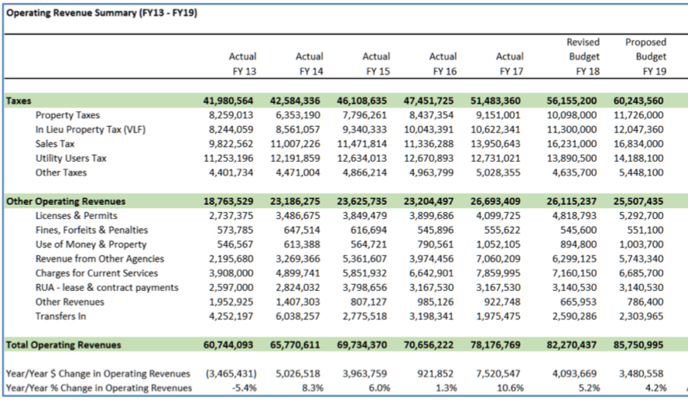
Rialto –Tax/ Revenue Detail

Slide 27
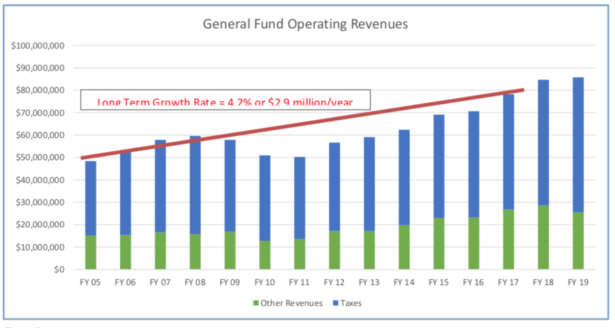
Rialto Revenue Growth

Slide 28
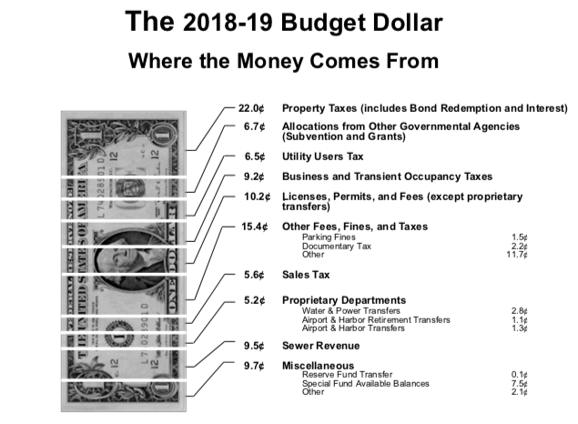
Los Angeles City Revenues

Slide 29
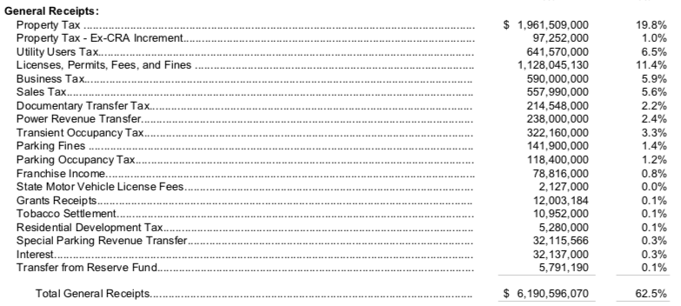
Los Angeles City Tax Revenue

Slide 30
Current Year Revenues
Property Taxes – set by Prop 1
Excess ERAF (Educational Revenue Augmentation Fund)
Parcel tax can be passed by voters – Special tax
  2/3^{rds} or Upland rule

Slide 31
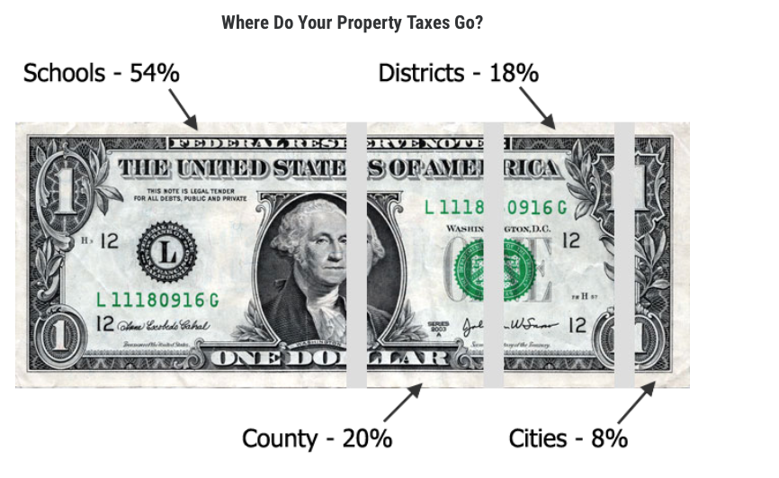
Ventura

Slide 32
Sales Tax
Los Angeles County 9.5%
  Los Angeles City 9.5
Orange County 7.75
  Santa Ana 7.75
San Diego City 7.75
San Bernardino 7.75
  Rialto 7.75
Ventura 7.25

Slide 33
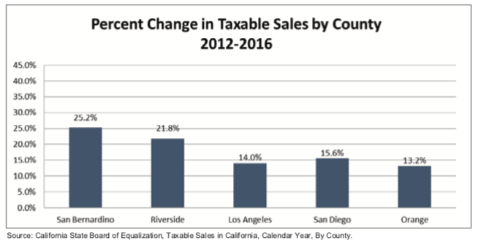
San Bernardino

Slide 34
Property Transfer Tax per $1,000 – County rate set by state law
Los Angeles County (unincorporated) $1.10
  Los Angeles City ($215M) $4.50City + 1.10 Cnty
Orange County (unincorporated) ($27 M) $1.10
  Santa Ana ($850K) $.55 City/.55 County
San Diego City ($11M) $.55 City/.55 County
San Bernardino (unincorporated) ($10M) $1.10
  Rialto ($240K) $.55 City/.55 County
Ventura (unincorporated) ($6.1M) $1.10
Berkeley $15.00/1.10 Pomona $2.20/1.10 San Mateo $5.00/$1.10
Richmond tiered – top rate $30.00 (3%) over $10M
San Francisco tiered – top rate $30.00 over $25 M ($228 M)

Slide 35
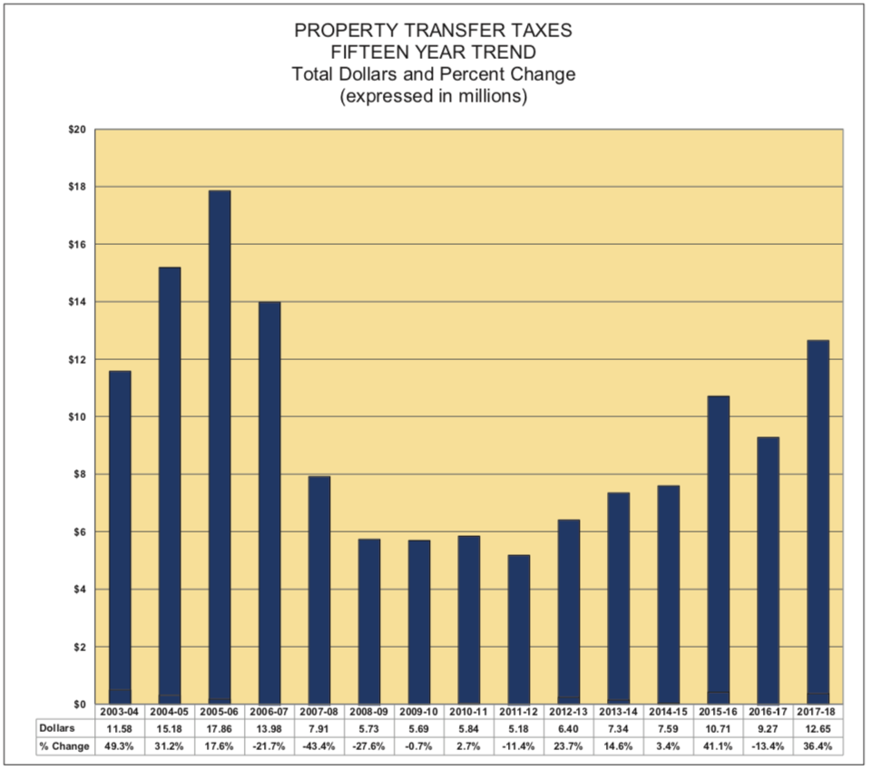
San Bernardino -Property Transfer Tax ($1.10/ $1000 or ½ in cities)

Slide 36
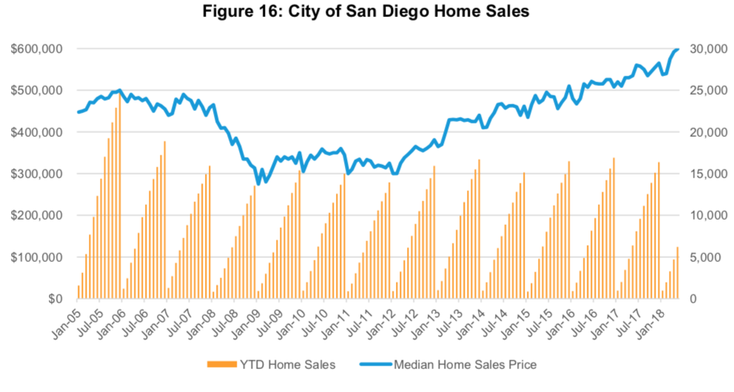
San Diego

Slide 37
Utility Users Tax (4 counties, 157 Cities, 54% of state population)
Los Angeles County ($52M) 4.5%
  Los Angeles City ($640M) 9-10%
Orange County -
  Santa Ana ($25M) 5.5%
San Diego City -
San Bernardino -
  Rialto ($14M-27% of GF) 8%
Ventura -

Slide 38
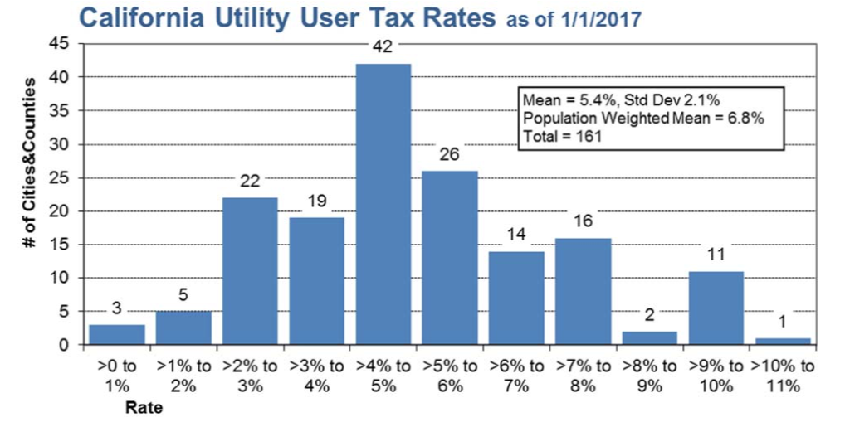
Utility Users Tax Rates

Slide 39
Hotel Tax (Transient Occupancy Tax)
Los Angeles County 12%
  Los Angeles City 14%
Orange County ?
Santa Ana 11%
San Diego City 10.5%
San Bernardino 7%
  Rialto 9%
Ventura 8%

Slide 40
Expenditures – Uses of Funds
Opportunities

Slide 41
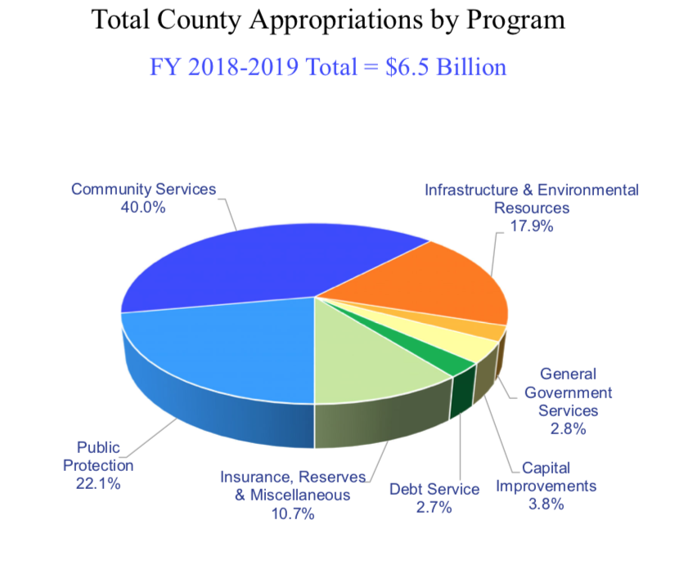
Orange County Total Budget Appropriations

Slide 42
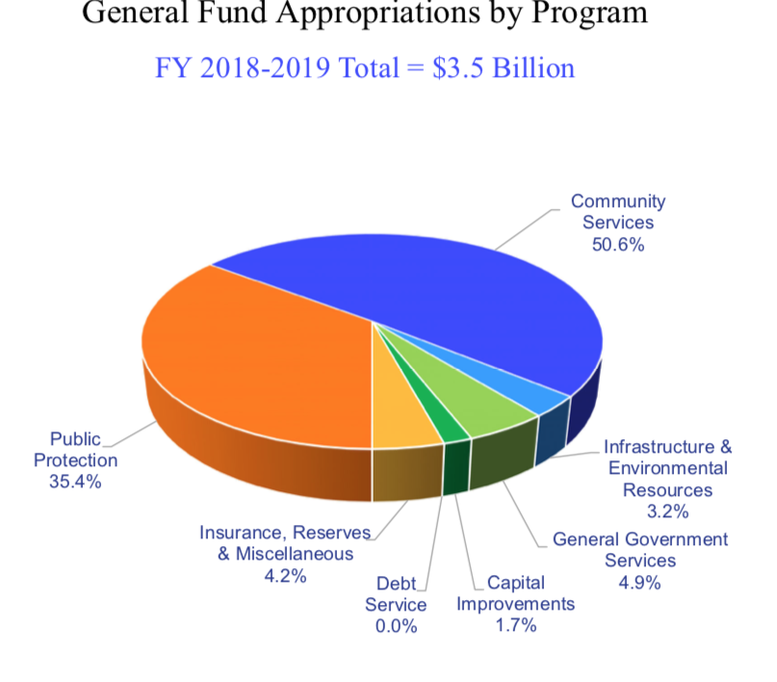
Orange County General Fund Appropriations

Slide 43
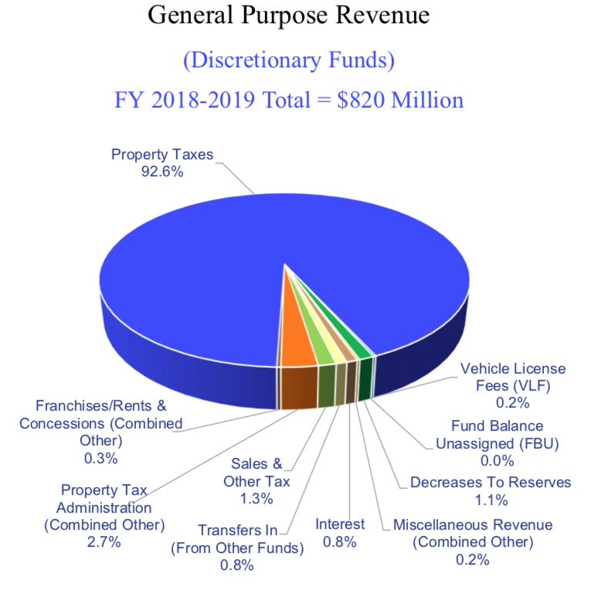
Orange County Discretionary Revenue

Slide 44
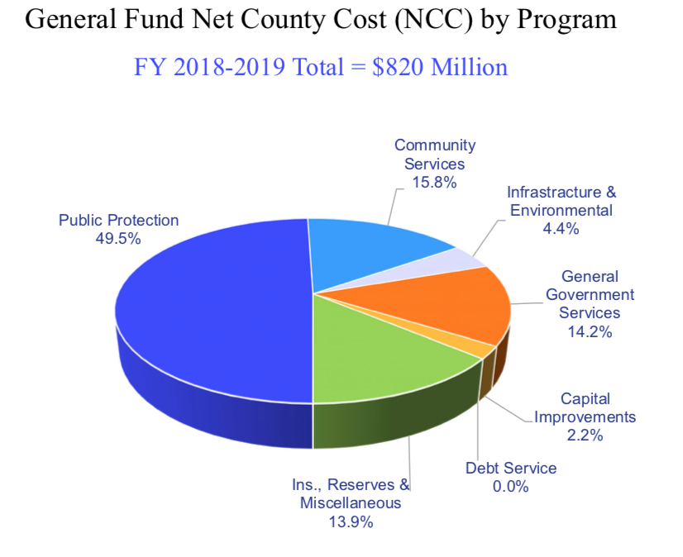
Orange Net County Cost

Slide 45
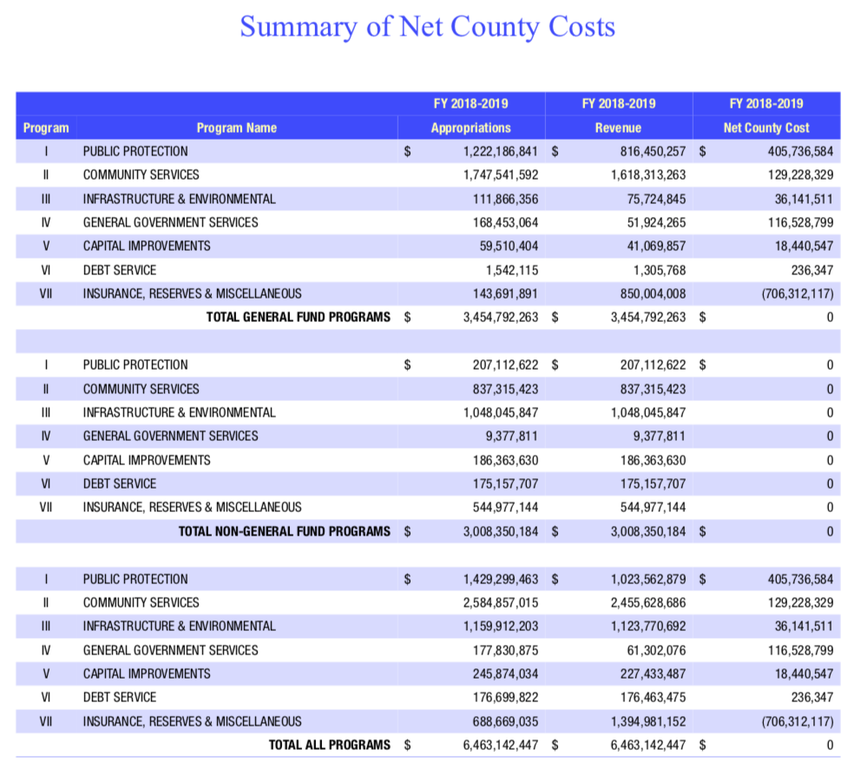
Orange County Net County Costs

Slide 46
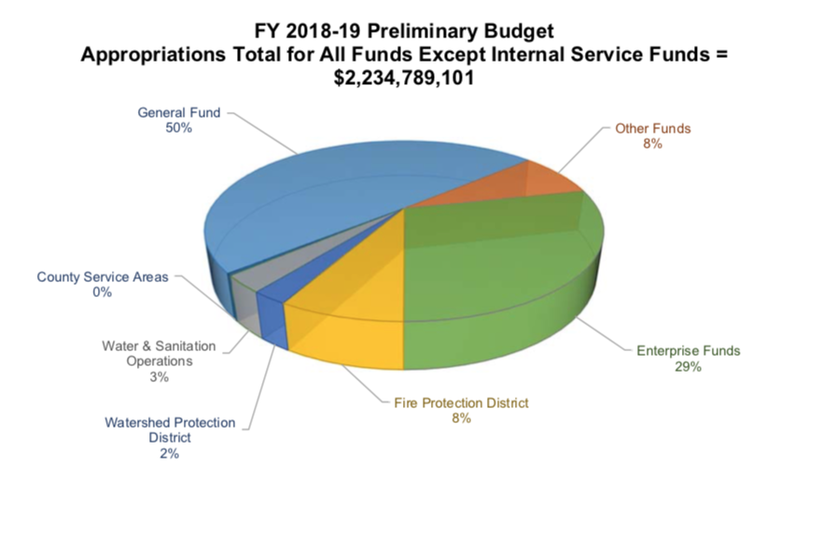
Ventura County Spending Summary

Slide 47
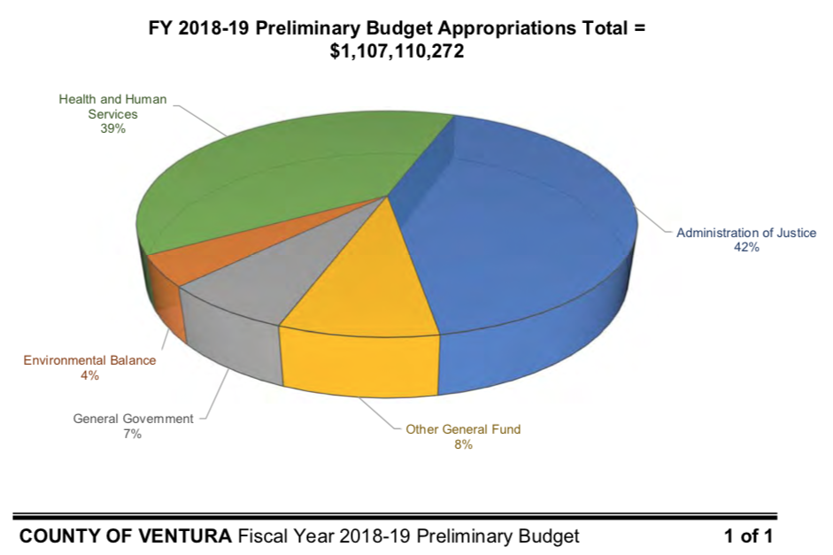
Ventura General Fund Spending Summary

Slide 48
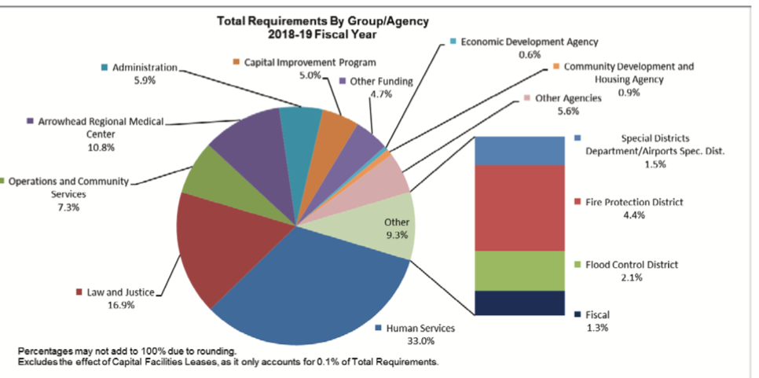
San Bernardino Spending Summary

Slide 49
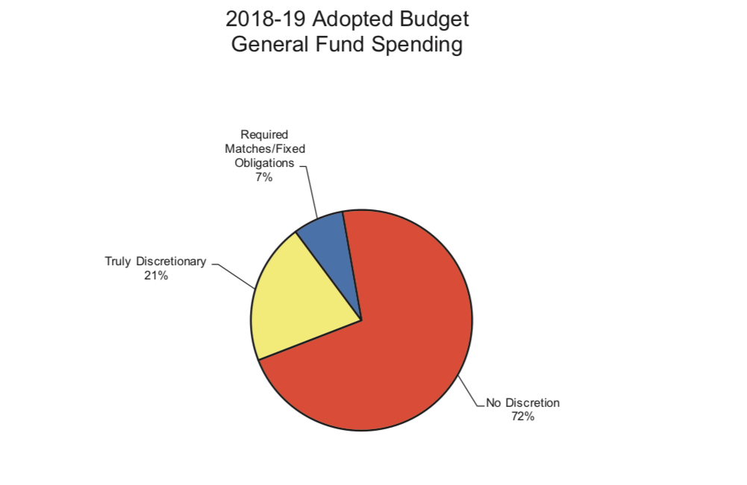
San Bernardino Discretionary Summary

Slide 50
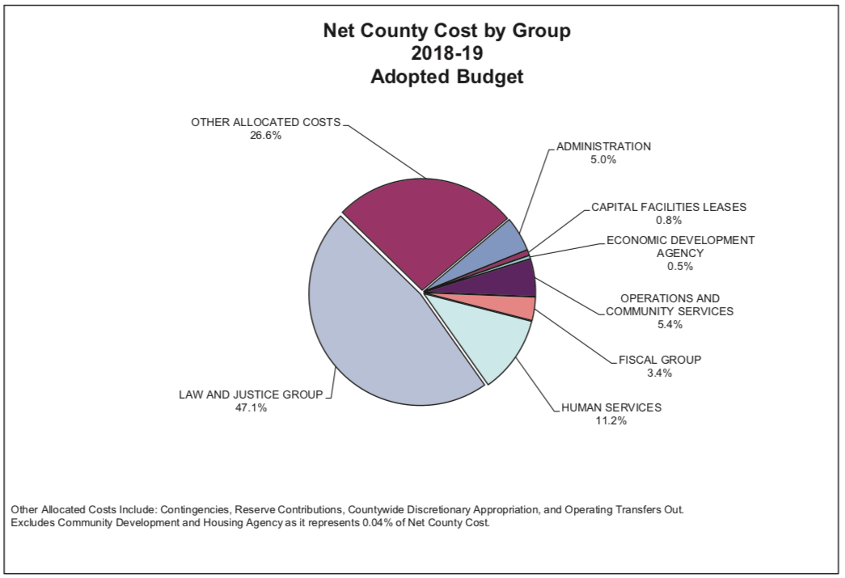
San Bernardino Net County Cost

Slide 51
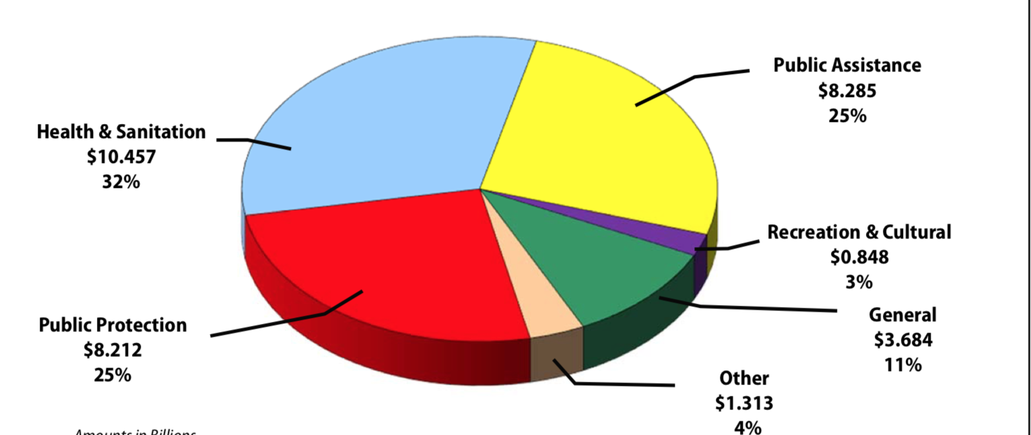
Los Angeles County Budget Summary

Slide 52
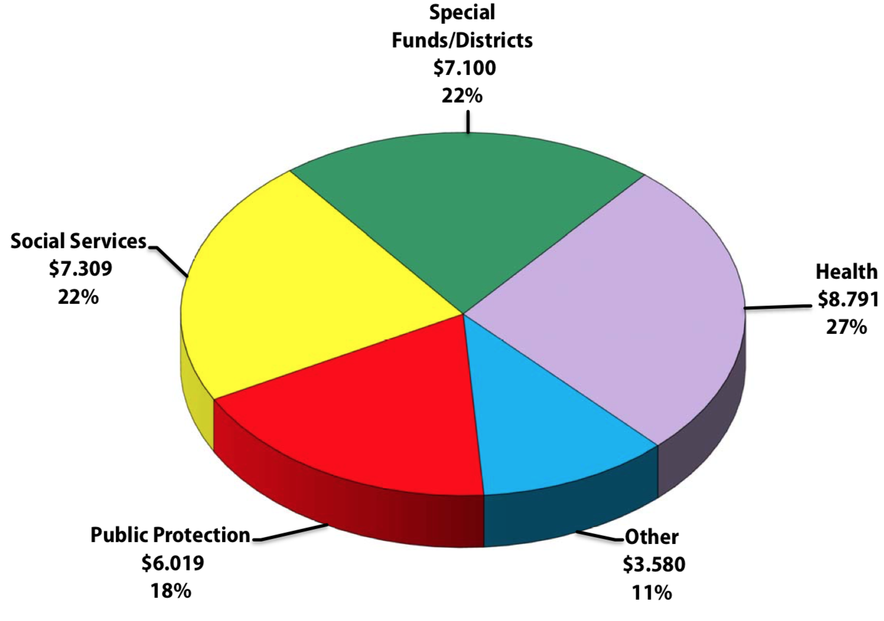
Los Angeles County Spending Summary

Slide 53
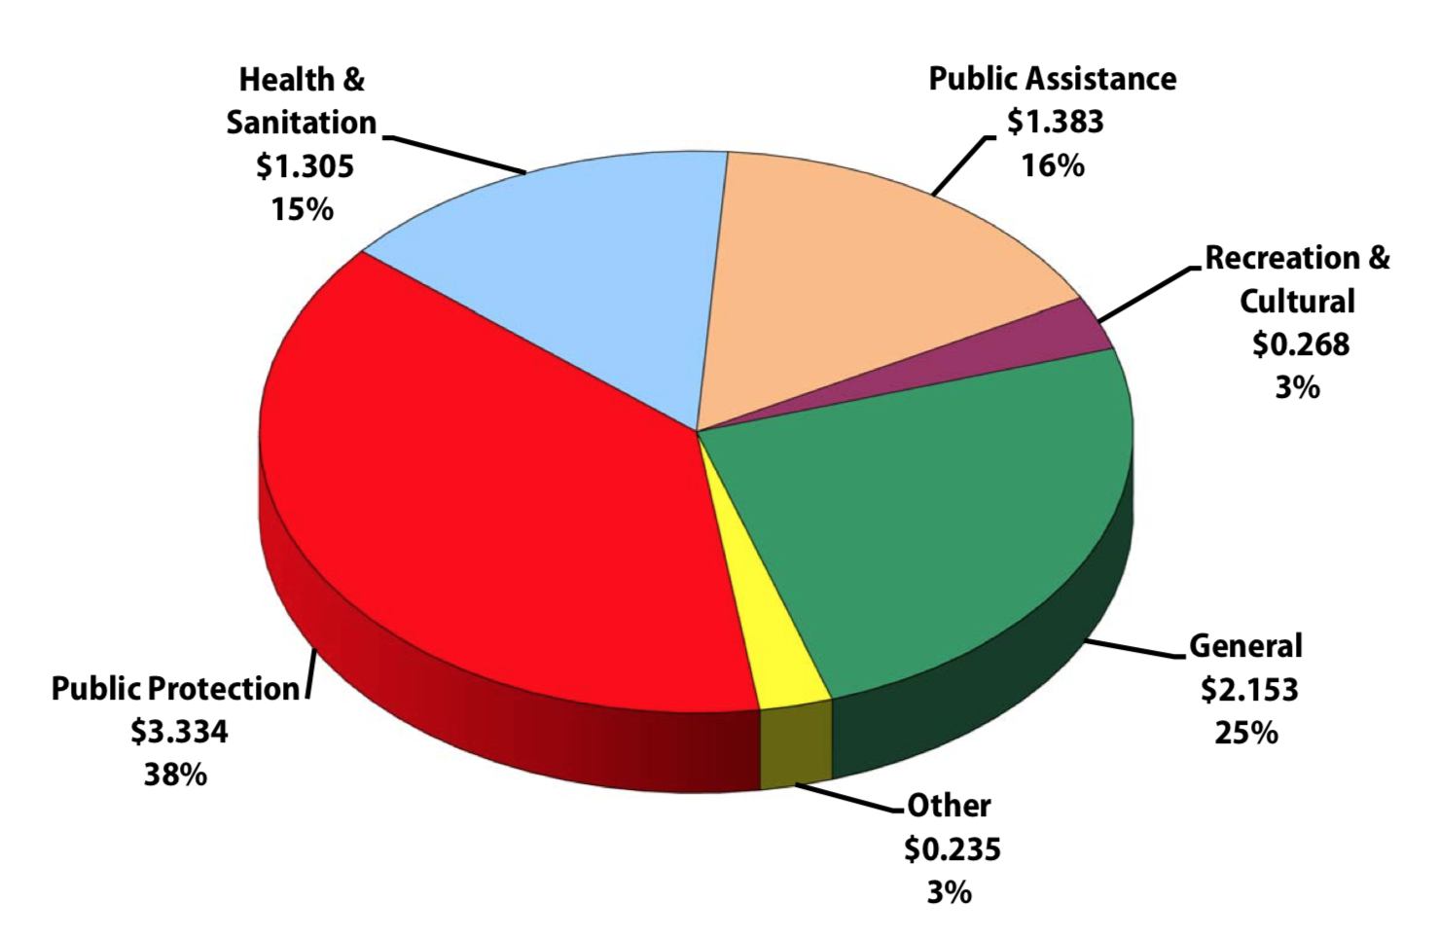
Los Angeles County Net County Cost

Slide 54
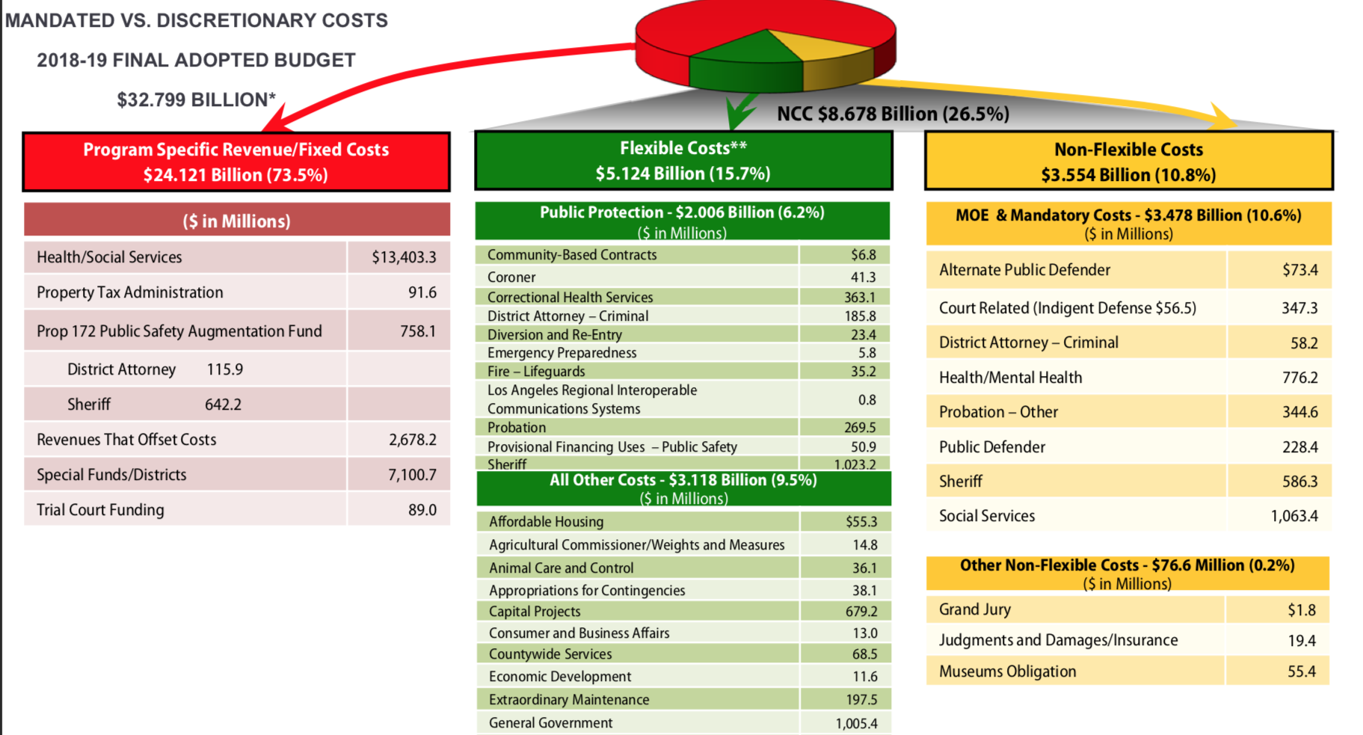
Los Angeles County Mandated vs. Discretionary Costs

Slide 55
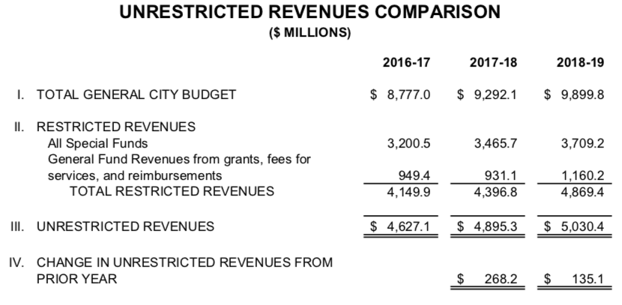
Los Angeles City Unrestricted Revenue Summary

Slide 56
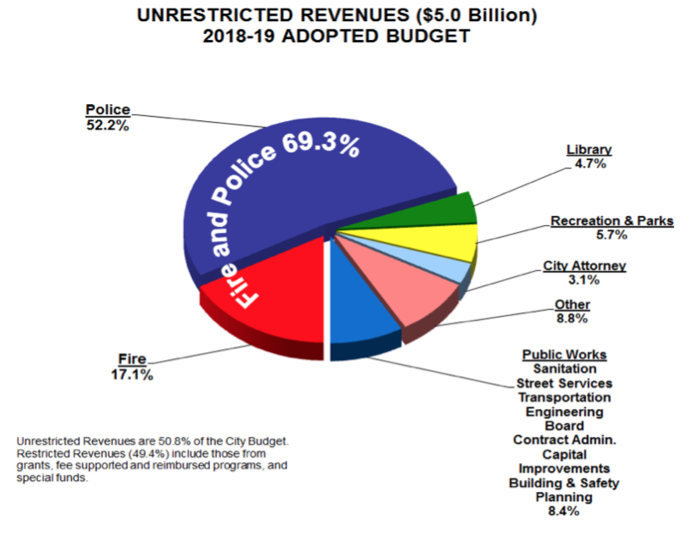
Los Angeles City – Use of Unrestricted Revenue

Slide 57
Santa Ana Budget Spending Summary
2018-19 budget
  Police $130
  Fire $52
  Park/Rec $21
  Other $61
  Total $265
  Revenues up 15.7% from 2018
    Cannabis $10
    Prior Year $10

Slide 58
Dedicated Children and Youth Spending
Target how local funds are spent—not all funds
Set-aside a portion of total budget for kids
Cut a particular program and use funds for new programs for kids
  Juvenile Probation

Slide 59
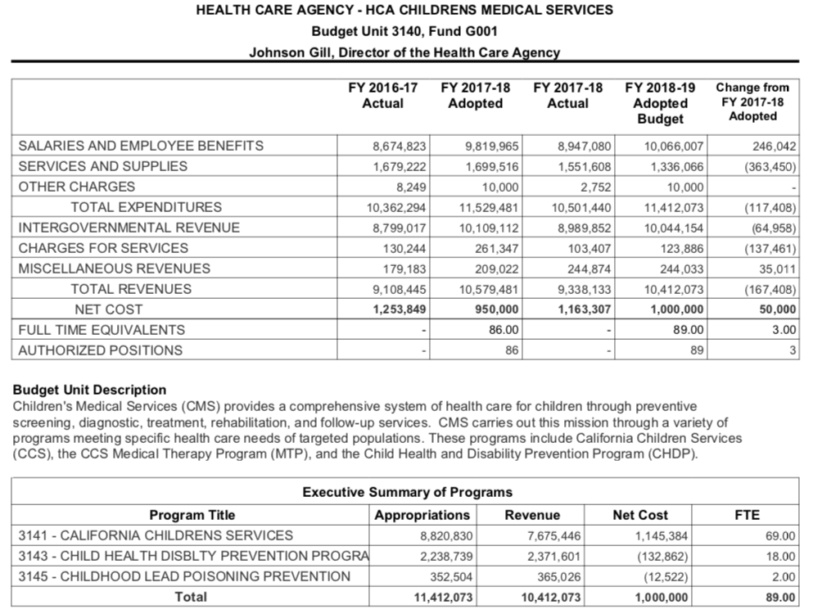
Ventura- Children Health Spending

Slide 60
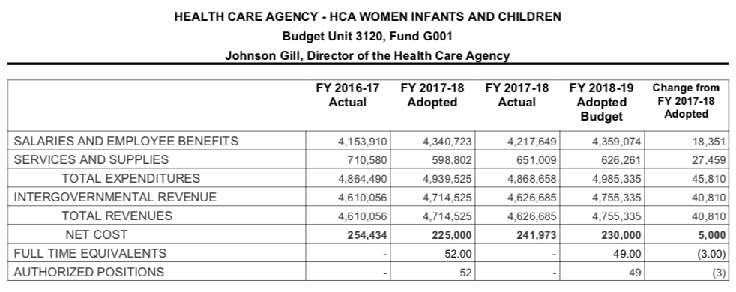
Ventura WIC

Slide 61
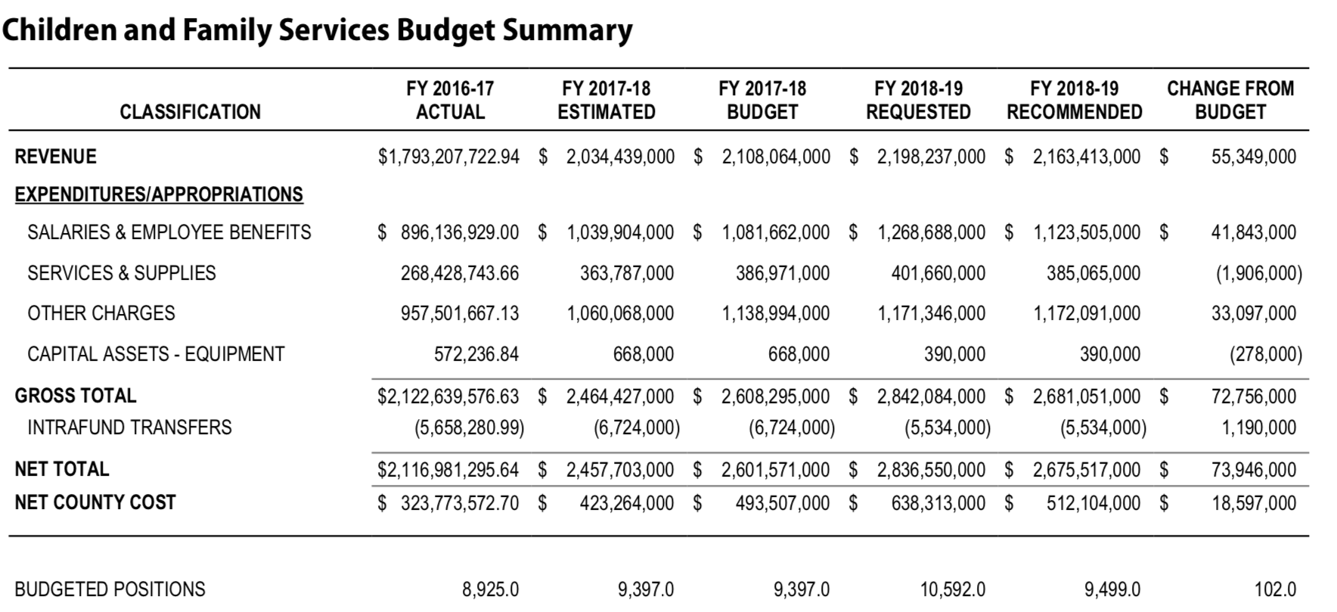
Los Angeles County Children and Family Services Summary

Slide 62
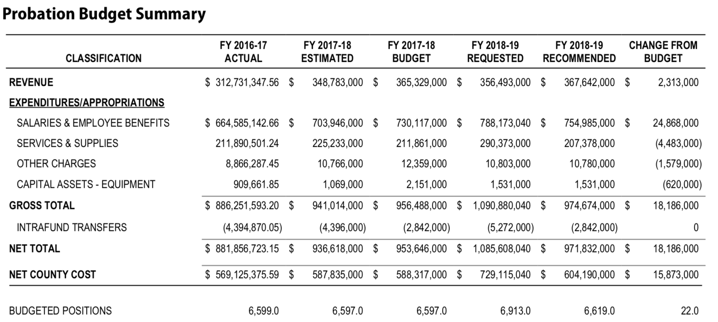
Los Angeles County Probation Summary

Slide 63
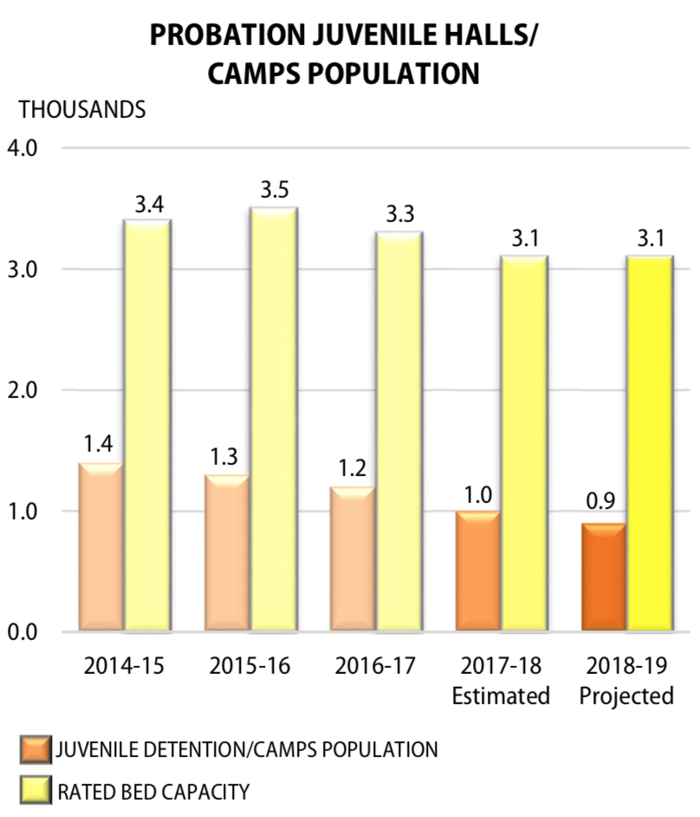
Los Angeles County Juvenile Probation Info

Slide 64
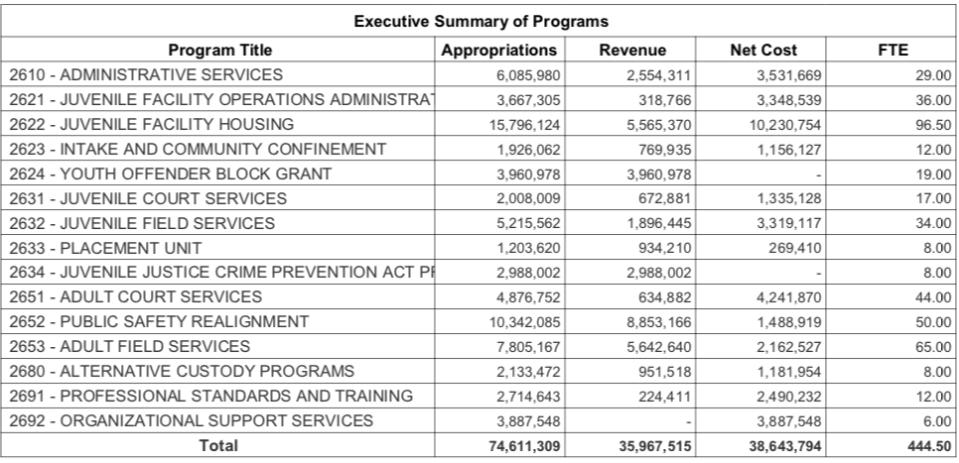
Ventura County Probation Department
Juvenile spending $30 M, county share $18 M

Slide 65
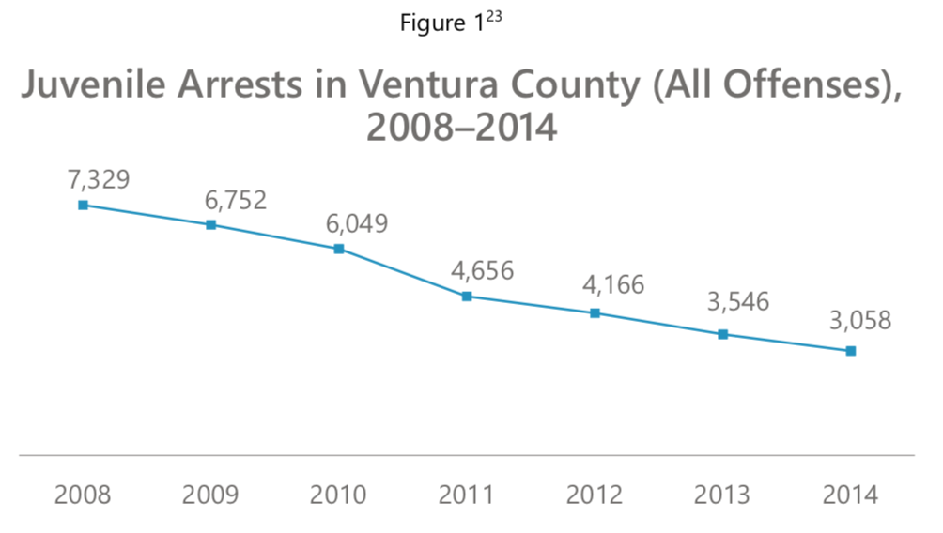
Ventura Juvenile Arrest Trends

Slide 66
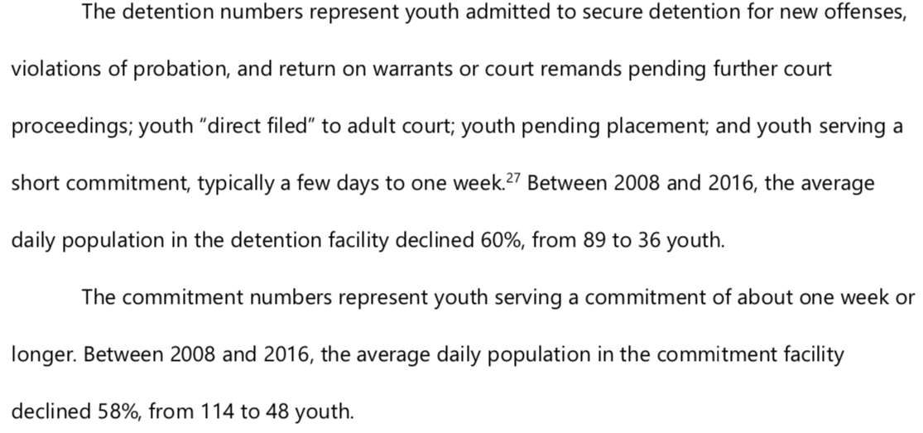
Ventura County Juvenile Justice Plan- April 2017

Slide 67
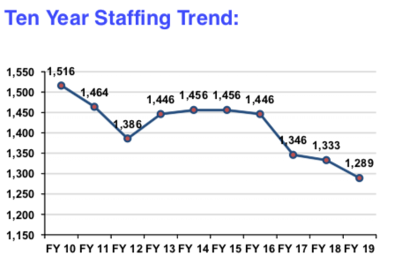
Orange County Probation
In FY 2015-16, 100 vacant positions were deleted in an effort to offset position needs in the County that were available due to a decrease in the juvenile detention population.

Slide 68
Orange County Probation Beds
Juvenile Hall 434
Joplin Youth Center 64
Youth Guidance Center (Substance abuse) 80
Youth Leadership Academy 120
Total 698 Beds

Slide 69
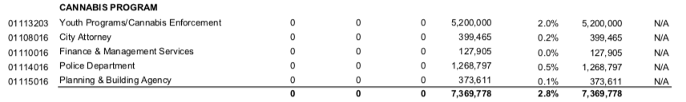
Santa Ana Cannabis Spending

Slide 70

Santa Ana Youth Spending Detail

Slide 71
Good Budget Examples
Rialto -0verall good budget presentation and discussion of revenues, reserves, risks, etc.
Ventura – good budget instruction procedural document
San Bernardino – good county overview and explanations of things like realignment in discretionary fund section
Orange County – good budget introduction—lots of good information
Biggest Problem—almost no program budgeting or meaningful performance data

Slide 73
Messaging This Moment
A handbook for progressive communicators
By
Anat Shenker-Osario

Slide 74
Shared Values—not problems
Liberals start with problem, then solution, then call for action
People have 99 problems already – they don’t want to hear more
Martin Luther King didn’t say “I have a problem”
Start with values
“Most of us seek to treat others the way we want to be treated” not “our treatment of undocumented immigrants is horrendous”

Slide 75
Offer clear villains and heroes
You lose your keys—you don’t lose your job—someone takes your job away.
Don’t say “the climate is changing”. Say “Corporations make profits by damaging our climate”.
If no one caused this problem, where will you look to fix it?

Slide 76
Create Something Good—don’t merely reduce the bad.
Describe what you seek-–not just what you oppose
A “no” without a “yes” sounds like politics as usual.
Don’t say “mitigate climate change”
Say “Protect our children’s health”
Don’t repeat accusations:
Don’t say say “Immigrants are not “criminal aliens”.
Say “Immigrant Americans move here for the promise of freedom and opportunity. That’s a good thing—so let’s make it work.”

Slide 77
Focus on Outcomes—not process
Don’t say
Don’t say “Medicaid is being decimated by moving block grants to the states”
Say
Say “People need to see doctors when they are ill so they can get healthy again. This change will deny treatment to the sick.”
Don’t say
Don’t say: “We propose raising sales taxes to reduce the number of families on the waiting list for childcare”
Say
Say: “We all want kids to grow and thrive”

Slide 78
Alienate the opposition without provoking them.
We usually try not to offend. Which means no one cares. Even our supporters don’t know what to do with blah.
Make your opponents outliers. They will never be with you anyway.
Don’t say “improving wages will grow our economy”
15% of US voters are opposed to:
Every working parent should be paid enough to set their kids off for a bright future
Use that opposition against them while galvanizing your supporters

Slide 79
Troy Library
https://www.youtube.com/watch?v=nw3zNNO5gX0

Slide 80
Get less Modest
Don’t say “we strive to accomplish”
1
Say “ We achieve”, “We create”
2

Slide 81
To Communicate
Start with shared values—”No matter our differences, most of us want pretty similar things—to get through the workday and have time with family and friends”.
Then introduce the problem—But for some people, the most basic things—like using public restrooms—have been turned into a daily struggle because they don’t look or feel like a generic “man” or “woman”.
And offer solutions—all of us need a secure, clean and comfortable place to go to the bathroom—no matter what we look like or how we identify. So let’s make all single user restrooms gender neutral.

Slide 82
Questions
Ed Harrington
  edhrr@cs.com

