Slide 1
Strategies, Challenges, Lessons Learned from Budget Wars and Children and Youth Ballot Measure Campaings
Margaret Brodkin
2019

Slide 2
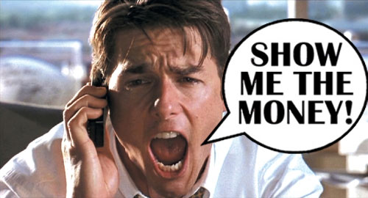
THE TRUTH ABOUT SUSTAINABLE FUNDING
How we spend our money reflects our values.
Achieving good outcomes for kids costs money.
The real money is in the public sector – NOT in grants.
Acting locally has great potential.
CHLDREN’S FUNDS IN U.S.

Slide 3
WHY PUBLIC BUDGETS MATTER?
State of our children is a crisis.
A budget is a moral document that reflects community priorities.
Funding inequity is a social justice issue.
Lack of resources is greatest resistance to change

Slide 4
WHAT’S WRONG WITH THIS PICTURE?
San Bernardino City spending San Bernardino County discretionary spending

Slide 5
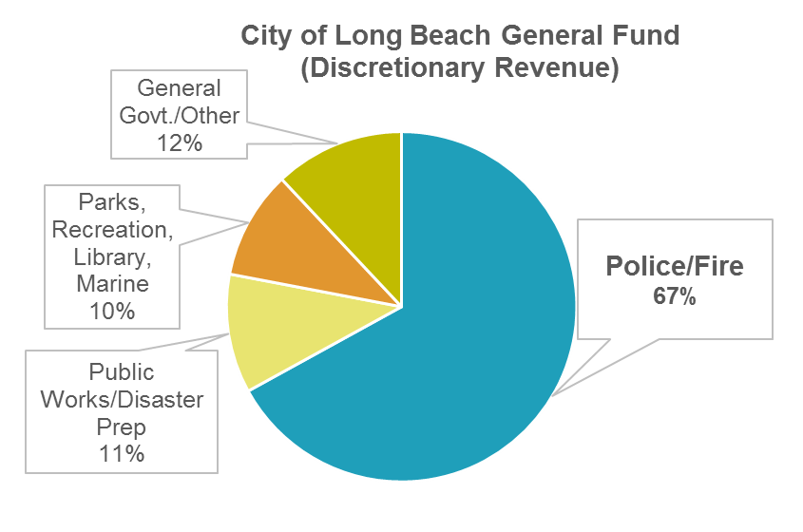
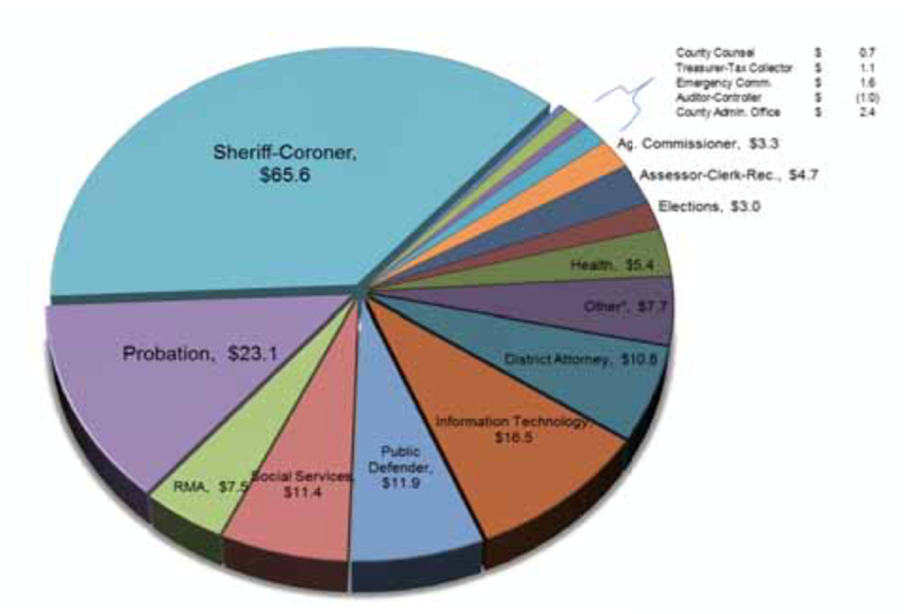
WHAT’S WRONG WITH THIS PICTURE?
Monterey County

Slide 6
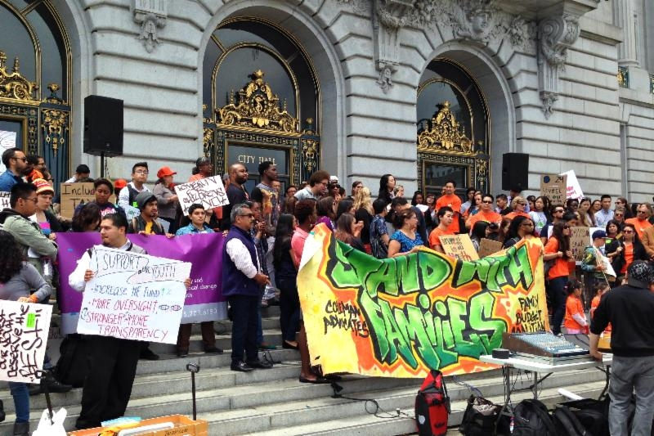
CBO’S AND ADVOCATES FOR CHILDREN NOT PREPARED FOR BUDGET BATTLES
Reliance on short-term solutions to single agency budget needs
Lack of knowledge about public budgets
Lack of participation in local budget processes
Lack of collective action to address public budget issues
Missed opportunities to build social and political capital and change how resources are allocated.
WE MUST RE-INVENT OUR ROLE IN CIVIC LIFE.

Slide 7
The San Francisco Story
Notes:
1., change LA Co0….to Greater LA Summer Matters Network
2 add 2018 to the date

Slide 8
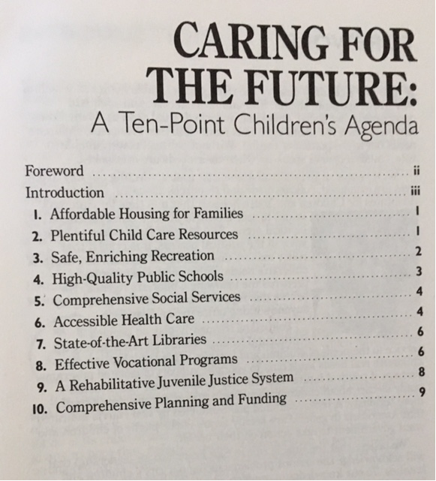
The First Lesson
RHETORIC RESOURCES
Children’s agenda – passed by Board of Supervisors, signed by Mayor

Slide 9
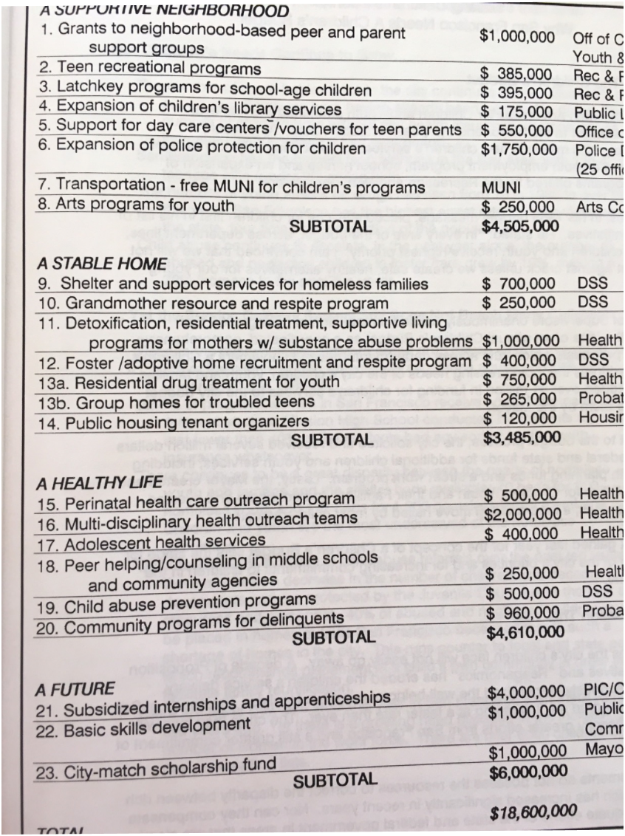
ORGANIZING AND SPECIFICITY
Formed Children’s Budget Coalition – 120 agencies
Submitted Children’s budget 3 consecutive years

Slide 10
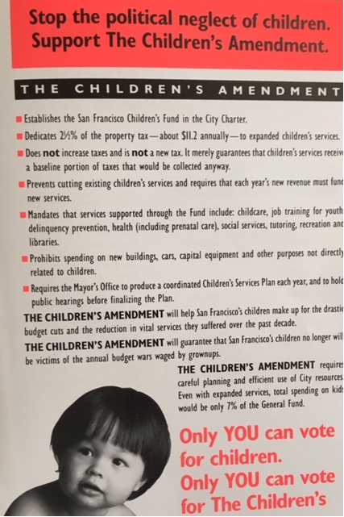
Amending the City Charter
INVENTING THE CHILDREN’S FUND
Institutionalizing funding for kids – annual set-aside of property tax
Protecting existing funding – Children’s baseline

Slide 11
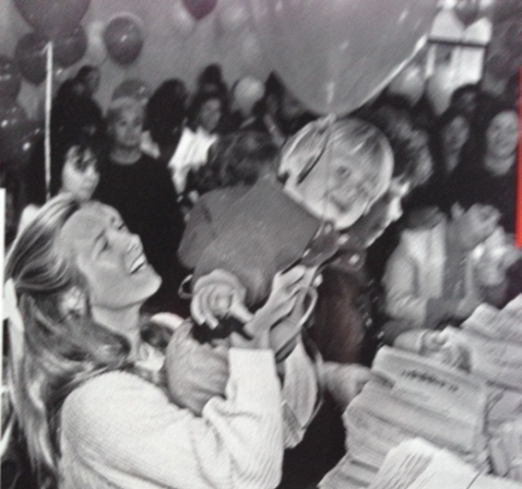
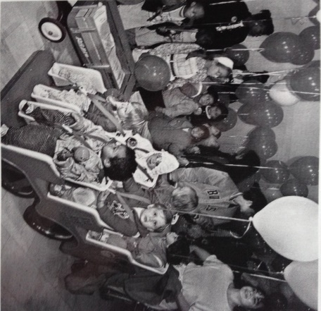
GOING TO THE PUBLIC Circumventing City Hall
68,000 signatures Power
Elections are powerful – the magic of local campaigns
Take the initiative – frame the issue
Political hardball is essential
Propose a solution
“Never doubt that a small group of committed citizens can change the world. Indeed it is the only thing that ever has.” – Margaret Mead

Slide 12
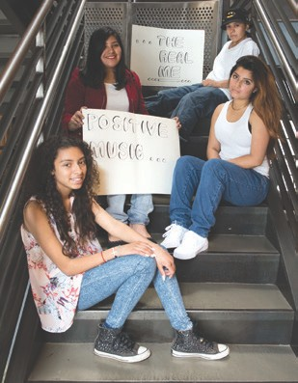
BENEFITS OF THE SAN FRANCISCO CHILDREN & YOUTH FUND
OUTCOME HAS BEEN TRANSFORMATIVE
Focus on prevention
Expanded opportunities for children, youth, families
Powerful department in local government for planning, coordination, accountability, transparency, and community engagement
Policy and systems reform – enabled by discretionary funds and local office for children’s issues
Leveraging of other dollars
Youth leadership in City Hall
Children’s constituency empowered
NOTE: RETURN ON INVESTMENT WAS HUGE.

Slide 13
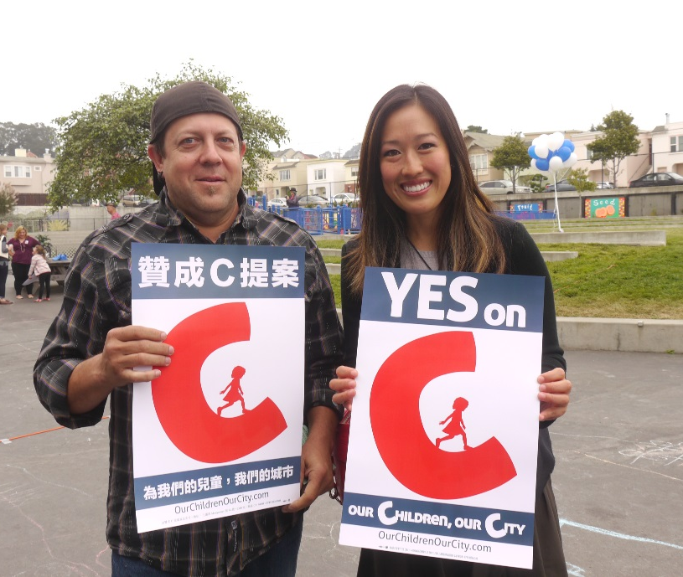
An Emerging Movement
CHILDREN’S FUNDS IN U.S.
All ages – San Francisco, 8 counties in Florida, Seattle, Portland, Oakland, Baltimore, King County
Preschool – Denver, San Antonio, San Francisco, Cincinnati
Violence Prevention – Little Rock, San Bernardino, Oakland, Santa Rosa
Mental health – 8 counties in Missouri, 3 counties in Ohio
Soda – Philadelphia, San Francisco, Oakland, Albany, Berkeley, Boulder
Notes:
1. Just note where King County is Ca?

Slide 14
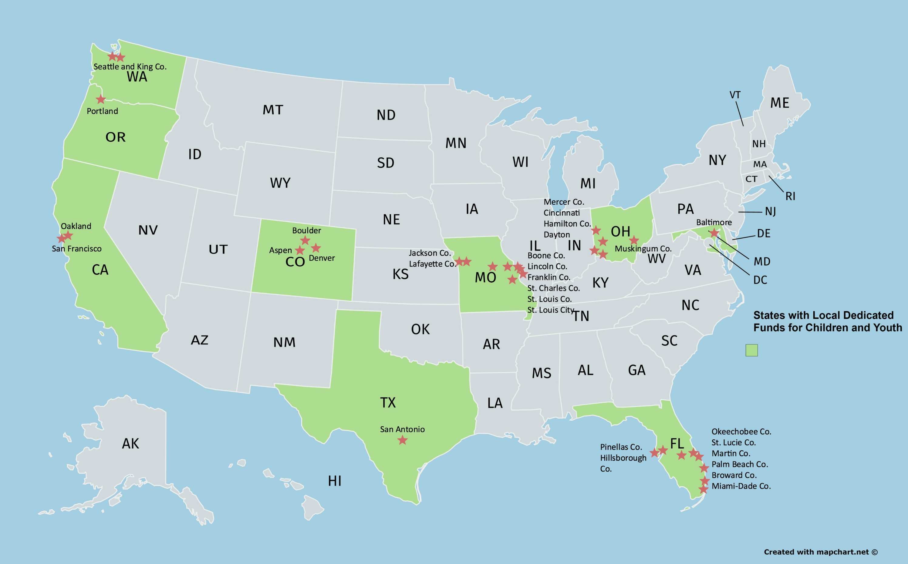
Notes:
delete

Slide 15
The BASICS
Notes:
1., change LA Co0….to Greater LA Summer Matters Network
2 add 2018 to the date

Slide 16
TWO WAYS TO GET PUBLIC DOLLARS
REALLOCATE EXISTING DOLLARS
Budget process – childcare funding
Ballot – San Francisco, Oakland
GENERATE NEW DOLLARS
Budget process – Santa Cruz
Ballot – Alameda, San Joaquin, San Francisco
.

Slide 17
EARLY STEPS
Notes:
1., change LA Co0….to Greater LA Summer Matters Network
2 add 2018 to the date

Slide 18
Roadmap For Creating Dedicated Funding
THERE ARE KEY ELEMENTS OF WORK, BUT NO LINEAR PATH
Making the case
Building the base
Crafting the plan
Mounting the campaign

Slide 19
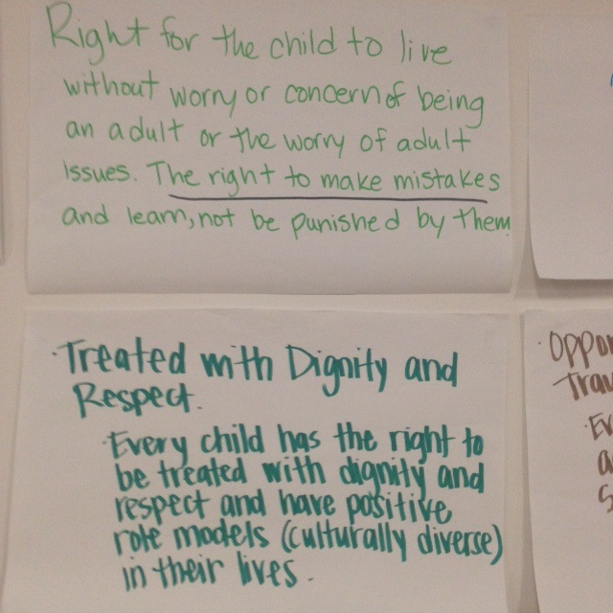
BUILDING THE CASE
Document need
e.g. Report Card on state of kids
Build a consensus agenda
e.g. Bill of Rights
Develop a fiscal map of current funding
Communicate the case for investing in children – to public and policymakers

Slide 20
UNDERSTANDING THE BUDGET
CREATING A CHILDREN’S BUDGET
Prevention vs. Rehabilitation
Changes over the years
Compared to other expenditures and overall budget
How much is discretionary

Slide 21
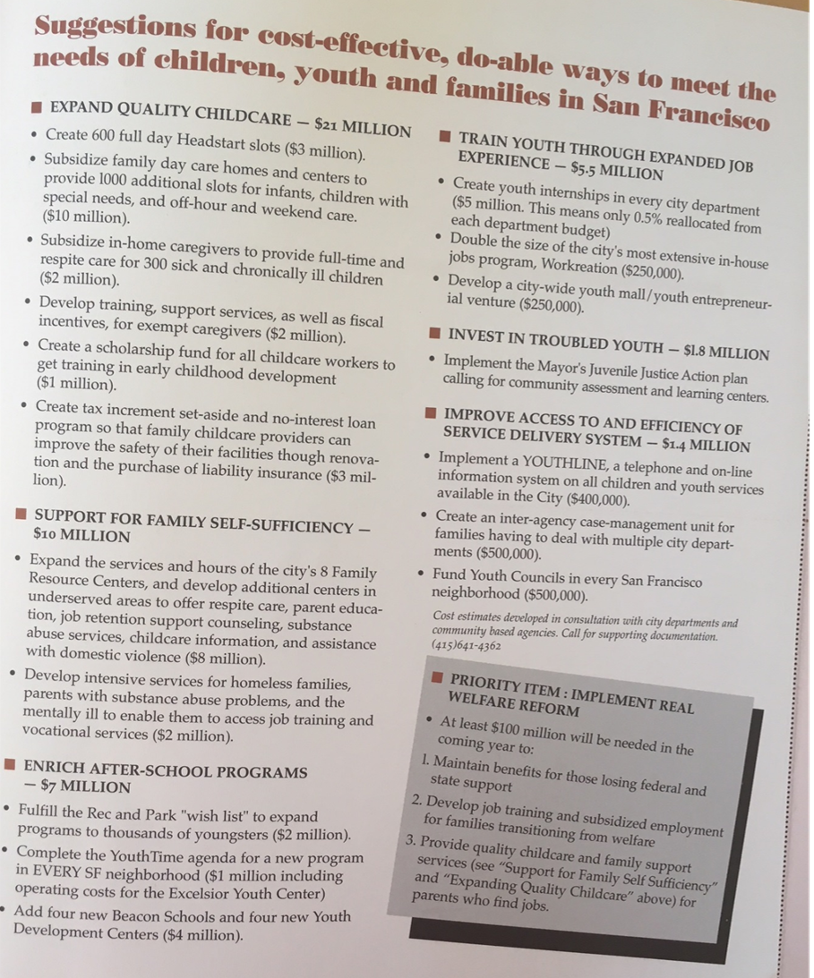
CREATING A PROPOSAL
Make goals very concrete.
What is the cost? What program? Who will be served? Documentation of need? Potential outcomes?
Criteria for setting goals:
Availability of resources, Popular with public, Coalition of supporters, Cost benefit, Visible results, Builds power, Rallies parents/youth/consituents,

Slide 22
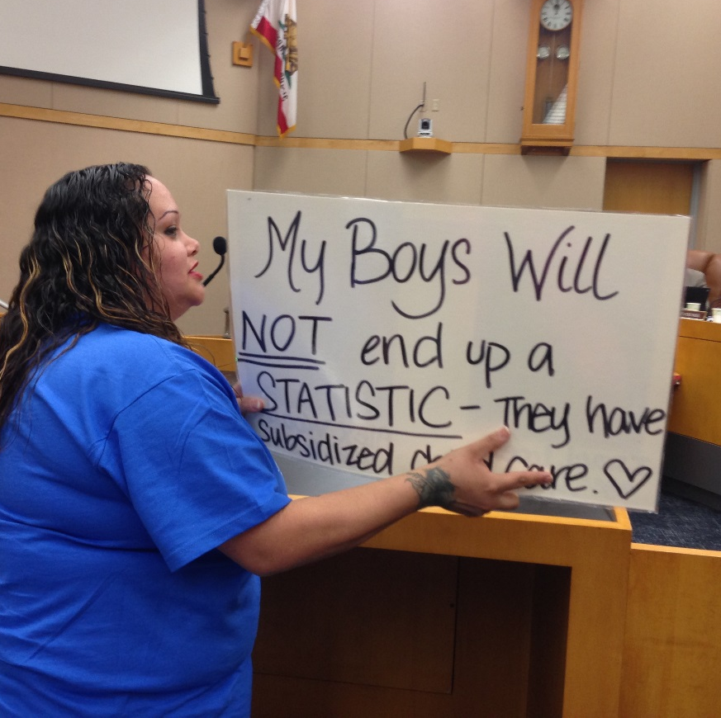
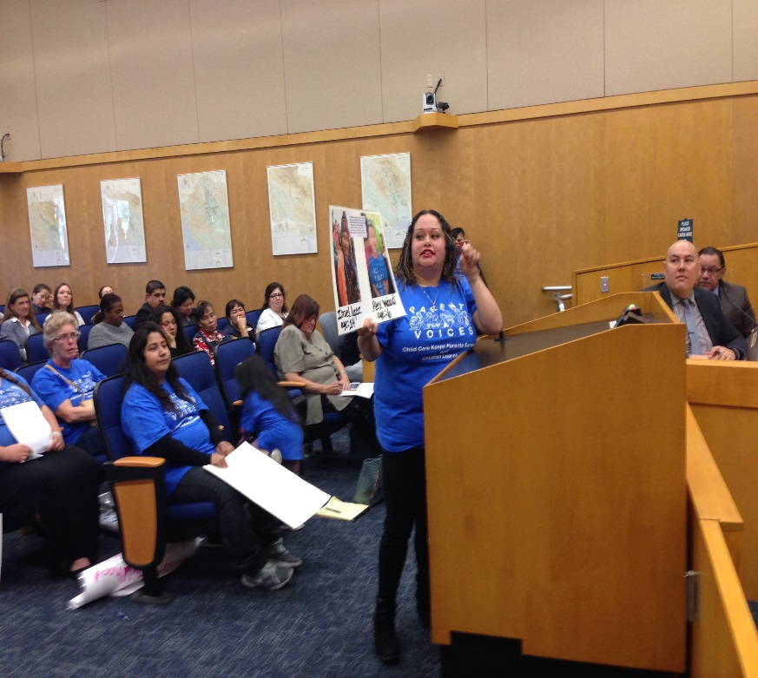
COMMUNICATING THE NEED
Reports have a place, but they need to be supplemented by compelling stories.
Decision-makers have short attention spans.
3 minutes is all you get in a formal public hearing.
Avoid jargon and too much data.
Tell stories.
Make it personal.

Slide 23
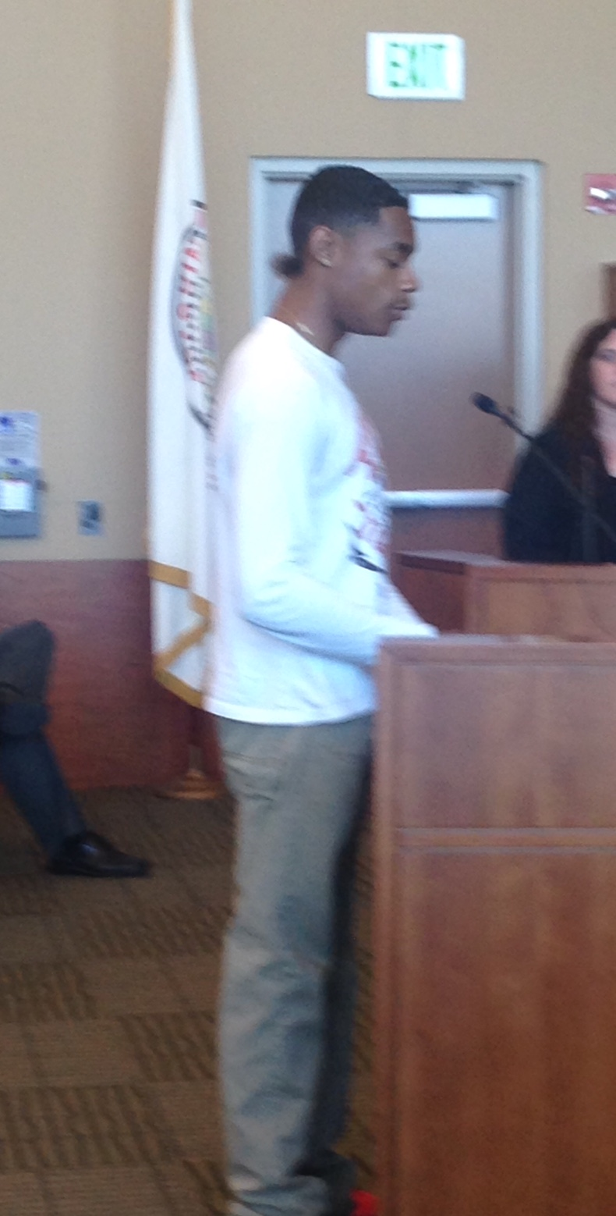
ELEMENTS OF A STRONG MESSAGE
What’s wrong? – Statement of concern
Why does it matter? – Statement of values
What should be done? – Policy objective
Vehicles for communication:
Meetings w elected, Rallies/demonstrations, Letters to editor, Testimony at hearings, Fact sheets, Social media, Paid media, Video, Post cards, Letters to targets, Art projects, Feature stories, Radio, PSA’s, Reports, Photographs, Editorial meetings, Signs, T-shirts, Phone banks

Slide 24
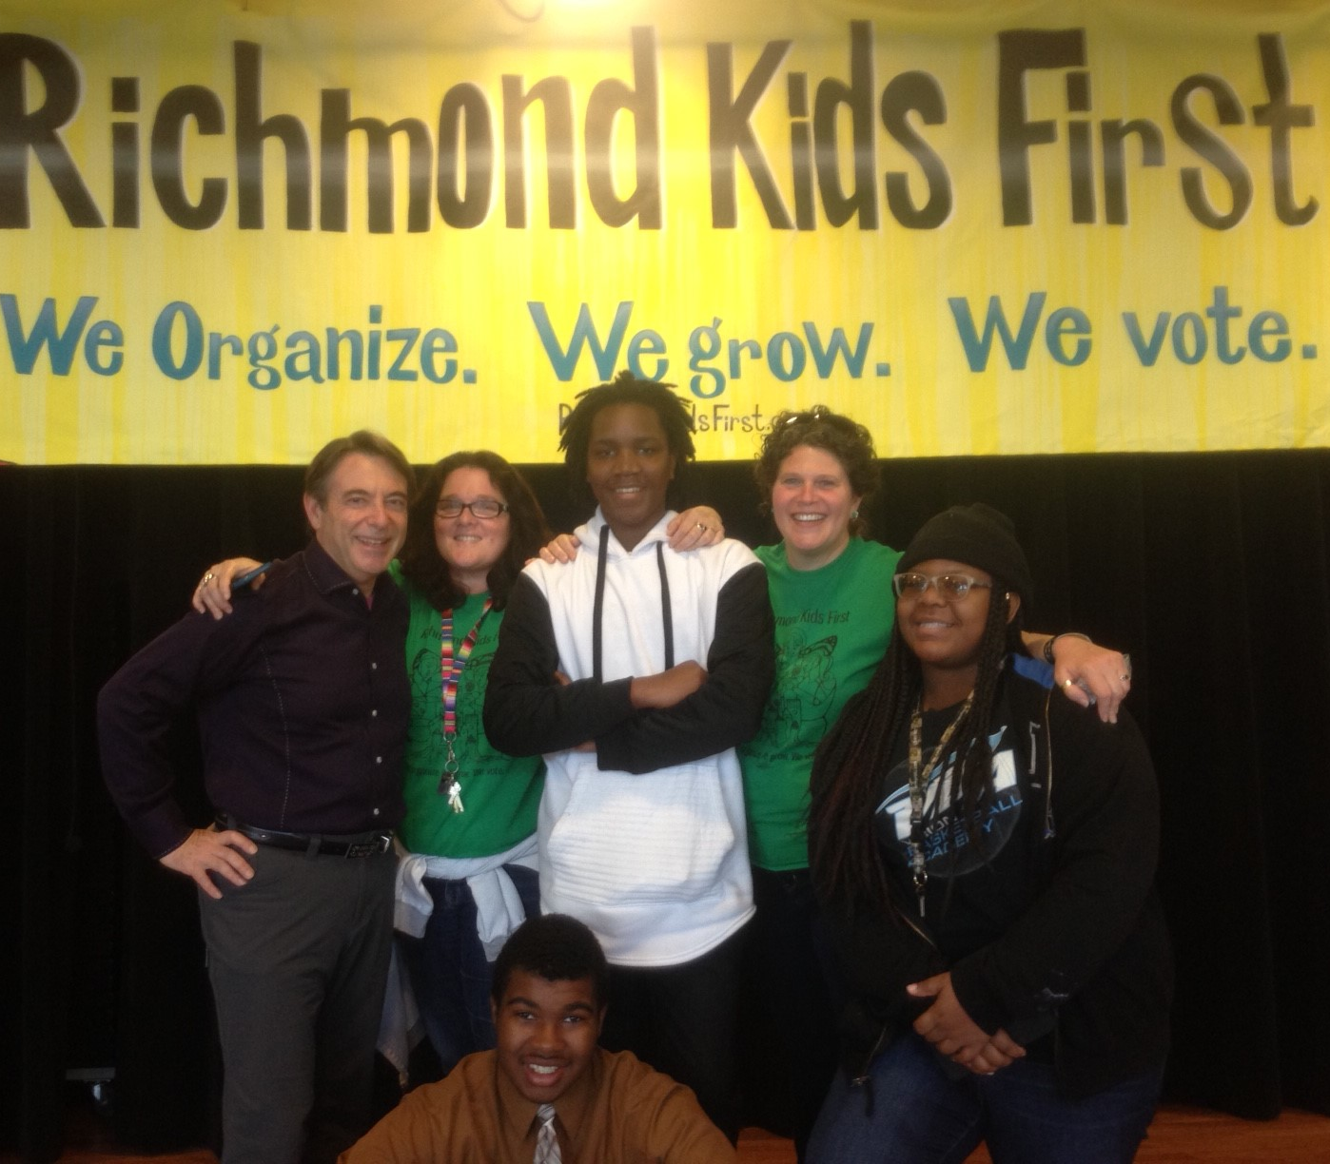
ORGANIZING BUILDING THE BASE
MOST IMPORTANT STRATEGY
Increasing the political and social capital of children, youth and families.
Activities can include coalition building, public education, door-to-door outreach, community meetings, house parties, rallies.
Build a powerful organization driven by community.

Slide 25
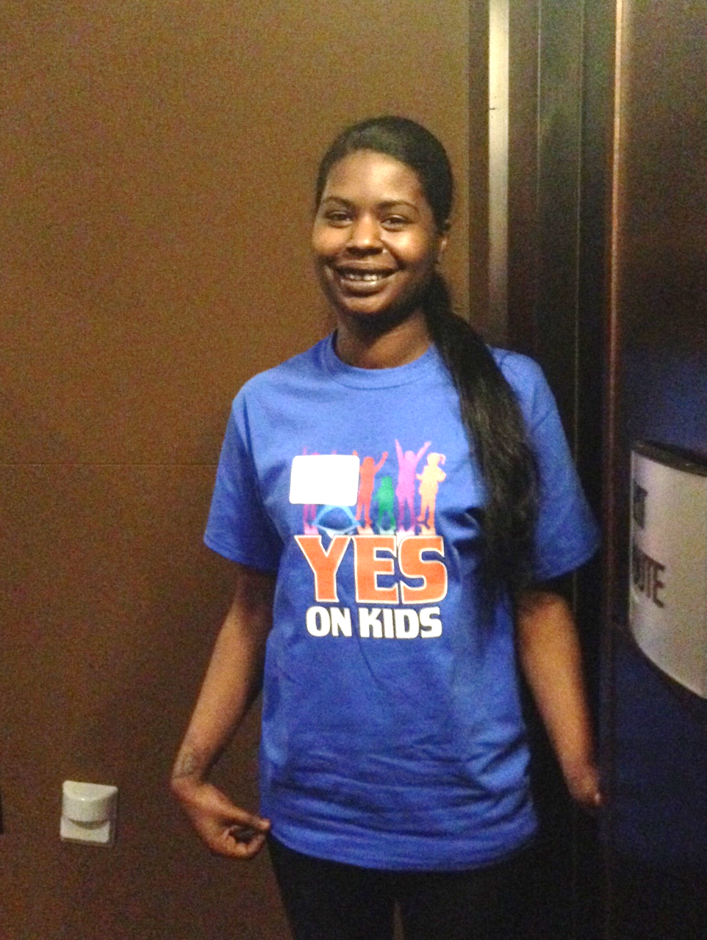
COALITIONS AND ALLIES
San Francisco Budget Justice Coalition
ACCE AFT 2121 AIDS Legal Referral Panel API Council Arts for a Better Bay Area Bay Area Community Resources (BACR) Causa Justa::Just Cause Chinese Progressive Association Coalition of Agencies Serving the Elderly Coalition on Homelessness Coleman Advocates for Children and Youth Community Alliance of Disability Advocates Community Housing Partnership Community Partnership for LGBTQQ Youth (CPQY) Dolores Street Community Services (DSCS) El/La Para TransLatinas Hamilton Families Homeless Emergency Service Providers Association (HESPA) HIV/AIDS Provider Network (HAPN) Hospitality House Jobs With Justice Larkin Street Youth Services LYRIC New Door Ventures NEXT Village SF Parent Voices St. James Infirmary San Francisco Child Care Planning & Advisory Council San Francisco Housing Rights Committee San Francisco Human Services Network San Francisco Immigrant Legal & Education Network (SFILEN) Senior and Disability Action Service Employees International Union, Local 1021 Sheroes Project South of Market Community Action Network (SOMCAN) Supportive Housing Provider Network (SHPN) TGI Justice Project Young Women's Freedom Center

Slide 26
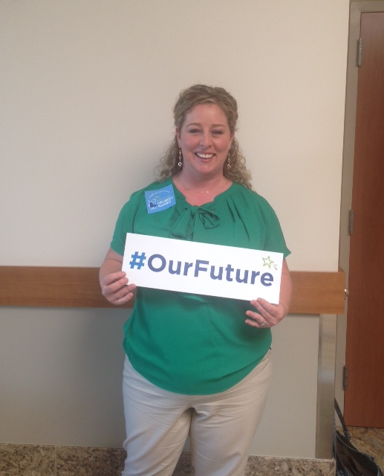
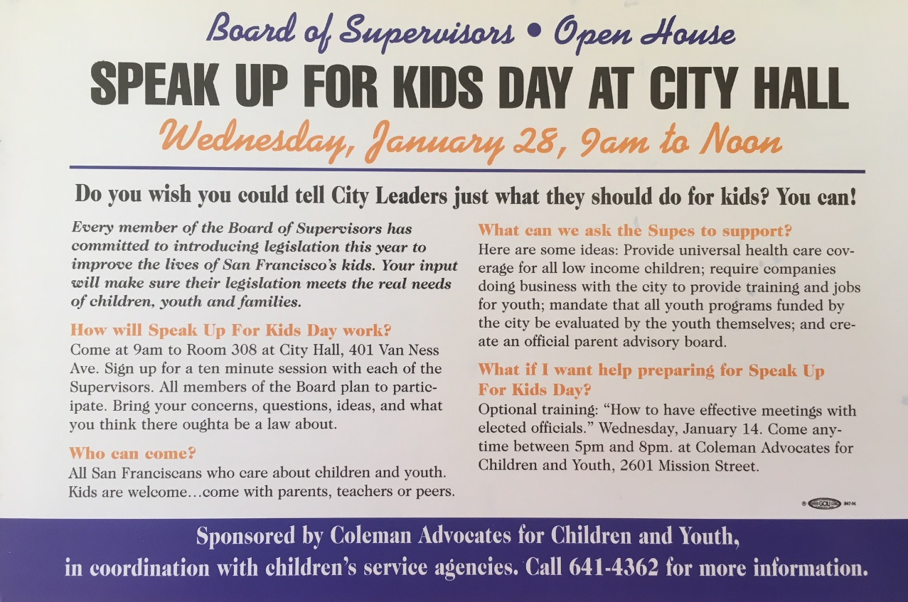
OUTREACH FOR PUBLIC SUPPORT
Social media
Outreach to community groups
Conferences and public forums
Mailings and newsletters
Speak out – speak up for kids days

Slide 27
Economic Impact of Child Care Industry in San Francisco Generates $191 M annually Provides 4,415 jobs annually Enables parents to work Prepares future generations for the workforce.

Slide 28
POLLING YIELDS VALUABLE INSIGHTS Early childhood wellness programs and improving safety for kids walking near schools are viewed as the most important funding priorities.
Ext./Very Impt.
62%
60%
59%
59%
58%
57%
54%
Q9. I am going to read you a list of ways in which the funds generated by this measure could be spent. Please tell me how important each item is to you personally: extremely important, very important, somewhat important, or not too important. Split Sample

Slide 29
FUNDING OPTIONS
Notes:
1., change LA Co0….to Greater LA Summer Matters Network
2 add 2018 to the date

Slide 30
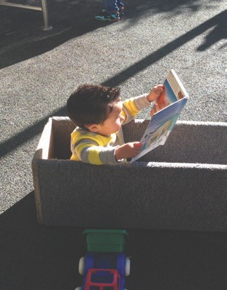
WHAT TO CONSIDER IN MAKING DECISIONS ABOUT FUNDING STRATEGY?
Be open to unexpected opportunities. Know when to compromise.
Gaps in services – priority needs
Legal realities – e.g. voter threshold
Public opinion
Consensus of sponsoring coalition
Political champions
Strength of opposition
Potential volunteers
Resources of advocates

Slide 31
FINDING THE RIGHT FUNDING STRATEGY
Kids' needs
Your capacity
Political reality
MANY STRATEGIES CAN WORK.
FIND THE SWEET SPOT.
Annual budget allocation
Taxes - sales, real estate transfer, parcel, business, utility, hotel, marijuana
Fees - admissions, amenities, mitigations, abatement
Carve-out – reallocation
Note – potential new funding from Schools and Communities First Act: Monterey - $66M; San Beneto - $6.2M; Santa Cruz - $46M

Slide 32
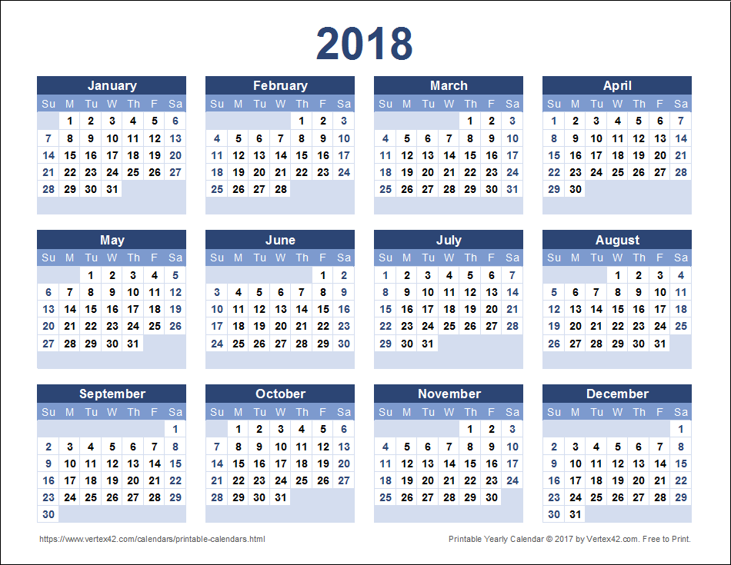
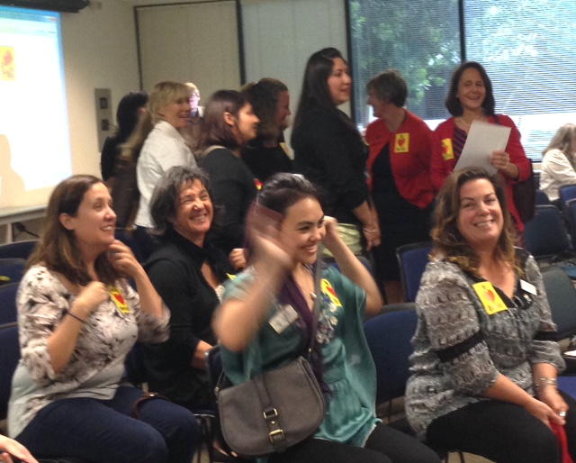
LOCAL ANNUAL BUDGET BATTLES
Creating a public budget is a year-round process.
Showing up is half the battle
Start small – oppose budget cuts
End big – create dedicated
funding for your priorities

Slide 33
CITY AND COUNTY TAXES
THEY CAN BE GENERAL OR SPECIAL TAXES.
Sales - combined limit 2% add-on to base of 7.5% - done in 1/8 cent increments
Real estate transfer – can be made progressive by increasing with value of property
Parcel – can be based on size of parcel, and can have many exceptions – always a special tax
Business - gross receipts, car rental, parking
Utility (UUT) – gas, water, sewer, cable, phones
Hotel – Transient Occupancy Tax (TOT) – ranges from 8 – 14%
Marijuana – Cultivation, Manufacturing, Sales – can be passed by a percentage range
Admission – Parks, Sporting events, Concerts, etc.
Some taxes are cities/county unincorporated areas only, i.e. business, UUT, marijuana, admission

Slide 34
Lessons Learned
Notes:
1., change LA Co0….to Greater LA Summer Matters Network
2 add 2018 to the date

Slide 35
ELECTIONS 2016 & 2018
NAPA
MARIN
SOLANO
SACRAMENTO
RICHMOND
ALAMEDA
SAN FRANCISCO
OAKLAND
SAN JOAQUIN
Notes:
delete

Slide 36
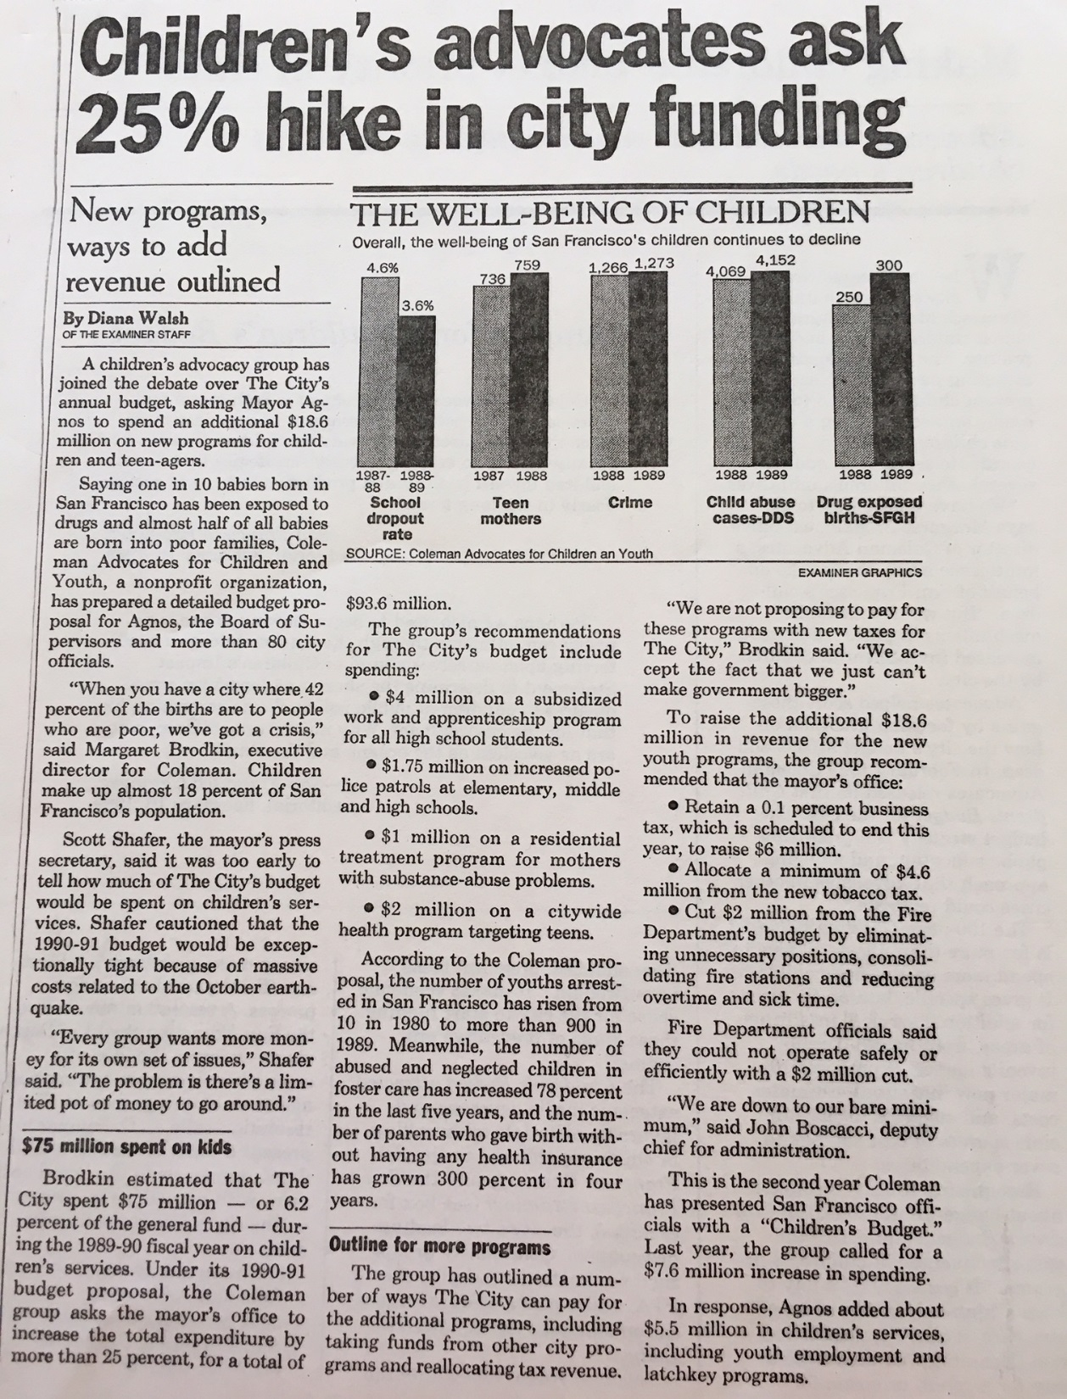
USE THE MEDIA
HAVE A SIMPLE MESSAGE
Press conferences
Op-eds
News releases
Feature stories
Follow the c’s – crisis, conflict, constumes, celebrities
Find a news hook.
OFTEN MORE IMPORTANT TO TALK TO THE MEDIA, THAN DIRECTLY TO DECISION-MAKERS.

Slide 37
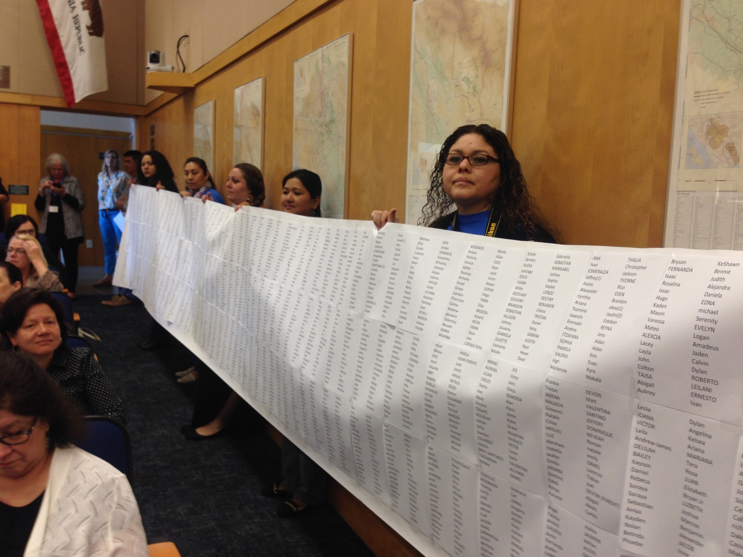
DRAMA HELPS – Childcare Waiting List

Slide 38
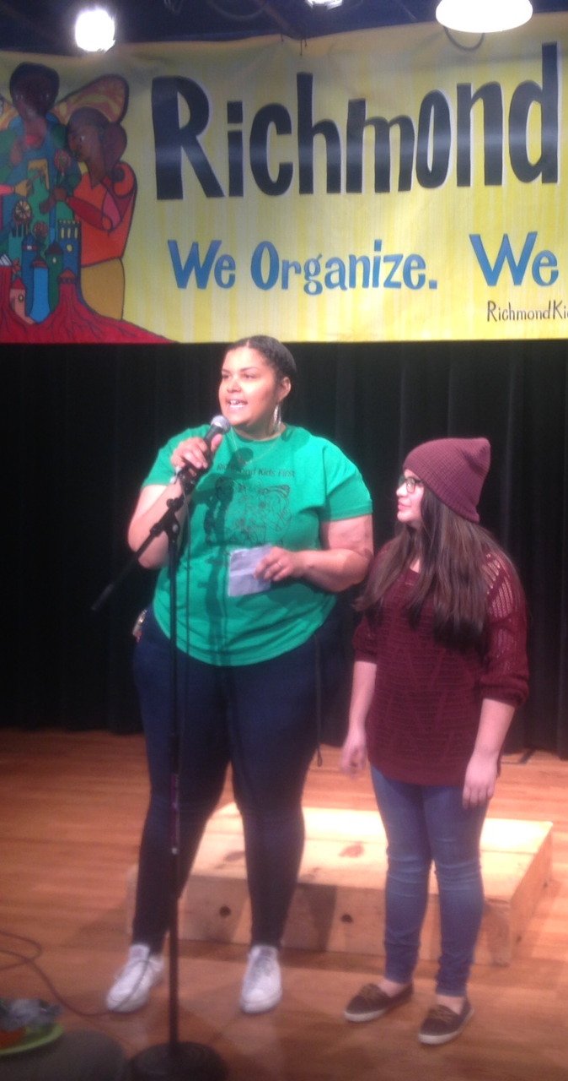
AUTHENTIC VOICES
Hard to say no to kids and parents, and folks telling their real stories.
Leadership development is empowering, therapeuputic, and long-lasting.

Slide 39
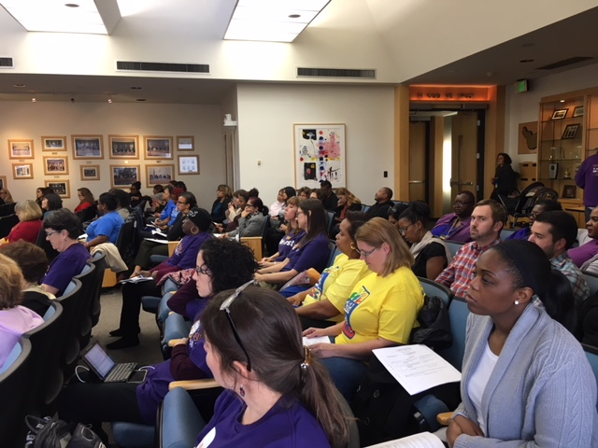
NUMBERS COUNT

Slide 40
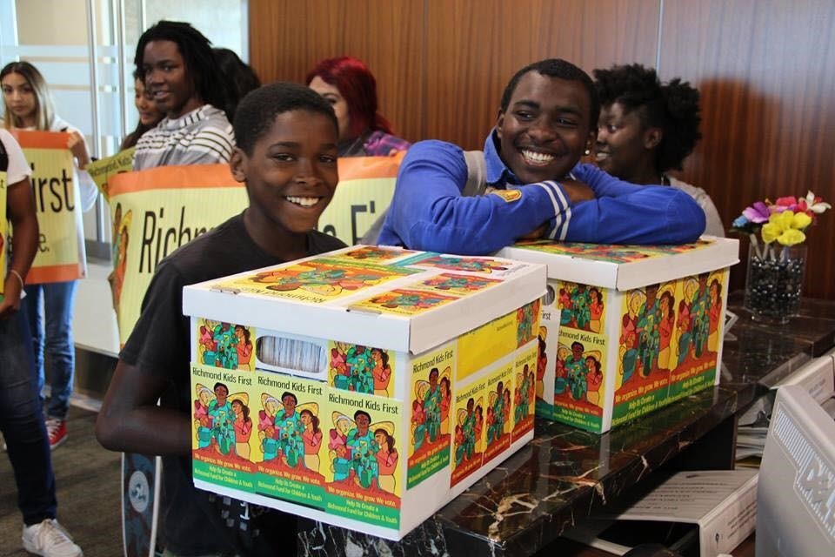
Elections are Great Opportunities
Candidate forums
Candidate questionnaires
Educating candidates
Placing measures on ballot

Slide 41
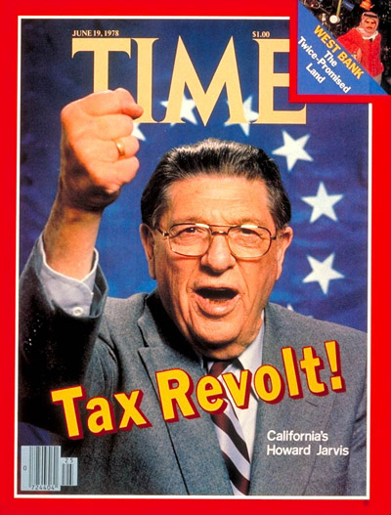
PREPARE FOR OPPOSITION
Anti-tax, Anti-government
Protecting turf and status quo
Competing priorities – roads and cops
“Sacred cows” – political heavyweights
No more money
BEWARE QUIET OPPOSITION
Not the right time
Not the right approach
BUDGET ADVOCACY IS ONE BATTLE AFTER ANOTHER.
Must be the folks who never go away.

Slide 42
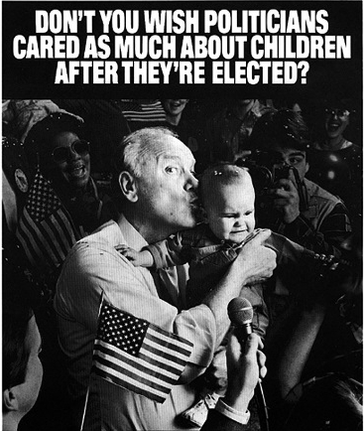
PERSUASION AND PRESSURE
Both Are Essential
Soft traditional tactics – reports, meetings, letters, testimony, op-eds, site visits, calls
POLITICAL HARDBALL – demonstrations, sit-ins, petitions, public challenges and direct criticism, guerilla theatre, press events, withdrawl of political support, circumventing the traditional process

Slide 43
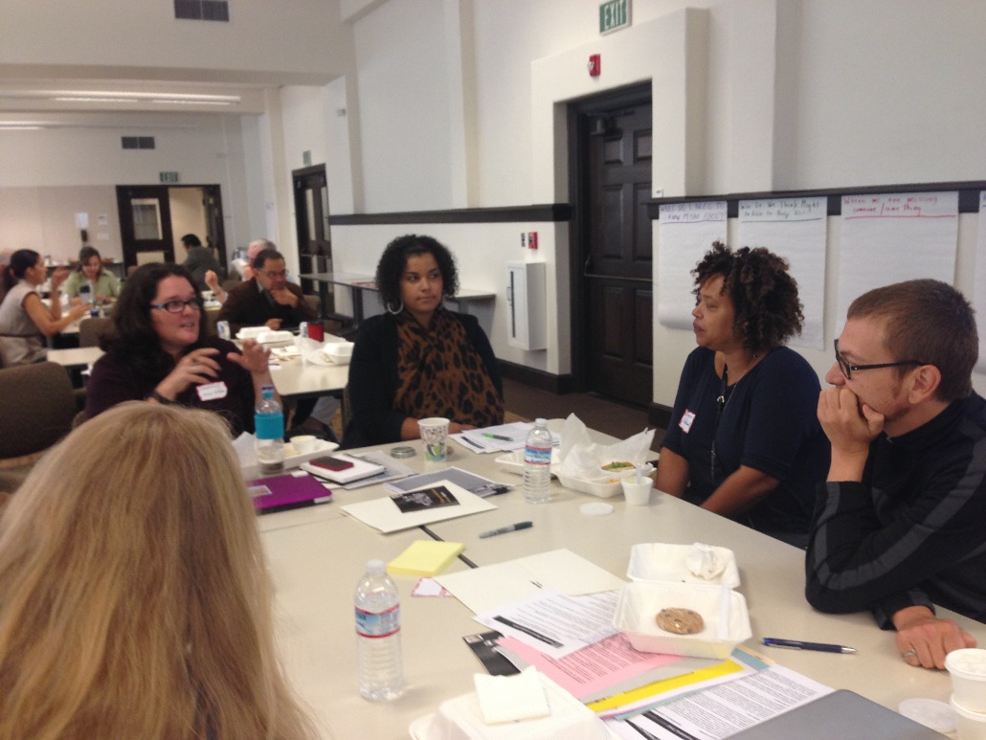
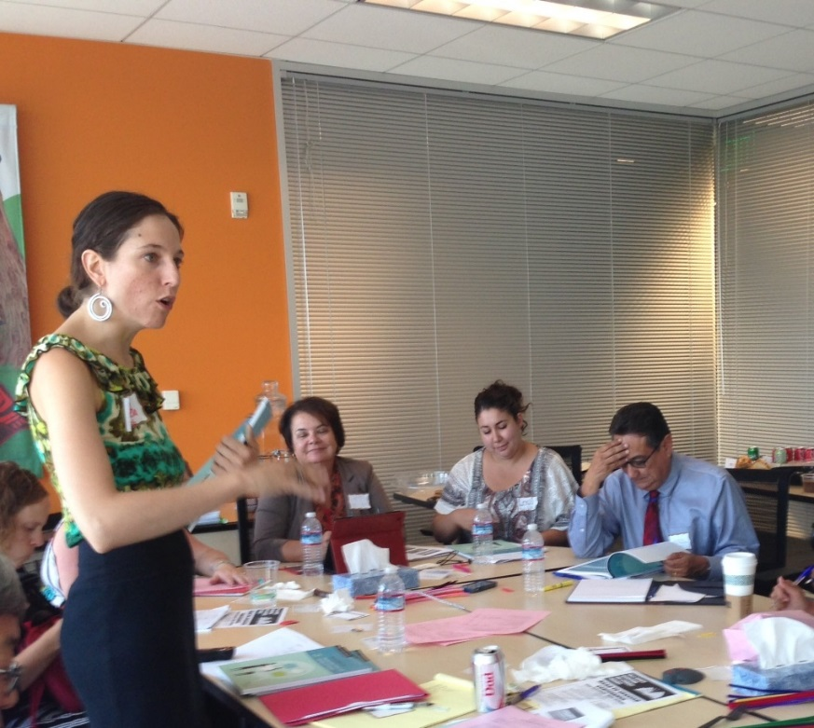
COORDINATING THE WORK
STAFF IS ESSENTIAL.
Lack of staff is biggest barrier to moving forward.
Staff can mobilize the resources of a network and ensure ongoing momentum:
Research
Convene meetings
Develop materials
Train youth, parents, volunteers
Liaison with decision-makers
Outreach to media
Build the coalition

Slide 44
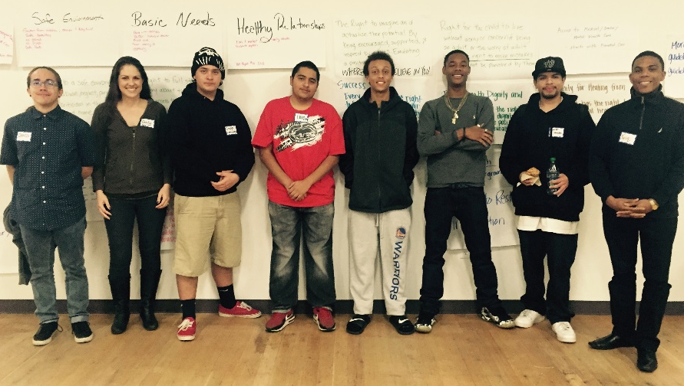
NON-PROFITS NEED MORE SUPPORT AND POLITICAL PREPARATION
Assets – Tradition of social
justice, Understand problems
close-up, Deep connection
to youth and parents.
Challenges – Financial
conflicts, Political inexperience,
Not knowing legal rights, Lack
funding for advocacy/organizing. Fathers and Families in San Joaquin County with Bill of Rights they have written

Slide 45
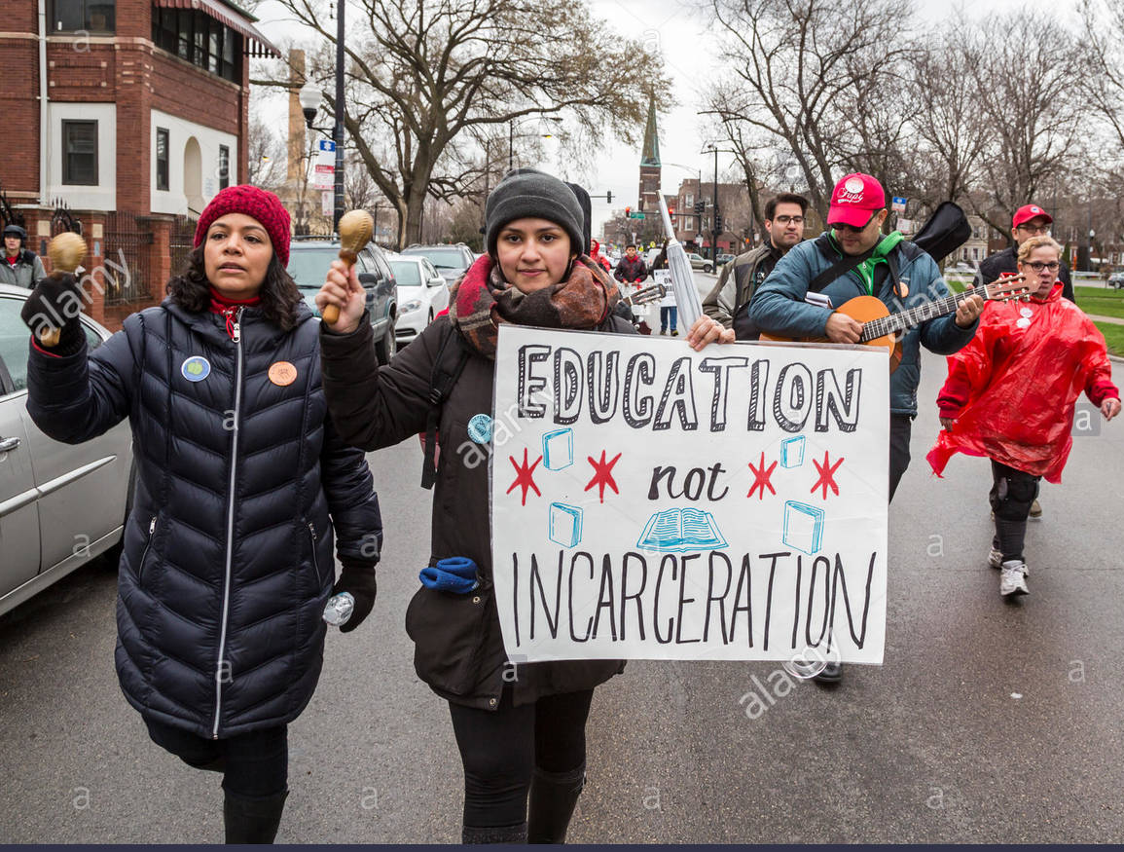
SUMMARY
Budgets and elections are unique organizing and communication opportunities to create sustainable funding.
Non-profits have untapped power.
It takes a village – collective action.
It entails persuasion and hardball politics.
Youth and parents have influential voices.
Take the initiative – don’t wait for politicians.
Drama helps make the case. Media amplifies the case.
Expect opposition.
Power builds power.
It is exhilarating!
Notes:
Delete unless these are lessons learned from tax and revenue work then keep

Slide 46
PLANNING WHAT’S NEXT
Notes:
1., change LA Co0….to Greater LA Summer Matters Network
2 add 2018 to the date

Slide 47
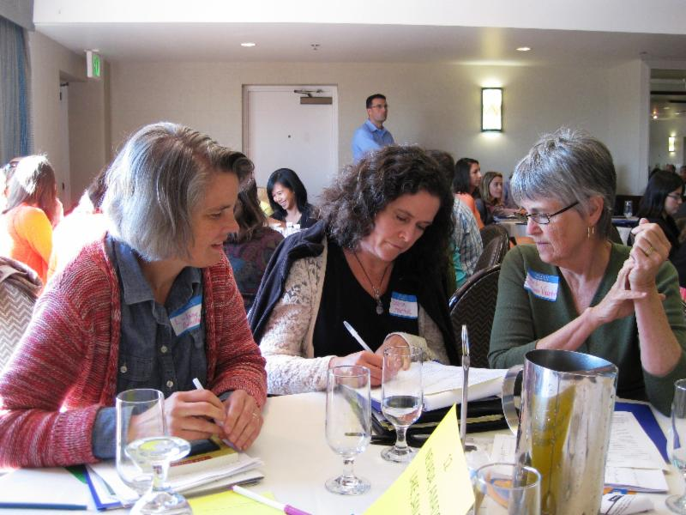
DEVELOPING AN ADVOCACY STRATEGY
What do you want? – your objectives
Who are your allies? – partnerships/coalitions
Who can give you what you want? – your audience/target
What do they need to hear? – your message
Who do they need to hear from? – your messengers
How can we get them to hear it? – your delivery strategy

Slide 48
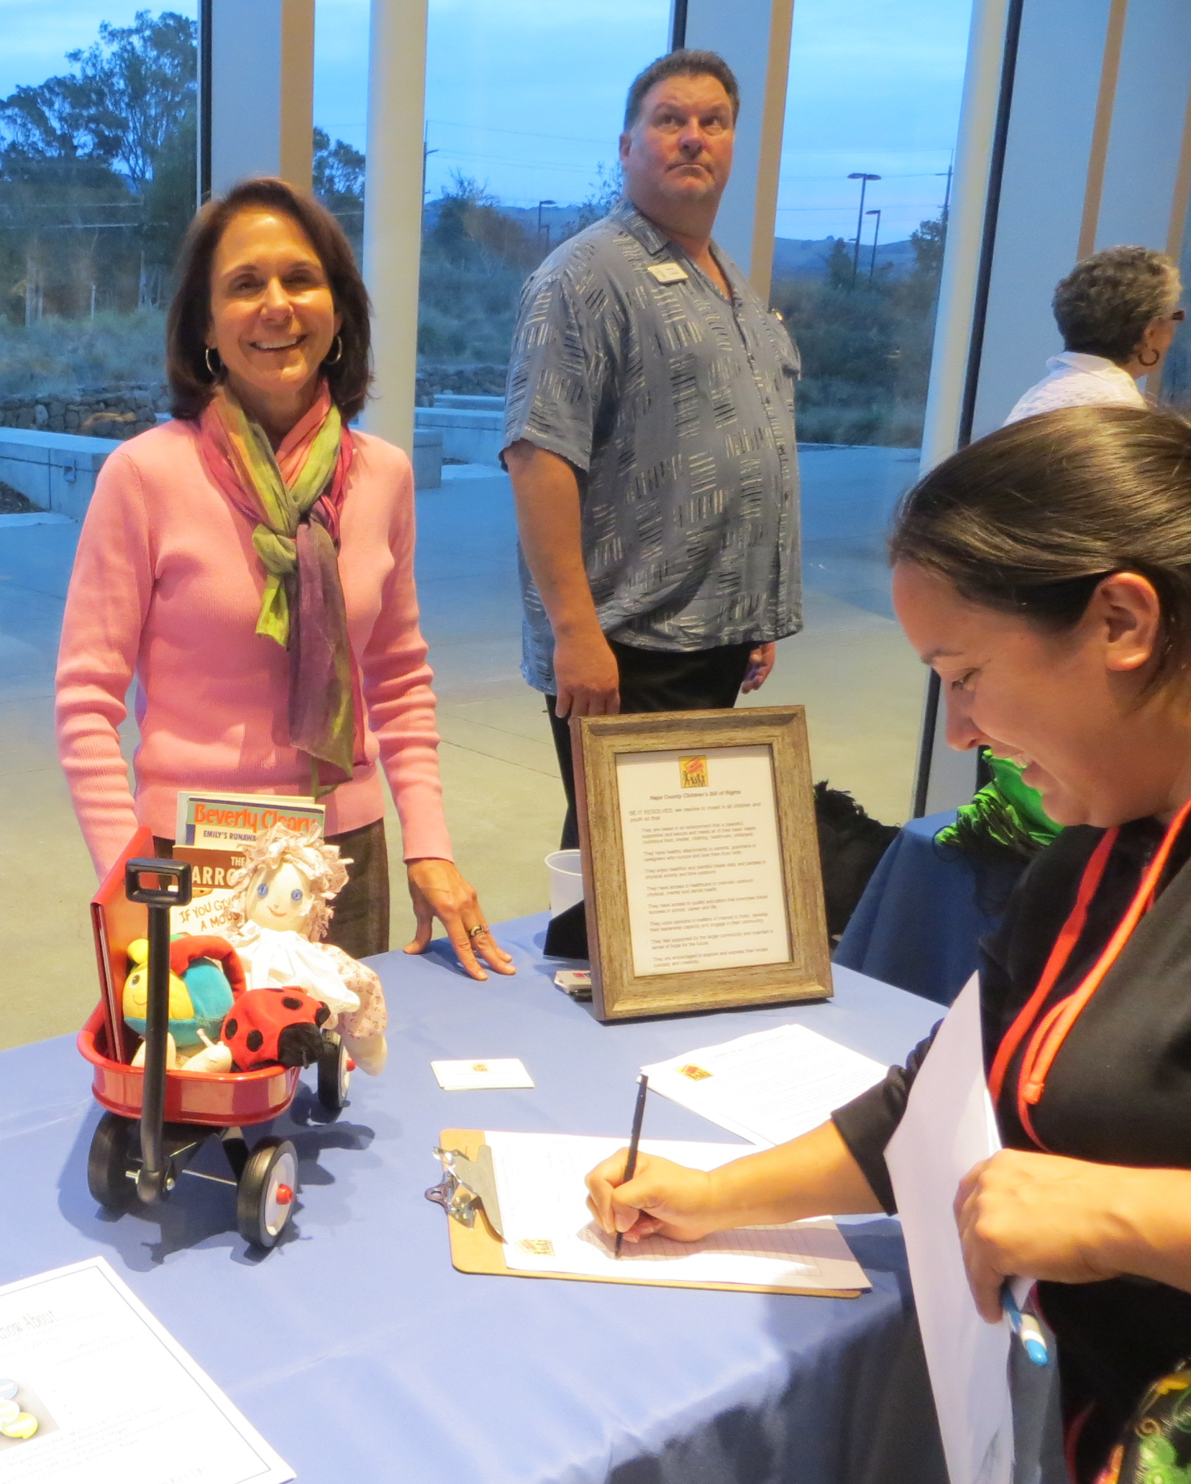
WHERE SHOULD WE START?
THERE ARE MANY POSSIBLE NEXT STEPS
Educate colleagues about dedicated public funding
Convene a strategy meeting of allies
Become budget advocates
Create a Children and Youth Bill of Rights or Budget
Testify at hearings about unmet needs
Educate the public about needs of kids
Have a Town Hall with elected officials
Research your legal options
Conduct a survey or a poll

Slide 49
ARE YOU READY?
Convening organization
Dedicated staff support
Network/coalition that can work together
CBO’s prepared for political engagement
Baseline information on community needs
Passion and willingness to take risks
Time to do the work and organize the base
Political champion (if possible)
Resources for a campaign

Slide 50
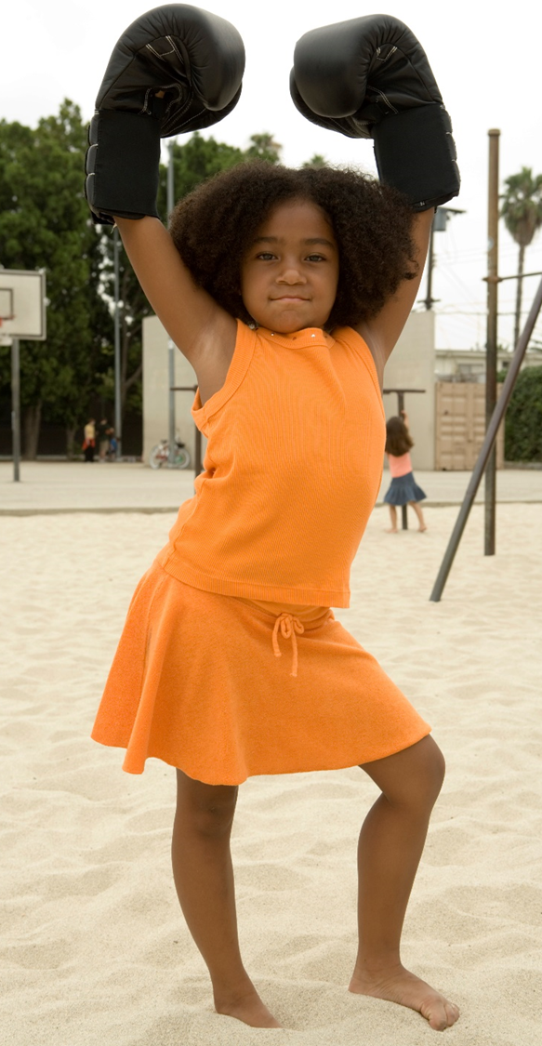
WE HAVE WHAT IT TAKES
The Potential Power of IECC
We can make the case.
We have energy.
There are a lot of us – 69 organizations
We have allies.
Now is the time for local politics.
We can build on the lessons of our pioneering colleagues
We have great leadership.
Notes:
delete

