Slide 1
San Bernardino County Budget and Taxes

Slide 2
Budget Information

Slide 3
San Bernardino Key Budget Dates- 2019
Oct.–Feb.
Capital program and Departmental Fees
Jan.–Feb.
Multi-year forecast and labor agreement budget prep
Mar.–3 Apr.
Budget Instructions. Dept input to budget system and County Fiscal Plan. Recommended budget and discretionary revenue allocations
7 May
Budget workshop
21 May
Proposed Budget to Board
11 June
Budget hearing, deliberation and adoption

Slide 4
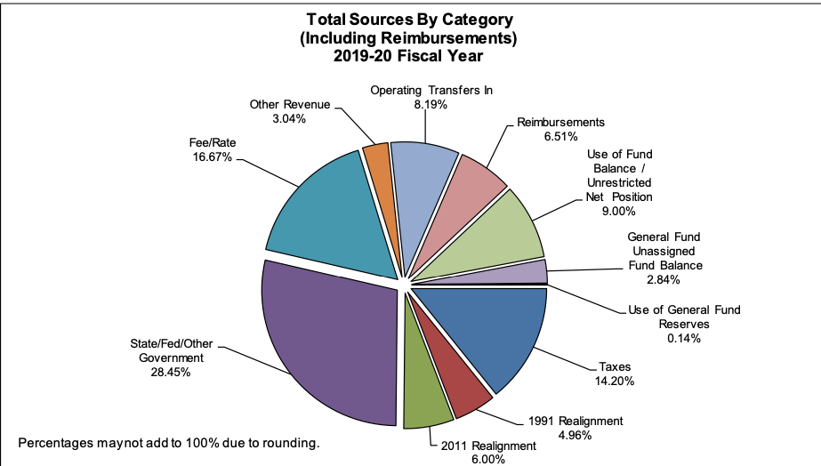
San Bernardino Total Sources

Slide 5
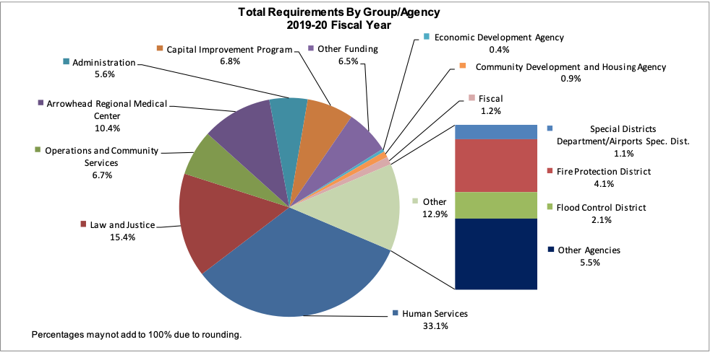
San Bernardino Budget Spending

Slide 6
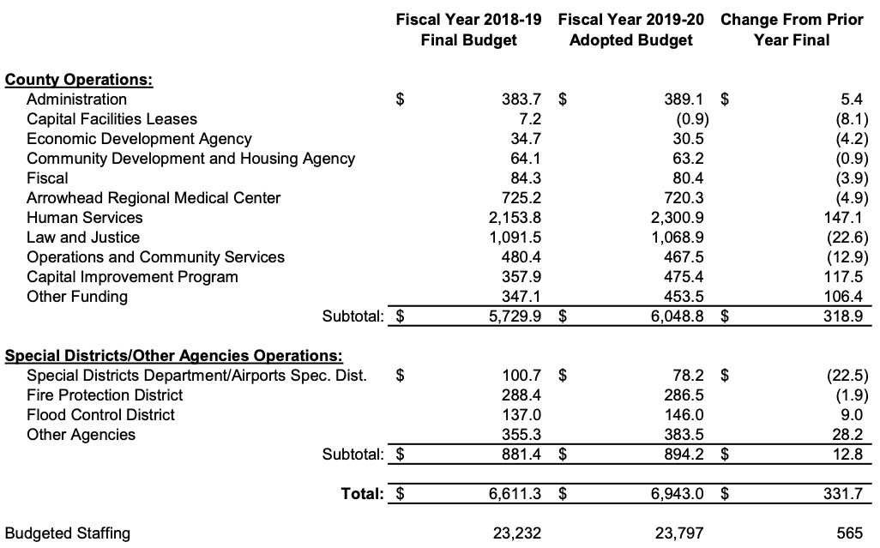
San Bernardino Budget Spending

Slide 7
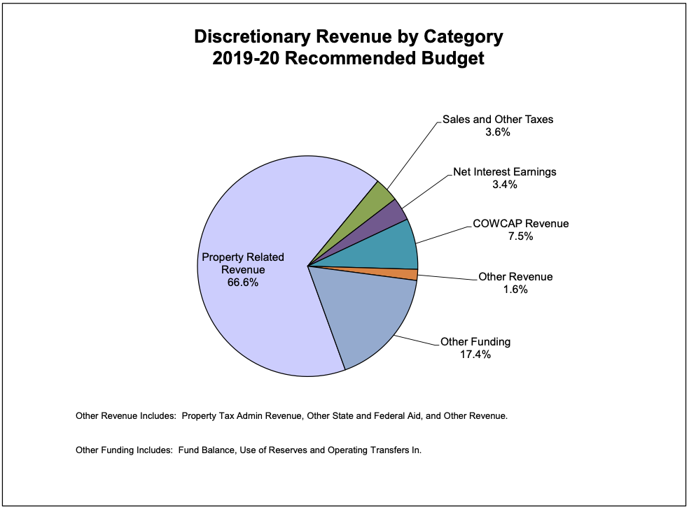
San Bernardino Discretionary Revenue

Slide 8
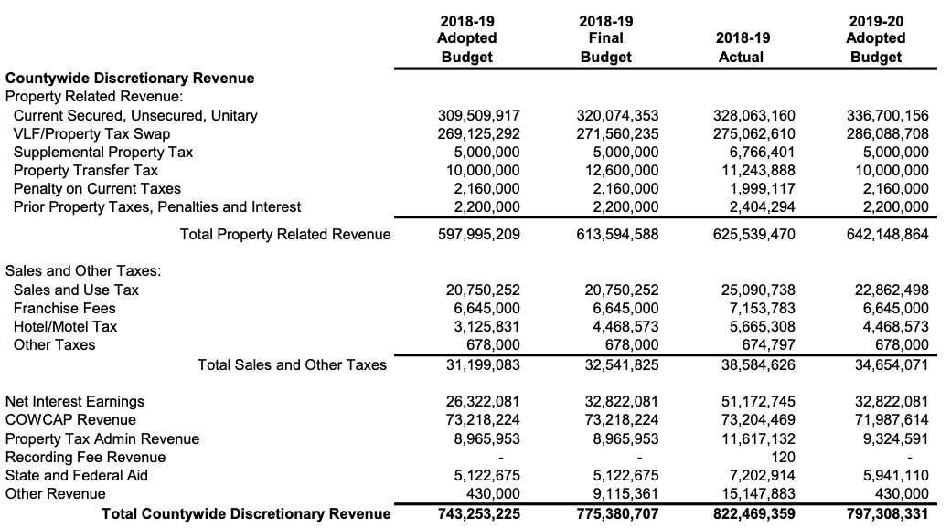
San Bernardino Discretionary Revenue

Slide 9
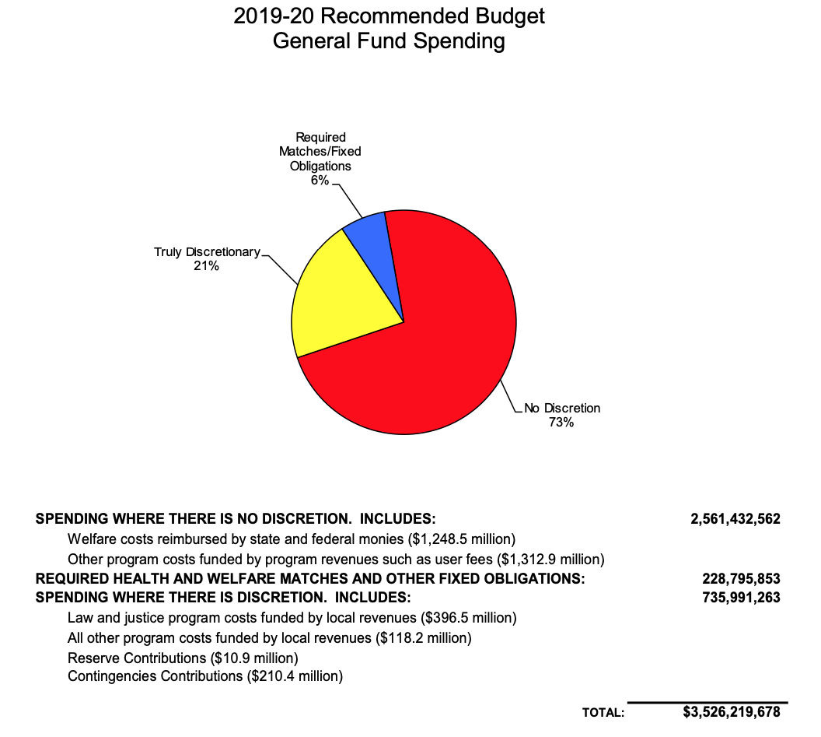
San Bernardino Discretionary Spending

Slide 10
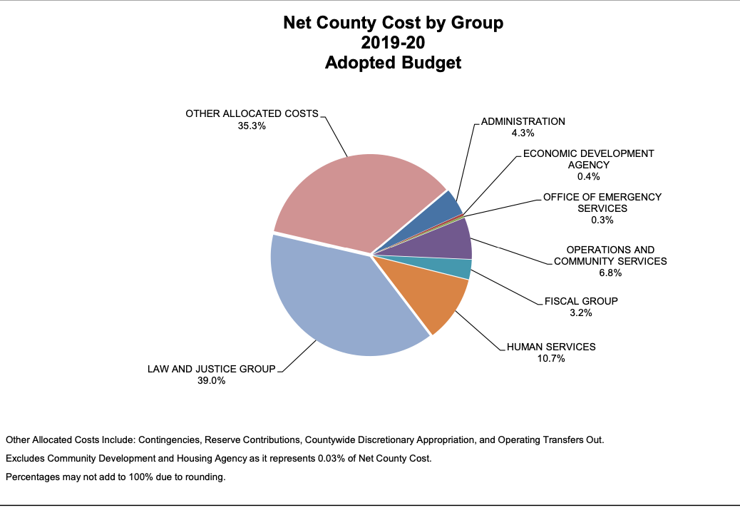
San Bernardino Discretionary Spending

Slide 11
Economy and Taxes

Slide 12
San Bernardino County Sales Tax
All Cities and unincorporated areas charge 7.75 except:
  Barstow 8.75
  Montclair 8.00
  Norton AFB 8.00
  San Bernardino 8.00
  Yucca Valley 8.75
California cap is 9.25%

Slide 13
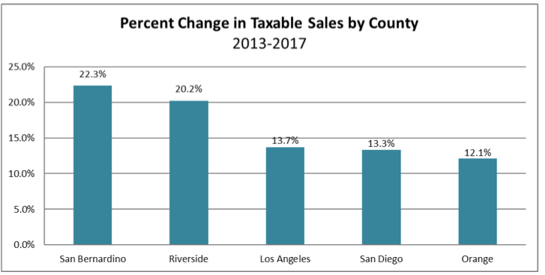
Sales Tax Growth Comparison

Slide 14
Sales Tax Comparisons
Los Angeles 9.50%
Anaheim 7.75
Santa Ana 9.25
Arcadia 10.25
Burbank 10.25
Glendale 10.25
Long Beach 10.25
San Diego County 7.75%

Slide 15
Hotel (Transient Occupancy Tax)
San Bernardino County tax for unincorporated areas is 7%
Comparisons:
  San Bernardino City 10%
  Los Angeles 15.5
  San Francisco 15.5
  Las Vegas 18.0
  Houston 17.0
  Oakland 14.0
  Anaheim 15.0

Slide 16
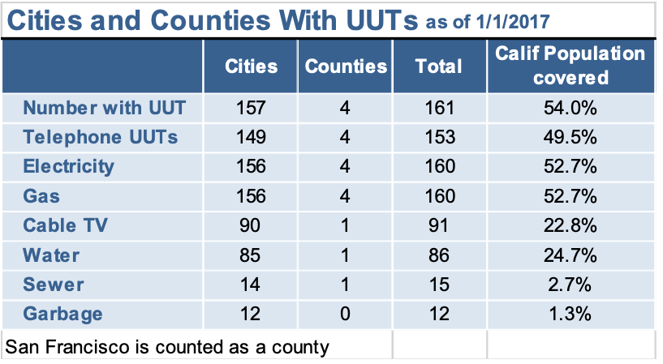
Utility Users Tax Information

Slide 17
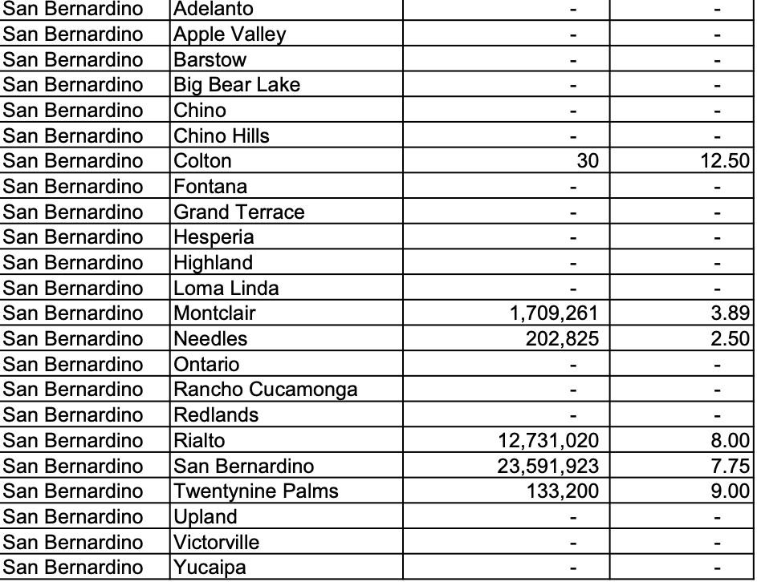
San Bernardino Utility Users Tax

Slide 18
Questions
Ed Harrington
edhrr@cs.com

