Slide 1
San Diego County Budget and Taxes

Slide 2
Budget Information

Slide 3
San Diego Key Budget Dates- 2019
2/5 Operational Plan Instructions Issued
3/20 Deadline for preliminary departmental submissions
4/19 Draft budget to CAO
5/6 Budget available to public
6/10-19 Budget Hearings
6/25 Final deliberations and adoptions

Slide 4
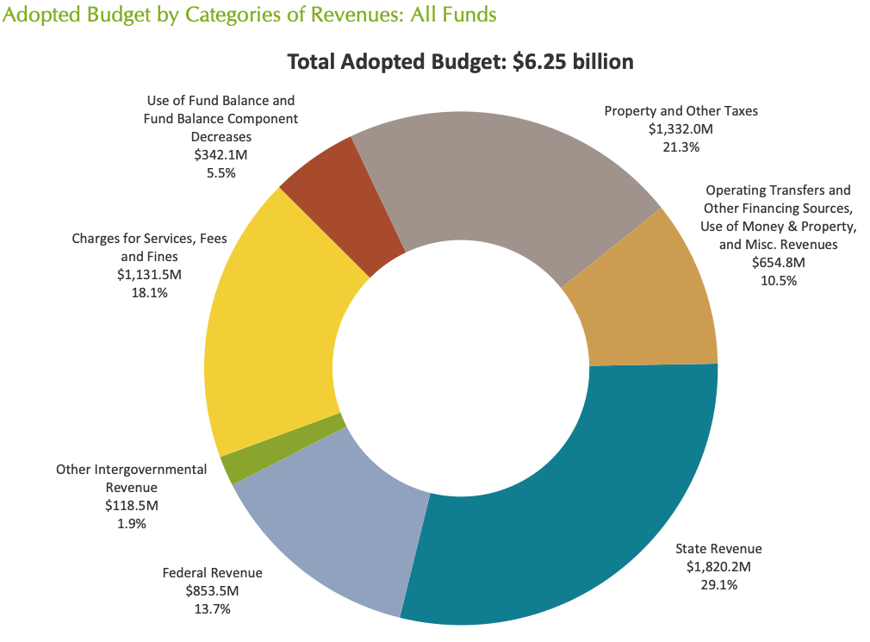
San Diego Total Budget Revenue

Slide 5
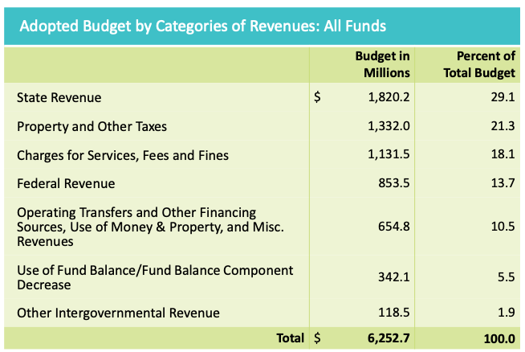
San Diego Total Budget Revenue

Slide 6
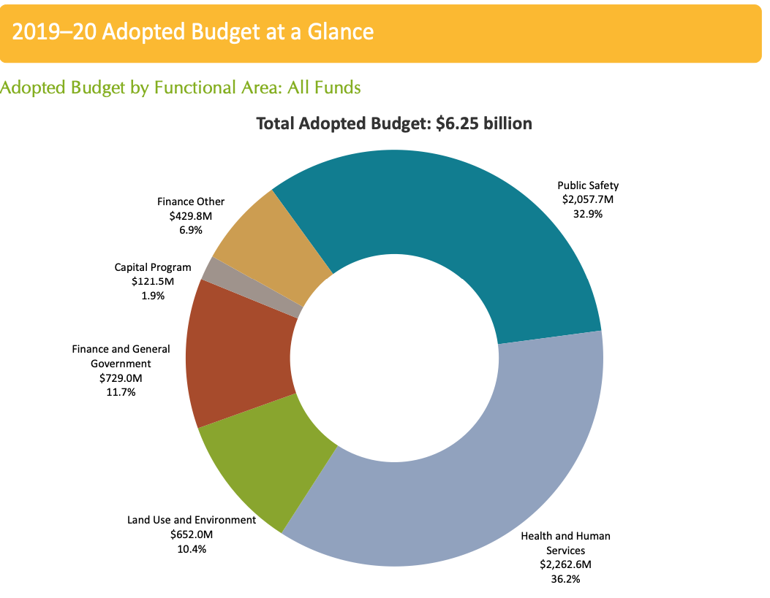
San Diego Total Budget Spending

Slide 7
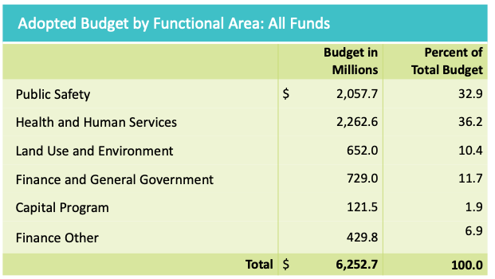
San Diego Total Budget Spending

Slide 8
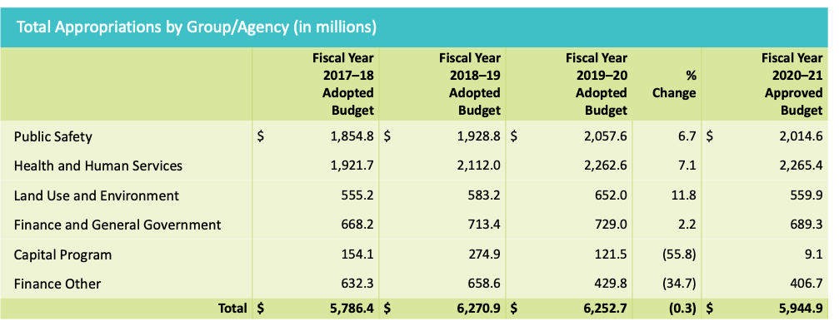
San Diego Total Spending History

Slide 9
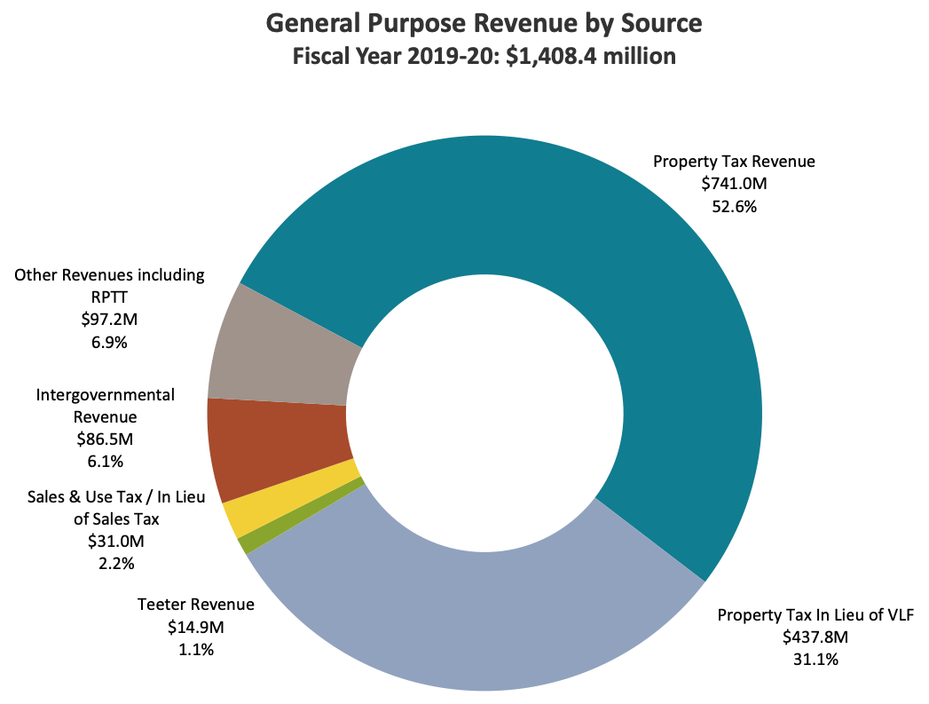
San Diego Discretionary Budget Sources

Slide 10
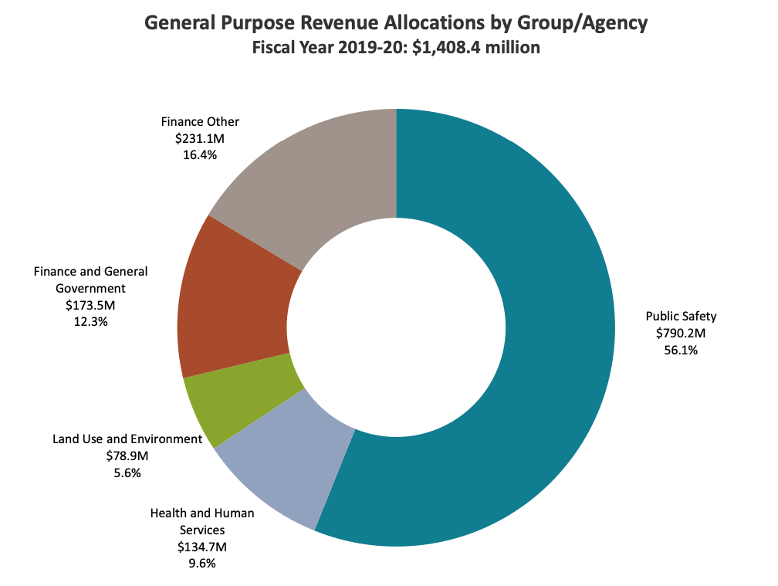
San Diego Discretionary Spending

Slide 11
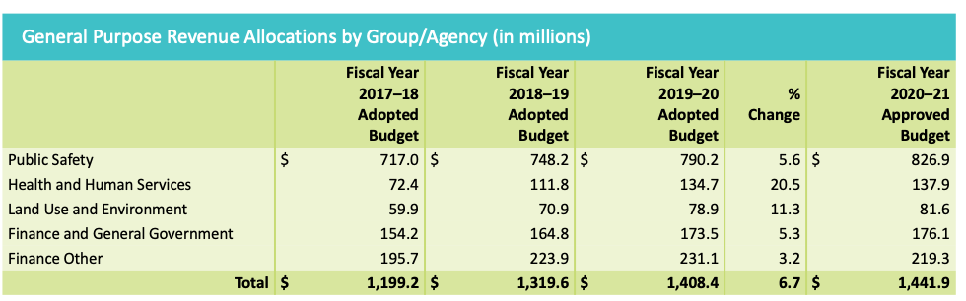
San Diego Discretionary Spending

Slide 12
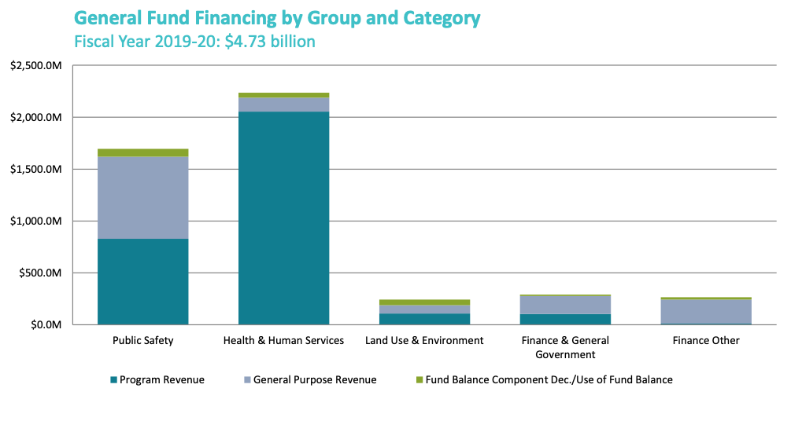
Where do local dollars go?

Slide 13
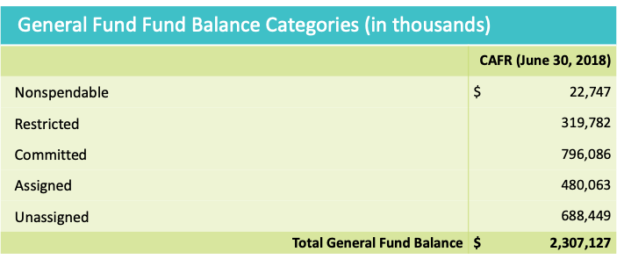
San Diego Fund Balances

Slide 14
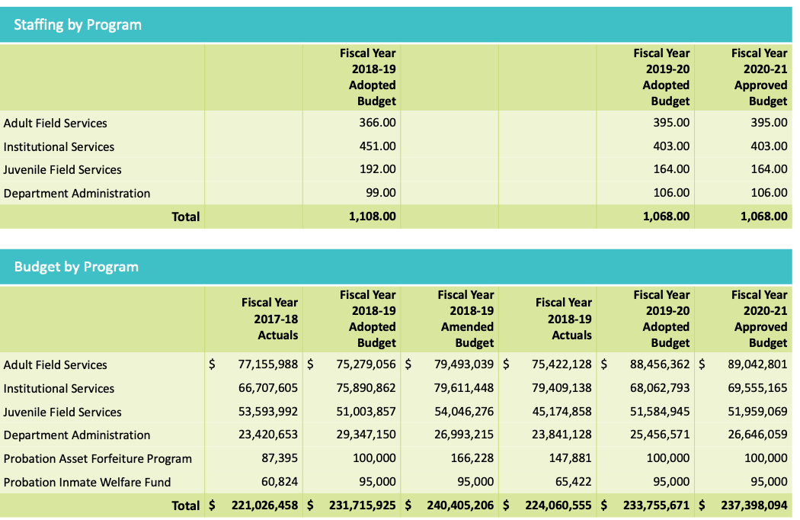
San Diego Probation Department Staffing and Budget

Slide 15
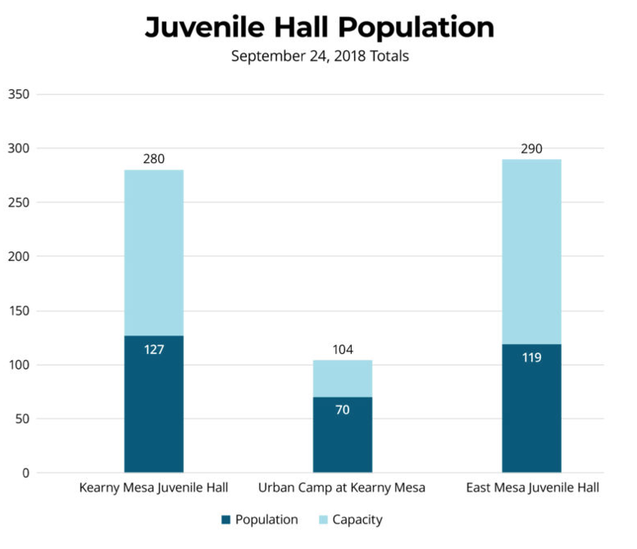
Juvenile Hall Population
Voice of San Diego

Slide 16
Economy and Taxes

Slide 17
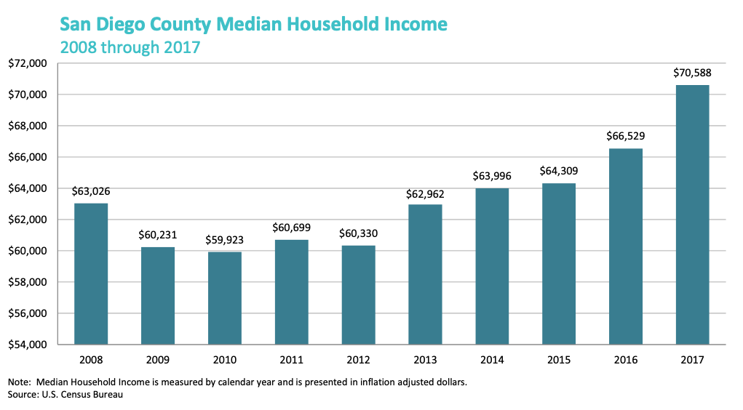
San Diego Household Income

Slide 18
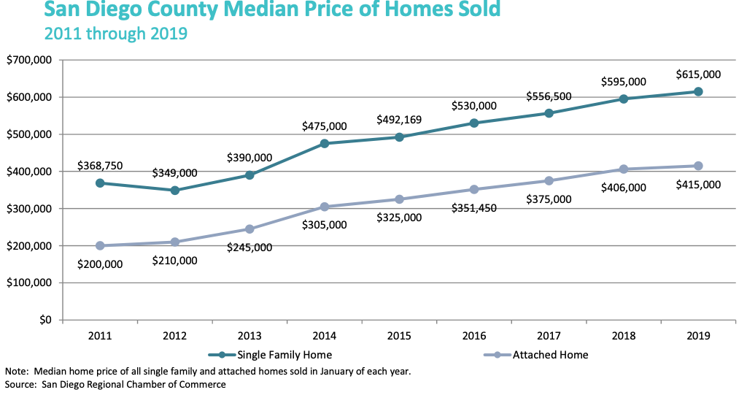
San Diego Growth in Home Prices

Slide 19
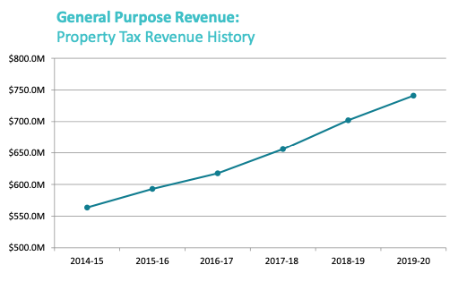
San Diego Property Tax Growth

Slide 20
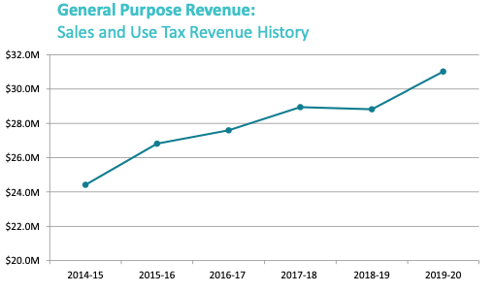
San Diego Sales Tax Growth

Slide 21
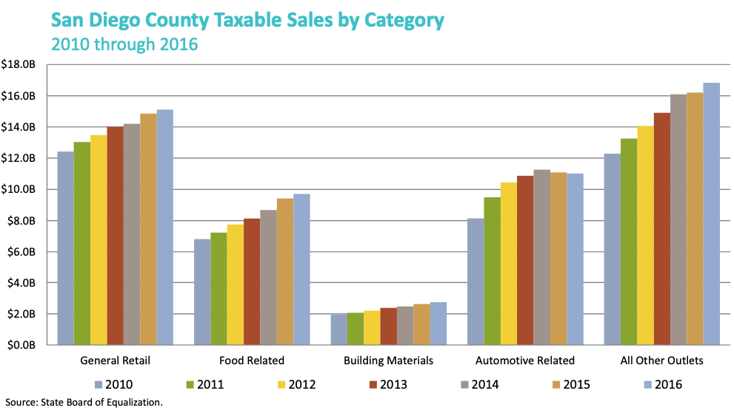
San Diego Sales Tax Information

Slide 22
San Diego County Sales Tax
All Cities and unincorporated areas charge 7.75 except:
  Chula Vista 8.75
  Del Mar 8.75
  El Cajon 8.25
  La Mesa 8.50
  National City 8.75
  Oceanside 8.25
  Otay 8.75
  San Luis Rey 8.25
  Vista 8.25
California cap is 9.25%
Countywide tax increase of .5% could bring in $300 million (Double check)

Slide 23
Sales Tax Comparisons
Los Angeles 9.50%
Anaheim 7.75
Santa Ana 9.25
San Bernardino 8.00
Arcadia 10.25
Burbank 10.25
Glendale 10.25
Long Beach 10.25
San Diego County 7.75%

Slide 24
Hotel (Transient Occupancy Tax)
San Diego County tax for unincorporated areas is 8%
Comparisons:
  San Diego City 10.5---12.5%
  Los Angeles 15.5
  San Francisco 15.5
  Las Vegas 18.0
  Houston 17.0
  Oakland 14.0
  Anaheim 15.0

Slide 25
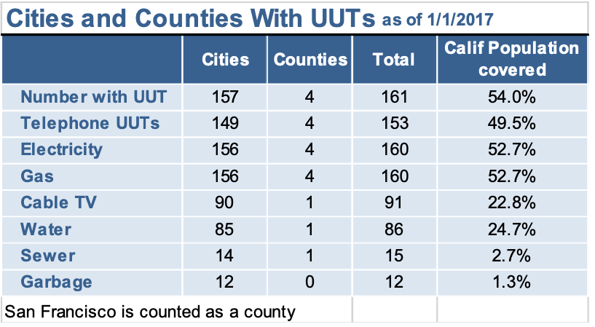
Utility Users Tax Information

Slide 26
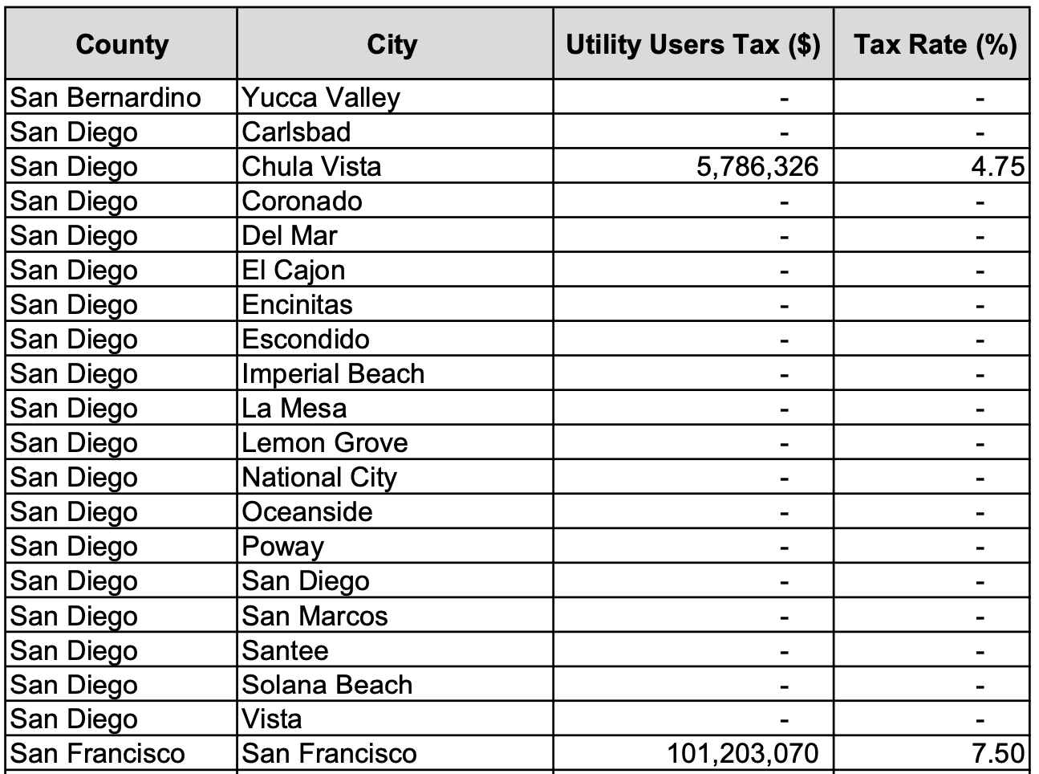
San Diego Utility Users Tax

Slide 27
Questions
Ed Harrington
edhrr@cs.com

