Slide 1
GETTING LOCAL DOLLARS FOR EARLY CARE AND EDUCATION: STRATEGIES, CHALLENGES, LESSONS, NEW DIRECTIONS
Margaret Brodkin, Director Funding the Next Generation
Amy Reisch, First 5 Marin Children and Families Commission
Kristen Spanos, CEO, First 5 Alameda County
Francine Rodd, Executive Director, First 5 Monterey County
Gina Daleiden, Executive Director, First 5 Yolo County
Alethea Arguilez, Executive Director, First 5 San Diego
Angie Dillon-Shore, Executive Director, First 5 Sonoma County
Erin Gabel, Deputy Director, External and Government Affairs, First 5 California
Margot Grant Gould, Policy Director, First 5 Association of California
FEB. 4, 2020
FIRST 5 SUMMIT, IRVINE, CALIFORNIA
Will be posted on funding the next generation website

Slide 2
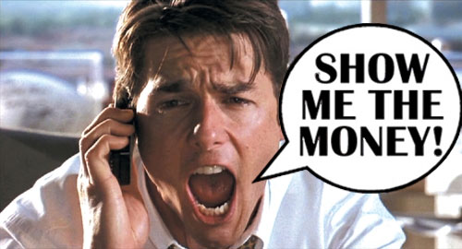
THE TRUTH ABOUT SUSTAINABLE FUNDING
How we spend our money reflects our values.
Achieving good outcomes for kids costs money.
Funding inequity is a social justice issue.
The real money is in the public sector – NOT in grants.
Acting locally has great potential.
CHLDREN’S FUNDS IN U.S.

Slide 3
FIRST 5’S CAN BUILD THE SKILLS AND POLITICAL CAPITAL TO PLAY A POWERFUL ROLE IN PUBLIC FINANCE DECISIONS
CHALLENGES
History of reliance on state funding - Little need for local revenue advocacy
Focus on primary role as funder, less experience working to change local public policy
Inexperience with collective action to address local revenue issues
Unique and challenging role – both inside and outside government
OPTIONS
Work in coalition with advocacy groups/advocates
Help form an “outside” organization
Cultivate insider political champions
Push from the inside
Move outside government
Be as bold as possible – don’t be intimidated

Slide 4
ONLY 2 WAYS TO GET PUBLIC DOLLARS
Each strategy has built-in resistance.
1. Reallocate existing dollars
2. Generate new dollars
Three arenas
Budget process
Legislative policies
Ballot
.

Slide 5
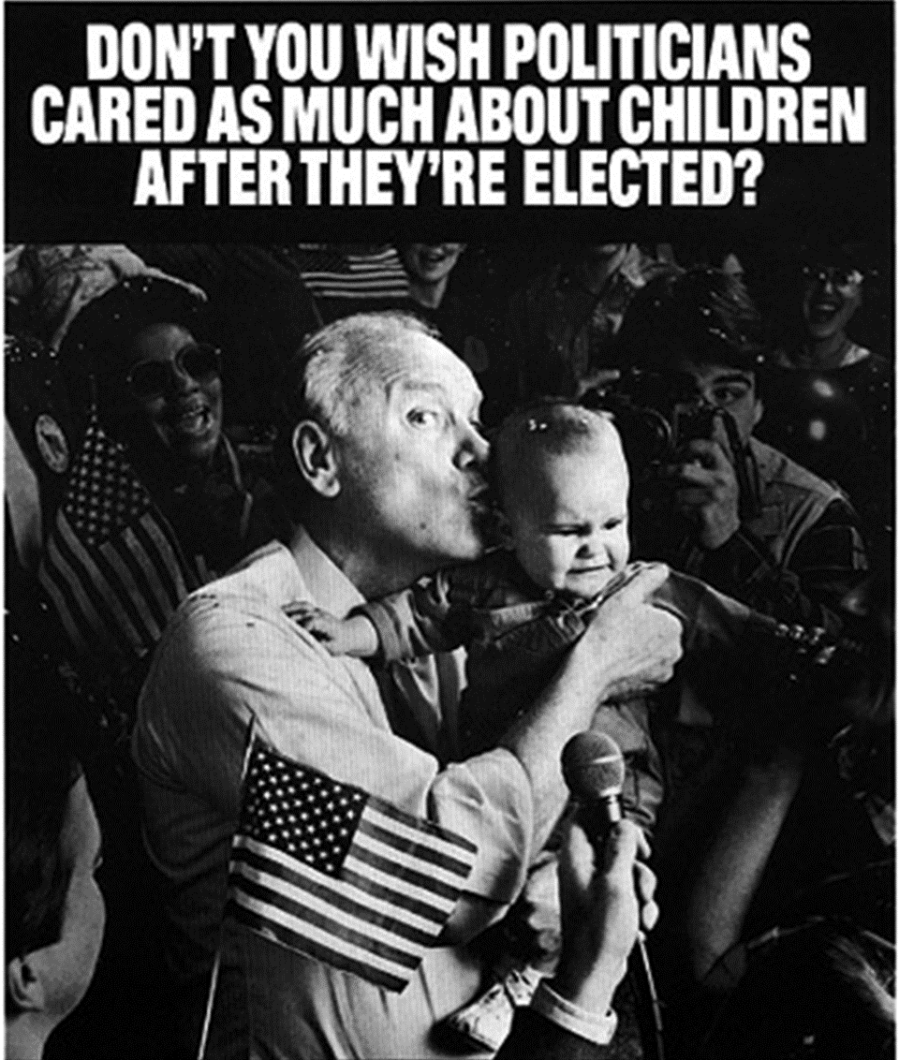
CHALLENGES IN CHANGING BUDGET PRIORITIES
PRESERVING THE STATUS QUO
SACRED COWS
TURF
NEVER THE RIGHT TIME
NEVER THE RIGHT APPROACH
NO NEW MONEY
PENSION COSTS
PURPOSEFUL MYSTIFICATION

Slide 6
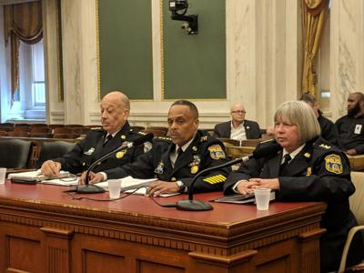
CBO’S, COMMUNITY ADVOCATES, GENERAL PUBLIC ARE NOT PREPARED FOR BUDGET BATTLES
WHO IS PREPARED?
BUREACRATS – city agency directors, city finance experts, administrators
UNIONS - particularly public safety unions
CORPORATIONS – and others with financial power
ENTRENCHED INTERESTS – already in budget

Slide 7
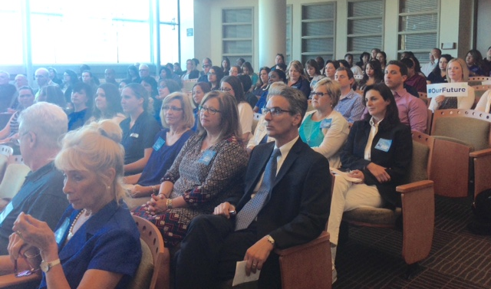
LOCAL BUDGET PROCESS
REALLOCATING EXISTING DOLLARS – WHERE TO GET THE MONEY
General budget request – no specific revenue source identified
Carve-out of new funds – e.g. increases in general fund, cannabis or realignment
Realignment of realignment $ – exploit flexibility in child welfare and behavioral health
Unexpended dollars – e.g. mental health services act
Target low priority items for reallocation
Moving funds from punishment to prevention – e.g. juvenile halls
Pilot projects

Slide 8
LOCAL POLICIES
CAN BE ON THE BALLOT – OR PASSED LEGISLATIVELY
EXISITING OR NEW DOLLARS
Set-asides of existing dollars – e.g. SF PFA, Oakland Fund for Children, Sacramento Fund
Mitigations for making money, saving money or impacting a community – development impact fees, development agreements, community benefit agreements, PILOT (payment in lieu of taxes) i.e. hospitals – Most are city strategies.
In-kind resources – facilities funds, loan funds, free admissions to city/county programs/facilities
Work with community development agencies and housing developers.

Slide 9
CITY AND COUNTY TAXES
MUST BE ON THE BALLOT
Can be General or Special taxes
Sales - combined limit 2% add-on to base of 7.5% - done in 1/8 cent increments
Real estate transfer – can be made progressive by increasing with value of property
Parcel – can be based on size of parcel, and can have many exceptions – always a special tax
Business - gross receipts, car rental, parking
Utility (UUT) – gas, water, sewer, cable, phones
Hotel – Transient Occupancy Tax (TOT) – ranges from 8 – 14%
Marijuana – Cultivation, Manufacturing, Sales – can be passed by a percentage range
Admission – Parks, Sporting events, Concerts, etc.
Some taxes are cities/county unincorporated areas only, i.e. business, UUT, marijuana, admission

Slide 10
SAN FRANCISCO CHILDREN’S FUND SOTYR
Notes:
1., change LA Co0….to Greater LA Summer Matters Network
2 add 2018 to the date

Slide 11
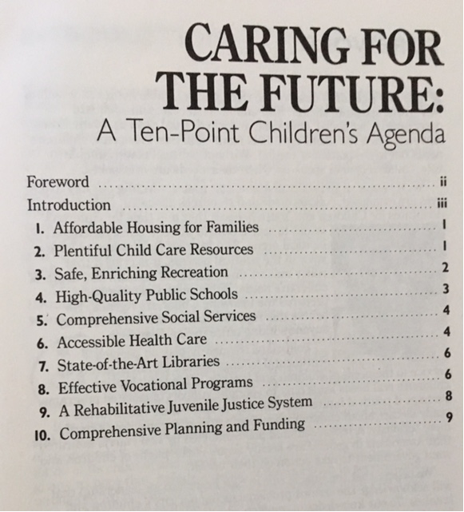
The First Lesson
RHETORIC RESOURCES
Children’s agenda – passed by Board of Supervisors, signed by Mayor

Slide 12
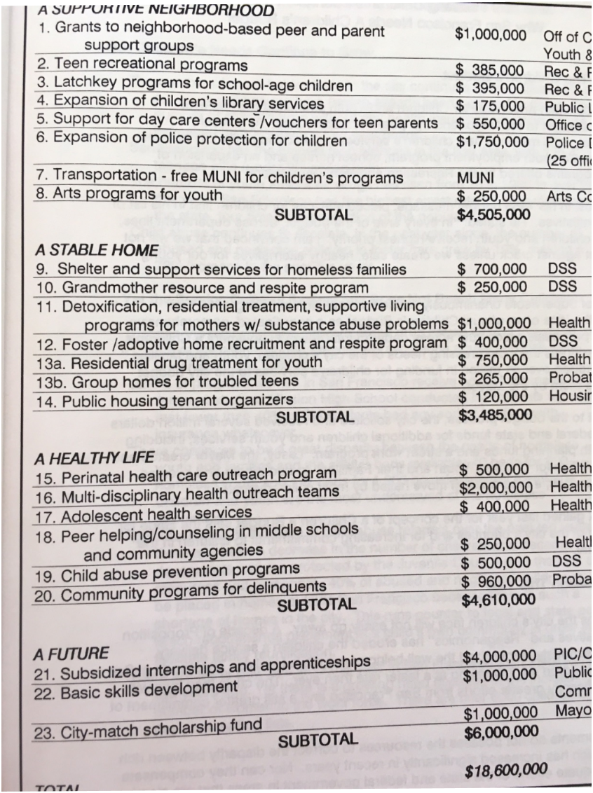
ORGANIZING AND SPECIFICITY
Formed Children’s Budget Coalition – 120 agencies
Submitted Children’s budget 3 consecutive years

Slide 13
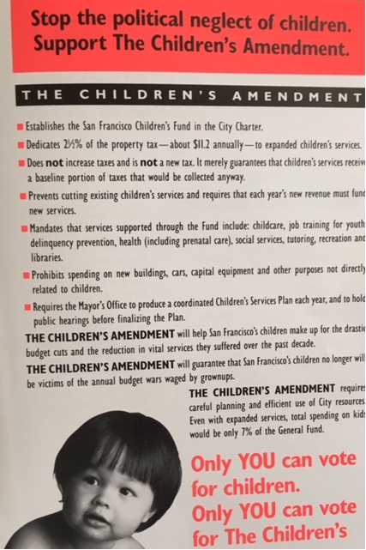
Amending the City Charter
INVENTING THE CHILDREN’S FUND
Institutionalizing funding for kids – annual set-aside of property tax
Protecting existing funding – Children’s baseline

Slide 14
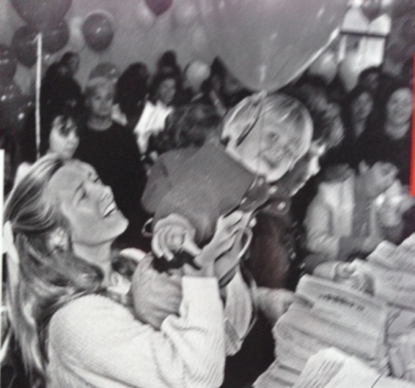
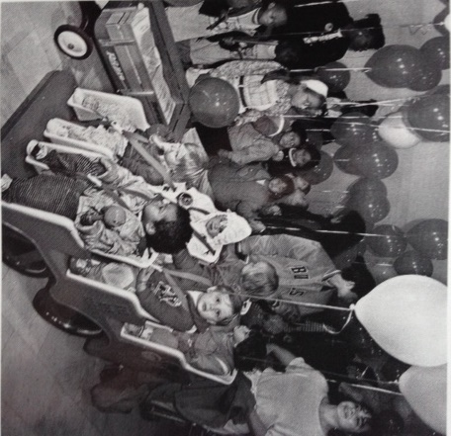
GOING TO THE PUBLIC Circumventing City Hall
68,000 signatures Power
Elections are powerful – the magic of local campaigns
Take the initiative – frame the issue
Political hardball is essential
Propose a solution
“Never doubt that a small group of committed citizens can change the world. Indeed it is the only thing that ever has.” – Margaret Mead

Slide 15
BENEFITS OF THE SAN FRANCISCO CHILDREN & YOUTH FUND
OUTCOME HAS BEEN TRANSFORMATIVE
Focus on prevention
Expanded opportunities for children, youth, families
Powerful department in local government for planning, coordination, accountability, transparency, and community engagement
Policy and systems reform – enabled by discretionary funds and local office for children’s issues
Leveraging of other dollars
Youth leadership in City Hall
Children’s constituency empowered
NOTE: RETURN ON INVESTMENT WAS HUGE.

Slide 16
ADVOCACY TIPS
Notes:
1., change LA Co0….to Greater LA Summer Matters Network
2 add 2018 to the date

Slide 17
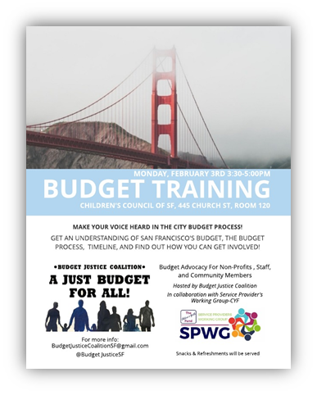
WHERE TO START: UNDERSTANDING THE BUDGET
WHEN TO GET INVOLVED
IN BUDGET PROCESS
Year-Round
Budget instructions to departments
Department planning
Negotiations with county executive
Mid-year fiscal reports to Board of Supervisors – study sessions
Community meetings
Hearings at Board of Supervisors
Is your goal something local government can do?
Do you understand the process and where you can intervene.
What are current budget expenditures?
What is the competition for dollars?
Do you have ideas for a funding source?

Slide 18
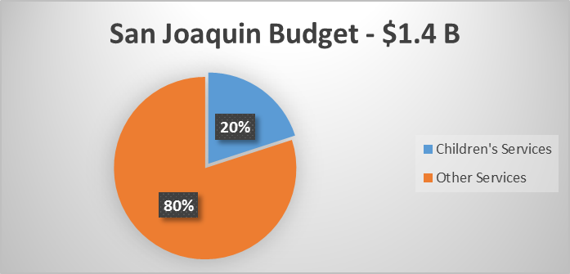
MAKING THE CASE WITH BUDGET STATISTICS IN SAN JOQUIN

Slide 19
ONLY .1% OF SAN JOAQUIN’S DISCRETIONARY DOLLARS GO TO PREVENTION SERVICES FOR CHILDREN.

Slide 20
Roadmap to Influence Local Fiscal Policy
NO LINEAR PATH
1. Making the case
2. Crafting the “ask”/proposal
3. Building the base
4. Mounting the campaign

Slide 21
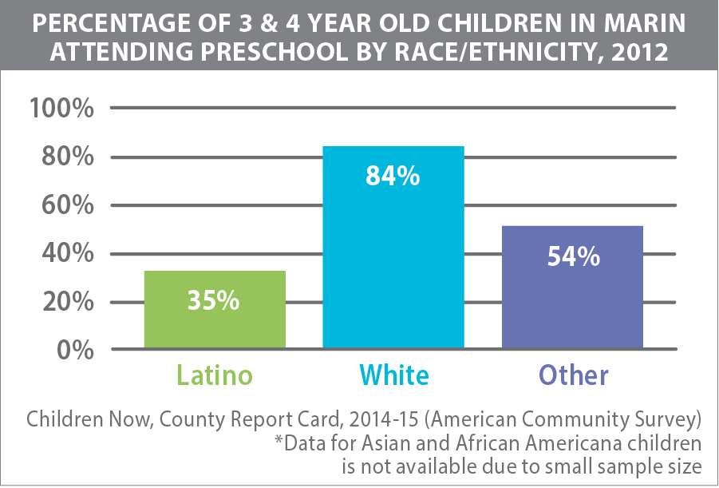
1. MAKING THE CASE
Document need Report Card on state of kids
Build a consensus agenda Bill of Rights
Develop a fiscal map of current funding A Children’s Budget
Communicate cost-benefits to public and policymakers
ONE STRATEGY: Create county task force on children

Slide 22
CREATING A CHILDREN’S BUDGET
A LANDSCPE AND ANALYSIS OF EXPENDITURES FOR CHILDREN
Prevention vs. Rehabilitation
Changes over the years
Compared to other expenditures and overall budget
How much is discretionary

Slide 23
Economic Impact of Child Care Industry in San Francisco Generates $191 M annually Provides 4,415 jobs annually Enables parents to work Prepares future generations for the workforce.

Slide 24
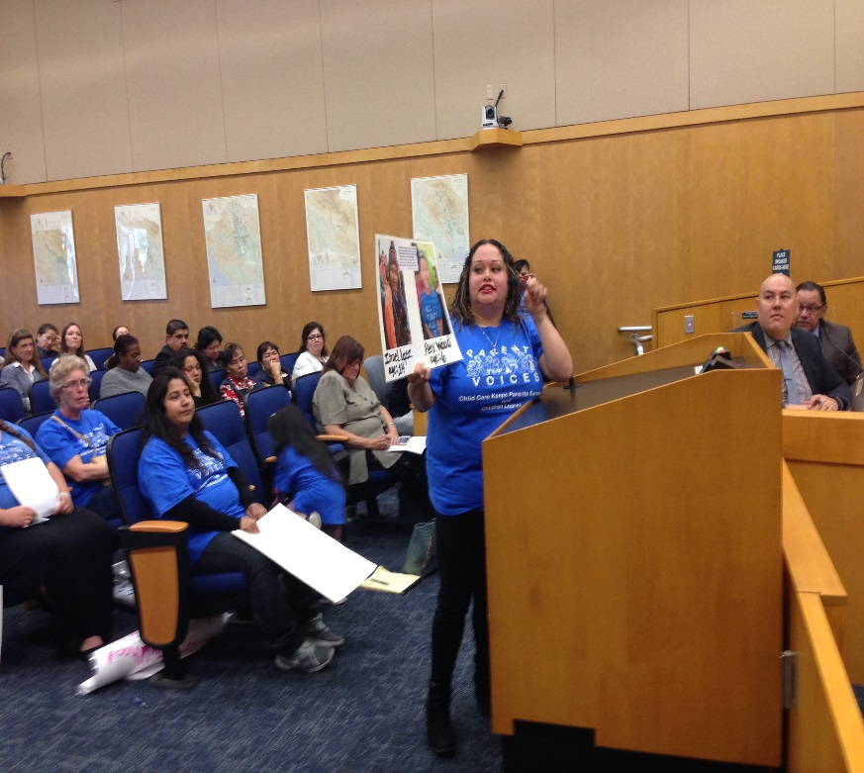
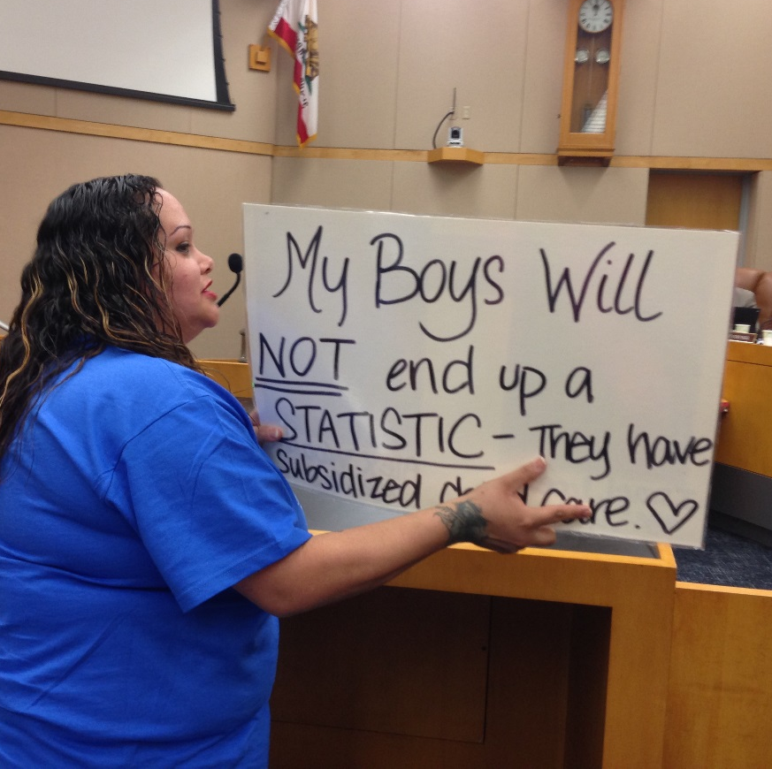
COMMUNICATING THE NEED
Reports have a place, but they don’t change budgets alone.
Decision-makers have short attention spans.
1 - 3 minutes is all you get in public hearings.
Avoid jargon and too much data.
Tell stories.
Make it personal.
Authentic voices of parents are powerful.

Slide 25
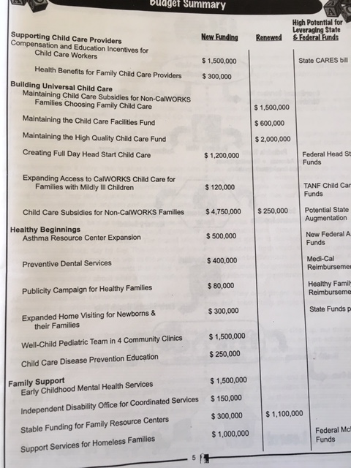
2. CRAFTING A PROPOSAL
Make proposal concrete.
What is the cost?
What program?
Who will be served?
Documentation of need
Potential outcomes?

Slide 26
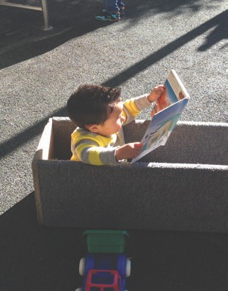
WHAT TO CONSIDER IN MAKING DECISIONS ABOUT FUNDING STRATEGY?
Be open to unexpected opportunities – and compromises
WHAT DO YOU WANT FUNDED?
Gaps in services – priority needs
LEGAL CONSIDERATIONS
Options and constraints
POLITICAL CONSIDERATIONS
Political feasibility and public opinion
Political champions and allies
Strength of opposition
Visible outcome
Builds political capital
ORGANIZATIONAL CONSIDERATIONS
Consensus of sponsoring coalition
Potential volunteers
Potential to rally parents and constituents
Resources of advocates
BIG ENOUGH TO MATTER
SMALL ENOUGH TO WIN

Slide 27
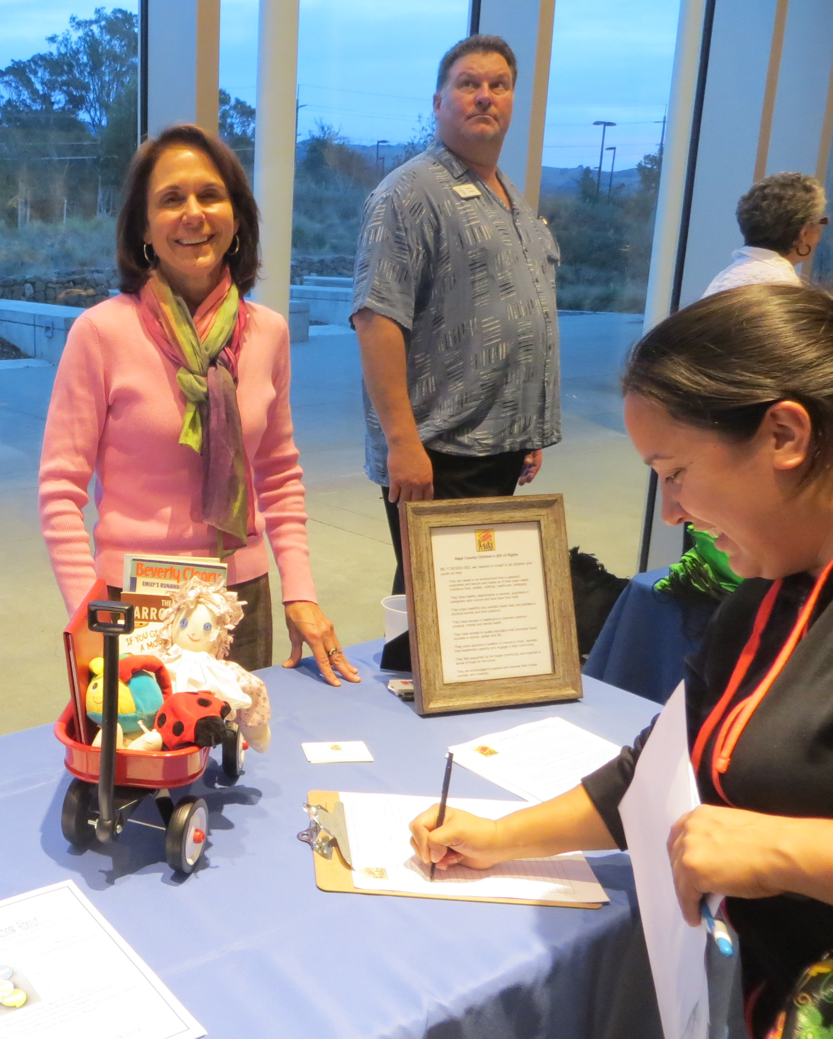
3. BUILDING THE BASE
DEVELOP A HUGE MAILING LIST
Outreach to community groups
Utilize Social Media
Conferences and public forums
Mailings and newsletters
Public events to speak out for kids
Form or join coalitions

Slide 28
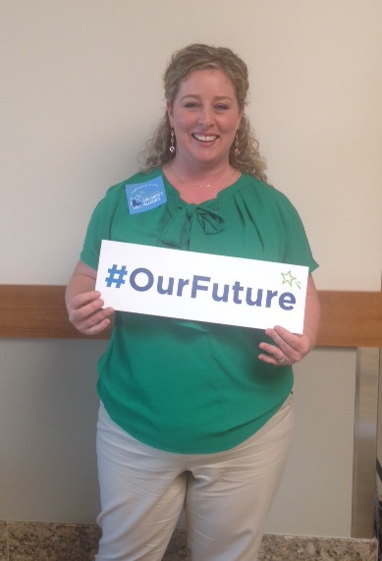
Coalitions can include individuals or organizations, including businesses, religious organizations, allied children’s organizations, parents, elected officials, community activists, labor, community foundations, civic organizations.

Slide 29
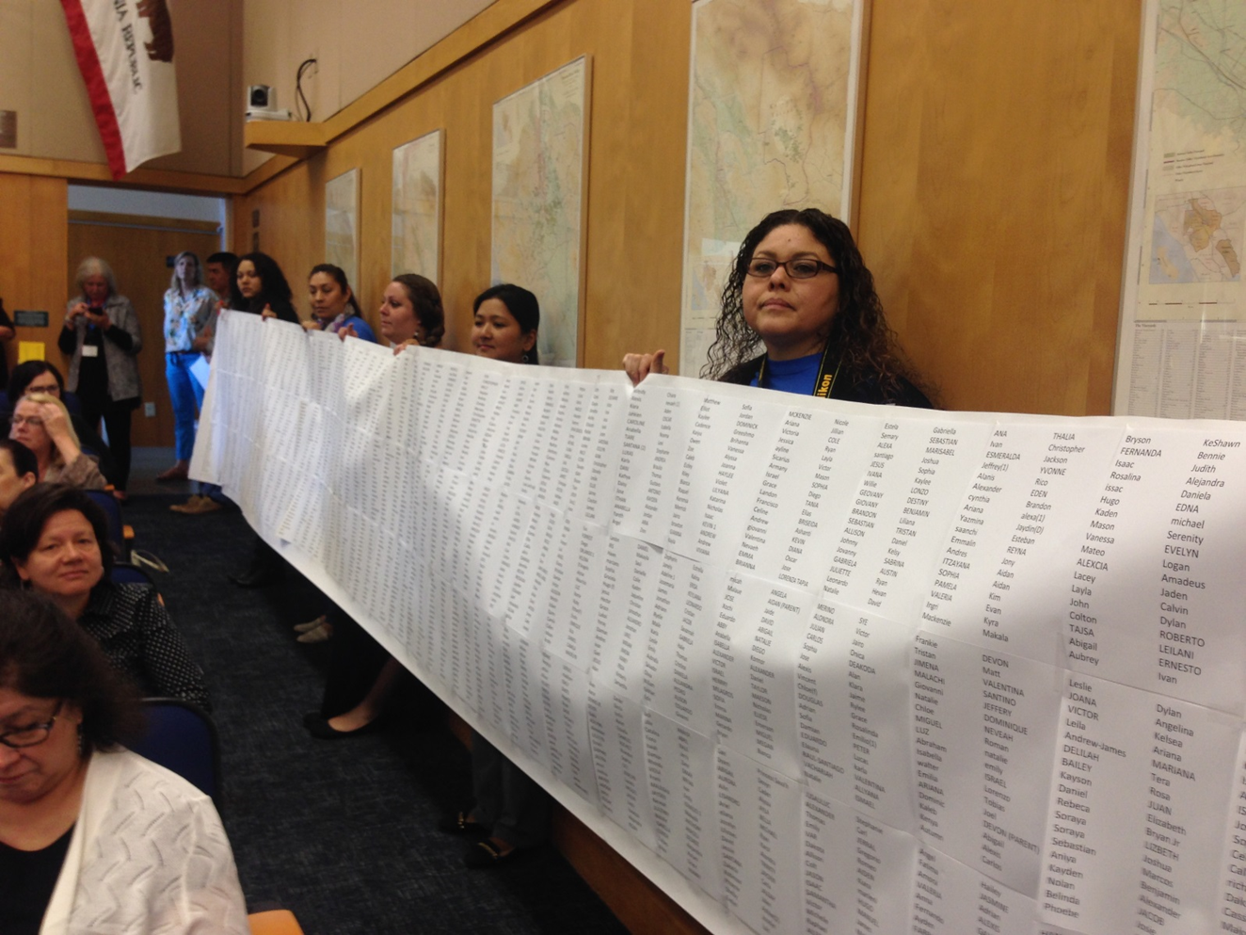
4. MOUNTING A CAMPAIGN
PERSUASION AND PRESSURE
TRADITIONAL TACTICS – reports, meetings, letters, testimony, op-eds, site visits, calls
POLITICAL HARDBALL – demonstrations, sit-ins, petitions, public challenges and direct criticism, guerilla theatre, press events, withdrawal of political support, circumventing the traditional process

Slide 30
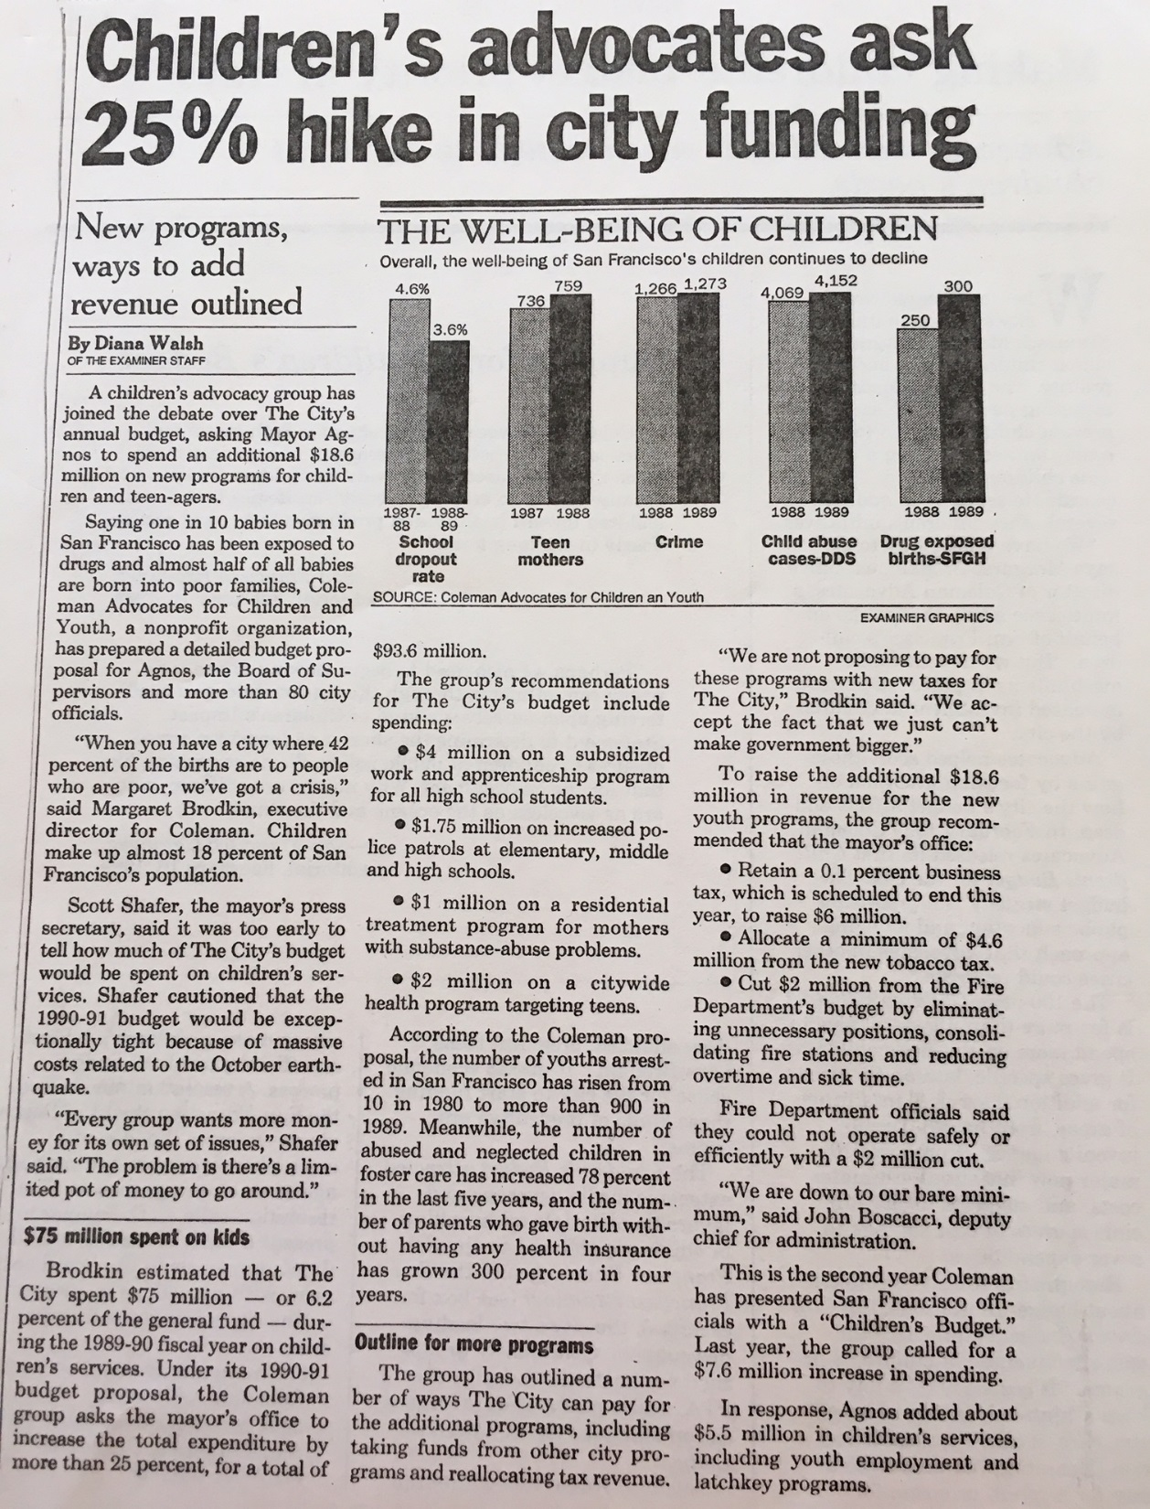
USE THE MEDIA
HAVE A SIMPLE MESSAGE
Press conferences
Op-eds
News releases
Feature stories
Follow the c’s – crisis, conflict, constumes, celebrities
Find a news hook.
OFTEN MORE IMPORTANT TO TALK TO THE MEDIA, THAN DIRECTLY TO DECISION-MAKERS.

Slide 31
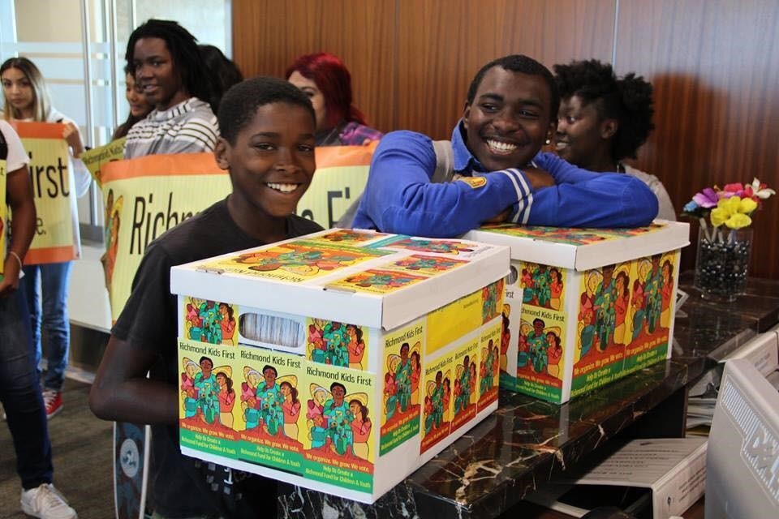
Elections are Great Opportunities
Candidate forums
Candidate questionnaires
Educating candidates
Placing measures on ballot

Slide 32
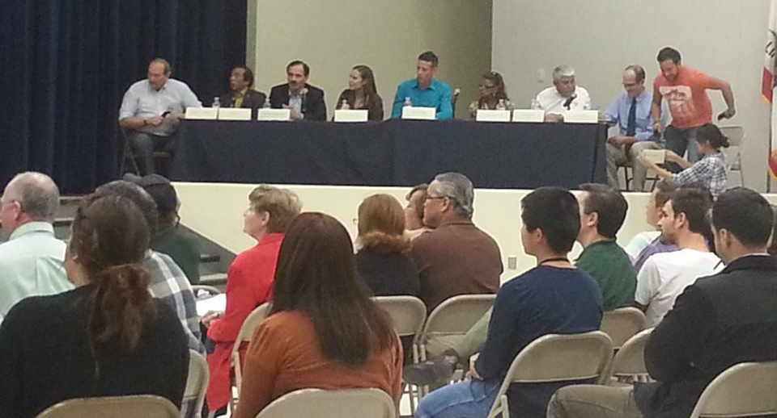
REFORM THE PROCESS
Creating accessible forums for public input at all levels and at all points in the process
Creating access to decision-makers
Empowering the legislative body
Strengthen budget policy support
TRANSPARENCY, TRANSPARENCY, TRANSPARENCY

Slide 33
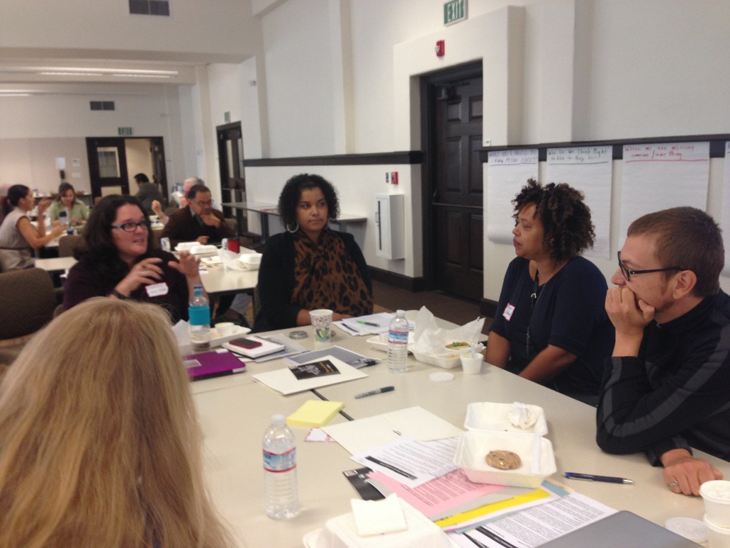
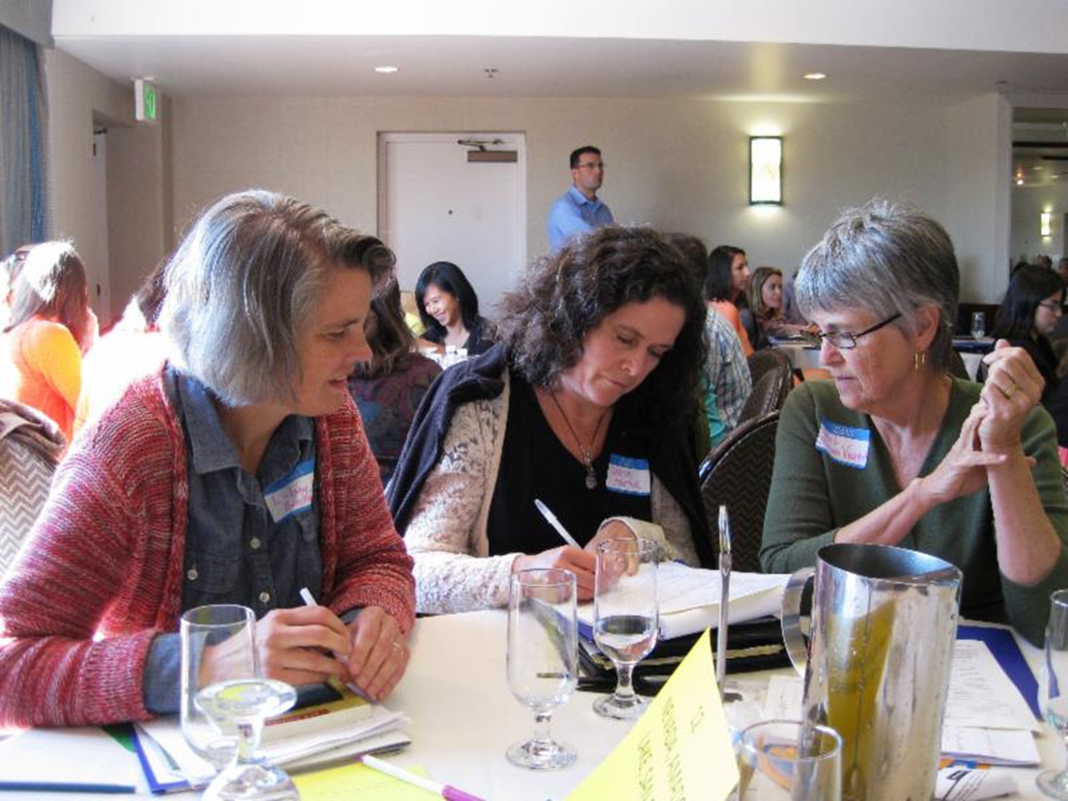
MAKING REVENUE ADVOCACY A PART OF YOUR WORKPLAN
STAFF IS ESSENTIAL.
Lack of staff is biggest barrier to moving forward.
Staff can mobilize the resources of a network and ensure ongoing momentum:
Research
Convene meetings
Develop materials
Train parents, volunteers
Liaison with decision-makers
Outreach to media
Build the coalition

Slide 34
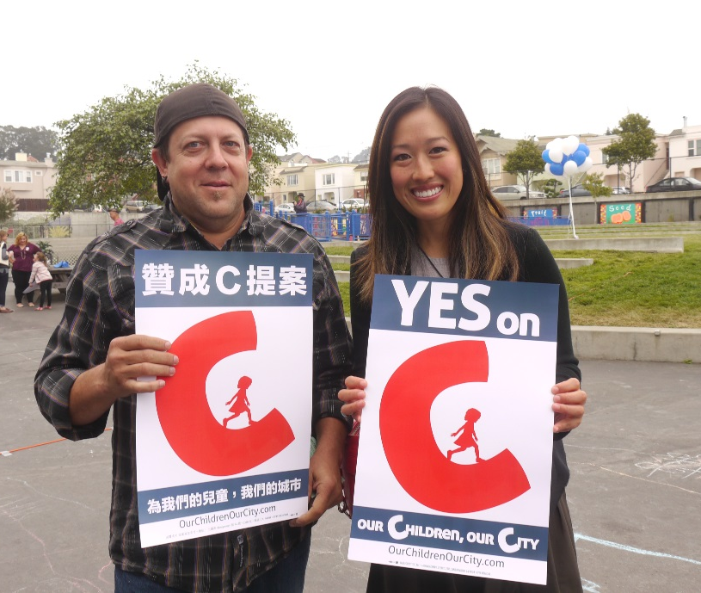
An Emerging Movement
CHILDREN’S FUNDS IN U.S.
All ages – San Francisco, 8 counties in Florida, Seattle, Portland, Oakland, Baltimore, King County
Preschool – Denver, San Antonio, San Francisco, Cincinnati, Kent County
Violence Prevention – Little Rock, San Bernardino, Oakland, Santa Rosa
Mental health – 8 counties in Missouri, 3 counties in Ohio
Soda – Philadelphia, San Francisco, Oakland, Albany, Berkeley, Boulder
Notes:
1. Just note where King County is Ca?

Slide 35
ELECTIONS 2016 & 2018: WHAT HAPPENED?
NAPA – 45%
MARIN – 63%
SOLANO – 59%***/45%
SACRAMENTO – 65.8%
RICHMOND – 76, 65, 63%***
ALAMEDA – 66.2%
SAN FRANCISCO – 50.9%**
OAKLAND – 61.8%**
SAN JOQUIN COUNTY – 63.5%
CAPITOLA – 75%***
Notes:
delete

Slide 36
FIRST 5 EXAMPLES
Notes:
1., change LA Co0….to Greater LA Summer Matters Network
2 add 2018 to the date

Slide 37
THE MARIN STORY
Essential element: Marinkids, a coalition of organizations and local leaders
Critical to building the case
Got broad buy-in for a children’s agenda
Neutral player with no hidden agenda
Shepherded public education on children issues
Produced Action Guide – used by providers and policy folks
Grassroots and Grass tops represented
CHALLENGE: Became too grass-tops, risk-averse, timid
2009 - Formed MarinKids
Debated options for local revenue
2012 – Decision to create sales tax measure – WHY: survey by Parent Voices, promising polls, support from Board of Supervisors
Developed Governance and Spending plan.
2014 - Postponed putting measure on 2014 ballot due to competing public safety measure
2016 - Supervisors placed on ballot – conducted traditional campaign
Created campaign committee – Strong Start
Lost with 63% of vote. WHY?
Bottom of ballot Focus on Presidential
Not enough $ Not universal

Slide 38
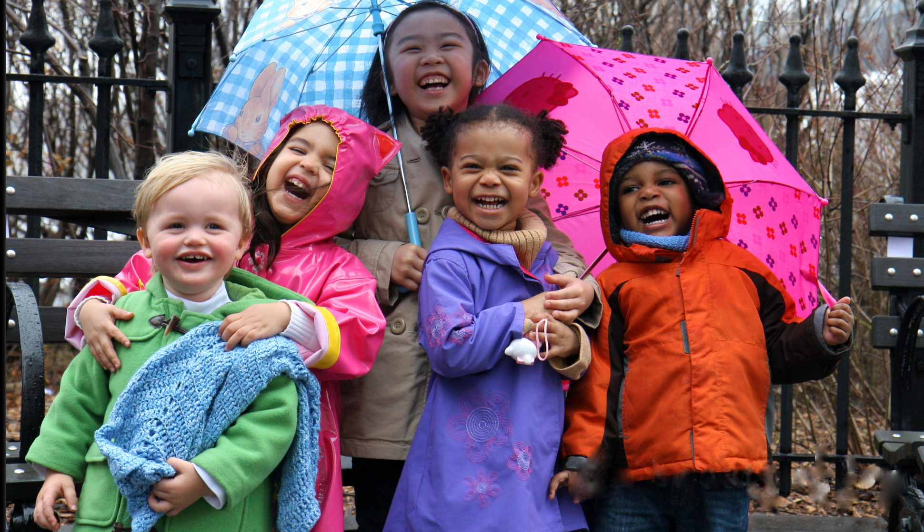
Alameda County Children’s Health and Child Care and Initiative (Care for our Kids) – Measure C
County-Wide Half-Percent Sales Tax Measure, (2nd attempt); Election March 3rd, 2020
Estimated $150 million/year new funding for Child Care & Early Education (80%) & Children’s Hospital Trauma Center (20%)
Community Driven (Parent Voices, Resource & Referral Agencies, Labor, UCSF Benioff Children’s Hospital Oakland, Providers and ECE stakeholders) with community accountability, First 5 Alameda identified as Administrator of the 80% ECE Fund
Increases access to new enrollments and enhancing rates to support quality care for participating providers, ensuring teacher wages at a min. of $15 with annual increase

Slide 39
Alameda County Children’s Health and Child Care and Initiative (Care for our Kids) – Measure C
Challenges:
Negotiating and compromising across stakeholders in development of a codified ordinance
Readying the system for an infusion of funding
Administrative organization (e.g. office space, financial modeling, technology, staffing growth, contracts)
Across the field with stakeholders (e.g. workforce, facilities, reporting, technology, outreach & recruitment)
Lessons Learned:
Clear understanding and articulation of community need, and policy opportunity…use KRA research
Articulate administrative competency (e.g. financial management, contract administration, programmatic expertise)

Slide 40
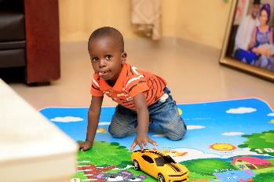
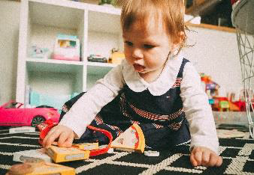
Coalition Engaged With:
The Chicano Federation
Cajon Valley Union School District,
Early Childhood Programs
Child Development Associates (CDA)
Children’s Paradise Preschool & Infant Centers Inc.
Coronado Unified School District
Educational Enrichment Systems (EES)
Escondido Community
First 5 San Diego
Child Development Center
The San Diego Foundation
Neighborhood House Association
Metropolitan Area Advisory Committee
Grossmont College
Higher Learning Academy
Parent Voices San Diego
Man. Empire Unified School District
San Ysidro School District
San Diego for Every Child
San Diego County Office of Education
San Diego Workforce Partnership
SAY San Diego
South Bay Union School District
YMCA Childcare Resource Service
SAN DIEGO ECE COALITION
Came together to influence CA budget decisions last spring.
Key coalition supporters and partners included the community foundation, political champions, and workforce sector.
Organic next step: What to do collectively in San Diego for our sustainability.
Built on synergy from past initiatives, new research and media attention which created a new urgency across sectors and with elected officials.
Coalition established its first budget priority – addressing loss of Quality Preschool Initiative – asking for $3.4M would go through First 5.
In February, began strategy to influence local budget – addressing Board of Supervisors for addition to local budget.
Campaign plans include letters, meetings, testimony.
Unique role of First 5 in budget advocacy – what to consider.
Coalition members “are all passionate about the families we work with, and genuinely enjoy each other.”

Slide 41
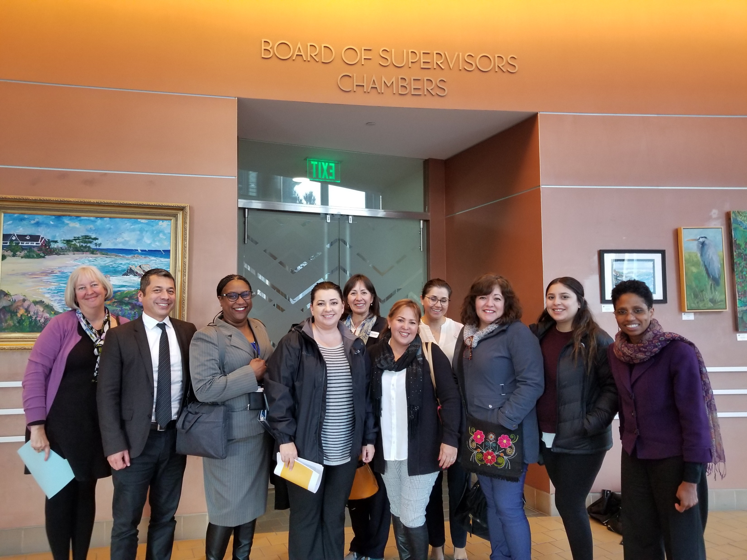
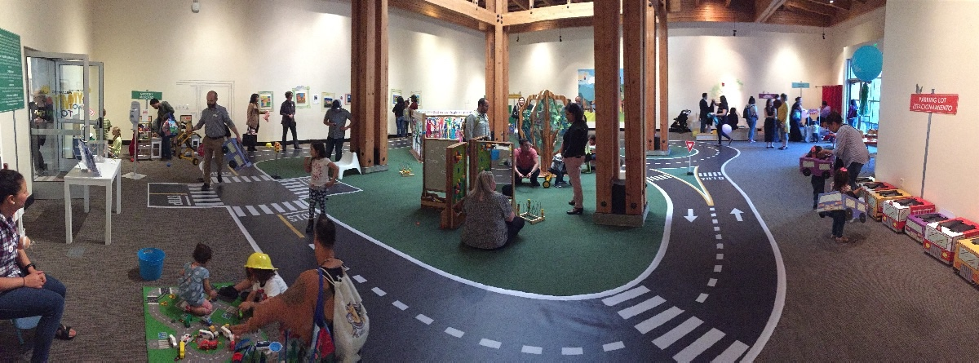
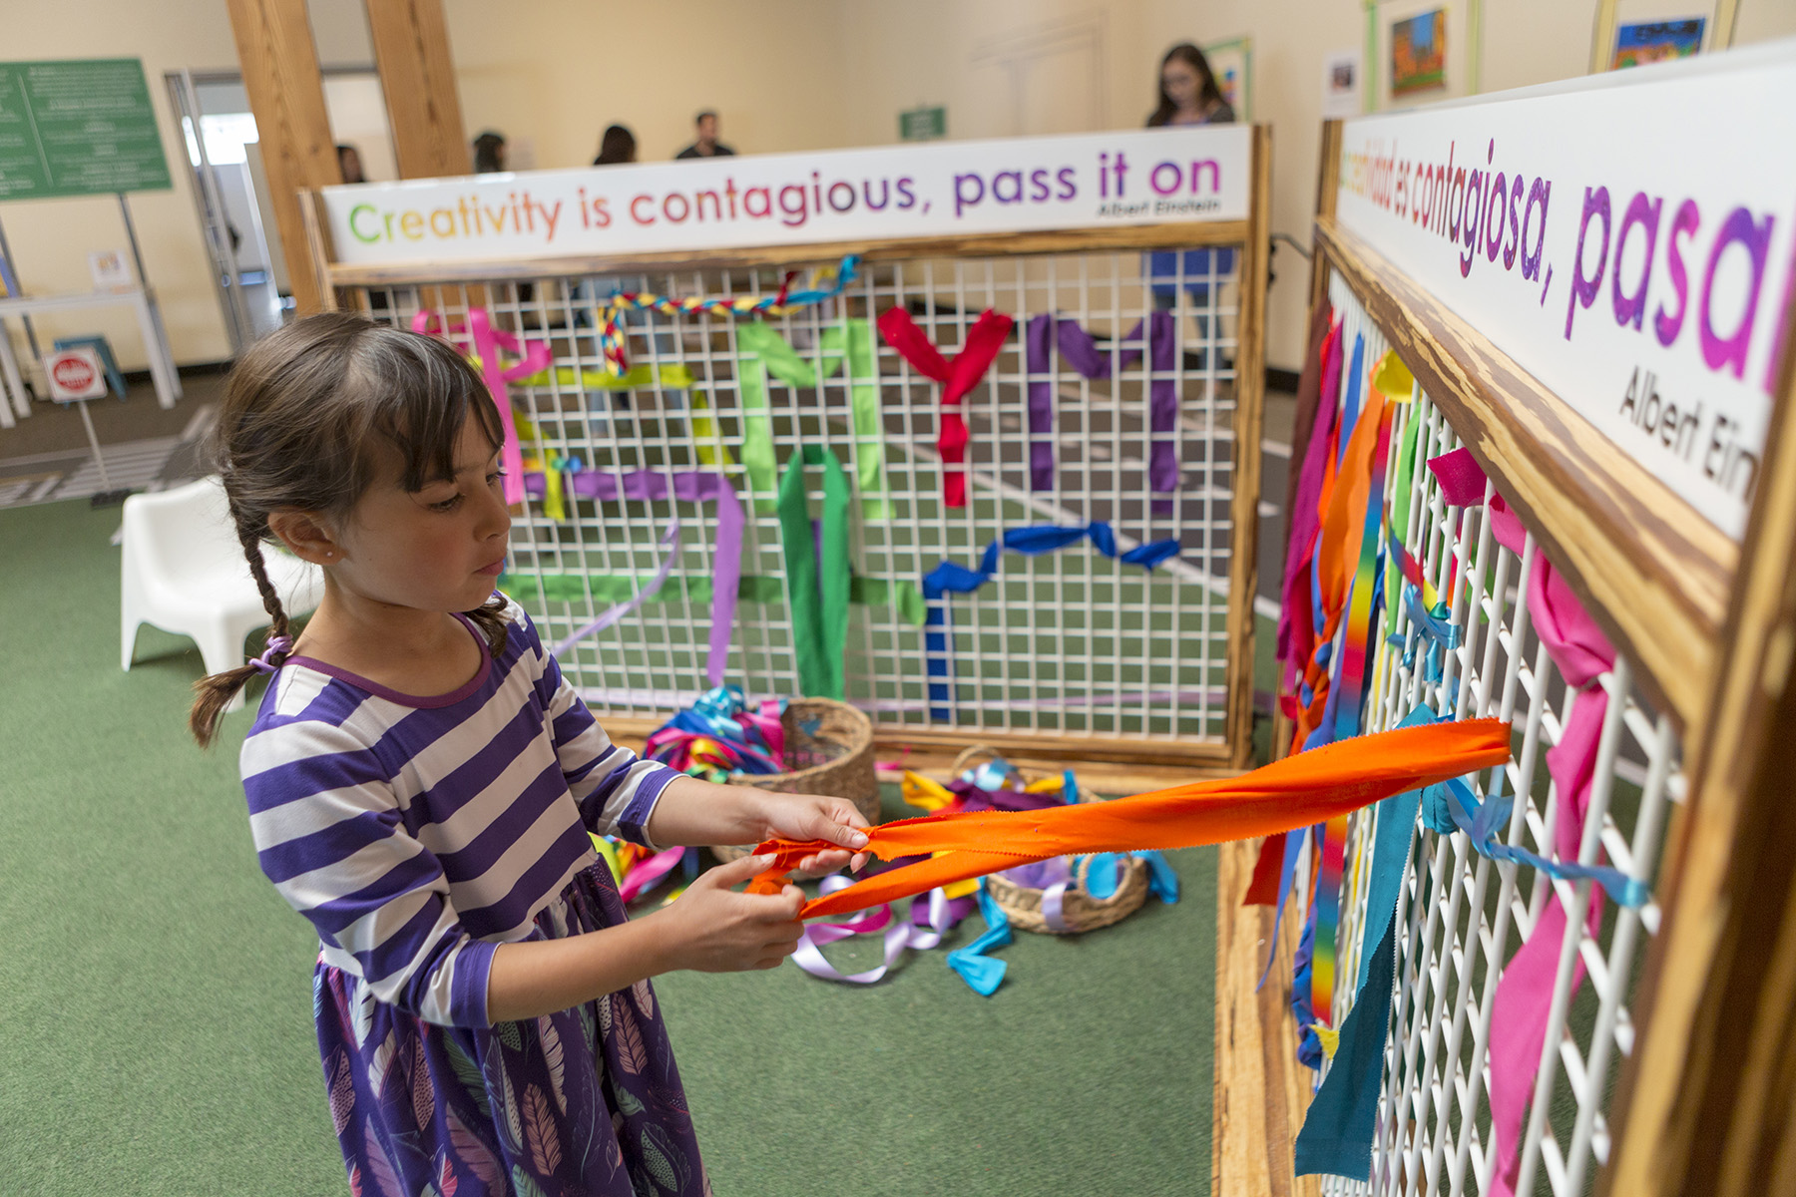
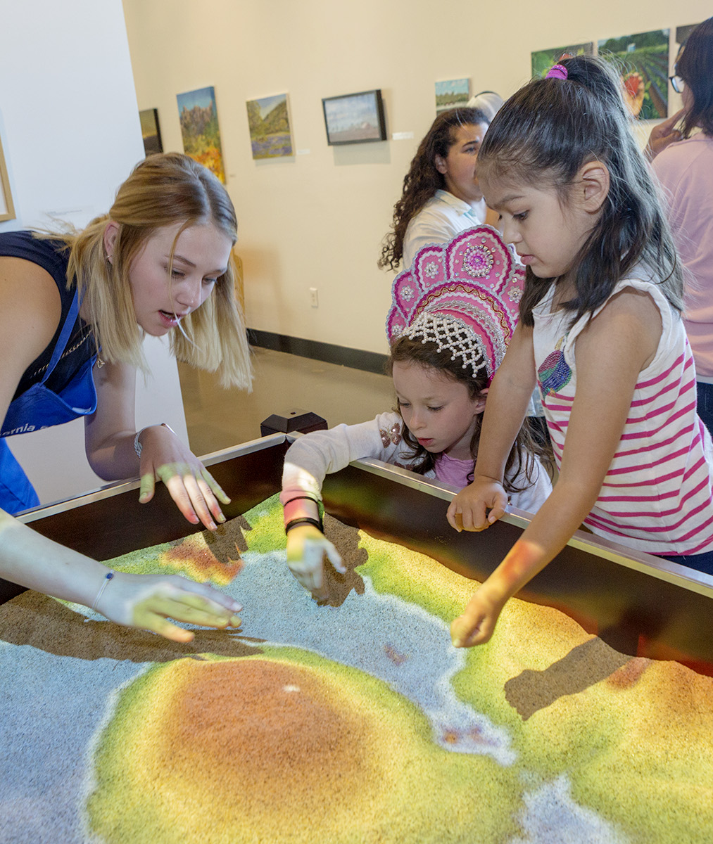
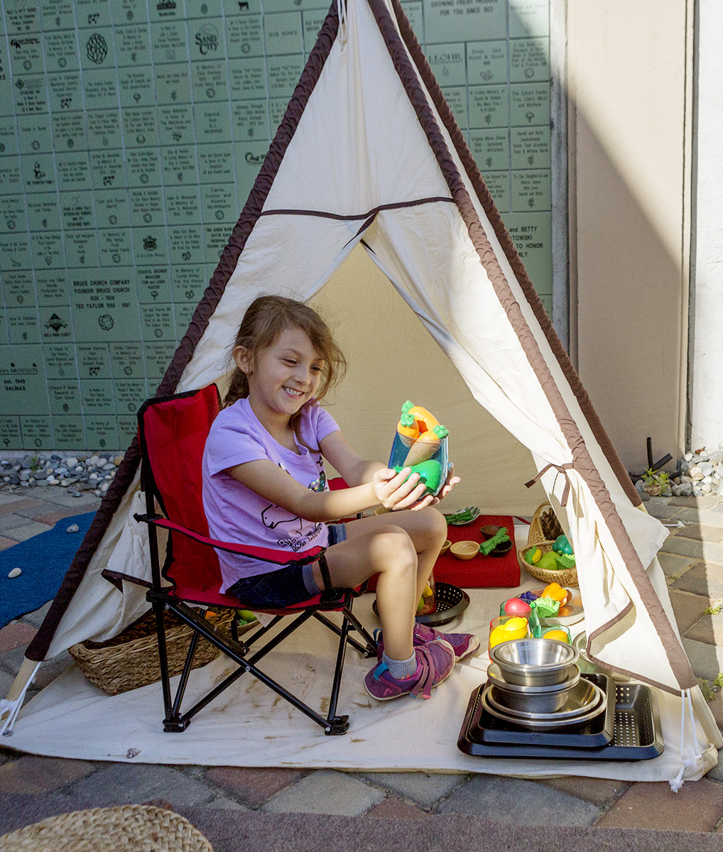
Funding Early Childhood
Strategies:
Advocating for County cannabis revenue
Polling for a local ballot measure
Challenges:
Communicating early childhood easily
No sense of urgency for early childhood
Need to ‘put on our own mask first’
Shifting paradigms creates uncertainty/fear
Lessons:
Those that know us love us; most don’t know us
Local advocacy key
Partnerships are critical
Relationships matter
Multiple approaches needed

Slide 42
Mechanisms Explored
Pay for Success (Social Impact Bond)
Ballot measure – Sales Tax
Fee on single-use plastics
City dedicate local cannabis tax revenue
Cannabis industry “partnerships”

Slide 43
Challenges
Recurring natural disasters have exacerbated competing priorities
Fundraising
Plastics & cannabis: unsustainable declining revenue sources

Slide 44
Lessons Learned
Keep the long view & build political capital
Legal opinion & polling are critical
Local First 5 Commission as administrator of revenue is feasible

Slide 46
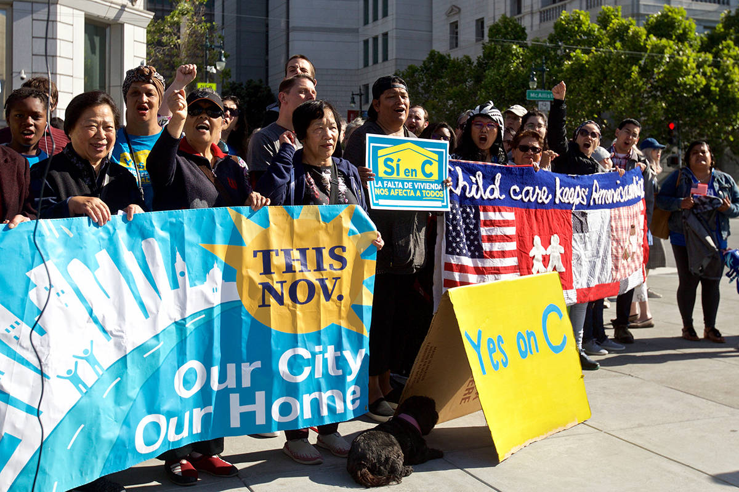
San Francisco – Local Children’s Initiatives, including First 5 Administered Preschool for All
County-Wide Public Education and Enrichment Fund, 2004 general fund set-aside,
Board of Sups driven with community support (School District, non-profits, community advocates, parents) with community accountability, First 5 SF identified as Administrator of the PFA Fund.
PEEF grew to $77 mil in FY 13-14. New funding for public schools (two-thirds) and Preschool for All (PFA) (one-third); Increased access to quality care, particularly for 4-year old's,
In November 2014 reauthorized together with the Children’s Fund as “Children and Families First" City Funds, Tax and Administration Proposal, Proposition C, Total funding exceeds $200 mil. annually.
The new ordinance, Children and Families First, which includes PFA, sunsets in 25 years.(2040),
PFA is now administered through the Office of Early Care and Education
Notes:
Have to understand the political context; Advocates are your partners if you listen and work with them. You need internal and external champions.
Community driven design and response to need leads to improved program design as long as children and families remain at the center of the planning;
Partnership is EVERYTHING Public agency partners, elected officials, community leaders, CBO’s
Program breadth and depth is important to real change and that takes real money
Leadership matters
Outsourcing the work is nimble and creates important partners increasing the external support . Also keeps resources close to communities and families.
Data and accountability for programs is important in garnering support and getting initiatives renewed
2/3rds votes is a difficult threshold, but can be achieved 50+1 is much more achievable
Note – SF voters approved an infant toddler initiative which raised $125 mil. For quality ECE for I/T’s. This measure is tied up in the courts around the 50+1 threshold. Won it’s first court decision. But is continuing through appeals.
When expanding funds are forthcoming, the youngest often come last. 0-5 after others children and youth. 0-2 after 3-5. Consequently, First 5, by it’s very charge, must be the champion for families with infants and toddlers who often face the greatest barriers to accessing quality child care.

Slide 47
When expanding funds are forthcoming, the youngest often come last. 0-5 after other children and youth. 0-2 after 3-5. First 5, by its very charge, must be the champion for families with infants and toddlers who often face the greatest barriers to accessing quality childcare. LESSONS
Have to understand the political context; Advocates are your partners if you listen and work with them. You need internal and external champions.
Community driven design and response to need leads to improved program design as long as children and families remain at the center of the planning.
Partnership is EVERYTHING - Public agency partners, elected officials, community leaders, CBO’s
Program breadth and depth is important to real change and that takes real money.
Leadership matters.
Outsourcing the work is nimble and creates important partners increasing the external support . Also keeps resources close to communities and families.
Data and accountability for programs is important in garnering support and getting initiatives renewed.
2/3rds votes is a difficult threshold but can be achieved - 50+1 is much more achievable.
Note – SF voters approved an infant toddler initiative which raised $125 mil. For quality ECE for I/T’s. This measure is tied up in the courts around the 50+1 threshold. Won it’s first court decision. But is continuing through appeals.
Notes:
Have to understand the political context; Advocates are your partners if you listen and work with them. You need internal and external champions.
Community driven design and response to need leads to improved program design as long as children and families remain at the center of the planning;
Partnership is EVERYTHING Public agency partners, elected officials, community leaders, CBO’s
Program breadth and depth is important to real change and that takes real money
Leadership matters
Outsourcing the work is nimble and creates important partners increasing the external support . Also keeps resources close to communities and families.
Data and accountability for programs is important in garnering support and getting initiatives renewed
2/3rds votes is a difficult threshold, but can be achieved 50+1 is much more achievable
Note – SF voters approved an infant toddler initiative which raised $125 mil. For quality ECE for I/T’s. This measure is tied up in the courts around the 50+1 threshold. Won it’s first court decision. But is continuing through appeals.
When expanding funds are forthcoming, the youngest often come last. 0-5 after others children and youth. 0-2 after 3-5. Consequently, First 5, by it’s very charge, must be the champion for families with infants and toddlers who often face the greatest barriers to accessing quality child care.

Slide 48
Table Discussions
What alterative revenue streams are you exploring and/or contemplating in your county for children’s services?
Who are your critical partners in this work?
Are there revenue streams you are not interested in exploring?
What did today’s presentation spark for you?

Slide 49
FUNDING THE NEXT GENERATION
Provides technical assistance to coalitions working on local funding streams for children and youth
Sponsors learning communities and conferences
Support includes speaking, convening, facilitating, trouble-shooting, coaching, and more.
Numerous tools and resources are available.
CONTACT:
Margaret Brodkin, Margaret@fundingthenextgeneration.org
415-794-4963
www.fundingthenextgeneration.org

