Slide 1
LOCAL FUNDING MEASURES FOR KIDS: STRATEGIES AND PROSPECTS FOR 2022 AND BEYOND
SPONSORED BY FUNDING THE NEXT GENERATION
What we do:
Provide inspiration and technical assistance to coalitions in California working on local funding streams for children and youth – through budgets, policy and ultimately the ballot.
We sponsor learning opportunities of all kinds; facilitate and speak at local and state forums; provide coaching and trouble-shooting; and build new tools and strategies to ensure equitable resources for kids.
PURPOSE OF THIS WEBINAR:
Review revenue measures for children and youth in 2020 in California
Help local leaders consider options for local revenue strategies
Provide insight into how FNG can help you and how you can help each other.
Margaret Brodkin, director and founder
Margaret@fundingthenextgenerationlorg

Slide 2
AGENDA
Summary of 2020 revenue measures in California – Dave Metz
Overview of 8 local revenue strategies in 2020 – Margaret Brodkin
Lessons learned from local leaders – Round Robin
Christina Gilbert, San Joaquin Children’s Alliance, San Joaquin County
Clarissa Doutherd, Parent Voices, Alameda County
Angie Dillon-Shore, First 5 ED, Sonoma County
Julio Marcial, Liberty Hill Foundation, Los Angeles County
Monica Mares, Youth Forward, City of Sacramento
Lian Cheun, Khmer Girls in Action, City of Long Beach
Jesus Sanchez, Gente Organizada, City of Pomona
Courtney Baltiyskyy, YMCA San Diego, City and County of San Diego
Future landscape for children’s measures
Nicole Derse, 50+1 Strategies – politics
Dave Metz, FM3 - messaging
What is needed to support your local efforts
Poll - questions
Discussion through chat

Slide 4
The November Election

Slide 5
After a lousy showing in March, California revenue measures rebounded well in November.
430
(83%)
386
(79%)
268
(71%)
260
(76%)
233
(76%)
240
(74%)
238
(40%)
204
(65%)
191
(59%)
103
(54%)
111
(77%)
78
(67%)
79
(73%)
87
(67%)
85
(77%)
89
(81%)
From Michael Coleman, CaliforniaCityFinance.com

Slide 6
As usual, local general taxes tended to fare the best.
Local Revenue Measures November 2020
Measure | Total | Pass | Passing %
City General Tax (Majority Vote) | 132 | 108 | 82%
County General Tax (Majority Vote) | 8 | 8 | 100%
City Special Tax or G.O. Bond (2/3 Vote) | 14 | 6 | 43%
County Special Tax or G.O. Bond (2/3 Vote) | 8 | 5 | 63%
Special District (2/3 Vote) | 25 | 13 | 52%
School Parcel Tax 2/3 | 13 | 10 | 77%
School Bond 55% | 60 | 48 | 80%
Total | 260 | 198 | 76%
From Michael Coleman, CaliforniaCityFinance.com

Slide 7
Sales taxes, parcel taxes, and cannabis taxes were particularly popular.
From Michael Coleman, CaliforniaCityFinance.com

Slide 8
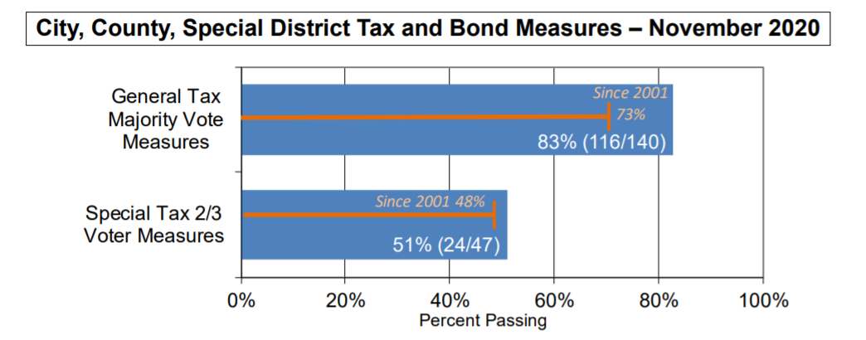
Overall, both general and special taxes outperformed their typical passage rates.
From Michael Coleman, CaliforniaCityFinance.com

Slide 9
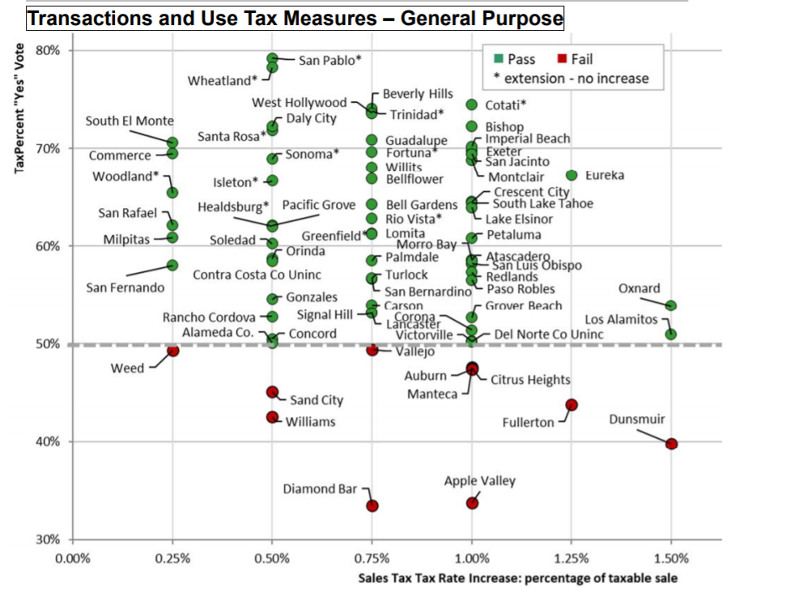
There was no clear correlation between sales tax rates and success at the ballot.
From Michael Coleman, CaliforniaCityFinance.com

Slide 10
What Happened in March?
A number of factors likely led to historically poor approval rates:
Too many measures on the ballot, including some marginal ones, in anticipation of better turnout.
Greater uncertainty around COVID and its economic impacts
Likely underinvestment in campaigns
Less acute sense of need than is currently the case
The strong performance of measures this November will likely lead more agencies to move forward in 2022

Slide 11
2020 CA Revenue Strategies for Kids
Location Type of tax To be funded by tax %Vote
Dedicated tax
San Joaquin County Cannabis tax (Nov) 50% Children and youth 65%
Alameda County** Sales tax (March) Early care/pediatric hospital 64%
Sonoma County* Sales tax (Nov) Mental health & homelessness 68%
General tax
City of Long Beach* Oil tax (Nov) General services – health, youth, climate 57%
Budget set-aside
Los Angeles County* 10% General Fund (Nov) Community reinvestment – alternatives 57% to incarceration
City of Sacramento 2.5% General Fund (March) Youth Fund 45%
Budget augmentations….on path to ballot measure
City of Pomona CDBG, 50% Developer’s fee Youth programs and youth artists $2M
San Diego City/County CARES Act/COVID $ Childcare vouchers/Provider grants $35M

Slide 12
WHY WE NEED MEASURE X Cannabis tax for san Joaquin county A YES vote on Measure X will ensure the county can effectively regulate Cannabis businesses, provide for public health, and expand proven programs for our children. CHRISTINA Gilbert, San Joaquin alliance for children

Slide 13
MEASURE C SALES TAX FOR CHILD CARE AND PEDIATRIC CARE Clarissa Doutherd, parent voices

Slide 14
ANGIE DILLON-SHORE,
FIRST 5 SONOMA COUNTY, ED
SOMONA COUNTY
DEDICATED SALES TAX FOR MENTAL HEALTH AND SERVICES FOR HOMELESS

Slide 15
Passed by 57%
Paid & volunteer programs
Over 10,000 voter contacts
Preparing for implementation
Researching additional revenue source for 2022
LIAN CHEUN, KHMER GIRLS IN ACTION

Slide 16
JULIO MARCIAL, LIBERTY HILL FOUNDATION

Slide 17
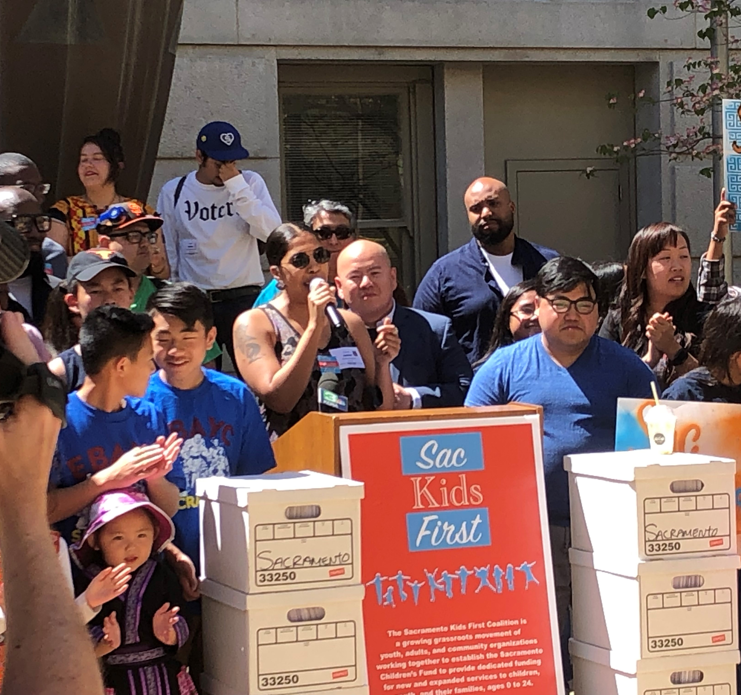
MONICA MARES YOUTH FORWARD Budget set-aside

Slide 18
Jesus Sanchez,
Founder/Director of Gente Organizada

Slide 19
COURTNEY BALTIYSKYY, SAN DIEGO YMCA

Slide 20
2020 CA Revenue Strategies
Getting a 2/3 vote is hard.
Building a strong community coalition and infrastructure is essential.
Inside-government champions make a huge difference.
Position of labor can significantly impact campaign.
Starting with a small step can build momentum.
The less dedicated the funding in the measure, the greater the post-election fight.
Digital campaigns can work – and they are cost-effective.
It’s a journey – building power for community.

Slide 21
Emerging Messaging

Slide 22
The challenge of balancing childcare and work ranks among voters’ top concerns.
I’m going to read you a list of issues that some people say are problems in Washington State. Please tell me whether you think it is an extremely serious problem, a very serious problem, a somewhat serious problem, or not a serious a problem in Washington State.
Ext./Very Ser. Prob.
86%
71%
67%
65%
64%
60%
FM3 Washington Voter Survey – October 2020

Slide 23
More than half of parents do not feel their current situation is sustainable.
Thinking about your current situation in providing care for your children, do you feel like your situation now will work for the long-term, will work only for the short-term, or is it not working so well now?
Asked of parents with children under 18
50% of parents with children age 5 and under say it will only work in the short-term; 17% say it is not working now.
FM3 Washington Voter Survey – October 2020

Slide 24
Three in five say that since the pandemic started, they have come to view early learning and childcare as more important.
Since the coronavirus pandemic started, 16% of childcare facilities and preschools have had to close and nearly half are at risk of closing, leaving many parents to have to manage care for children 5 and under on their own while working. In addition, many K-12 schools have moved to distance learning, meaning parents also have to care for and supervise older children at home. Since the start of the pandemic, do you view early learning and childcare programs for children 5 and under as more important or less important than you did before?
Total More Important 62%
Total Less Important 13%
FM3 Washington Voter Survey – October 2020

Slide 25
Nationally, voters agree that early learning is essential and should be publicly-funded.
Total Agr. | Total Disagr.
84% | 15%
79% | 20%
77% | 22%
Like healthcare and education, high-quality, affordable childcare for families with young children is an essential service
The COVID-19 crisis has shown us how essential it is that we build a childcare system that makes childcare available and affordable to all families who need it
The care and education of children is publicly-funded starting in kindergarten; it should be the same for younger children as well
First Five Years Fund Survey, September 2020

Slide 26
Messaging Supporting Investment in ECE (Ranked in Order of Effectiveness)
(WORKFORCE) Early childhood educators who serve infants and toddlers have one of the most important jobs: caring for young children and helping them learn, grow and be prepared to succeed. But it is hard to recruit and retain qualified educators because many of them only earn $10 per hour, with no benefits. This proposal increases the state’s investment in early childhood educators working with our young children at a crucial time in their lives.
(PARENTS) Before the coronavirus pandemic, many families needed two incomes to get by – and many single parents were forced to work multiple jobs. Many parents relied on professional early care and education programs just to get through the day. Many of these programs are at risk of closing if they do not get the emergency funding in this proposal to keep them open to help our state’s economy restart and recover.
(BRAIN DEVELOPMENT) Research shows that a child’s brain develops most dramatically during the first few years of life. During this critical period, a window of opportunity exists to lay the foundation for all of the years that follow. This proposal protects and expands access to quality early care and education programs so we can prepare more Wisconsin children to learn, grow and succeed.
(WORKING POOR) Tens of thousands of young children are left out of our current early care and education system because their family makes too much to qualify for a state subsidy, but not nearly enough to afford child care on their own. This proposal helps close this gap and lets more working families enroll their young children in quality early care and education programs to help them learn, grow and succeed.
FM3 Wisconsin Voter Survey – October 2020

Slide 27
Making the Case for Youth Investment Measures: Emerging Themes
Heightened urgency for addressing pre-existing concerns that affect kids and families: affordable housing, health and safety programs, parks and recreation
Preventing/restoring cuts as opposed to expanding services
Economic ROI of investment in youth may be more salient
Strong support for and appreciation of essential workers – many of whom are parents and in need of additional support
General dissatisfaction with distance learning and loss of youth programming – desire for more and better alternatives
Addressing equity concerns that particularly affect families

Slide 29
FUNDING THE NEXT GENERATION
FOR TECHNICAL ASSISTANCE AND INFORMATION ON LOCAL DEDICATED FUNDING FOR CHILDREN AND YOUTH, RECORDINGS OF WEBINARS, SUBSCRIBING TO OUR MAILING LIST
Regular general sessions for Californina on topics of interest related to strategies and skills of funding measures
Joint sessions of general interest with our national partner – Children’s Funding Project
Cohort, by invitation, of leaders of local coalitions who are planning for measures in 2022 or 2024 and want to be part of a learning community for peer support, access to technical assistance from FNG team, and possibility of campaign funding.
Margaret@fundingthenextgeneration.org
Call – 415-794-4963
www.fundingthenextgeneration.org

Slide 30
FUNDING THE NEXT GENERATION
San Joaquin County cannabis tax for children’s services - https://xforsanjoaquin.com/
Alameda County sales tax for early care and education – https://www.fundingthenextgeneration.org/nextgenwp/wp-content/uploads/2021/01/Alameda-Measure-C-FAQ-Final.pdf
Sonoma sales tax for mental health and homelessness - https://www.yesonoforsonomacounty.org/
Long Beach oil tax for youth development and general purposes - https://www.yesonus.com/
Sacramento budget set-aside for youth fund - https://sackidsfirst.org/
Los Angeles budget set-aside for community reinvestment and alternatives to incarceration - https://yesonj.reimagine.la/
San Diego campaign for CARES funding for early care - https://www.fundingthenextgeneration.org/nextgenwp/wp-content/uploads/2021/01/San-Diego-ECE-Advocacy-Summary.pdf
Pomona organization mounting campaign for funding for youth - https://www.genteorganizada.org/

