Slide 2
The November Election

Slide 3
After a lousy showing in March, California revenue measures rebounded well in November.
430
(83%)
386
(79%)
268
(71%)
260
(76%)
233
(76%)
240
(74%)
238
(40%)
204
(65%)
191
(59%)
103
(54%)
111
(77%)
78
(67%)
79
(73%)
87
(67%)
85
(77%)
89
(81%)
From Michael Coleman, CaliforniaCityFinance.com

Slide 4
As usual, local general taxes tended to fare the best.
Local Revenue Measures November 2020
Measure | Total | Pass | Passing %
City General Tax (Majority Vote) | 132 | 108 | 82%
County General Tax (Majority Vote) | 8 | 8 | 100%
City Special Tax or G.O. Bond (2/3 Vote) | 14 | 6 | 43%
County Special Tax or G.O. Bond (2/3 Vote) | 8 | 5 | 63%
Special District (2/3 Vote) | 25 | 13 | 52%
School Parcel Tax 2/3 | 13 | 10 | 77%
School Bond 55% | 60 | 48 | 80%
Total | 260 | 198 | 76%
From Michael Coleman, CaliforniaCityFinance.com

Slide 5
Sales taxes, parcel taxes, and cannabis taxes were particularly popular.
From Michael Coleman, CaliforniaCityFinance.com

Slide 6
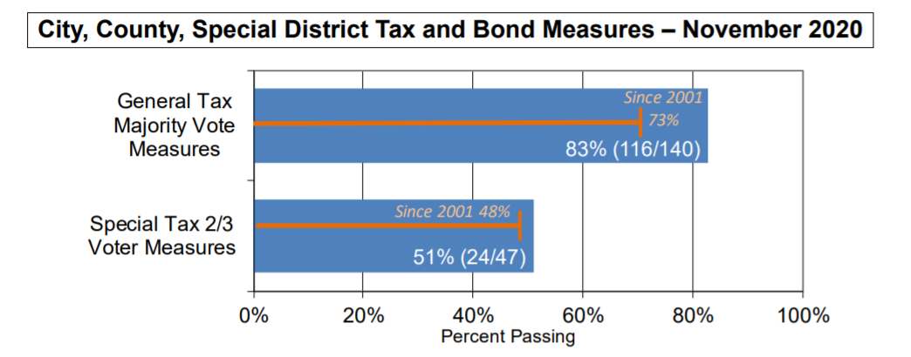
Overall, both general and special taxes outperformed their typical passage rates.
From Michael Coleman, CaliforniaCityFinance.com

Slide 7
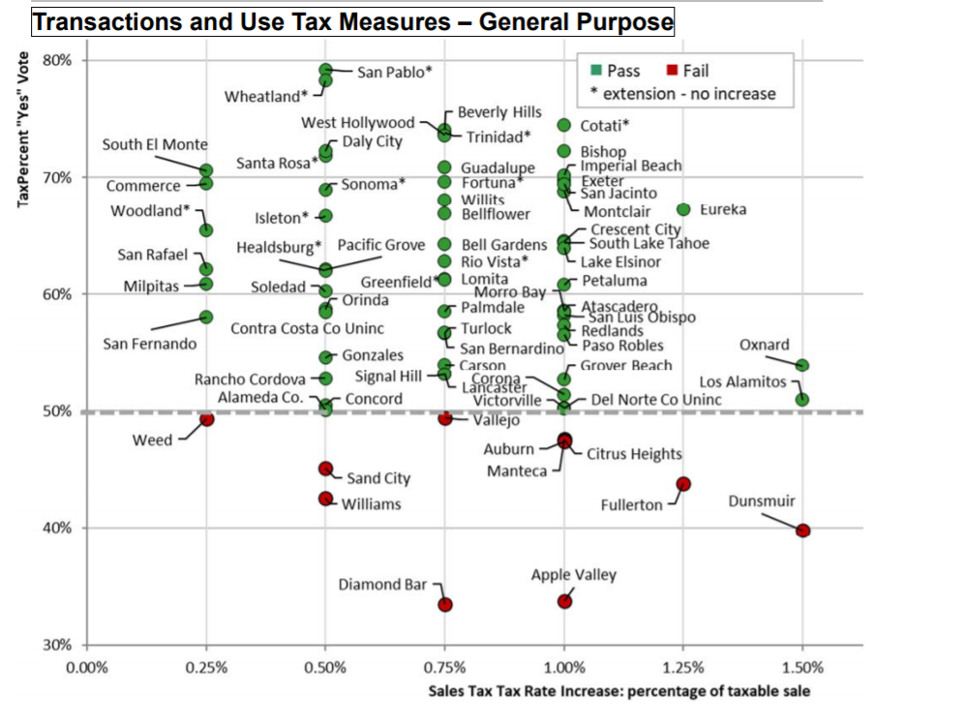
There was no clear correlation between sales tax rates and success at the ballot.
From Michael Coleman, CaliforniaCityFinance.com

Slide 8
What Happened in March?
A number of factors likely led to historically poor approval rates:
Too many measures on the ballot, including some marginal ones, in anticipation of better turnout.
Greater uncertainty around COVID and its economic impacts
Likely underinvestment in campaigns
Less acute sense of need than is currently the case
The strong performance of measures this November will likely lead more agencies to move forward in 2022

Slide 9
Emerging Messaging

Slide 10
The challenge of balancing childcare and work ranks among voters’ top concerns.
I’m going to read you a list of issues that some people say are problems in Washington State. Please tell me whether you think it is an extremely serious problem, a very serious problem, a somewhat serious problem, or not a serious a problem in Washington State.
Ext./Very Ser. Prob.
86%
71%
67%
65%
64%
60%
FM3 Washington Voter Survey – October 2020

Slide 11
More than half of parents do not feel their current situation is sustainable.
Thinking about your current situation in providing care for your children, do you feel like your situation now will work for the long-term, will work only for the short-term, or is it not working so well now?
Asked of parents with children under 18
50% of parents with children age 5 and under say it will only work in the short-term; 17% say it is not working now.
FM3 Washington Voter Survey – October 2020

Slide 12
Three in five say that since the pandemic started, they have come to view early learning and childcare as more important.
Since the coronavirus pandemic started, 16% of childcare facilities and preschools have had to close and nearly half are at risk of closing, leaving many parents to have to manage care for children 5 and under on their own while working. In addition, many K-12 schools have moved to distance learning, meaning parents also have to care for and supervise older children at home. Since the start of the pandemic, do you view early learning and childcare programs for children 5 and under as more important or less important than you did before?
Total More Important 62%
Total Less Important 13%
FM3 Washington Voter Survey – October 2020

Slide 13
Nationally, voters agree that early learning is essential and should be publicly-funded.
Total Agr. | Total Disagr.
84% | 15%
79% | 20%
77% | 22%
Like healthcare and education, high-quality, affordable childcare for families with young children is an essential service
The COVID-19 crisis has shown us how essential it is that we build a childcare system that makes childcare available and affordable to all families who need it
The care and education of children is publicly-funded starting in kindergarten; it should be the same for younger children as well
First Five Years Fund Survey, September 2020

Slide 14
Messaging Supporting Investment in ECE (Ranked in Order of Effectiveness)
(WORKFORCE) Early childhood educators who serve infants and toddlers have one of the most important jobs: caring for young children and helping them learn, grow and be prepared to succeed. But it is hard to recruit and retain qualified educators because many of them only earn $10 per hour, with no benefits. This proposal increases the state’s investment in early childhood educators working with our young children at a crucial time in their lives.
(PARENTS) Before the coronavirus pandemic, many families needed two incomes to get by – and many single parents were forced to work multiple jobs. Many parents relied on professional early care and education programs just to get through the day. Many of these programs are at risk of closing if they do not get the emergency funding in this proposal to keep them open to help our state’s economy restart and recover.
(BRAIN DEVELOPMENT) Research shows that a child’s brain develops most dramatically during the first few years of life. During this critical period, a window of opportunity exists to lay the foundation for all of the years that follow. This proposal protects and expands access to quality early care and education programs so we can prepare more Wisconsin children to learn, grow and succeed.
(WORKING POOR) Tens of thousands of young children are left out of our current early care and education system because their family makes too much to qualify for a state subsidy, but not nearly enough to afford child care on their own. This proposal helps close this gap and lets more working families enroll their young children in quality early care and education programs to help them learn, grow and succeed.
FM3 Wisconsin Voter Survey – October 2020

Slide 15
Making the Case for Youth Investment Measures: Emerging Themes
Heightened urgency for addressing pre-existing concerns that affect kids and families: affordable housing, health and safety programs, parks and recreation
Preventing/restoring cuts as opposed to expanding services
Economic ROI of investment in youth may be more salient
Strong support for and appreciation of essential workers – many of whom are parents and in need of additional support
General dissatisfaction with distance learning and loss of youth programming – desire for more and better alternatives
Addressing equity concerns that particularly affect families

Slide 16
Polling

Slide 17
The public is paying a high amount of attention to polling…
In the course of this election, how often would you say you read about the results of recent political polls:
2018
2020
FM3 CA Election Week Survey

Slide 18
…though its trust in the results is very low.
How often do you think public opinion polls accurately reflect what the public thinks:
2018
2020
FM3 CA Election Week Survey

Slide 19
So What Happened?
It’s too soon to say, but a few hypotheses are emerging:
Problems may be highly localized and connected to federal races
Single-mode surveys may have yielded coverage bias
Turnout models may have been too restrictive
Latinx opinion may not have been accurately captured
The pandemic may have affected participation patterns
Problems may be candidate-specific -- “defiant” Trump voters may have opted out, especially to media surveys
Conversely, progressives may have disproportionately “opted-in”
The latter two will be most important to investigate – testing whether non-participation is becoming psychographically-concentrated.

