Slide 1
TIPS ON BUDGET ADVOCACY
Margaret Brodkin
August 21, Napa, California

Slide 2
WHY BUDGETS MATTER?
A budget is a moral document that reflects community values.
Funding inequity is a social justice issue.
It all costs money. Lack of resources is greatest resistance to change

Slide 3
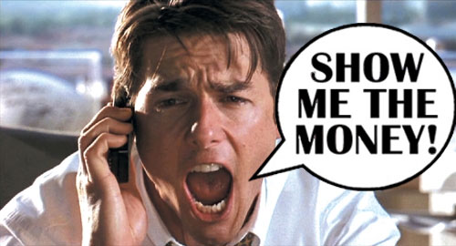
WHAT IS BUDGET ADVOCACY?
Process of working to change public budget priorities:
Reallocation
Expanding line items
New programs
Dedicated funding
Taxes and fees

Slide 4
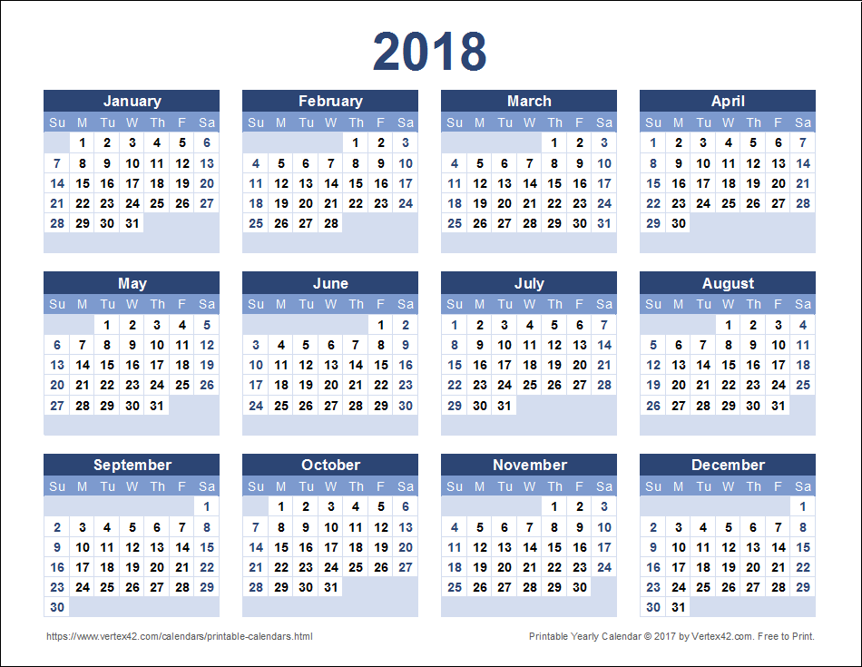
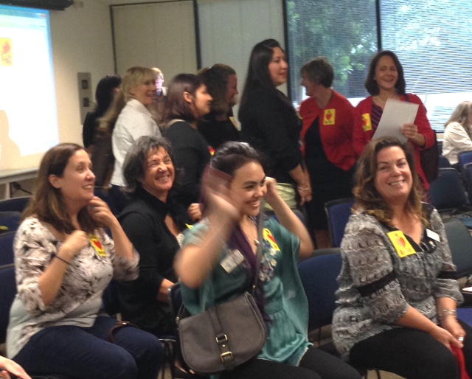
IMPORTANT TO REMEMBER
Creating a public budget is a year-round process.
Showing up is half the battle
Start small – oppose budget cuts
End big – create dedicated
funding for your priorities

Slide 5
CHALLENGES
PRESERVING THE STATUS QUO
SACRED COWS
TURF
NEVER THE RIGHT TIME
NEVER THE RIGHT APPROACH
NO NEW MONEY
PURPOSEFUL MYSTIFICATION
INEXPERIENCE OF ADVOCATES

Slide 6
UNDERSTANDING THE BUDGET
HOMEWORK HELPS
What level of government can respond to your proposal?
What are current expenditures?
Prevention vs. Rehabilitation
Changes over the years
Compared to other expenditures and overall budget
How much is discretionary
What is the competition for dollars?
Do you have ideas for a funding source?

Slide 7
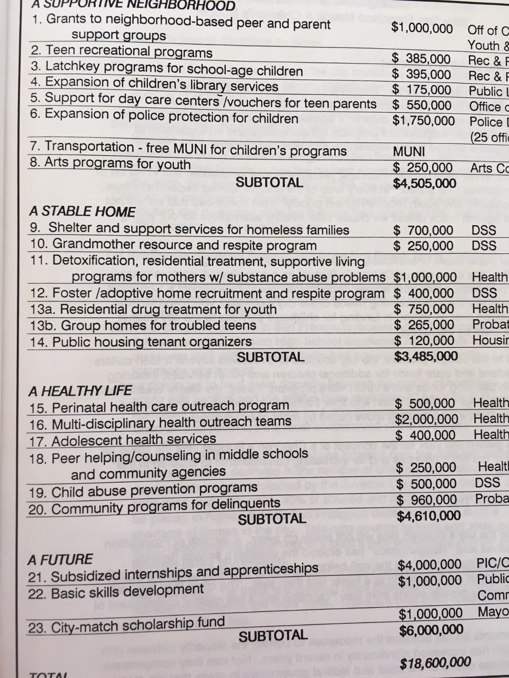
SETTING CONCRETE GOALS
Make goals very concrete.
What is the cost? What program? Who will be served? Documentation of need? Potential outcomes?
Criteria for setting goals:
Availability of resources, Popular with public, Coalition of supporters, Cost benefit, Visible results, Builds power, Rallies parents/youth/consituents,
Big enough to matter --- Small enough to win!

Slide 8
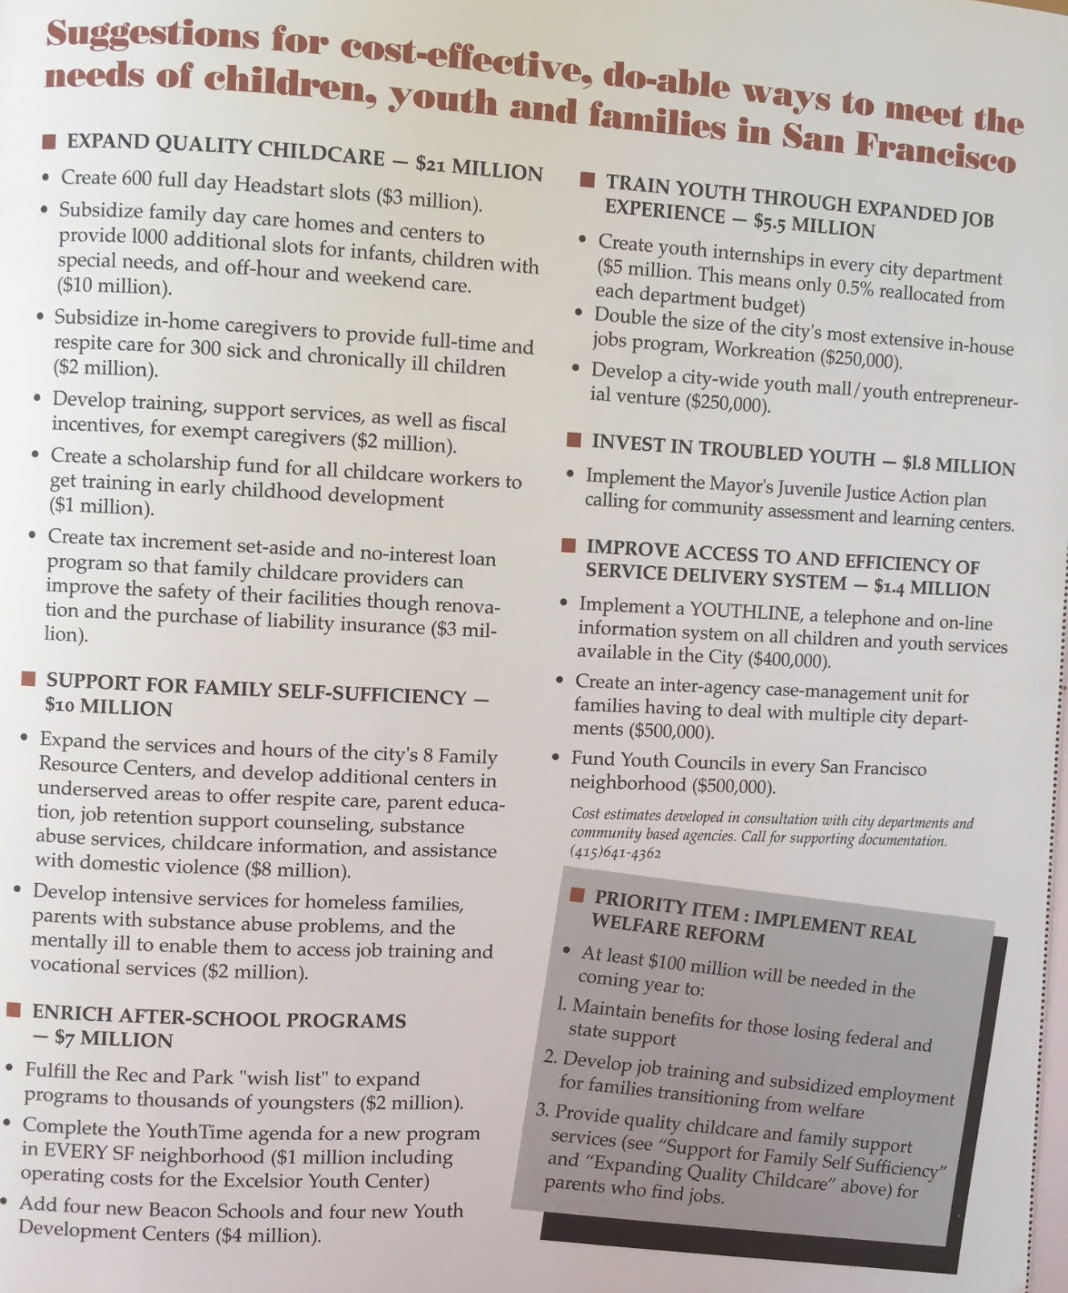
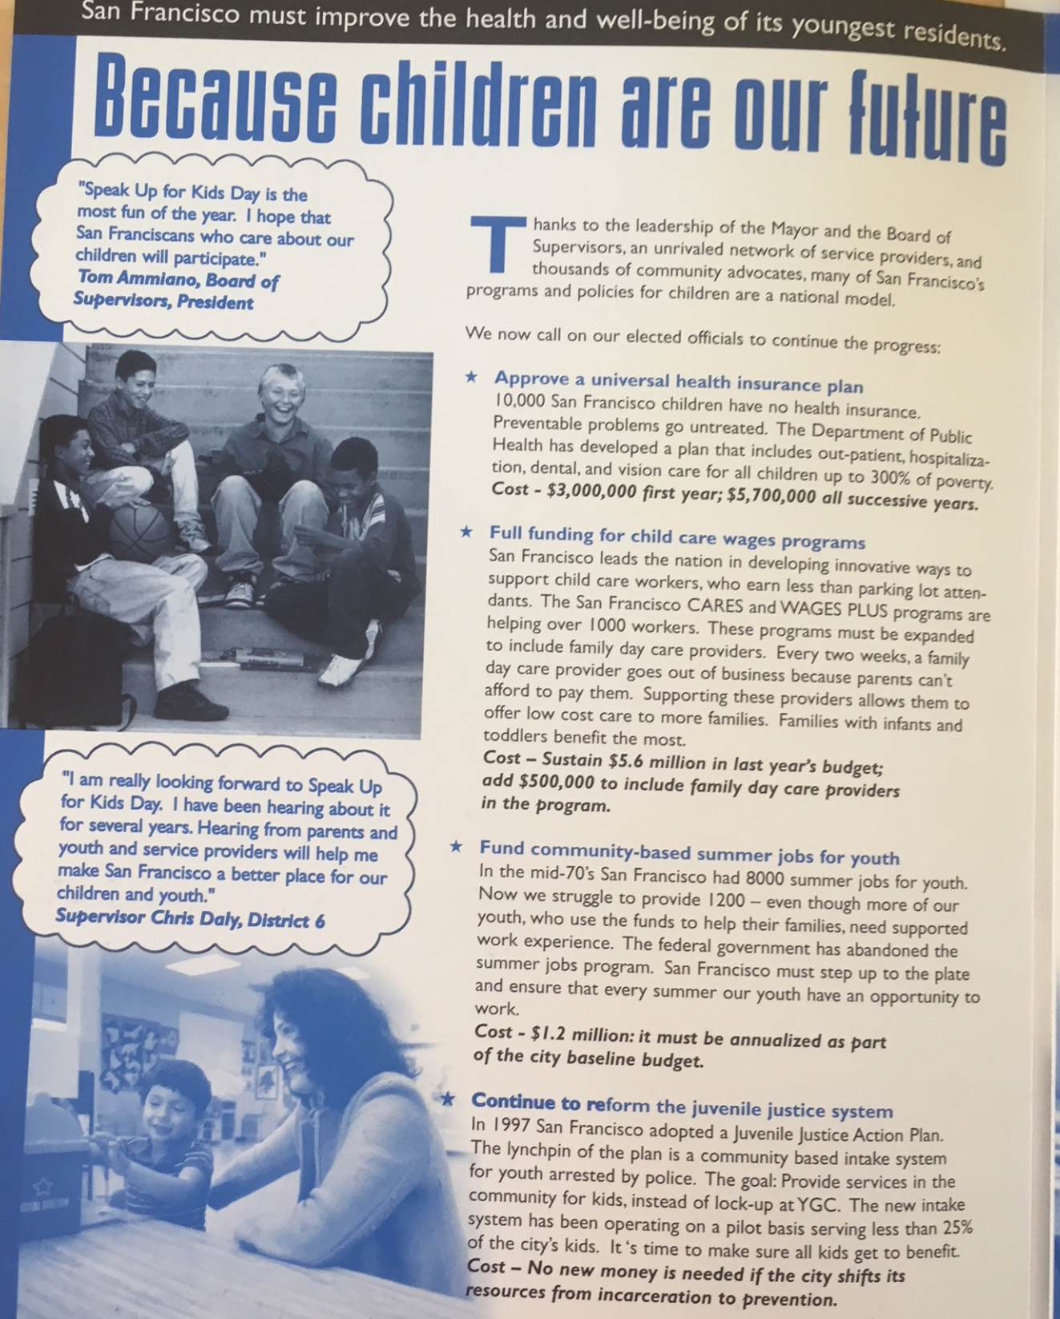

Slide 9
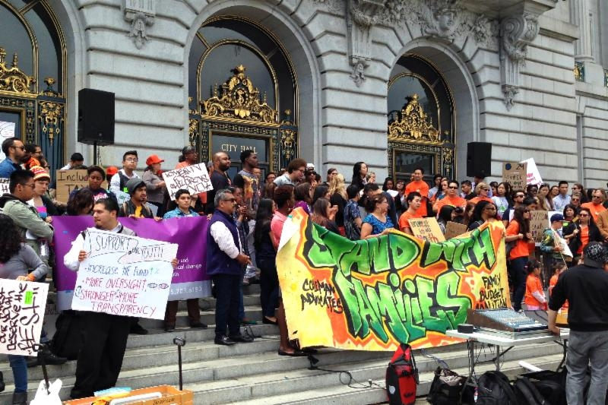
PERSUASION AND PRESSURE
Soft traditional tactics – reports, meetings, letters, testimony, op-eds, site visits, calls
POLITICAL HARDBALL – demonstrations, sit-ins, petitions, public challenges and direct criticism, guerilla theatre, press events, withdrawl of political support, circumventing the traditional process

Slide 10
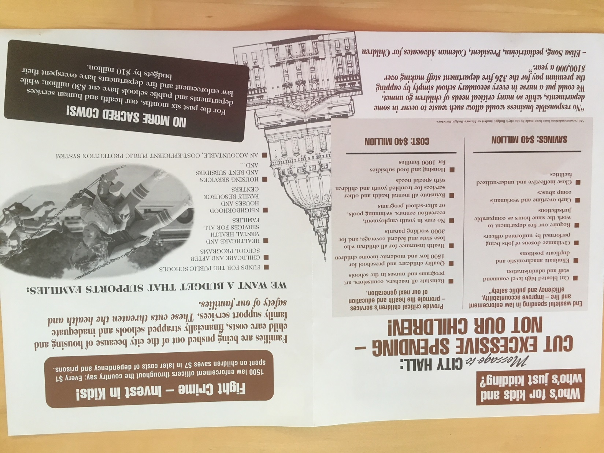
,

Slide 11
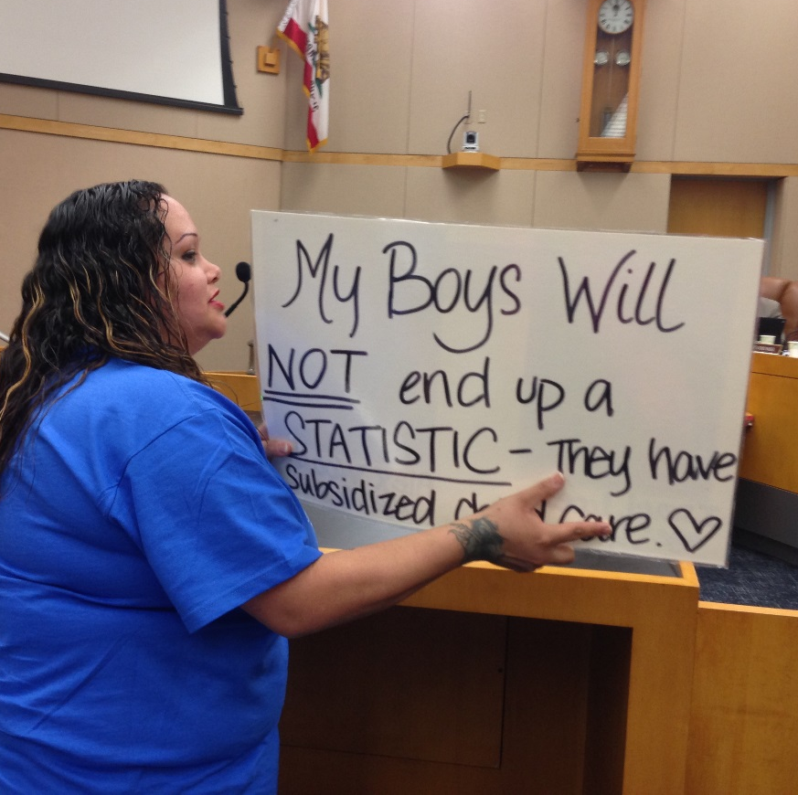
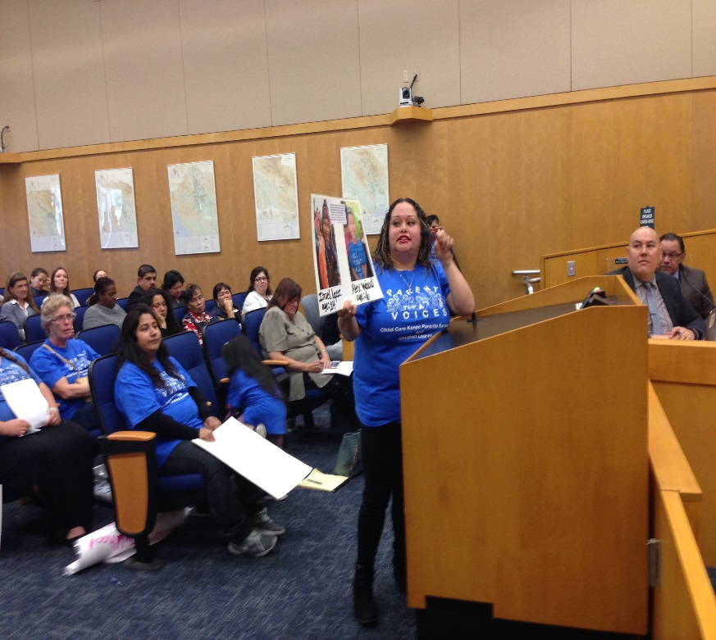
COMPELLING SIMPLE MESSAGES
Reports have a place, but they don’t change budgets.
Decision-makers have short attention spans.
3 minutes is all you get.
Avoid jargon and too much data.
Tell stories.
Make it personal.

Slide 12
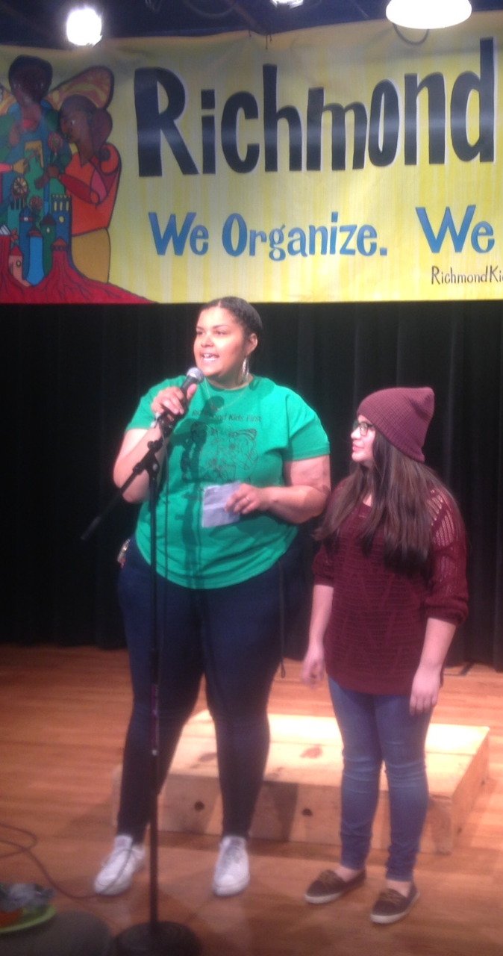
AUTHENTIC VOICES
Elected official to advocate: Whatever you do, stop bringing all those kids.
Advocate: I guess I’ll double the number of kids that we bring.
Hard to say no to kids and parents, and folks telling their real problems.

Slide 13
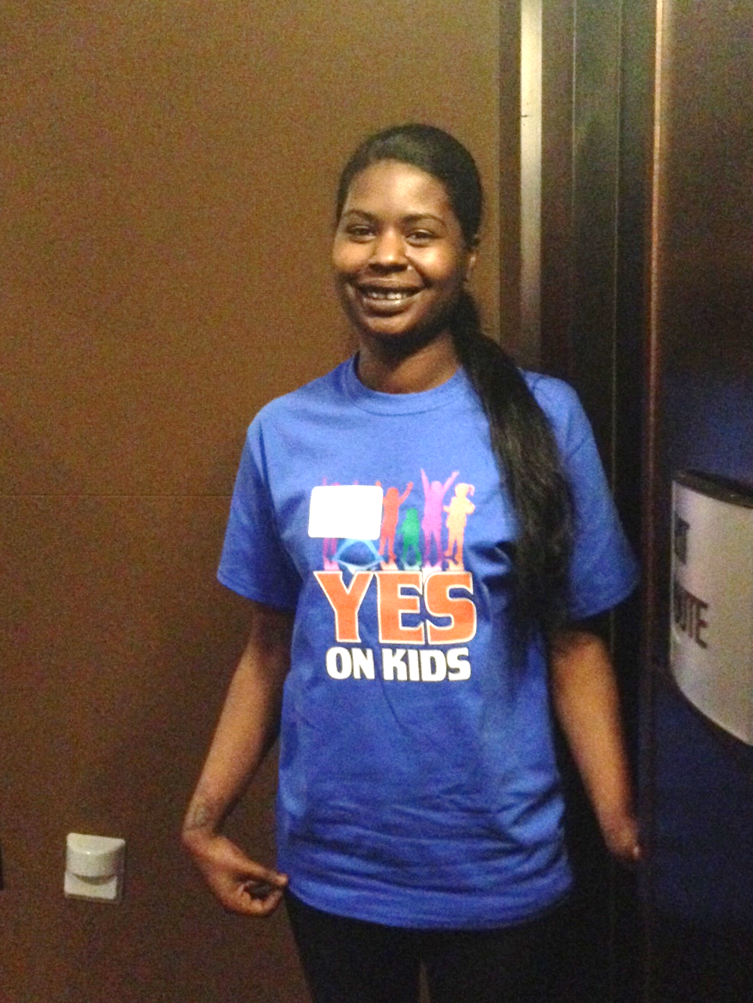
COALITIONS AND ALLIES
San Francisco Budget Justice Coalition
ACCE AFT 2121 AIDS Legal Referral Panel API Council Arts for a Better Bay Area Bay Area Community Resources (BACR) Causa Justa::Just Cause Chinese Progressive Association Coalition of Agencies Serving the Elderly Coalition on Homelessness Coleman Advocates for Children and Youth Community Alliance of Disability Advocates Community Housing Partnership Community Partnership for LGBTQQ Youth (CPQY) Dolores Street Community Services (DSCS) El/La Para TransLatinas Hamilton Families Homeless Emergency Service Providers Association (HESPA) HIV/AIDS Provider Network (HAPN) Hospitality House Jobs With Justice Larkin Street Youth Services LYRIC New Door Ventures NEXT Village SF Parent Voices St. James Infirmary San Francisco Child Care Planning & Advisory Council San Francisco Housing Rights Committee San Francisco Human Services Network San Francisco Immigrant Legal & Education Network (SFILEN) Senior and Disability Action Service Employees International Union, Local 1021 Sheroes Project South of Market Community Action Network (SOMCAN) Supportive Housing Provider Network (SHPN) TGI Justice Project Young Women's Freedom Center

Slide 14
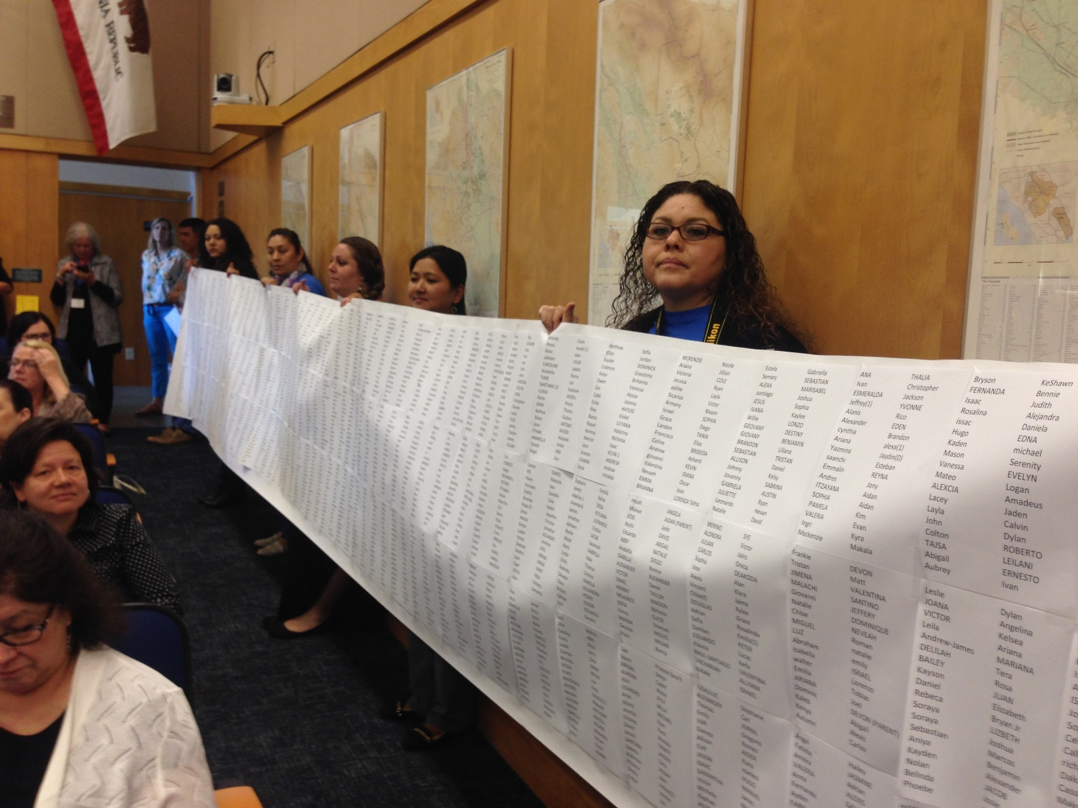
DRAMA HELPS

Slide 15
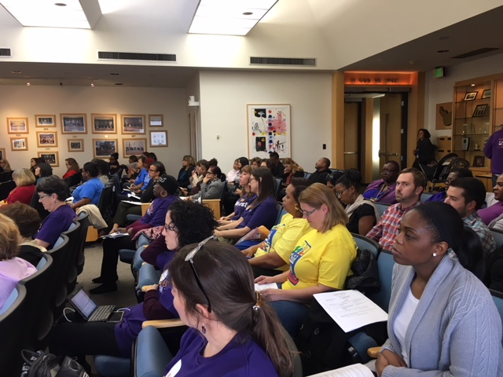
NUMBERS COUNT

Slide 16
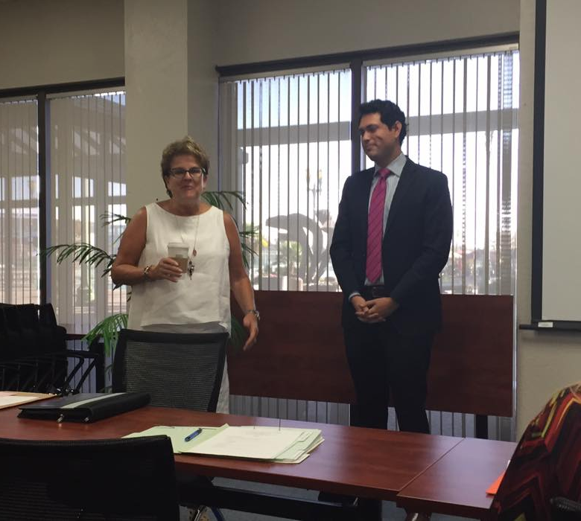
POWERFUL CHAMPIONS AND ALLIES IN GOVERNMENT
Often there are folks within the bureaucracy who want change as much as outside advocates – Find them and strategize together.
Elected officials may be champions of your cause. Your job is to make it easier for them to convince their peers.

Slide 17
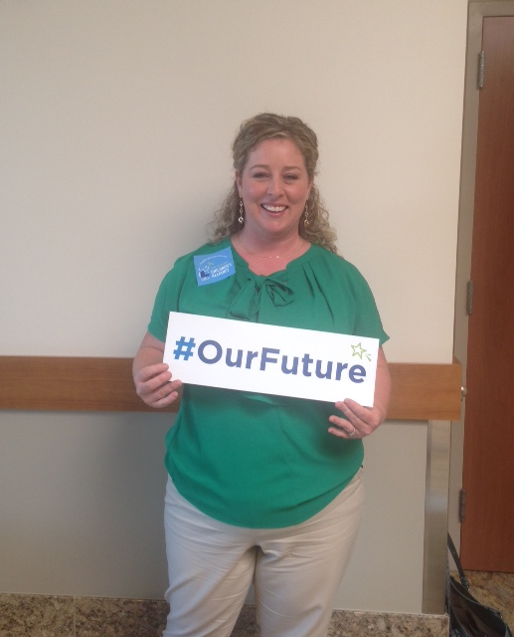
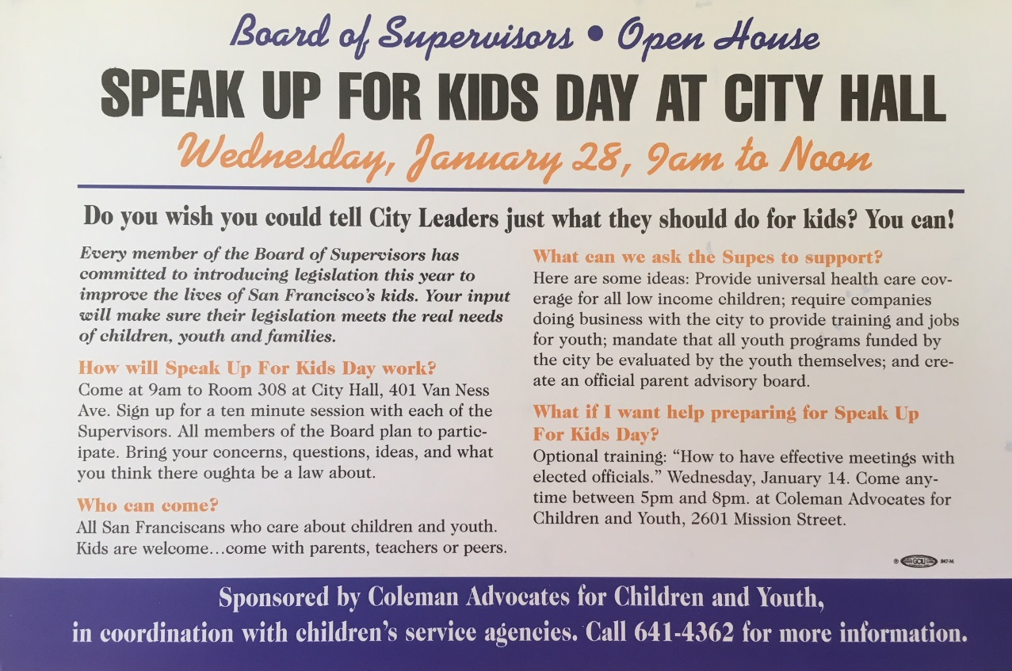
ORGANIZE PUBLIC SUPPORT
Social media
Outreach to community groups
Conferences and public forums
Mailings and newsletters
Speak out – speak up for kids days

Slide 18
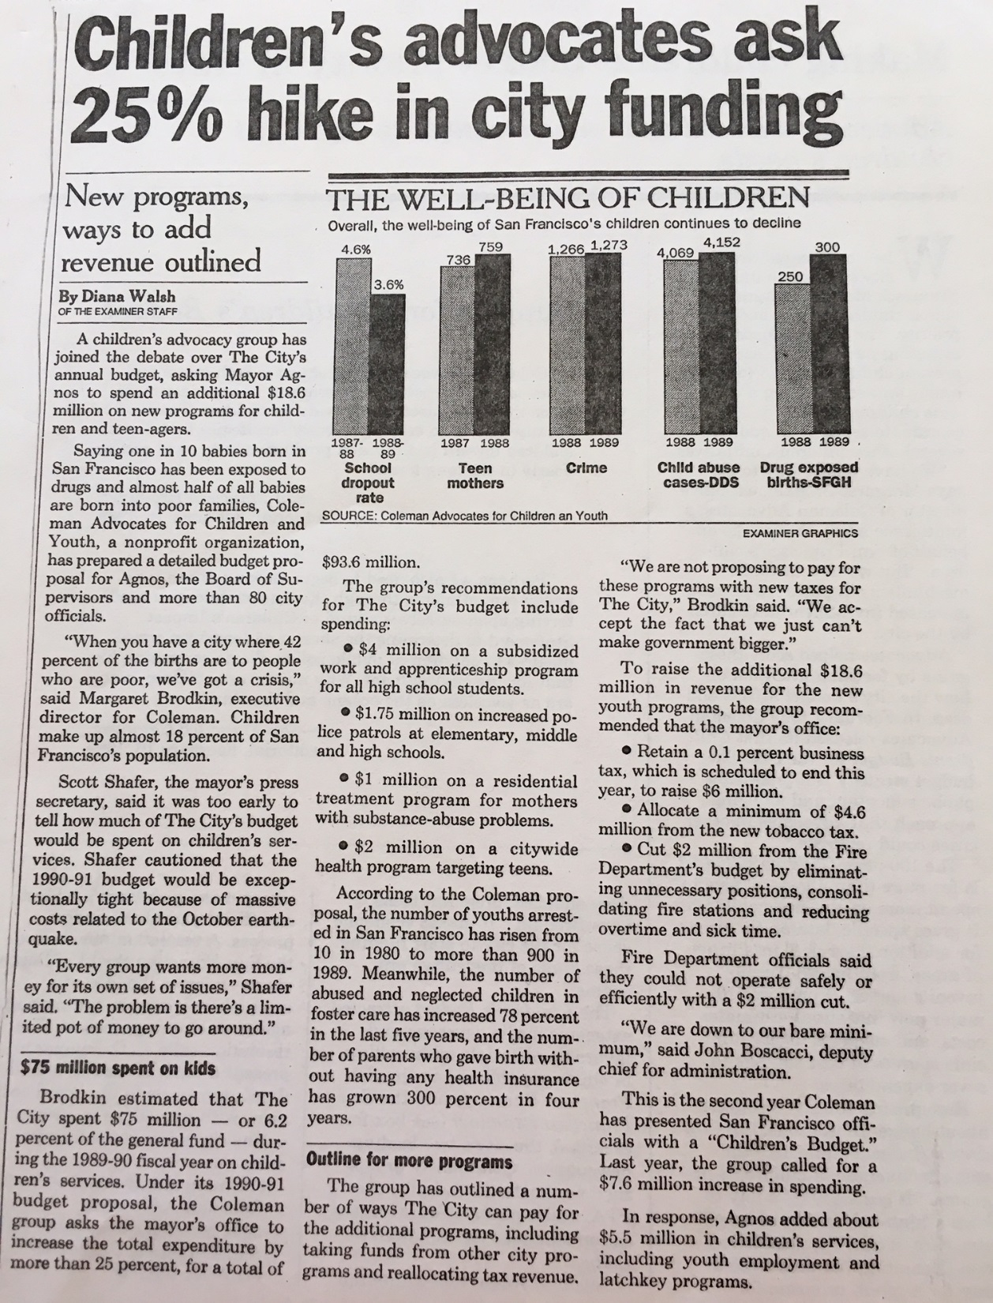
USE THE MEDIA
HAVE A SIMPLE MESSAGE
Press conferences
Op-eds
News releases
Feature stories
Follow the c’s – crisis, conflict, constumes, celebrities
Find a news hook.
OFTEN MORE IMPORTANT TO TALK TO THE MEDIA, THAN DIRECTLY TO DECISION-MAKERS.

Slide 19
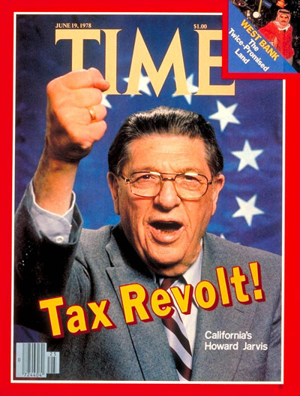
PREPARE FOR OPPOSITION
The Taxpayer revolt is alive and well.
New items in the budget threaten increased spending and therefore new taxes.
New revenue measures mean taxes or reallocations – built-in opposition.
Opposition is often behind the scenes – particularly when status quo is threatened.
BUDGET ADVOCACY IS ONE BATTLE AFTER ANOTHER.
Must be the folks who never go away.

Slide 20
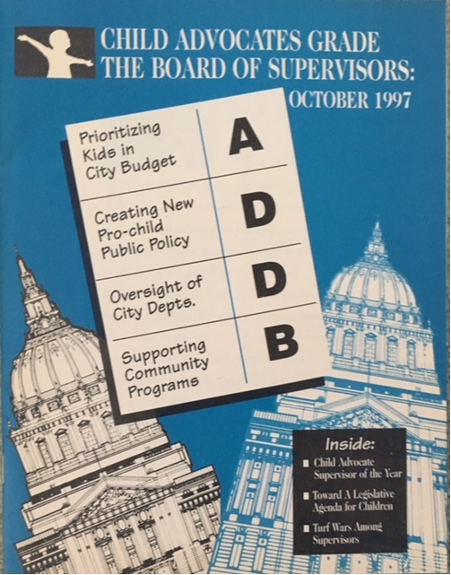
BUILD IN ACCOUNTABILITY
Hold decision-makers accountable after the budget process – for negative AND positive decisions.
Newsletters
Report cards
Follow-up meetings
Newspaper ads
Accountability sessions

Slide 21
REFORM THE PROCESS
Creating accessible forums for public input at all levels and at all points in the process
Creating access to decision-makers
Empowering the legislative body
Strengthen budget policy support
TRANSPARENCY, TRANSPARENCY, TRANSPARENCY

