Slide 1
Your Campaign Starts
NOW

Slide 2
PHASES OF A CAMPAIGN
There are five phases of a campaign
1
Pre-campaign phase
3
Ramp-up phase
5
Post-election phase
2
Campaign phase
4
Get Out The Vote! (GOTV)
Notes:
Content:
Thinking about running a campaign can seem like a long, insurmountable journey. To help break it down into digestible chunks, you can think about a campaign in five phases. Whether you’re the candidate or a campaign staffer, these phases will dictate the intensity and nature of the work that you’re doing on a day-to-day basis:
The first phase is The Pre-Campaign Phase, during which you conduct a lot of research on exactly what office to run or work for, the voters you’ll need to reach out to, and taking the time to set your campaign up to be able to launch as a serious contender for office. This is before you file for office, and depending on when your election is, this could be as soon as a few months out from election day, or as far away as over a year from election day.
The second phase is The Campaign Phase, during which your campaign will spend time engaging voters and raising money. This takes place right after you file, and lasts until about two months before election day. The focus of the campaign during this phase is typically on fundraising and building grassroots support, identifying supporters and endorsers.
The third phase is The Ramp-up Phase, during which you will take what you have learned from the Campaign Phase and begin to set your sights on communicating with and mobilizing voters. This period lasts until voters start voting – you want to take this time to be prepared to encourage voters to return their ballots as soon as they are mailed out or when in-person voting starts, whichever comes first.
The fourth phase is The Get Out The Vote (GOTV) Phase, during which your campaign will be focused on turning out your supporters and talking to as many voters as possible to turn out the vote. This lasts for however long voters are voting, and this differs depending on where you live and your local and state election laws. For example, voters in Florida who have enrolled in vote-by-mail have their ballots sent out to them more than a month before election day.
And finally, the fifth phase is The Post-Election Phase, during which you will wrap up your campaign and take time to reflect on what occurred during the election, and – hopefully – begin to think about your transition into public office. This takes place for a few days – maybe a week or two – after election day, and your transition lasts until your first day in office.
--CLICK--

Slide 3
7 Things You Can Do Now
1
Build Your Planning Circle
2
Grow Your List of Supporters
3
Do Your Research
4
Begin A Messaging Campaign
5
Use 2024 As A Learning Opportunity
6
Getting Involved In Your Local Budget Process
7
Start Envisioning Your Measure
Notes:
JESSICA

Slide 4
What is your campaign’s
Theory of Change?
What are the goals your seek to achieve through this campaign?
What are the strategies and actions needed to accomplish those goals?
What outcomes do you expect to see result from those strategies and actions?
Notes:
JESSICA
Defining success is critical to do early
Be explicit here about what your desired out comes are
Multiple definitions of success
Theory of change vs theory of winning
A successful campaign hinges on meticulous planning and a clear understanding of the desired outcome. To achieve this, it's crucial to embrace an expanded theory of winning that goes beyond conventional measures of success. This involves not only securing victories, but also influencing public opinion and policy shifts.

Slide 5
Build Your Planning Circle
KNOW WHERE YOU WANT TO GO
Get the right people involved EARLY!
Bring multiple perspectives to the table
Be conscious of equity & implicit bias- Trust takes time
Use this opportunity to build skills within your coalition
Notes:
Sarah
Learning Point: Coalitions allow us to have stronger and more effective campaigns
Content:
Building an inclusive, effective, winning coalition is hard work. We need to prioritize relationships and trust building at each phase of your ballot measure lifecycle.
It’s important to get the right people engaged early. And when we say early, we mean when you first start exploring a potential measure and looking to develop the policy. Organizations are much more likely to be invested if they have helped craft and develop what moves forward. Inviting prospective partners to the table early on allows them to be all-in with you sooner rather than later and also democratizes knowledge and decision-making, which can prevent misunderstandings and tension later.
A coalition-led effort provides a place to have multiple perspectives represented and to refine your idea. If there are going to be disagreements or competing priorities, it is helpful to have the opportunity and the space to include those ideas or hear those competing perspectives before you have the language set and are on the ballot. It is also helpful to have the opportunity to address these behind closed doors rather than having these cracks in the coalition play out on the front page of your local paper. A strong coalition that represents multiple perspectives has the ability to be more than the sum of its parts.
Organizations do have their own interests, and understanding their interests is key. Be aware of differing priorities and understand motivations as to why people are at the table.
Trainer give an example of how they have done this or ask for an example from participants.
BISC example: One way to do this in practice is to invite your partners, particularly those who are directly impacted, to participate in the design process for your exploratory research. Each organization will bring their own perspective to how the questions should be framed so you are getting the data you need to make informed decisions from the communities you need to engage. It is one of the best ways to co-create and build relationships and communication, doesn’t require a financial commitment to engage, and facilitates long-term buy in since everyone was part of the journey from the onset
Be conscious of implicit bias and dominant culture in building your coalitions
Ballot measure campaigns often fall into the default status quo in setting up their teams. Look beyond the dominant culture establishment ways of doing things to ensure that your coalition includes traditionally marginalized or disenfranchised communities and that your leadership includes members of the most impacted communities. Well give you some examples of this in a few minutes.
Last but not least: Trust takes time!
It’s important to develop a culture of respect and safety. Creating culture amongst a group takes intention, time, and ownership of mistakes when they happen.
It can be helpful when a coalition has been working together for years on an issue and building trust - via state tables, or advocacy on otherissues, or as we have all learned the past few years, resisting together, rather than being formed specifically to support a particular initiative - for the first time.

Slide 6
Getting The Right People Engaged
Look for organizations and leaders who:
Have a history of leading work on this issue.
Are directly impacted by this issue.
Can help you answer the questions you need to put together your measure
Have deep relationships in the communities you need to vote in favor of your ballot measure.
Have deep relationships in the communities or with individuals you need to stay neutral on your ballot measure.
Notes:
Julie
Learning Point: We need to be intentional about who we engage in our coalitions
Content:
How do we identify the right people to engage in a ballot measure coalition?
You want to reflect on the following groups and individuals who might need to be involved: [click]
Organizations and leaders who have a history of leading work on this issue [click]
Organizations and leaders who are directly impacted by this issue [click]
Organizations and leaders who have deep relationships in the communities you need to vote in favor of your ballot measure [click]
Organizations and leaders who might be with us and have deep relationships in the communities you need to stay neutral on your ballot measure [click]
Organizations and leaders with power in the progressive space who will work against your ballot measure
BISC also recommends conducting a Coalition Power Analysis and Capacity Assessment. A Coalition Power Analysis and Capacity Assessment is a distinct process fundamental to an effective campaign. It is a systematic way of looking at who is with you, who is against you, and how important their support or opposition is to the campaign. This is a key step to building an effective coalition.
We’re going to do one of these assessments together in our workshop today.

Slide 7
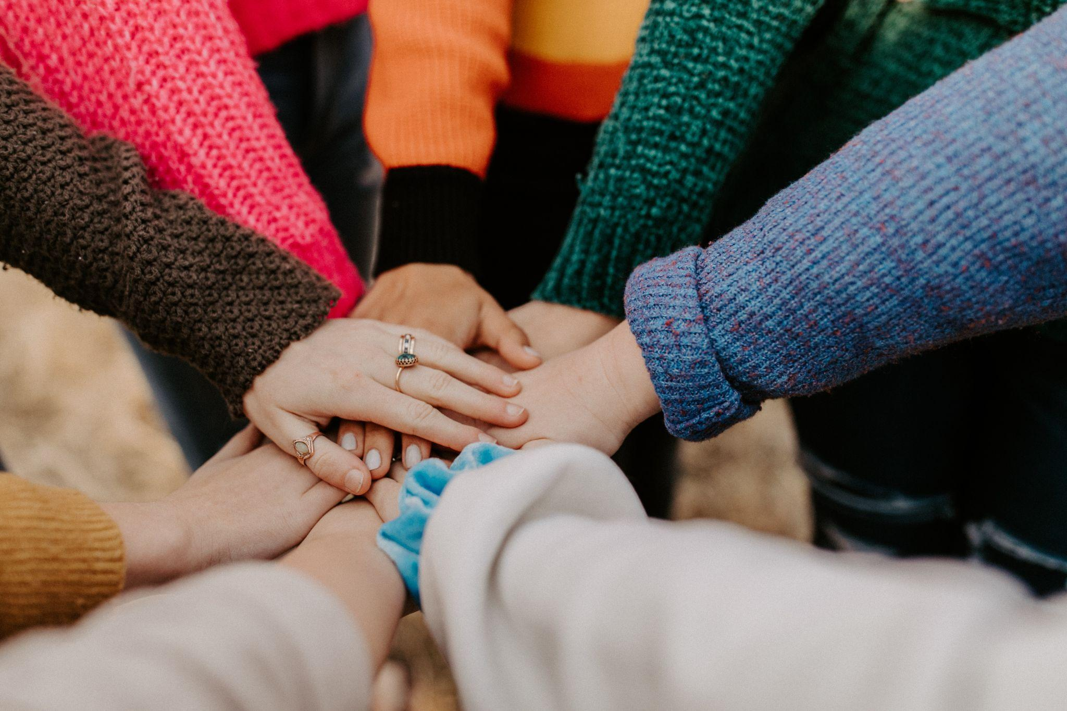
BUILDING YOUR CAPACITY TO WIN
Structure your organization/coalition to work collectively toward your vision
Strengthen the network of support for young children in your county
Build the political capital of agencies in your circle
Increase your attention and focus on the larger public
Communicate about your successes early and often

Slide 8
Building Your Email List
INVEST IN YOUR EMAIL PROGRAM
(Use deliverability best practices, offer incentives, use video, provide toolkits, etc.)
PARTNER WITH OTHER ORGS
(Do joint actions, offer opt-in programs, etc.)
RUN DIGITAL ADS
ABC!
ALWAYS BE COLLECTING

Slide 9
The Three Pillars of Campaign Messaging
Find Opportunities to Use Research to Understand What Your Community Thinks
Mobilization
Education/Awareness
Persuasion
Notes:
ADDISU
Campaigns come in various forms, each with distinct goals and tactics. Electoral campaigns aim to secure political positions, while candidate campaigns focus on supporting specific individuals

Slide 10
MESSAGING CAMPAIGN COMPONENTS
UTILIZE THE PRESS
(Op Eds, LTEs, press events)
BE STRATEGIC ABOUT WHAT/HOW YOU COMMUNICATE ONLINE
SYNC YOUR MESSAGING WITH COALITION PARTNERS
LEVERAGE EVERY OPPORTUNITY YOU CAN!

Slide 11
Using 2024 As A Learning Opportunity
SHARE RESEARCH/POLLING OPPORTUNITIES
TRAIN & TEST VOLUNTEERS
PLAY POLITICS
BUILD/STRENGTHEN KEY RELATIONSHIPS

Slide 12
GET INVOLVED IN YOUR LOCAL BUDGET PROCESS
Work with the FNG team to analyze your local budget
Choose your budget targets strategically
Do public messaging and organizing around advocacy
Share your successes
Notes:
Sarah
Learning Point: Coalitions allow us to have stronger and more effective campaigns
Content:
Building an inclusive, effective, winning coalition is hard work. We need to prioritize relationships and trust building at each phase of your ballot measure lifecycle.
It’s important to get the right people engaged early. And when we say early, we mean when you first start exploring a potential measure and looking to develop the policy. Organizations are much more likely to be invested if they have helped craft and develop what moves forward. Inviting prospective partners to the table early on allows them to be all-in with you sooner rather than later and also democratizes knowledge and decision-making, which can prevent misunderstandings and tension later.
A coalition-led effort provides a place to have multiple perspectives represented and to refine your idea. If there are going to be disagreements or competing priorities, it is helpful to have the opportunity and the space to include those ideas or hear those competing perspectives before you have the language set and are on the ballot. It is also helpful to have the opportunity to address these behind closed doors rather than having these cracks in the coalition play out on the front page of your local paper. A strong coalition that represents multiple perspectives has the ability to be more than the sum of its parts.
Organizations do have their own interests, and understanding their interests is key. Be aware of differing priorities and understand motivations as to why people are at the table.
Trainer give an example of how they have done this or ask for an example from participants.
BISC example: One way to do this in practice is to invite your partners, particularly those who are directly impacted, to participate in the design process for your exploratory research. Each organization will bring their own perspective to how the questions should be framed so you are getting the data you need to make informed decisions from the communities you need to engage. It is one of the best ways to co-create and build relationships and communication, doesn’t require a financial commitment to engage, and facilitates long-term buy in since everyone was part of the journey from the onset
Be conscious of implicit bias and dominant culture in building your coalitions
Ballot measure campaigns often fall into the default status quo in setting up their teams. Look beyond the dominant culture establishment ways of doing things to ensure that your coalition includes traditionally marginalized or disenfranchised communities and that your leadership includes members of the most impacted communities. Well give you some examples of this in a few minutes.
Last but not least: Trust takes time!
It’s important to develop a culture of respect and safety. Creating culture amongst a group takes intention, time, and ownership of mistakes when they happen.
It can be helpful when a coalition has been working together for years on an issue and building trust - via state tables, or advocacy on otherissues, or as we have all learned the past few years, resisting together, rather than being formed specifically to support a particular initiative - for the first time.

Slide 13
Start Envisioning Your Measure
WHAT’S THE RATIONALE FOR MEASURE/YOUR THEORY OF CHANGE?
WHAT DO WANT TO FUND?
WHAT IS THE FUNDING SOURCE FOR YOUR MEASURE?
WHAT GOVERNANCE & ACCOUNTABILITY MEASURES WILL YOU PUT IN PLACE?
FUNDING THE NEXT GENERATION WILL HELP YOU WITH ALL OF THIS ALONG THE WAY!

Slide 14
WHAT CAN YOU LEARN FROM THOSE WHO HAVE COME BEFORE YOU?
Utilize the Funding the Next Generation Network to find out:
What do you wish you had known at the outset?
What were the most important things you did to set up for success?
What would you have done differently?
Who should I be engaging now?

Slide 15
Decision-Making Scale
How do you decide to move forward? (rank each of these categories on 1-7 scale, with 7 being the highest, total highest score is 49)
To what extent will this ballot measure have a positive impact/truly make things better for children and youth in your community?
Does the polling show a path to victory?
Do you have a path to raise the money you need to win?
Do you have the people you need behind you?
Have you done your due diligence? Do you know what your potential opposition will look like? What have you done to minimize or stop it?
As for the electoral landscape, what else is on the ballot? Will it interfere with your measure?
Do you have the team you need to win?
Notes:
Marsha
Learning Point: There are many factors you need to weigh when deciding if a ballot measure should move forward.
Trainer Notes:
There are a number of factors that play an important role in whether or not a ballot measure campaign moves forward. We’re going to talk through each of these factors: Impact, Leadership & Team (your coalition), Viability & Research, Electoral Landscape, Resources, and Due Diligence. You need to be able to explain why a ballot measure is the best pathway forward.
This is when you transition into the Decision Phase.

Slide 16
Questions

